Slide 1
Analysis on Clinical and Financial Data of Patients with a Certain Condition
Matthew Zakharia Hadimaja

Slide 2
Analysis
Preprocessing
Prediction
Conclusion
machine learning algorithms
clean data
Exploration
join tables
visualisation
plots

Slide 3
Preprocessing
Raw data
Joining
bill_id
clinical_data
demographics
bill_amount
Cleaning
inconsistent labeling
wrong formats
unnecessary information
new variables
Single data table

Slide 4
Exploration
variables
on a predictor
between predictors
between predictor and response
categorical
bar plot
correlation
means across categories
numerical
histograms
continuous
binary
regression line
box plot

Slide 5
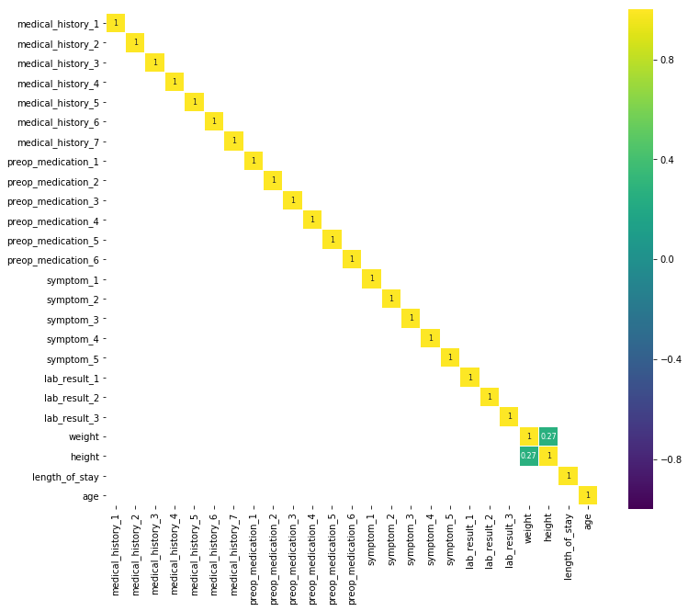
Exploration - numerical
Predictors are uncorrelated of each other. Only one predictor pair (weight-height) has correlation more than 0.05!

Slide 6
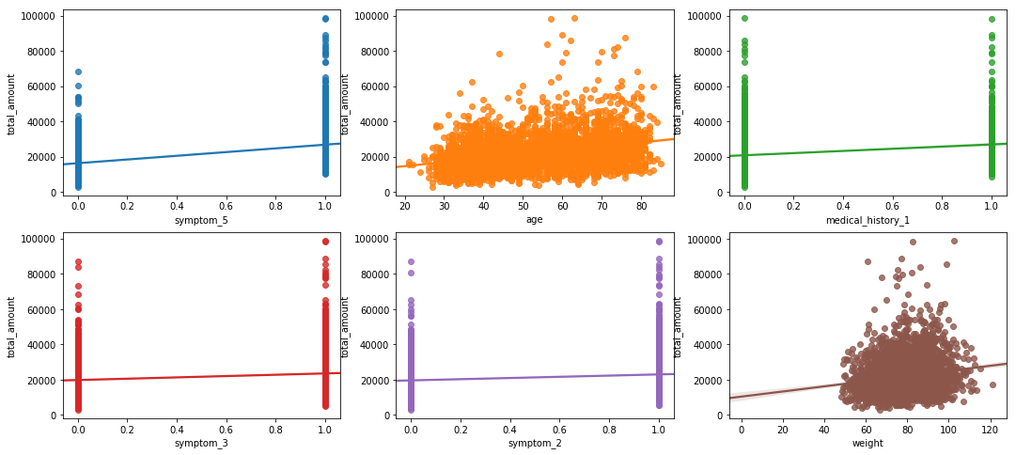
Exploration - numerical
Top 6 predictors with highest correlation with total_amount:
variable | correlation
symptom_5 | 0.517
age | 0.326
medical_history_1 | 0.227
symptom_3 | 0.184
symptom_2 | 0.158
weight | 0.158

Slide 7
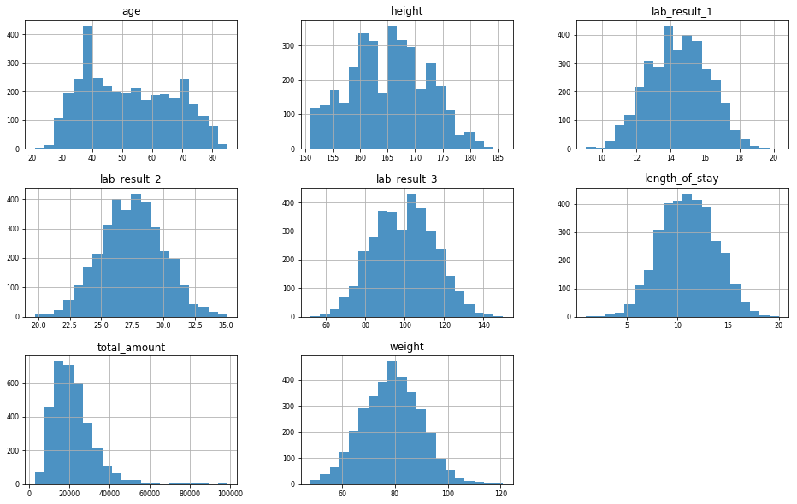
Exploration - continuous
Most distribution have Gaussian shape, with some following bimodal distributions.

Slide 8
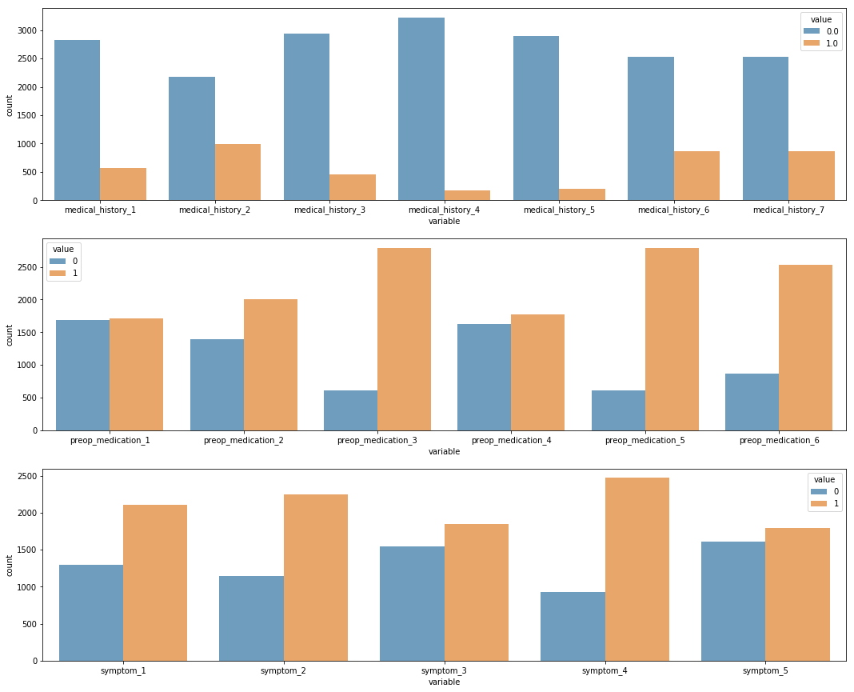
Exploration - binary
Medical history variables (top row) are unbalanced, but it is expected.
Patients under this condition are more likely to receive certain preop medications.
Some symptoms are more common than the other under this condition.

Slide 9
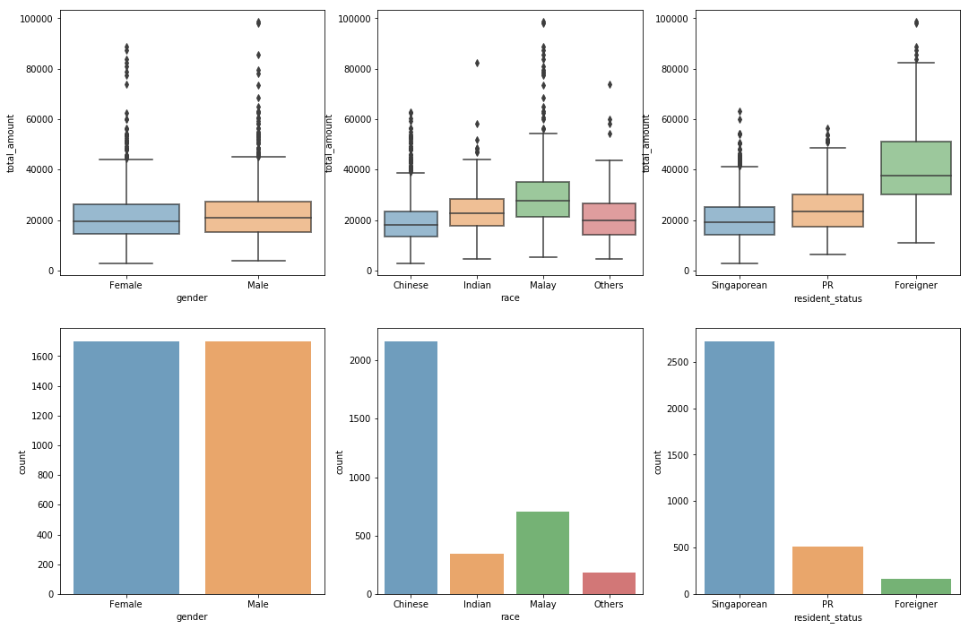
Exploration - categorical
No difference in cost across gender. The condition also affects each gender equally.
Malays and Indians have higher cost. Does this condition affect them more?
Foreigners and PRs pay more than Singaporeans do.
race and resident_status are not distributed equally in our data.

Slide 10
Prediction
Model selection
Model fitting
Model evaluation
MSE
Linear regression
Parameter tuning with cross-validation
Polynomial regression
LASSO
Regression tree
Support vector regression
Neural network
Preprocessing
Variable standardisation
Missing data filling
Dummy variable encoding
Train-test split
Model fitting
Residual plot

Slide 11
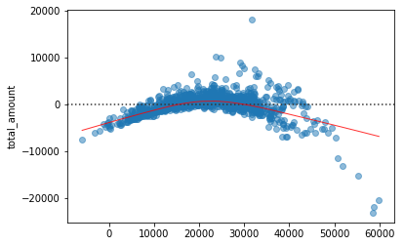
Prediction – linear regression
Baseline model
MSE = 2473.793
Important variables:
symptom_5, symptom_3, symptom_2
medical_history_1, medical_history_6
race and resident_status

Slide 12
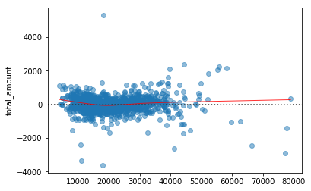
Prediction – polynomial regression
Best model
MSE = 520.633
Higher performance, more variables. May be difficult to explain.

Slide 13
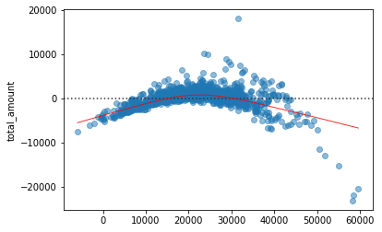
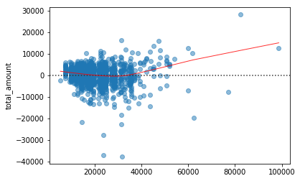
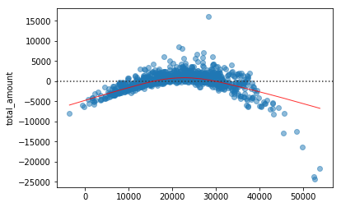
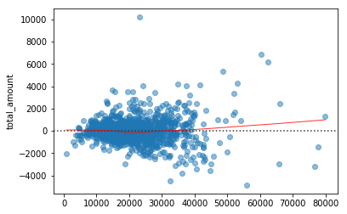
Prediction – other models
LASSO | Regression Tree | Support Vector Regression | Neural Network
Small penalty from CV Similar to OLS | Worst model, even with deep tree | CV chose linear kernel Similar to OLS | Better than OLS, but worse than polynomial regression
MSE: 2466.897 | MSE: 4868.979 | MSE: 2555.064 | MSE: 1122.375

Slide 14
Conclusion
Important cost drivers
Model selection
symptom variables
Less relevant variables
some medical history variables
preop medication variables
lab results
some medical history variables
age, weight
race, residential status
simple models with regularized parameter

