Slide 1
CONSULTANT ENGAGEMENT
Test Engagement
Doctor smoke test
2026-05-29

Slide 2
EXECUTIVE SUMMARY
Doctor finds three things to fix this week.
Doctor finds three things to fix this week.
1. First key claim
2. Second key claim
3. Third key claim
doctor fixture
2026-05-29
2 / 10

Slide 3
KEY 1
Key 1 / 3 — Discovery
doctor fixture
2026-05-29
3 / 10

Slide 4
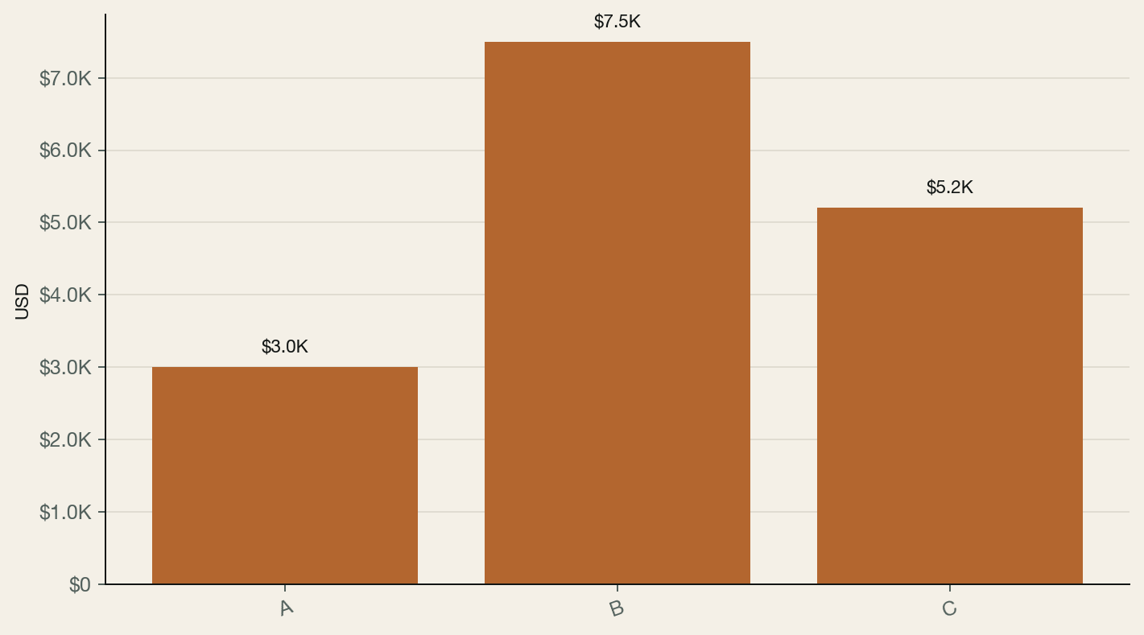
ANALYSIS
Bar chart rendering confirmed via doctor fixture.
Doctor bar fixture
Source: Doctor 2026-05-29
doctor fixture
2026-05-29
4 / 10

Slide 5
COMPARISON
Two-column layout supports text + chart.
• First bullet point
• Second bullet point
• Third bullet point
doctor fixture
2026-05-29
5 / 10

Slide 6
KEY METRICS
Three numbers anchor the engagement.
$2.3M
42%
1,240
REVENUE
GROSS MARGIN
ACTIVE USERS
FY26 run rate
Up 8pp YoY
Weekly
doctor fixture
2026-05-29
6 / 10

Slide 7
VOICE OF CUSTOMER
Customer voice supports the strategic direction.
“
This was the right call.
— Test Customer, VP of Ops
doctor fixture
2026-05-29
7 / 10

Slide 8
PRICING
Pricing matrix maps to segment willingness-to-pay.
doctor fixture
2026-05-29
8 / 10
Tier | Price | Features
Basic | $9 | 3
Pro | $19 | 12
Bundle | $39 | 25

Slide 9
RECOMMENDATION
Recommendation: build Self-Serve docs in Q3.
Build self-serve docs in Q3.
RISKS
NEXT STEPS
• First risk
• Second risk
• Third risk
1. First step
2. Second step
3. Third step
doctor fixture
2026-05-29
9 / 10

Slide 10
APPENDIX
Sources
[1] Test claim 1 — Test Source A (https://a)
[2] Test claim 2 — Test Source B
doctor fixture
2026-05-29
10 / 10

