Slide 1
NHL Game Prediction
A Data Engineering pipeline for better bets
By Matt Zirpoli

Slide 2

Introduction
Sports betting has been reintroduced on a larger scale than ever!
Analytics and advanced stats are relatively new to hockey
Predictive models offer a way to “beat Vegas”

Slide 3
































Data
Sources
NaturalStatTrick
Fivethirtyeight
NHL API
Features
Aggregated team stats collected by game
Back to back
ELO rating

Slide 4
The Model
Model features scaled
Three models trained and tested
Analytics and advanced stats are relatively new to hockey
Predictive models offer a way to “beat Vegas”
Model Performance
Model | Accuracy | Log Loss
Logistic Regression | 57.8% | 0.6684
XGBoost | 57.2% | 0.6782
Neural Network | 57.3% | 0.6556
Base | 54.1%

Slide 5
Pipeline – Scraping and Storage
Database
historical
NaturalStatTrick
Raw NST data
Team Stats
daily
historical
fivethirtyeight
Raw 538 data
Model features
daily
historical
NHL Schedule
Raw NHL data
daily
Scheduled matchups

Slide 6
Pipeline – Model and Display
Model features
Model
Predictions
Flask App
Scheduled matchups

Slide 7
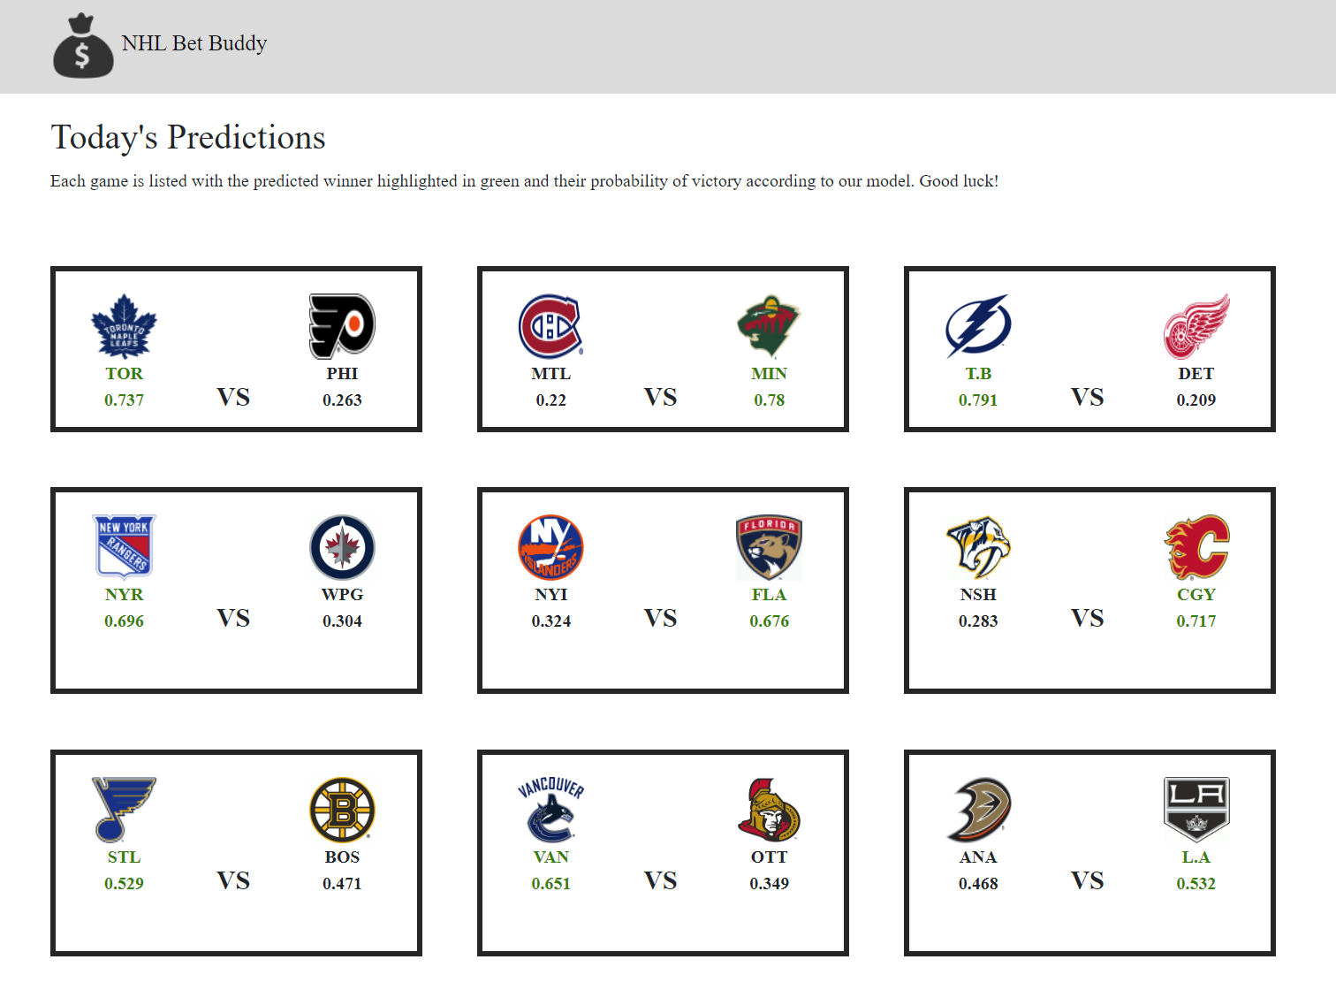
Flask Front End

Slide 8

Future Work
Model refinement
Create a ‘bottom-up’ model based on player statistics
Add a betting odds data source
Assess model options by value

Slide 9
Questions?

