Slide 1
NHL Game Prediction
A Data Engineering pipeline for better bets
By Matt Zirpoli

Slide 2

Introduction
Sports betting has been reintroduced on a larger scale than ever!
Analytics and advanced stats are relatively new to hockey
Predictive models offer a way to “beat Vegas”

Slide 3
































Data
Sources
NaturalStatTrick
Fivethirtyeight
NHL API
Features
Aggregated team stats collected by game
41 game rolling average
Merged on a game basis to show home v. away
Back to back games
ELO rating

Slide 4
The Model
Numeric features scaled, categorical one hot encoded
Three models trained and tested
Logistic Regression model was selected
Retrained daily on sliding window
Outputs predictions for Flask app
Model Performance
Model | Accuracy | Log Loss
Logistic Regression | 57.8% | 0.6684
XGBoost | 57.2% | 0.6782
Neural Network | 57.3% | 0.6556
Base | 54.1%

Slide 5
Pipeline – Scraping and Storage
Database
historical
NaturalStatTrick
Raw NST data
Team Stats
daily
historical
fivethirtyeight
Raw 538 data
Model features
daily
historical
NHL Schedule
Raw NHL data
daily
Scheduled matchups

Slide 6
Pipeline – Model and Display
Model features
Model
Predictions
Flask App
Scheduled matchups

Slide 7
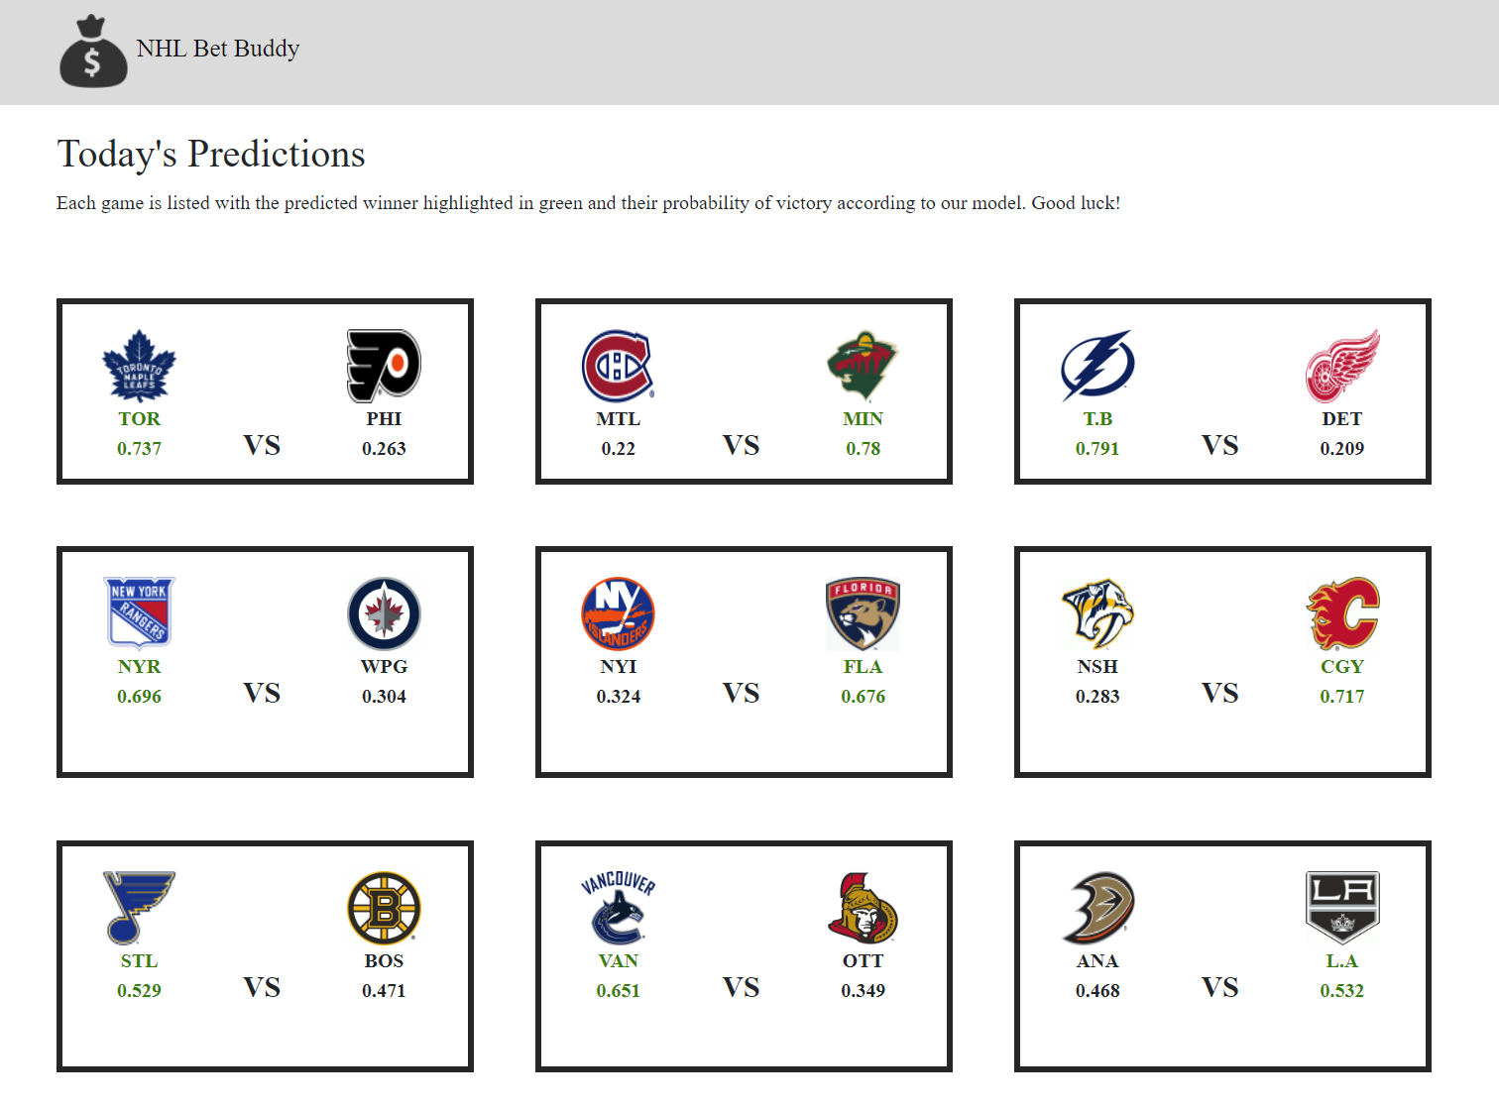
Flask Front End

Slide 8

Future Work
Model refinement
Create a ‘bottom-up’ model based on player statistics
Add a betting odds data source
Assess model options by value

Slide 9
Questions?

