Slide 1
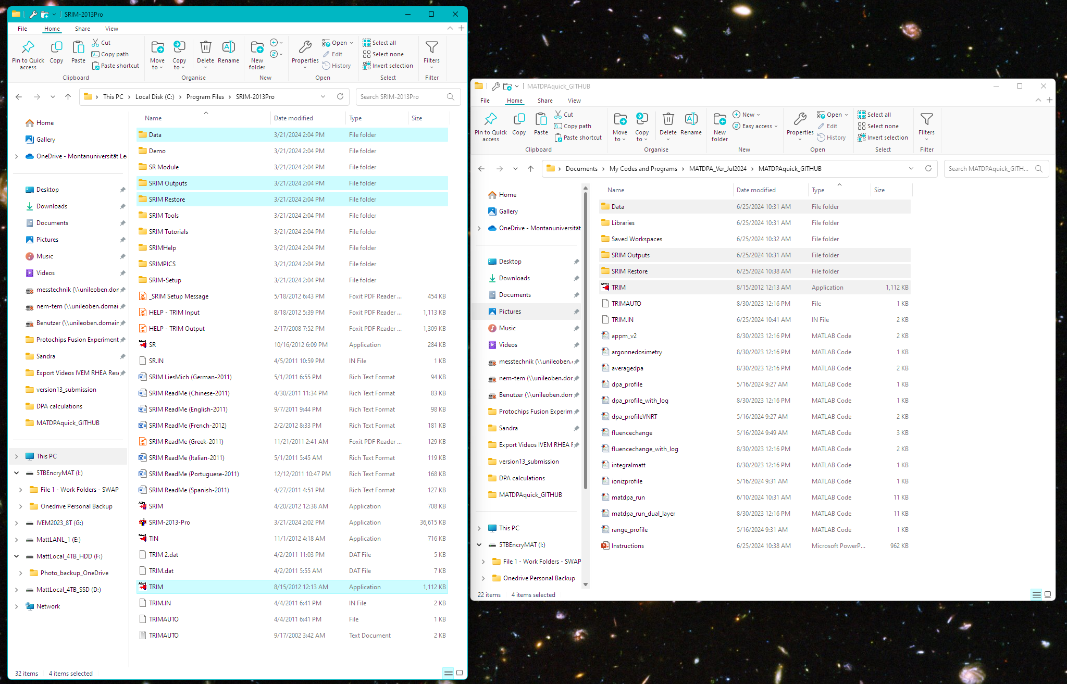
From your SRIM2013 installation directory, copy the following files and folders to the MATDPA directory
After copying, open “matdpa_run.m”

Slide 2
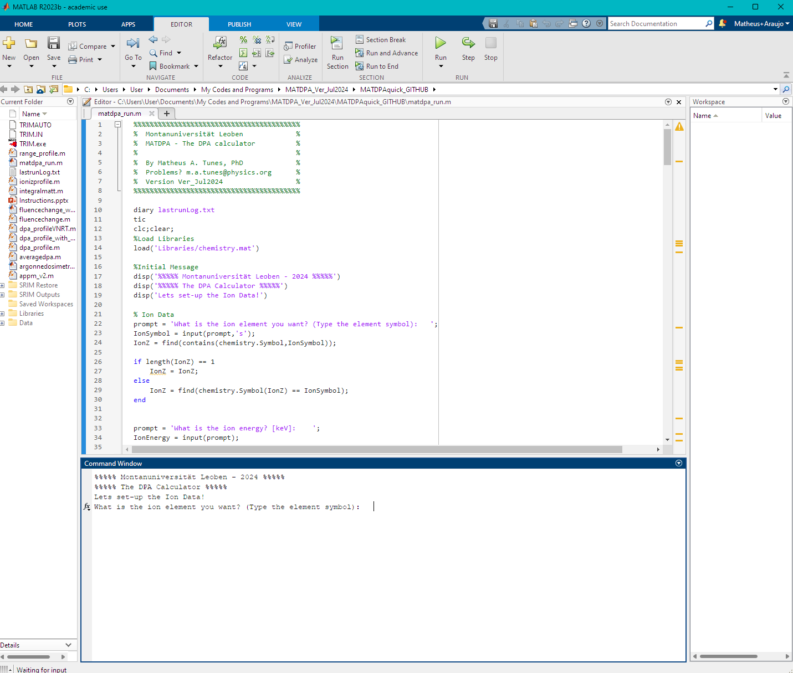
After opening the matdpa_run.m
Press run and follow the prompt for input!
When typing the elements, use the periodic table notation, e.g., Fe not FE or fe

