Slide 1
Work-Efficiency Management
PRESENTED BY:
BHANDARI KHUSHI
KUNVAR KARAN
MATURKAR JAY
PROJECT GUIDE:
MS. JINAL TRAILOR

Slide 2
TOPICS
INTRODUCTION
REQUIREMENTS
TOOLS AND TECHNOLOGY
OBJECTIVES
CURRENT SYSTEM
CURRENT SYSTEM DISADVANTGES
ADVANTAGES OF PROPOSED SYSTEM
SYSTEM USERS AND FUNCTIONALITIES
DIAGRAMS
SCREEN LAYOUTS
FUTURE ENHANCEMENT

Slide 3

INTRODUCTION
Work-Efficiency Management is a user-friendly windows based website.
This website is mainly target for the manage faculties Workflow.
It stores information regarding complete faculties work attandence, Active Faculty, Billing, Punching In and Punching Out Actions, Faculty List, Dashboard, Reports.
In this system there is mainly 2 users. The ADMIN user, and FACULTY user.
This system offers simple user interface for Department USER to easily work with manage faculties to who have to Go Outside the college for some time or Leave for college some days, Tracks information, and Report generation.

Slide 4
This smart, robust and cheap, WORK-EFFICIENCY management system provides better quality of procedure and service to USER.
In current system all types of works are done by manually. This often requires lots of time and efforts and more cost.
But with the WORK-EFFICIENCY MANAGEMENT SYSYTEM, It manages all kinds of database related to college faculties workflow.

Slide 5
requirments
Front-Design : React, html, css, jquery, ajax,
Front-End : React
Back-End : MySQL php

Slide 6
Tools and Technology Used
Tools :
Visual Studio code
HTML
CSS
JavaScript
React
XAMPP
RestAPI

Slide 7
OBJECTIVES
The main objective of this system is to design the system to perform all kinds of OPD workflow online.
Eliminate the use of manually written work.
To make system User-friendly interface to use, understand and operate easily.
To give security with username and password.
To make system easy and efficient.
To reduce the cost and save time.
To track and manage all kinds of information in easy way.
To maintain data with database and fetch all kinds of information.
To manage patient Bill or payment status.
To generate report of Registration charge, Dispensary charge or Lab charges of particular time and also can manage stocks of dispensary or lab equipment.

Slide 8





Current system

Slide 9
Current system disadvantages
Paper work
Time Consuming
Used lots of man power
Data redundant may possible
Human error leads to inaccurate information.
Cannot easily maintain data or fetch data
We cannot get up-to-date information.
It is not user friendly.
All types of works are manual there is no smart work performed.
Can’t handle or mange those types of workflow

Slide 10




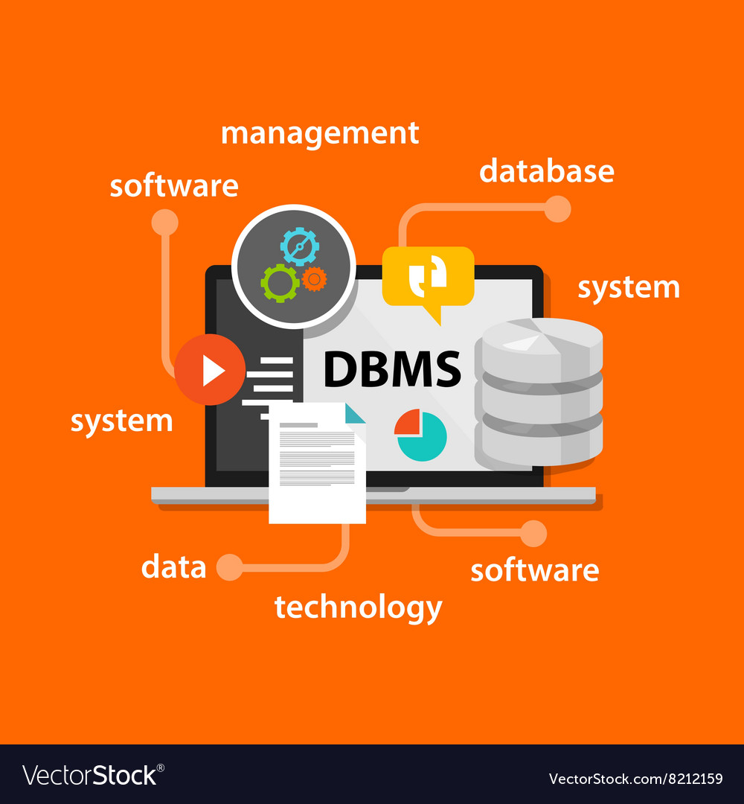
PROPOSED SYSTEM

Slide 11
Advantages of proposed system
Fast and easy way to maintain data
No manual entry so less time consuming
Improvement of work efficiency
Easy database maintains
Tracks information
Easily manage, sort, filter data
Generate Reports in PDF or EXCEL
Search any kind of information very easily
Less chances to lost data
Accurate work data
User-friendly responsive system

Slide 12

System users and functionalities
DEPARTMENT HOD
FACULTY

Slide 13
DEPARTMENT HOD
Can Login to system
Manage User, User type and their login passwords
Manage faculties who have to go outside the Department
Take action on PunchIn and Punchout Timing
Manage active faculty list
Generate reports of Going out faculties own department wise and also can generate time wise reports, etc ( 7, 14, 30 days)
Can see live dashboard who is in college, outside the college or a vacation

Slide 14
FACULTY
Faculties is the user who only see their history and reports.
Can Login to system
Manage their login passwords
Can revoke patient if by mistake removed from Active patient
Can Search particular faculty
They generate reports time wise.

Slide 15
DIAGRAMS
DFD DIAGRAM
ER DIAGRAM

Slide 16
SCREEN LAYOUTS

Slide 17
Future enhancement
In future we will provide online doctor consultation.
We will provide online Appointment booking.
We will provide waiting patient tracking system.
We will provide facility to online Dispensary order.
We will provide facility to online payment system.
We will test website at proper time by time and improve it.
We will provide lab test sitting at home by online booking schedule.

Slide 18
THANK YOU

