Slide 1
Work-Efficiency
Submission by :
Bhandari Khushi
Kunvar Karan
Maturkar Jay
Project Guide :
Ms. Jinal Tailor

Slide 2
Purpose of faculties attendance

Slide 3
Requirments
Front-Design : React, html, css, jquery, ajax,
Front-End : React
Back-End : MySQL php

Slide 4
Tools and Technology Used
Tools :
Visual Studio code
HTML
CSS
JavaScript
React
XAMPP
Reasapi

Slide 5
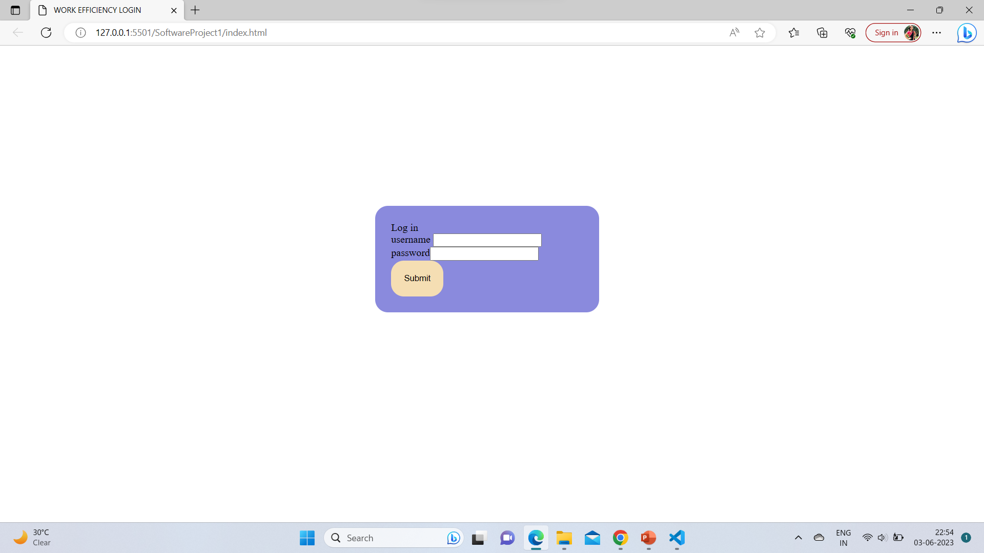
Login Page :

Slide 6
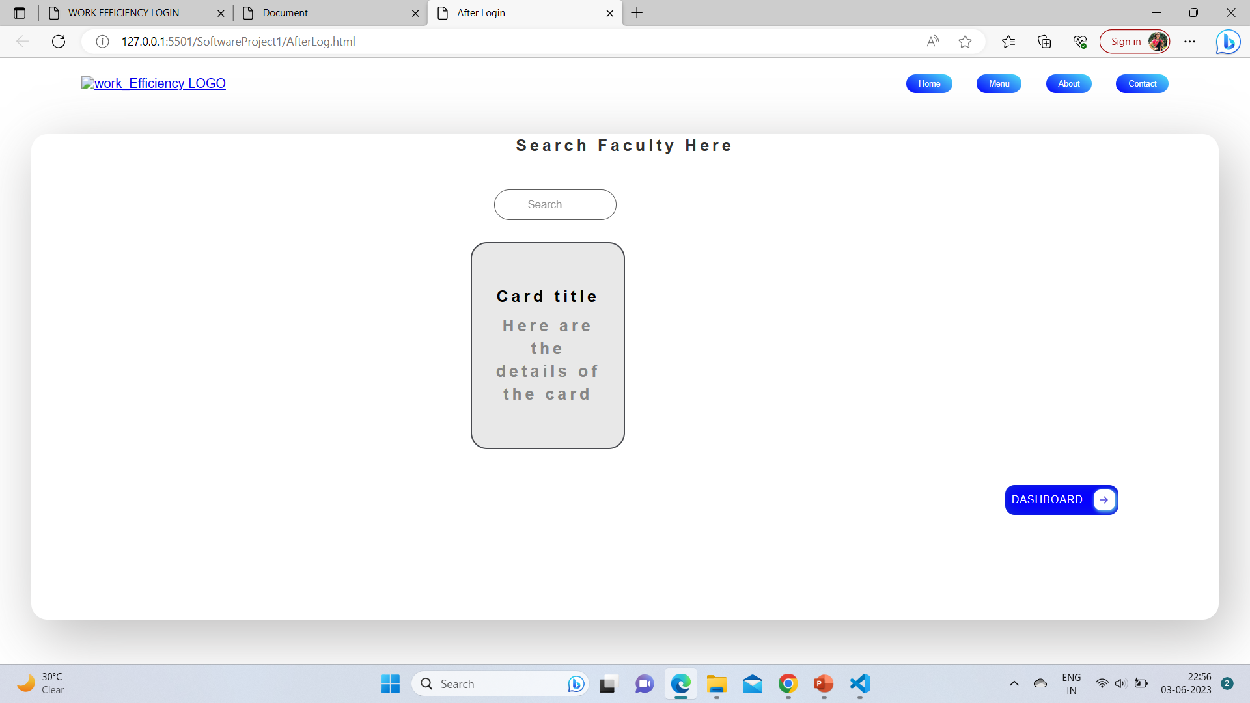
Home-page:

Slide 7
Module list :
User
Take attendance,
View the attendance record

Slide 8
Module list :
Admin
Can create/delete an account.
Can view the student’s accounts.
Can change the password.
Insert/delete/edit the information of available on daily attendance system.
Create/delete accounts
Change password for faculties

Slide 9
Advantages
The System is user friendly.
Cost effective.
Back up support.
Secured Data.
Covert into extand files, pdf etc.

Slide 10
Disadvantages
It is time consuming​
It consumes lot of manpower to better results​
It lacks of data security​
Retrieval of data takes lot of time​
Percentage of accuracy is less​
Reports take time to produce

Slide 11
Future Enhancement
In Future work, This application to develop a cross platforms like IOS, etc.
To authenticate the users based on the system users list which is maintained by the operating system.
In adding the more features attendance management system to develop access with user’s flexibility.

Slide 12
Reference

Slide 13
Thank You

