Slide 1
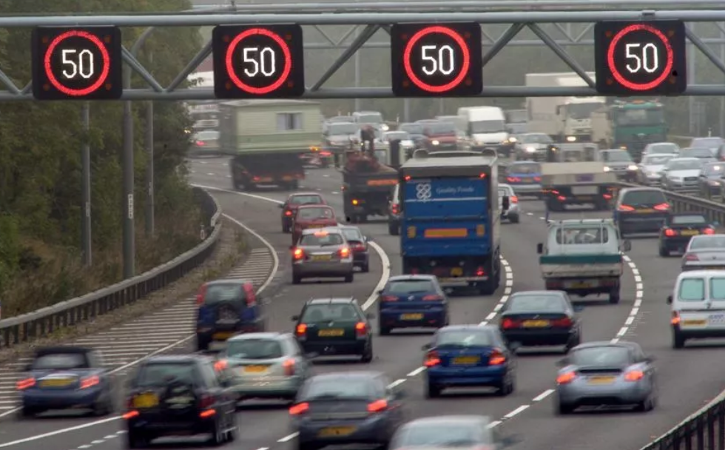
Case Study Speed Limit

Slide 2
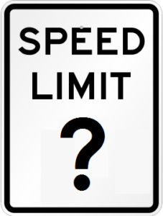
Project Description
SE4AII
SE4AIB

Slide 3
Project Description
The highway operator company keeps records of the current speed limit, weather, lighting conditions and accident history (including
near accidents).
Using machine learning, it wants to explore the relationship between those data. In production, the neural network shall only be used if it is dark or the weather is bad. Under those conditions it shall decide by what amount to reduce the speed limit.
Bad weather and darkness are not the only possible reasons to reduce the speed limit. Another reason is bad air quality. Here the company has no sufficient data for machine learning. So an LLM should decide based on the current air quality (queried via API) if and by how much the speed limit should be reduced.
If it is not dark and both the weather and the air quality are good, the speed limit is not reduced at all. It remains at 80 km/h.
SE4AII
qqq
SE4AIB

Slide 4
Data Description
SE4AII
SE4AIB

Slide 5
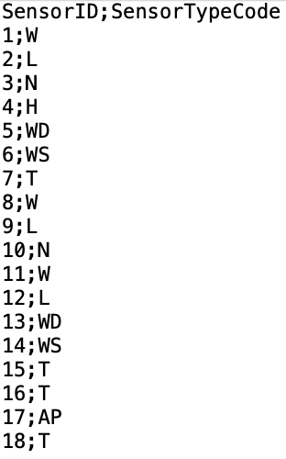
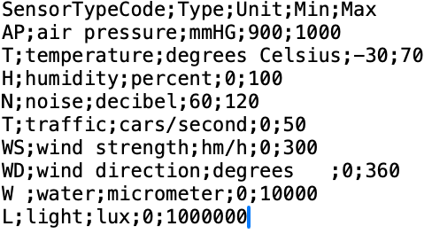
Data: Speed Limit
The highway is equipped with sensors. They are described in the files Sensors.csv and SensorTypes.csv (all filenames are extended by version numbers).
SE4AII
qqq
SE4AIB

Slide 6
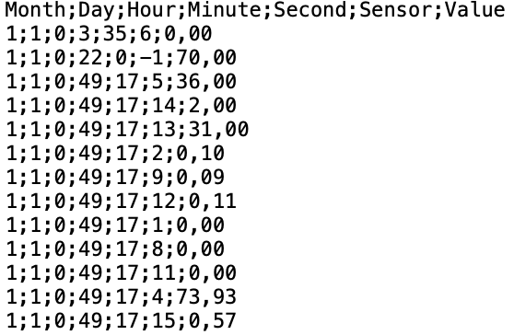
Data: Speed Limit / 2
Each sensor creates sensor readings – typically one per hour.
The file SensorReadings.csv (filename is extended by the year
and a version number) contains all sensor readings of a given time interval.
Note that the speed limit itself is coded as a special sensor reading with sensorID = -1 (e.g. the second line in the screenshot showing that the speed limit was 70 km/h on Jan 1st at 0:22 in the morning).
SE4AII
qqq
SE4AIB

Slide 7
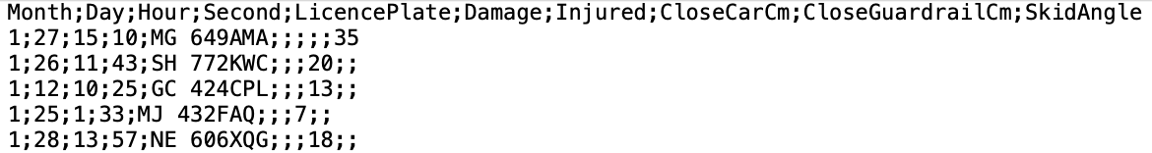
Data: Speed Limit / 3
Moreover, there is a file accidents.csv (filename extended by
year and version number), with accidents and near-accidents.
Damage for accidents: The damage caused by the accident in Euros.
Injured for accidents: The number of people injured in the accident.
CloseCarCm for near-accidents: How close the car came to another car (in cm).
CloseGuardailCm for near-accidents: How close the car came to the guardrail (in cm).
SkidAngle for near-accidents: By how many degrees the car was thrown out of the straight line.
SE4AII
qqq
SE4AIB

Slide 8
System Requirements
SE4AII
SE4AIB

Slide 9
System Requirements Speed Limit
REQ1: When it is dark or there is danger of black ice the
speed limit on the highway shall be reduced in such a way
that there will be on average at most one near-accident per hour.
REQ2: When poor air quality is predicted the speed limit on the highway shall be reduced in an appropriate way.
REQ3: If there is no reason to reduce the speed limit because of REQ1 or REQ2, it is set to 80 km/h.
SE4AII
qqq
SE4AIB

Slide 10
Requirements Specification
SE4AII
SE4AIB

Slide 11
First Steps of the Requirements Specification
Speed Limit
SPEC1: It is dark when the illuminance is below 500 millilux.
SPEC2: There is danger of black ice if there is more than 1000 micrometers water on the road and the temperature is below zero degrees Celsius.
SPEC3: A neural network shall learn from sensor data how
weather,
current speed limit and the
number of near-accidents
are connected.
SPEC4: A near-accident is defined as a car skidding or getting too close to another car or the highway guardrail.
SE4AII
qqq
SE4AIB

Slide 12
STOP UPLOAD HERE
SE4AII
qqq
SE4AIB

Slide 13
Integration
SE4AII
SE4AIB

Slide 14
RE Exercises
Find stakeholders
Complete system requirements
Complete requirements specifications
Add assumptions
Add glossary
Nonfunctional requirements
Avoid typical natural language requirements errors
qqq

Slide 15
System Requirements Speed Limit
Arc Diag with ROUTER
qqq

Slide 16
Data Preparation: Speed Limit
Visualize the structure of the data using a class diagram.
Analyze the data: What errors (inconsistencies, redundancies, missing values, wrong values, …) have you found? Specify how you will deal with those errors.
How will you use the neural network? What attributes does the input have (feature engineering)? What is the attribute to be predicted by the network? Specify how you get the input from the raw data.
HMXHSS
SE4AII
SE4AIB

Slide 17
Data Preparation: Speed Limit
Errors
Sensor type T ambiguous: Traffic and Temperature
Sensor 19 has readings, but no sensor description. Seems to be temperature sensor.
Sensors 7, 10 and 17 have a sensor description, but no readings
wind direction meaningful if windspeed = 0?
Sensor 18: empty readings for the first five hours of the 26th of January.
Sensor 15: empty sensor# for the last two hours of the 24th of January.
Sensor 2: NULL-string for month for the first six hours of the 18th of January. Imputation no problem (should read 1).
Sensor 13: 1.1. 12:00 to 14:00 Out of defined sensor range (more than 400 degrees wind direction).
What is the difference between 360 degrees and 0 degrees?
Sensor 15: one day completely missing (Jan 10th)
Sensor 4: readings of Jan 12th duplicated
Sensor 9: January instead of 1
Sensor 11: 17.1. 9:00 extreme high out of band value
Speed Limit 6.1. 20:00 for no understandable reason first dataset
Challenges
Only January
Lux: Better take logarithm?
LicencePlate: Privacy
Feature Engineering: Damage, Injured, DistCar, DistGuardRail, BadAngle --> Total Danger Index
Feature Engineering: Minute and Second as Input? Noise as input? Wind? Wind direction?
Feature Engineering: Average of several sensors if there are several?
Is Traffic (cars per second) an input or output variable? Don't we want to reduce the speed to maximize cars per second (among other things)?
SE4AII
SE4AIO

Slide 18
Development: Speed Limit
Write code that
repairs the data errors following you specification and
transforms the data into a ready-to-use format for the neural network following your specification.
SE4AII
qqq
SE4AIB

Slide 19
Retraining?: Speed Limit
Analyze SensorReadings.csv for the year after the training year
and decide whether it is necessary to retrain the neural network.
SE4AII
qqq
SE4AIB

