Slide 1




Speed Limit Project
Matúš Bondor, Aleksander Juraszek

Slide 2
How to read this presentation
Main path for the 7-minute talk: slides 1, 3, 6, 10, 17, 18, 23, 29 and 32
Slides 4–11: requirements and assumptions; 12–14: data
Slides 15–19: neural network and router; 20–22: LLM component
Slides 23–28: architecture and its tests; 29–30: MVP
Slides 31–32: retraining and lessons learned; 33–35: use of AI and summary
The car at the bottom shows how far you are in the presentation
Notes:
Reading guide. Update the slide numbers if the order changes.

Slide 3
Project summary
To be completed (planned Wed 11. 11.)
Notes:
Goal, approach and result in a few sentences. Write it last, after all results are known.

Slide 4
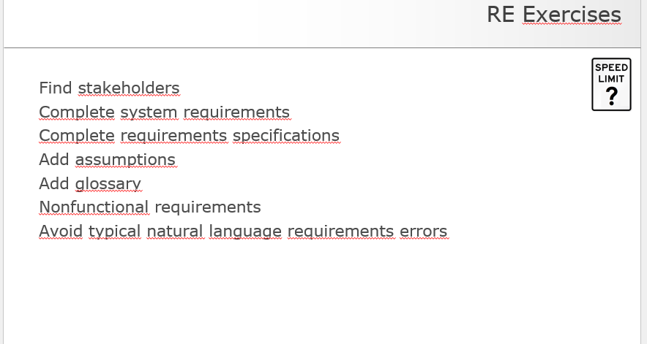
Tasks
Notes:
Task list from the case study (RE exercises).

Slide 5
Stakeholders
To be completed (planned Mon 9. 11.)
Notes:
Exercise SpeedLimit01. Use the IMS example and the EarlyBird checklist: operator, drivers, police, road maintenance, data protection officer, regulators, operations, testers, neighbouring systems.

Slide 6
System requirements
To be completed (planned Mon 9. 11.)
Notes:
Complete the system requirements (case study slide 14). Case study text: REQ1 reduce the limit when dark or ice risk so that at most one near-accident per hour; REQ2 reduce it for bad air quality; REQ3 80 km/h otherwise.

Slide 7
Specifications
To be completed (planned Mon 9. 11.)
Notes:
Complete the requirement specifications (SPEC1 to SPEC4 from the case study plus your own).

Slide 8
Non-functional requirements
To be completed (planned Mon 9. 11.)
Notes:
Exercise SpeedLimit07: non-functional requirements for SpeedLimit (qualities, measurable, with priority and stability).

Slide 9
Glossary
To be completed (planned Mon 9. 11.)
Notes:
Glossary of terms used in the project (near-accident, ice risk, router, limit, ...).

Slide 10
Assumptions
Near-accident = accident record with CloseCarCm, CloseGuardrailCm or SkidAngle filled in (SPEC4)
Accident hours 1–24 are shifted by −1 to match sensor hours 0–23
Sensor 16 (type code T) is treated as traffic, not temperature: range 2–30, weak correlation with temperature (0.21)
Sensor 19 has no description; it is a temperature sensor (correlation 0.998 with sensors 15 and 18)
Darkness threshold 500 is applied to the raw light value; lux vs. millilux gives the same 354 dark hours
Speed limit takes the values 40, 50, 60, 70, 80 km/h; sensor −1 holds the current limit
Notes:
Decisions made while cleaning the data. Each one is an assumption we could not verify with the data owner, so it is stated explicitly.

Slide 11
EU AI Act
To be completed (planned Mon 9. 11.)
Notes:
Exercise SpeedLimit04: no / yes / yes with technical and organisational measures, with reasoning. Assume worldwide deployment.

Slide 12
Class diagram of the data
To be completed (planned Mon 9. 11.)
Notes:
Class diagram of the data: sensors, sensor types, readings, accidents.

Slide 13
Data errors and fixes
Sensors 7, 10 and 17 have no readings: excluded (no air-pressure data for the air-quality part)
Type code T is used twice in SensorTypes (temperature, traffic): resolved per sensor, see assumptions
Trailing spaces in type codes ("W ", "WD "): trimmed before joining
CSV format: BOM, decimal comma, year N+1 readings without header: read with utf-8-sig and explicit column names
One accident record is completely empty (24 Jan, 15:45): removed
Wind direction is non-zero at zero wind speed (189 of 388 calm hours): direction not used as a feature
Errors listed in the case study but absent in the files: missing values, duplicates, NULL months, direction > 360°
Notes:
Real errors found in the supplied CSV files and what we did about each. Several errors from the case study slide do not occur in these files; we checked and documented that.

Slide 14
Data cleaning pipeline
Redundant sensors (3× water, 3× light, 3× temperature, 2× wind speed) are averaged per hour; correlation ≥ 0.996
Imputation: a missing hourly value would be filled by linear interpolation in time (none missing in the supplied files)
Speed limit rounded to the nearest of 40, 50, 60, 70, 80 km/h
Labels come from the accident table: a non-AI system acts as the oracle for the training target
Result: one row per hour, 744 rows per year, 8 inputs and 1 target
Notes:
Cleaning steps in order: read, aggregate redundant sensors, impute, join with accidents. Code is in 02_prepare_data.py.

Slide 15
Features and target
Target: number of near-accidents per hour
Inputs: speed limit, water, light, temperature, wind speed, humidity, noise, traffic
Water and light are log-transformed (range 0 to over 100,000); all inputs are standardized
Wind direction excluded; redundant sensors averaged
Split: 75 % training, 25 % testing, fixed random seed
Notes:
Feature engineering: inputs from sensors, target from accident records. Code is in speedlimit_core.py (make_features) and 03_train_model.py.

Slide 16
Training setup
To be completed (planned Fri 6. 11.)
Notes:
Model, split and training settings from 03_train_model.py: MLPRegressor with hidden layers 16 and 8, early stopping, 75/25 split, fixed random seed.

Slide 17
Neural network results
Model: MLPRegressor, hidden layers 16 and 8, early stopping
Test MSE 1.40 vs. 1.28 for the baseline "always predict the mean"
Mean 1.296 and variance 1.293 of near-accidents per hour: counts behave like random noise
Random forest and models with all raw sensors did not beat the mean either
Conclusion: the data do not support a reliable prediction; the MVP demonstrates the complete pipeline
Notes:
Honest result: the network is not better than the mean. This is a finding for the lessons learned, not a coding error. Check the numbers against your own training_report.txt.

Slide 18
Router and limit choice
Router (Software 1.0): dark if light < 500, ice risk if water > 1000 µm and temperature < 0 °C
Neither: default limit 80 km/h (REQ3)
Otherwise the network predicts near-accidents per hour for 80, 70, 60, 50 and 40 km/h
The highest limit with a prediction ≤ 1 is chosen (REQ1)
Guardrail: if no limit satisfies REQ1, use 40 km/h; negative predictions are clipped to 0
389 of 744 hours (52 %) are routed to the network: 354 dark, 62 with ice risk
Notes:
Router and limit selection are in speedlimit_core.py. Router tests (exercise SpeedLimit10b) are planned for Sun 8. 11.

Slide 19
Router tests
To be completed (planned Sun 8. 11.)
Notes:
Exercise SpeedLimit10b: four tests T1 to T4 from test_router.py as a table (ID, light, water, temperature, expected output).

Slide 20
LLM component: design
To be completed (planned Sun 8. 11.)
Notes:
Software 3.0 component: decides by how much to reduce the limit because of air quality. Describe inputs, output, prompt and why it is separate from the network.

Slide 21
LLM component: mock
To be completed (planned Sun 8. 11.)
Notes:
Mock implementation (no paid API). Describe how it can be replaced by a real LLM call later.

Slide 22
LLM component: tests
To be completed (planned Mon 9. 11.)
Notes:
Exercise SpeedLimit10c: at least five tests with input, golden answer (or none) and the source of the golden answer.

Slide 23
Architecture overview
To be completed (planned Tue 10. 11.)
Notes:
Exercise SpeedLimit21: components with a one-sentence description and the allowed-to-use diagram.

Slide 24
Training and production phase
To be completed (planned Tue 10. 11.)
Notes:
Show which components are used in training and which in production (feature engineering and cleaning are re-used).

Slide 25
Sequence diagram
To be completed (planned Tue 10. 11.)
Notes:
Sequence diagram: how the components interact and in which order they set the speed limit.

Slide 26
Tests per component
To be completed (planned Tue 10. 11.)
Notes:
Five test cases for each component (SpeedLimit21).

Slide 27
Change requests
To be completed (planned Tue 10. 11.)
Notes:
Three change requests: Fahrenheit sensors, only skids count as near-accidents, electric cars exempt from the air-quality reduction. Which components change and how.

Slide 28
Human in the loop
To be completed (planned Tue 10. 11.)
Notes:
Exercise SpeedLimit32b: where would you put a human in the loop and which skills would that person need?

Slide 29
MVP and GUI
To be completed (planned Sun 8. 11.)
Notes:
Screenshots of the Streamlit GUI with temperature, water and light inputs and the resulting speed limit.

Slide 30
End-to-end test
To be completed (planned Sun 8. 11.)
Notes:
One complete run from inputs to the limit, with the router, the network and the LLM component.

Slide 31
Retraining on year N+1
Year N+1: identical sensor readings, 844 accident records (997 in year N)
Mean near-accidents per hour fell from 1.30 to 1.11 (−15 %)
The network is no better than the mean on year N+1 either (MSE 1.13 vs. 1.07)
Retraining makes sense only with new, more informative data
Notes:
Retraining analysis for year N+1 (case study task). Numbers come from training_report.txt.

Slide 32
Lessons learned
Check that the target is predictable before building the model
Lower limits occur in bad conditions, so the model can link low limits with more accidents (confounding)
To be extended after the MVP is finished (planned Sun 8. 11.)
Notes:
First lessons learned. Add lessons from the LLM component, the GUI and the tests after the MVP is done.

Slide 33
Use of AI: prompts and models
To be completed (planned Wed 11. 11.)
Notes:
Which AI model and which prompts were used for which exercise (course rule: document prompt and model).

Slide 34
With AI vs. without AI
To be completed (planned Wed 11. 11.)
Notes:
Compare results without AI, with the first prompt and with the improved prompt for the exercises where you used AI.

Slide 35
Summary and next steps
To be completed (planned Wed 11. 11.)
Notes:
Short summary of the result and the next steps.

