Slide 1

IDEAL 2019
Detection of Abnormal Load Consumption
in the Power Grid Using Clustering
and Statistical Analysis
Matúš Cuper
Marek Lóderer
Viera Rozinajová
Slovak University of Technology
14.11.2019, Manchester UK

Slide 2
Problem statement
Identification of abnormal behavior
  data evolution, unlabeled dataset, noise, anomaly definition etc.
  classification, clustering, statistical methods etc.
  local and global anomalies
Prevention of illegal consumption, identification of malfunctioning devices, optimization of energy distribution
Behavior that differs from behavior of neighboring instances

Slide 3
Existing solutions
Clustering based
  sliding windows to keep relevant information
  suitable for quasi-periodic time series
Statistical based
  robust to anomalous fluctuations
  reduction of false-alarms
Other
  distance based
  density based

Slide 4
Proposed method
Clustering of time series
Scoring of instances and clusters
Customer selection
S-H-ESD analysis
Combining of computed scores

Slide 5
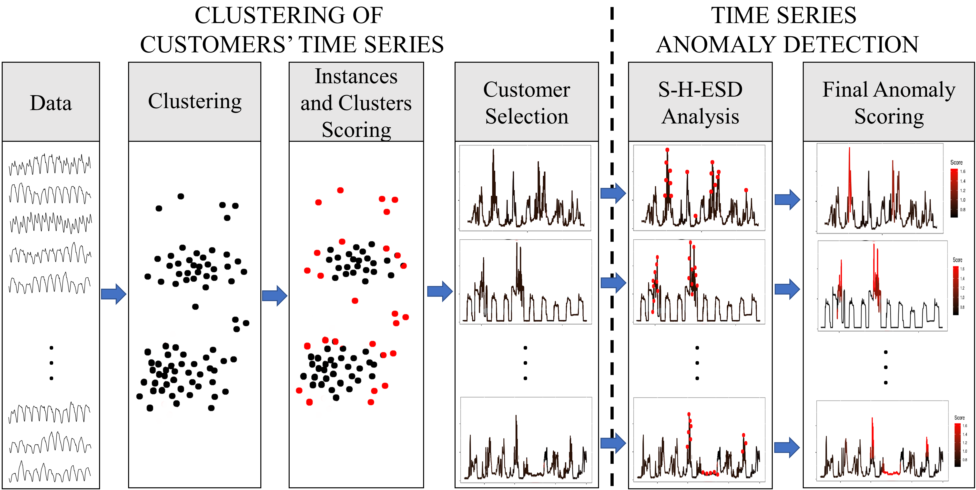
Proposed method

Slide 6
1. Clustering of time series
Data preprocessing
  normalization (z-score)
  window alignment
  division (workdays and non-workdays)
Dataset aggregation by sliding windows
  windows size (2 weeks)
  window shift (1 week)
Clustering using k-medoids
  distance metric (GAK)

Slide 7
2. Scoring of instances and clusters
Instance scoring
  different values for different instances
  relative distance of instance within given cluster
Cluster scoring
  different values for different clusters
  small cluster penalization

Slide 8
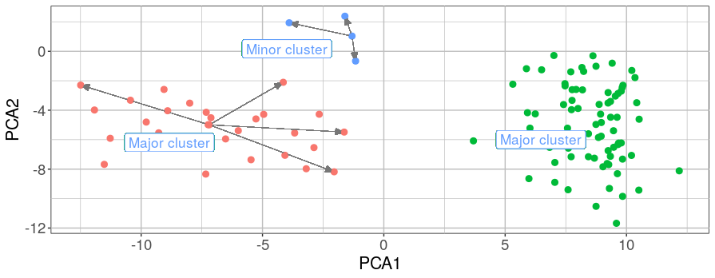
2. Scoring of instances and clusters

Slide 9
3. Customer selection
Interval of interquartile rule for anomaly detection
<Q1 – 1.5*IQR, Q3 + 1.5*IQR>
FeaClip method
Based on suspicion
Visualization

Slide 10
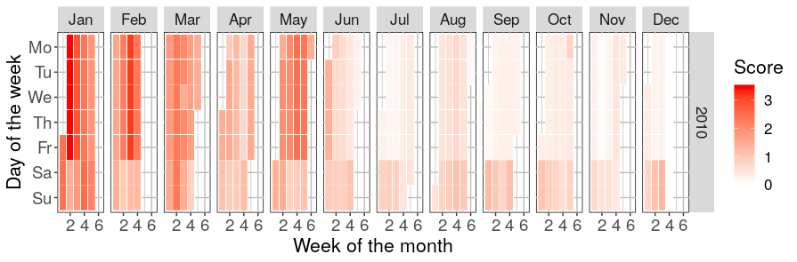
3. Customer selection

Slide 11
4. S-H-ESD analysis
Smoothing in order to eliminate numerous local anomalies
S-H-ESD analysis
  based on Grubb’s test
  using median absolute deviation
  capable of identifying up to 50% anomalies
Output of S-H-ESD analysis is a flag
  Intervals with dense occurrence of flags are grouped
  Intervals with sparse occurrence of flags are smoothed

Slide 12
5. Combining of computed scores
Combining of smoothed flags from S-H-ESD analysis and computed score from k-medoids
Lower granularity
Result is not flag indicating anomalousness, but number representing degree of anomalousness of given measurement

Slide 13
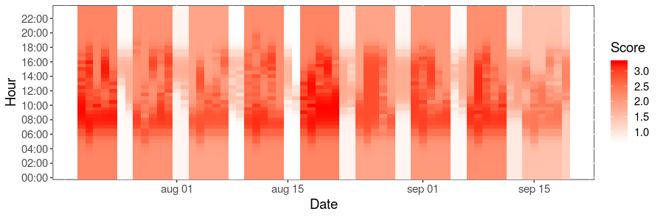
5. Combining of computed scores
Anomaly score =
Consumer score + S-H-ESD score

Slide 14
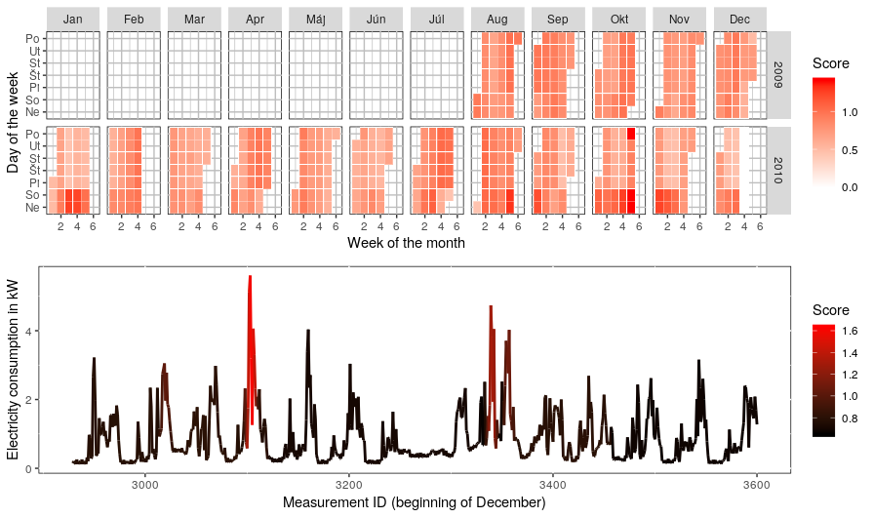
5. Combining of computed scores

Slide 15
Evaluation
Dataset from Irish CER Smart Metering Project
Clustering
  experiments
  cluster validation indexes
Proposed method compared to
  PEWMA
  SD-EWMA
  KNN-LDCD
  S-H-ESD

Slide 16
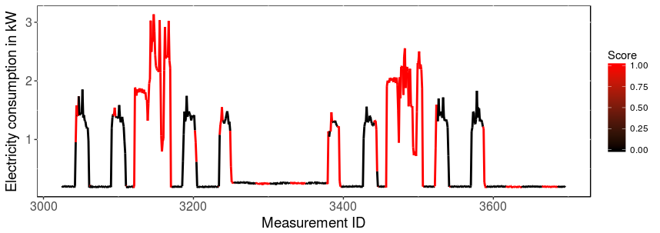
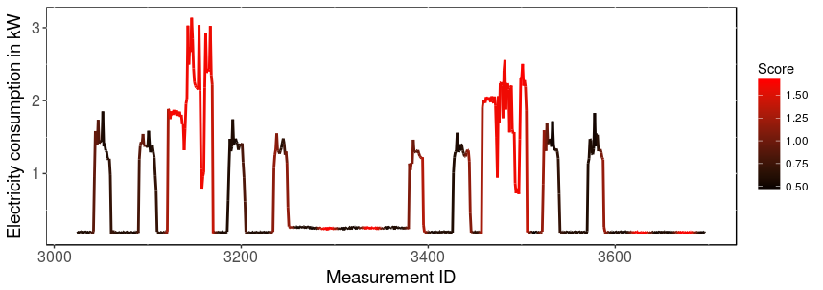
Evaluation
S-H-ESD
Proposed
Method

Slide 17
Evaluation
Method Name | TP | TN | FP | FN | Precision | Recall | F1 score
PEWMA | 0.6 % | 82.5 % | 3.3 % | 13.6 % | 17.67 % | 4.90 % | 7.67 %
SD-EWMA | 0.7 % | 83.1 % | 2.6% | 13.6 % | 20.36 % | 4.69 % | 7.62 %
KNN-LDCD | 0.04 % | 85.6 % | 0.03 % | 14.2 % | 60.00 % | 0.31 % | 0.62 %
S-H-ESD | 6.4 % | 58.1 % | 27.6 % | 7.9 % | 18.82 % | 44.90 % | 26.52 %
Proposed Method | 4.4 % | 80.6 % | 5.1 % | 9.9 % | 42.84 % | 39.27 % | 40.98 %
Reality | 14.3 % | 85.7 % | - | - | - | - | -

Slide 18
Summary
Only consumers with high score are analyzed
Flag replaced by degree of anomalousness
Possible online processing
Thank you for your attention

