Slide 1
Optimize your CI pipeline
In Ruby on Rails Applications
Jan Matuszewski

Slide 2
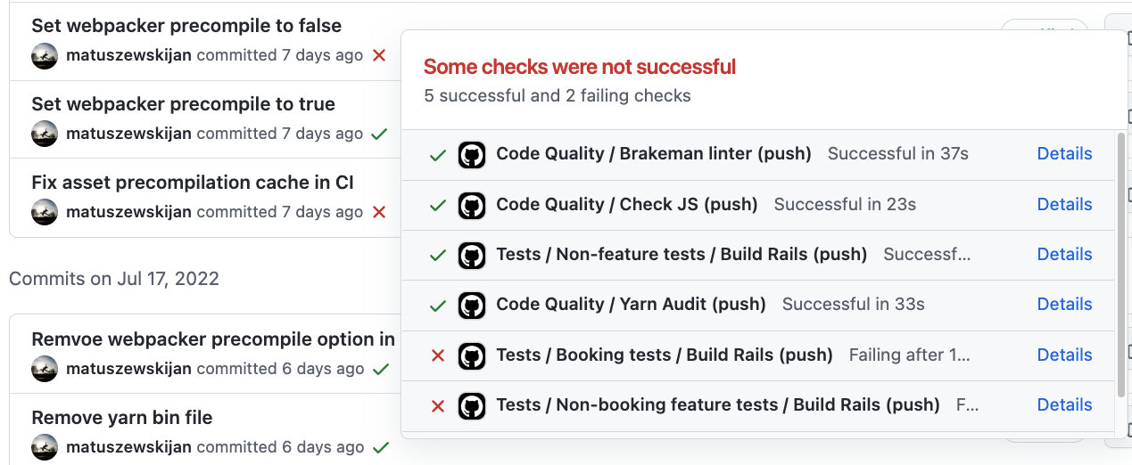
What is Continous Integration

Slide 3
Why optimizing?
Shorter feedback loop.
Every minute of CI time improvement results in 2% more Pull Requests*
Less context switching
*https://kellysutton.com/2020/05/18/speeding-up-a-rails-continuous-integration-pipeline.html

Slide 4
How?
Increase cache usage
Optimize your code
Parallelization

Slide 5
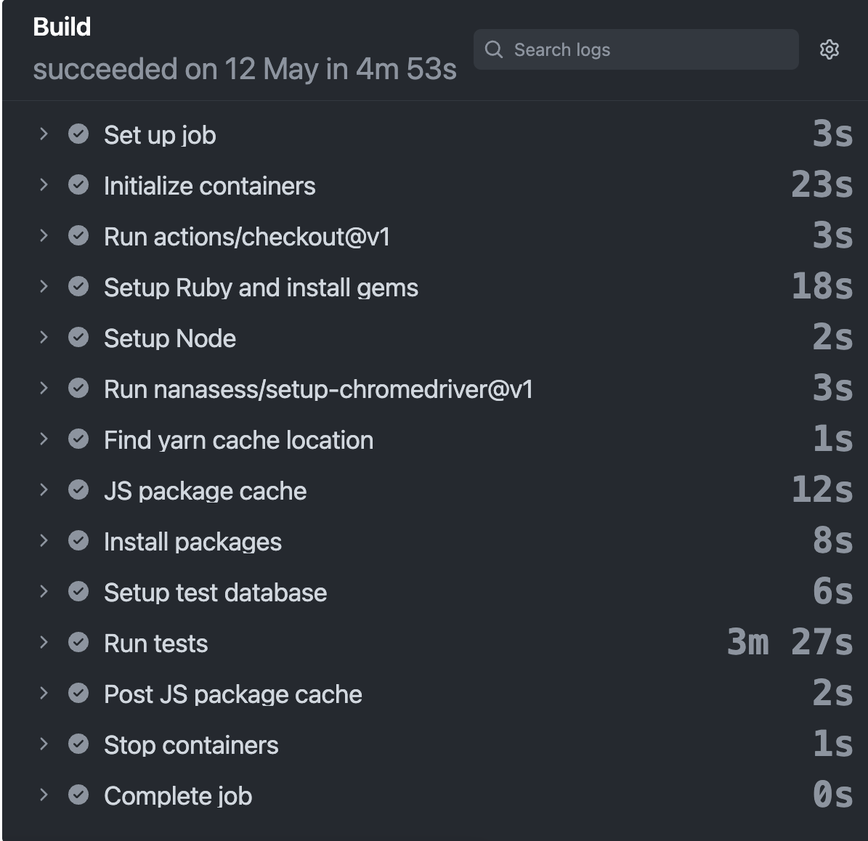
Where I started
Simple project with only a couple of tests running for 5 minutes
Configuration copied from various tutorials
No parallelization

Slide 6
Using optimal configuration
&
Caching

Slide 7
Things to check:
In your DB cleaner settings use transaction strategy*
Organize gems to Groups in Gemfile
Organize your dependencies and devDependencies in package.json
Disable logging in CI environment/log only fatal messages
Check Postgres health check settings(health-interval)
Use rails db:schema:load against rails db:migrate
https://github.com/DatabaseCleaner/database_cleaner#what-strategy-is-fastest

Slide 8
Cache Webpacker /packs
Make sure you cache webpacker public_output_path (probably public/packs)
Cache any other temp assets directory for non-webpacker apps
Use current webpacker digest/mtime as your cache key
# Works for Shakapacker(newest Webpacker version) gem
Webpacker::MtimeStrategy.new.send(:latest_modified_timestamp)
Webpacker::DigestStrategy.new.send(:last_compilation_digest)

Slide 9
CI Caching
- name: Get current assets version generated by Webpacker
id: get-webpacker-version
run: |
echo "::set-output name=key::$(bin/rails r 'print Webpacker::MtimeStrategy.new.send(:latest_modified_timestamp)')"
shell: bash
- name: Cache precompiled assets
uses: actions/cache@v3
with:
path: |
public/packs
public/assets
tmp/cache/webpacker
key: ${{ runner.os }}-assets-${{ steps.get-webpacker-version.outputs.key }}
restore-keys: |
${{ runner.os }}-assets-
- name: Precompile assets
- name: Run tests

Slide 10
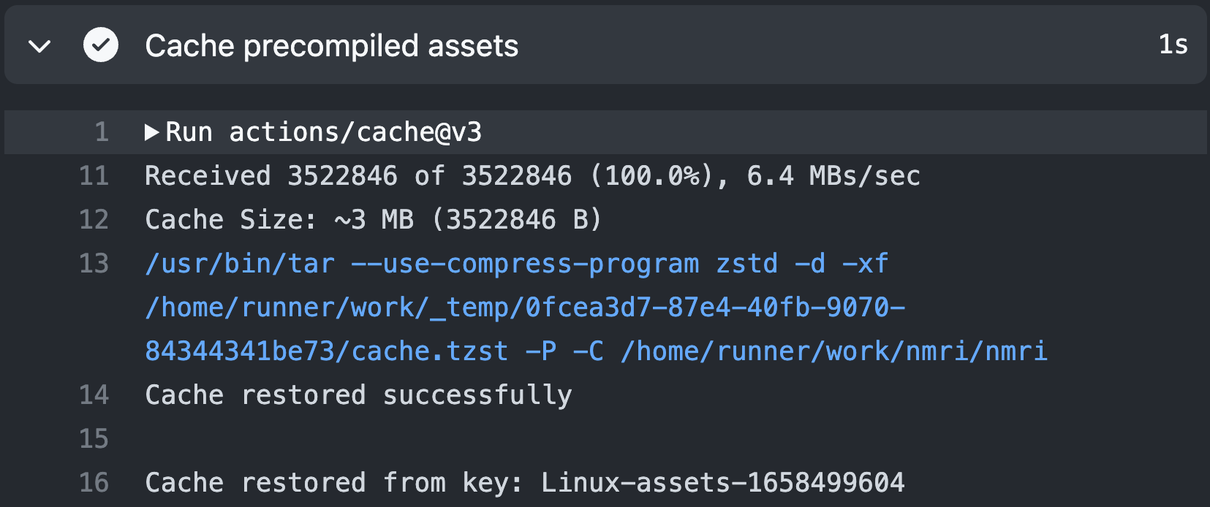

Slide 11
Cache | Artifacts
Internal storage | External storage
Save precompiled assets, node modules | Save test coverage, logs
Shared between runs | Not shared between runs
Deleted when unused for 7 days | Deleted after 90 days(or specified by retention-days option)
https://docs.github.com/en/actions/using-workflows/caching-dependencies-to-speed-up-workflows
https://docs.github.com/en/actions/using-workflows/storing-workflow-data-as-artifacts

Slide 12
Feature/Integration tests
The performance killer
Chromedriver options:
Check your Capybara.default_max_wait_time
chrome_options.add_argument(‘--no-sandbox')
chrome_options.add_argument(‘--disable-gpu')
Quick introduction to Chrome sandbox:
https://www.google.com/googlebooks/chrome/big_26.html

Slide 13
Puffing-Billy - request proxy
Could work as WebMock for your integration tests
Cache your front-end-side requests
Takes some time to set up correctly
Improves test execution on your local machine

Slide 14
Setup
Add proxy server to your driver initialization
Configure Billy:
Add cache_path to .gitignore and your cached folders in CI
chrome_options.add_argument("--proxy-server=#{Billy.proxy.host}:#{Billy.proxy.port}")
Billy.configure do |c|
c.cache = true
c.persist_cache = true
c.cache_path = ‘spec/req_cache/'
c.non_whitelisted_requests_disabled = true
c.ignore_params = [ # Do not match request parameters
'https://maps.googleapis.com/maps/vt',
'https://widget.trustpilot.com/stats/TrustboxImpression',
...
]
c.cache_request_body_methods = [] # Do not match POST request body
end

Slide 15
Locate your slowest tests
rspec —profile - will show you 10 slowest examples + slowest groups
Maybe there are some exceptionally slow examples? Is there a quick fix for it?
Locate flaky tests(using retries could slow thing tremendously)

Slide 16
Parallelization

Slide 17
What we want to avoid
😭
😀
https://docs.knapsackpro.com/ruby/knapsack

Slide 18
Trying parallel_tests gem
Automatically splits tests into groups
Generates file runtime stats for all tests*
*we have to somehow provide the runtimes file to CI
Easy to scale

Slide 19
Setup
Add TEST_ENV_NUMBER to your database configuration
Start your tests with command like:
Github Actions setup:
parallel_test spec/ -n $NO_GROUPS --only-group $GROUP --group-by runtime
strategy:
fail-fast: false
matrix:
ci_node_total: [4]
ci_node_index: [0, 1, 2, 3]
- name: Run tests
env:
NO_GROUPS: ${{ matrix.ci_node_total }}
GROUP: ${{ matrix.ci_node_index }}

Slide 20
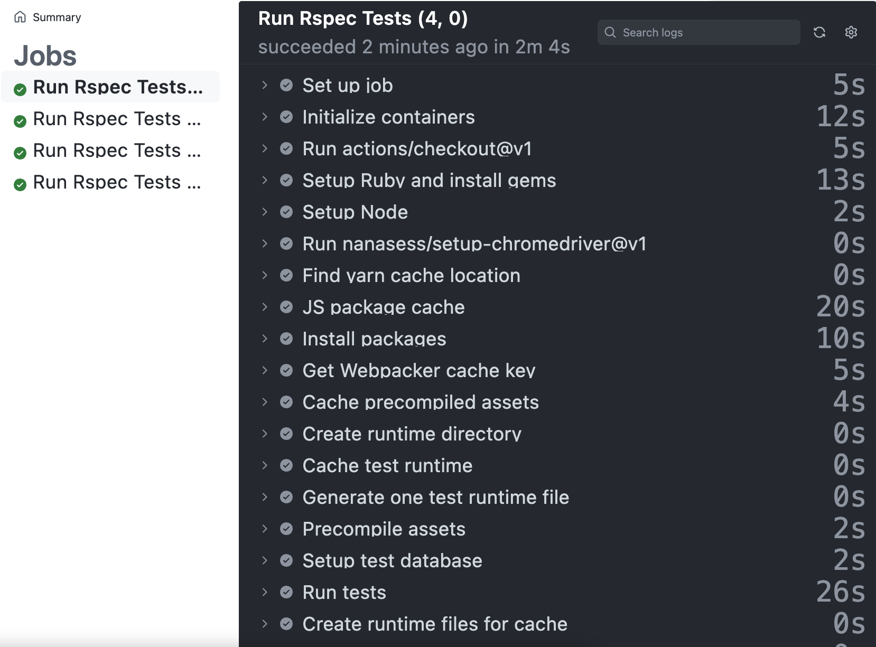
Results

Slide 21
Thank you!
Jan Matuszewski - matuszewski.jan@hotmail.com
https://kellysutton.com/2020/05/18/speeding-up-a-rails-continuous-integration-pipeline.html
http://railscasts.com/episodes/413-fast-tests
https://www.fullstacklabs.co/blog/parallelizing-tests-circleci-collecting-coverage-codeclimate

