Slide 1
Rails Asset Pipeline in a Nutshell
Jan Matuszewski

Slide 2
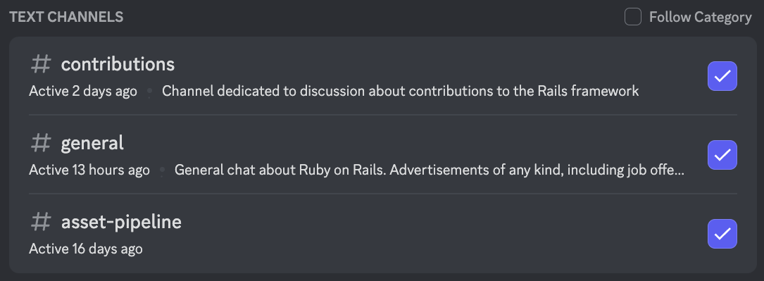

Slide 3
Purposes of Asset Pipeline

Slide 4
1. Serving assets to clients
How it’s done:
Move the assets to /public folder
Add <link rel="stylesheet" type="text/css" href=“style.css"> to <head>
Users download style.css for all pages
GET /index
GET /style.css
{Rails.root}/public/style.css
/index
/style.css

Slide 5
1.5. Caching
Serve asset only once, then use cache
GET /style.css
100ms
/style.css
Headers: Cache For 1 Week
GET /style.css
0ms
/style.css

Slide 6
2. Fingerprinting for cache invalidation
<link rel="stylesheet" href=“style-{checksum of file content}.css”>
GET /style-aaaa.css
100ms
/style-aaaa.css
Headers: Cache For 1 Week
GET /style-aaaa.css
0ms
/style-aaaa.css
GET /style-bbbb.css
100ms
/style-bbbb.css
Headers: Cache For 1 Week

Slide 7

3. Transpiling
Change the format of delivered files into one recognised by browser
Transpiler
Asset Pipeline
Fingerprinting, Compression
style.scss
style.css

Slide 8
Sprockets:
Fingerprinting
Concatenation
Compression
Source Maps
Transpiling
Jsbundling-rails
Cssbundling-rails
Dartsass-rails
Tailwindcss-rails

Slide 9
Rails 7 asset pipeline goals:
Make it “Node-less” by default
Stop using Sprockets for transpiling (prepare for Propshaft)
Utilize HTTP/2

Slide 10
Dartsass
Rails
Sprockets
app/assets/stylesheets/style.scss
app/assets/builds/style.css
public/assets/style-0a1b2c.css

Slide 11
Dart Sass Rails / TailwindCSS Rails
CSS Bundling Rails
VS
Standalone Executable Versions
Node transpiling
Node-less setup

Slide 12
Importmaps = aliases?
# config/importmap.rb
pin "vue", to: “https://ga.jspm.io/npm:vue@3.2.45/..."
Allows you to use
// application.js
import Vue from "vue"
Without npm or yarn

Slide 13
My takeaways
For learning:
Read all README’s
Reading the setup code(lib/setup folder)
Give thumbs on New Documentation

Slide 14
Thank you!
Jan Matuszewski
jmatuszewski.com

