Slide 1
Machine-Learning Detection of Bid Rigging
in Russian Public Procurement
Identifying cartel collusion in 44-FZ / 223-FZ auctions from open contract data
Term paper — defense presentation
Author: Matvey · Supervisor: [name]
HSE University, Saint Petersburg · 2026

Slide 2
MOTIVATION
Why cartels in public procurement matter
A concrete case: in a road-repair auction three "competing" firms take turns submitting near-identical bids and barely lower the starting price — the state overpays and the winner is decided in advance.
Bid rigging (sec. 2 part 1 art. 11 of the Competition Law) is the most damaging antitrust violation in procurement: it inflates prices and wastes budget funds.
The Federal Antimonopoly Service (FAS) detects cartels mostly reactively, case by case — slow and incomplete coverage of millions of contracts.
Open data (EIS / ClearSpending) records the price, parties and dynamics of every auction, so suspicious patterns are in principle observable at scale.
RESEARCH QUESTION
Can supervised models, trained on open contract data and confirmed FAS cartel cases, flag individual contracts as likely bid-rigging — and which signals drive that prediction?
2

Slide 3
LITERATURE
What the literature tells us
Screens for collusion
Behavioural bid markers
Economic "screens" flag markets by price and bid patterns — low bid dispersion, suspiciously stable shares, round-number bids (Harrington; Porter & Zona).
Cartels leave fingerprints: small price drops vs. the reserve, rotating winners, repeated firm pairs facing the same buyer (Imhof et al.; Conley & Decarolis).
ML on procurement data
Label-quality problem
Tree-boosting models (gradient boosting, random forests) on tender features outperform single-indicator screens for flagging rigged tenders.
Only detected & sanctioned cartels are labelled positive — true collusion is under-reported, a positive-unlabelled setting that biases naive evaluation.
Takeaway: price-dynamics + relationship features feed an ML screen; label noise must be handled explicitly.
3

Slide 4
DATA
Data: sources and construction
1 · FAS decisions
2 · Contracts
3 · Labelling
4 · Cleaning
Scrape br.fas.gov.ru; keep only true bid-rigging rulings (art. 11 §2). Extract violator INNs and the rigged auction numbers.
→
Pull all 44-FZ / 223-FZ contracts of those suppliers from ClearSpending API; enrich with supplier & customer registries.
→
Flag a contract collusion = True if its notification number is in the FAS-confirmed rigged-auction set; otherwise False.
→
Drop 94-FZ (legacy), fix INN formatting, merge sources, remove leakage/constant columns.
18,537
1,471
184 / 4,518
2010–2025
contracts (units of analysis)
cartel contracts — 7.9%
suppliers / customers
contract sign dates
Coverage: 16,989 contracts under 44-FZ and 1,548 under 223-FZ. Positive labels come from a limited pool of 184 sanctioned suppliers — handled in validation.
4

Slide 5
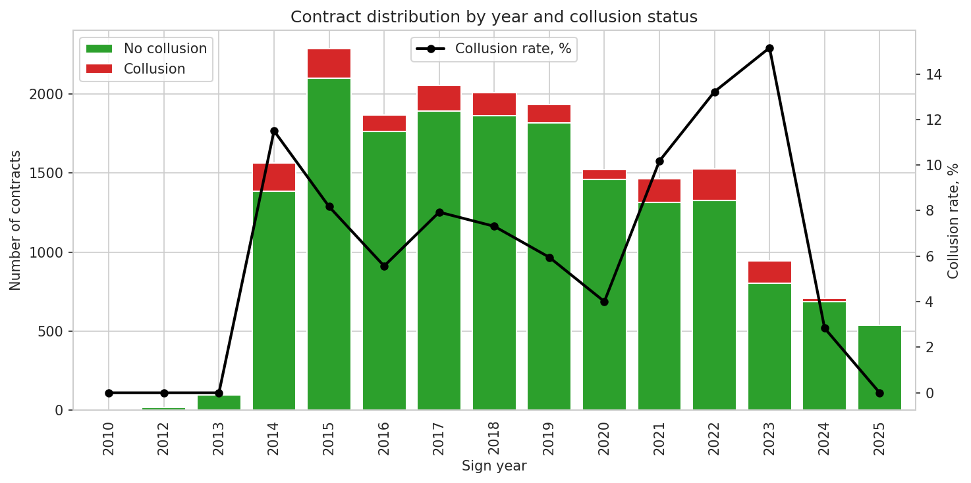
DATA
Dataset over time: volume and cartel rate
Green = clean contracts, red = cartel contracts (left axis); black line = cartel rate (right axis).
Contract volume grows over the sample; confirmed cartel contracts cluster in specific years.
This temporal concentration makes sign_year informative but also a confounder — addressed in the model section.
5

Slide 6
METHODS & DATA
Feature engineering: turning contracts into signals
Contract-level:
price drop vs. reserve (abs/%), log price, round-number price, currency, OKPD2 category, duration, seasonality (end-of-year/quarter).
Supplier & customer history (only past contracts — no leakage):
counts, average/median/std price, average past price drop, number of unique counterparties.
Relationship features:
customer–supplier concentration, repeated supplier–customer pairs, pair share of the buyer's portfolio.
~57 model features; identifiers and post-outcome fields excluded to avoid leakage.
Strongest single features (ROC-AUC)
Customer–supplier concentration | 0.73
Customer's unique suppliers (before) | 0.69
Pair share in customer portfolio | 0.67
Customer contracts (before) | 0.66
Price vs. supplier average | 0.65
Supplier avg. past price drop | 0.62
Relationship structure beats raw price signals — collusion is a network property.
6

Slide 7
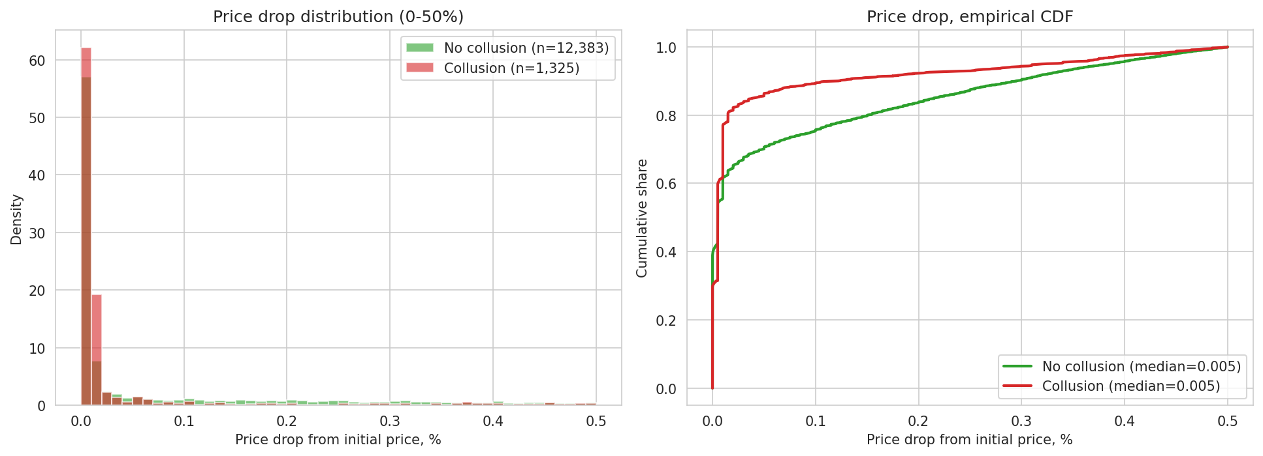
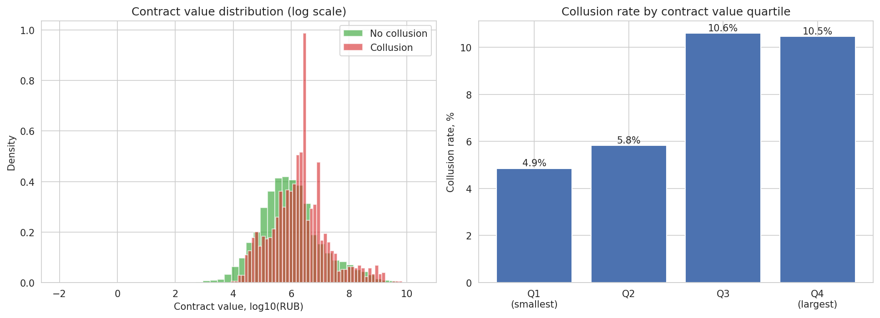
RESULTS — EDA
Cartels barely lower the price
Top: cartel contracts (red) concentrate at near-zero price drops — the reserve price is hardly competed down.
Bottom: collusion is not confined to small lots — the cartel rate rises in the higher-value quartiles.
Consistent with the screening literature: weak price competition is a hallmark of rigged auctions.
7

Slide 8
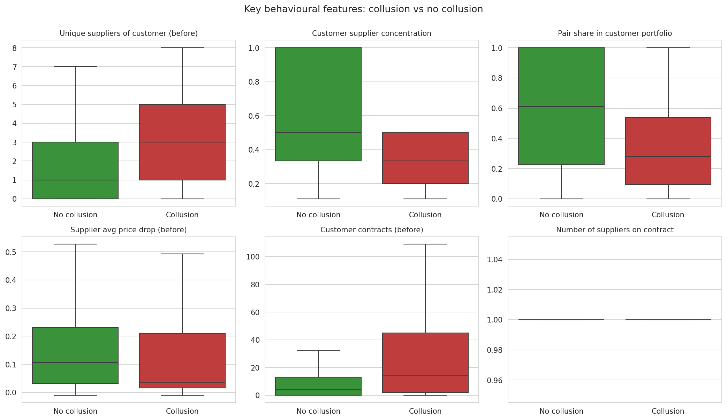
RESULTS — EDA
Behavioural differences: cartel vs. clean
Cartel contracts tend to involve buyers with fewer unique suppliers and higher supplier concentration.
Repeated supplier–customer pairs take a larger share of the buyer's portfolio.
Past price-drop behaviour of the supplier is systematically lower for cartel firms.
Distributions overlap — no single feature separates the classes, motivating a multivariate model.
8

Slide 9
METHODS & DATA
Models and honest validation
Models: gradient-boosted trees — CatBoost and LightGBM — handle categoricals, missing values and class imbalance.
Imbalance: positives are only 7.9%, so we evaluate with PR-AUC (vs. a 0.079 baseline) alongside ROC-AUC and F1.
Validation strategies:
Stratified K-fold — random split; optimistic because the same suppliers appear in train and test.
GroupK-fold by supplier (INN) — no supplier overlap; the honest test of generalisation to new firms.
Time-split — train on past, test on future, mimicking real deployment.
Label-noise handling: Cleanlab flags likely-mislabelled contracts (positive-unlabelled problem).
WHY GROUPING MATTERS
Positives come from just 184 sanctioned suppliers.
If a supplier is in both train and test, the model can memorise the firm instead of learning collusion.
GroupK-fold by INN removes this shortcut — its lower scores are the credible ones.
9

Slide 10
RESULTS
Model performance
Model / validation | PR-AUC | ROC-AUC | F1 | Precision | Recall
LightGBM — stratified | 0.778 | 0.965 | 0.679 | 0.577 | 0.827
CatBoost — stratified | 0.731 | 0.959 | 0.587 | 0.441 | 0.876
LightGBM — group by supplier | 0.509 | 0.882 | 0.493 | 0.486 | 0.500
CatBoost — group by supplier | 0.531 | 0.899 | 0.497 | 0.399 | 0.656
Baseline (positive share) | 0.079 | — | — | — | —
Honest (group-by-supplier) PR-AUC ≈ 0.51–0.53 — about 6.5× the 0.079 baseline.
ROC-AUC stays high (0.88–0.90): the model ranks contracts well even on unseen suppliers.
Stratified scores (0.73–0.78) are inflated by supplier overlap — reported only for contrast.
Operating point: high recall is achievable, so the screen can shortlist suspicious contracts for review.
10

Slide 11
RESULTS
What drives the prediction
Price competitiveness dominates:
price drop vs. reserve and vs. the supplier's own history are the top behavioural signals.
Relationship & market structure:
buyer's supplier diversity and repeated-pair share rank highly.
Context:
region, district and product category capture where collusion concentrates.
Caveat: sign_year is highly ranked but partly reflects when cases were prosecuted.
11

Slide 12
RESULTS
Label noise: missed cartels, not false alarms
Cleanlab flags 1,409 contracts as likely mislabelled (~11% of the working sample).
1,235 "False" contracts look strongly like collusion → plausibly undetected cartels.
174 "True" contracts look clean → possible over-reach / weak cases.
Correcting labels improves the honest model:
relabel suspected positives → negatives lifts PR-AUC 0.447 → 0.469 (better than baseline in 100% of bootstraps).
effect grows monotonically as more flagged noise is pruned (robustness check).
Confirms the positive-unlabelled nature: FAS labels under-count true collusion.
Label-noise strategy | PR-AUC | P>base
Baseline (raw labels) | 0.447 | —
Relabel → negative | 0.469 | 100%
Remove flagged | 0.461 | 98%
Relabel both ways | 0.460 | 94%
Group-by-supplier validation, CatBoost, 1,000-bootstrap CIs.
12

Slide 13
RESULTS
Robustness across sample definitions
Sample / setup | Rows | Cartels | Group PR-AUC | × baseline | Time-split PR-AUC
A — 44+223, with reserve | 18,537 | 7.9% | 0.414 | 5.2× | 0.658
B — 44+223, no reserve | 18,537 | 7.9% | 0.377 | 4.8× | 0.661
C — 44-FZ, with reserve | 16,989 | 8.5% | 0.388 | 4.5× | 0.681
D — 44-FZ, no reserve | 16,989 | 8.5% | 0.361 | 4.2× | 0.682
E — 44-FZ, complete rows | 13,176 | 8.6% | 0.465 | 5.4× | 0.643
Signal is stable: 4–5× the baseline across every sample definition.
The reserve-price (price-drop) features consistently add predictive power.
Time-split PR-AUC (0.64–0.68) shows the screen still works on future, unseen contracts; Strategy E (complete rows) is the cleanest and strongest honest setup.
13

Slide 14
DISCUSSION
Interpretation and limitations
What the results mean
Limitations
Open data carries a real, multivariate cartel signal — ~5× better than chance even on unseen suppliers.
Weak price competition + concentrated buyer–supplier relationships are the strongest markers, matching the screening literature.
The model is a triage tool: it shortlists contracts for human / FAS review, not a verdict.
Positive-unlabelled labels: only detected cartels are positive; undetected ones sit in the negative class.
Positives come from 184 suppliers — limited diversity; group validation mitigates but cannot fully remove this.
sign_year / region partly proxy enforcement activity, not pure collusion mechanics.
Findings are associational, not causal; flags require legal corroboration.
14

Slide 15
CONCLUSIONS
Conclusions
Answer to the RQ: yes — gradient-boosted models trained on open contract data and FAS cartel cases flag bid-rigging at ~5–6× the base rate, and the drivers are interpretable.
Top signals: small price drop vs. the reserve and vs. the firm's own history; concentrated, repeated buyer–supplier relationships.
Validation discipline matters: grouping by supplier and time-splitting cut optimistic scores roughly in half — report the honest numbers.
Label quality is central: correcting Cleanlab-flagged noise reliably improves the model and reveals likely undetected cartels.
Practical use: a ranked watch-list for antitrust analysts, focusing scarce investigative attention on the riskiest contracts.
15

Slide 16
SUMMARY
Summary
SUBJECT
Bid rigging (cartel collusion) in Russian 44-FZ / 223-FZ public-procurement auctions.
QUESTION
Can open contract data + FAS cases flag individual contracts as likely collusion, and why?
DATA
18,537 contracts (1,471 cartel, 7.9%), 184 suppliers / 4,518 customers, 2010–2025; ~57 features.
METHOD
CatBoost & LightGBM with PR-AUC; supplier-grouped & time-split validation; Cleanlab for label noise.
ANSWER
Honest PR-AUC ≈ 0.47–0.53 (~5–6× baseline); driven by weak price drops and concentrated relationships.
IMPLICATION
A deployable triage screen that focuses antitrust review and surfaces likely undetected cartels.
16

Slide 17
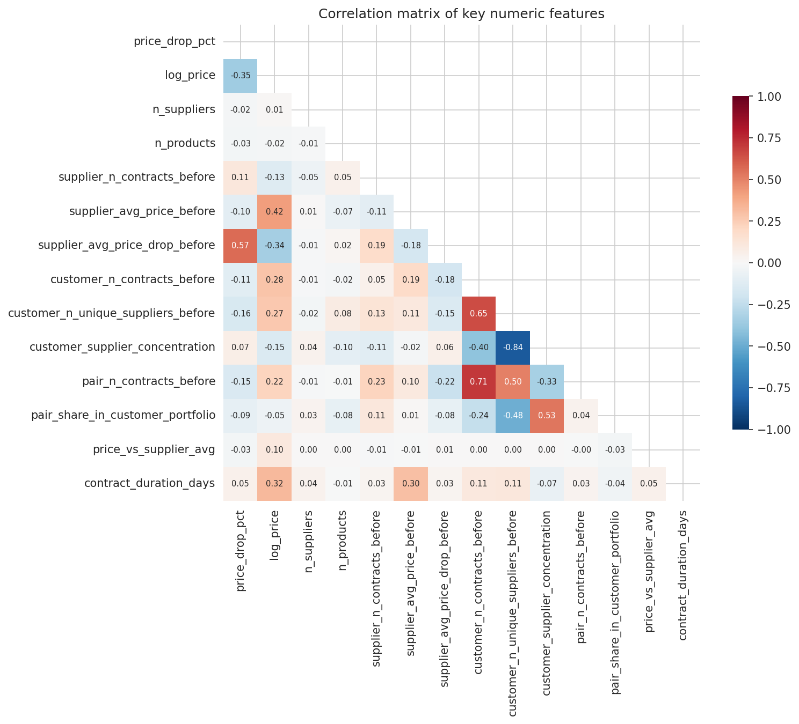
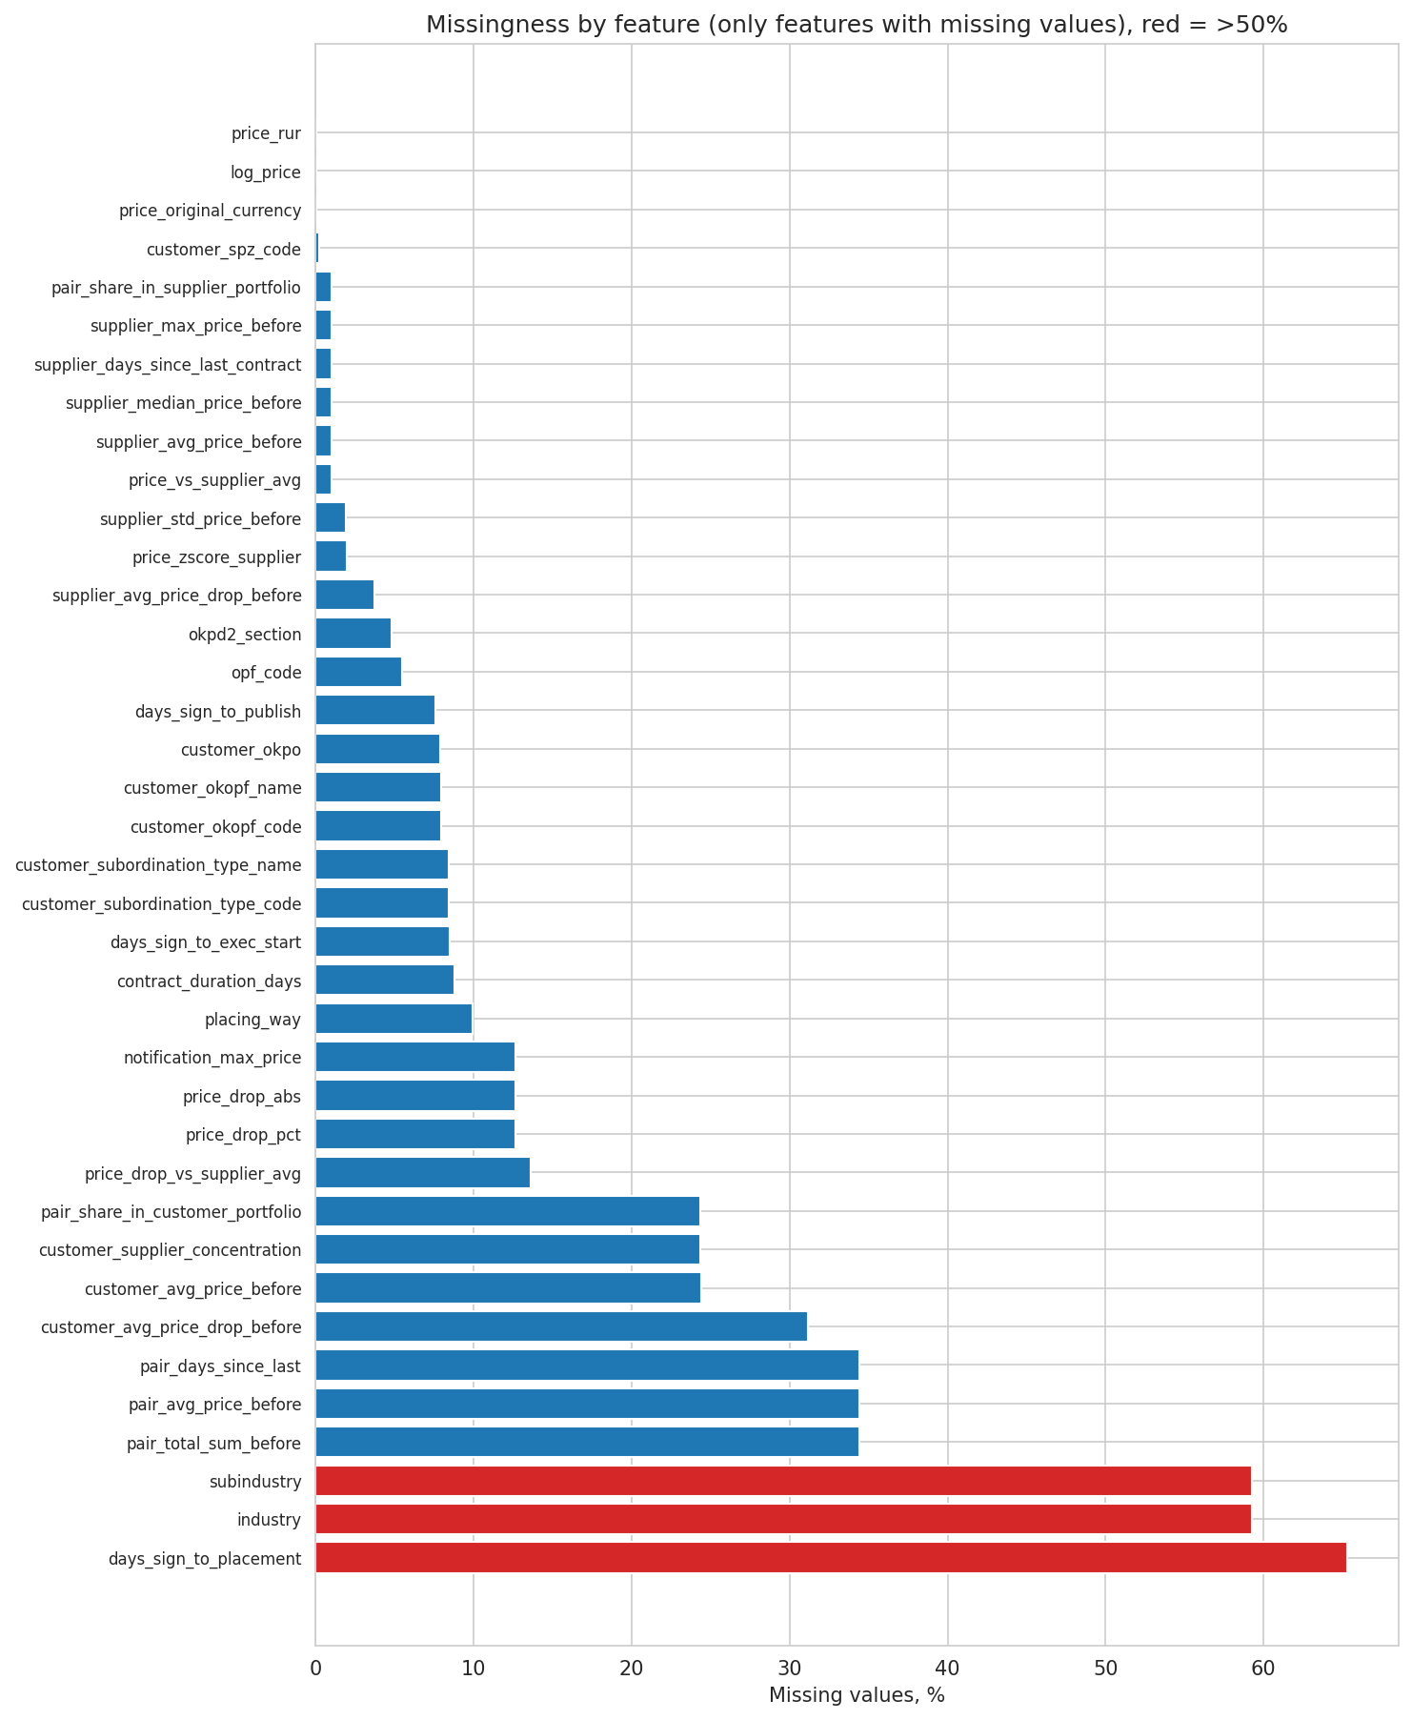
APPENDIX
Appendix — feature structure & data quality
Left: correlations among key numeric features (most are weak — limited redundancy). Right: missingness by feature; red bars > 50% missing (mainly reserve-price-derived fields), which the boosting models handle natively.
17

Slide 18
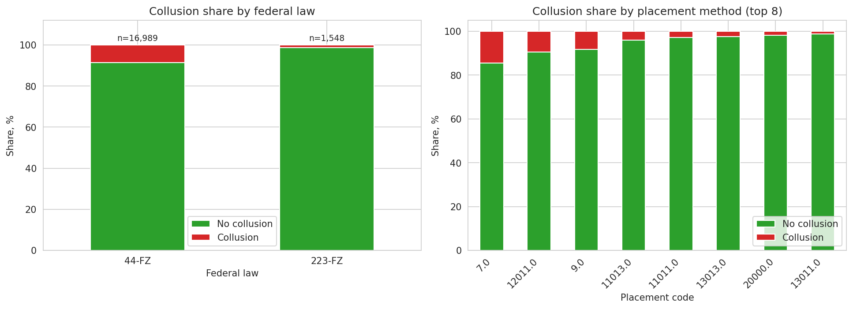
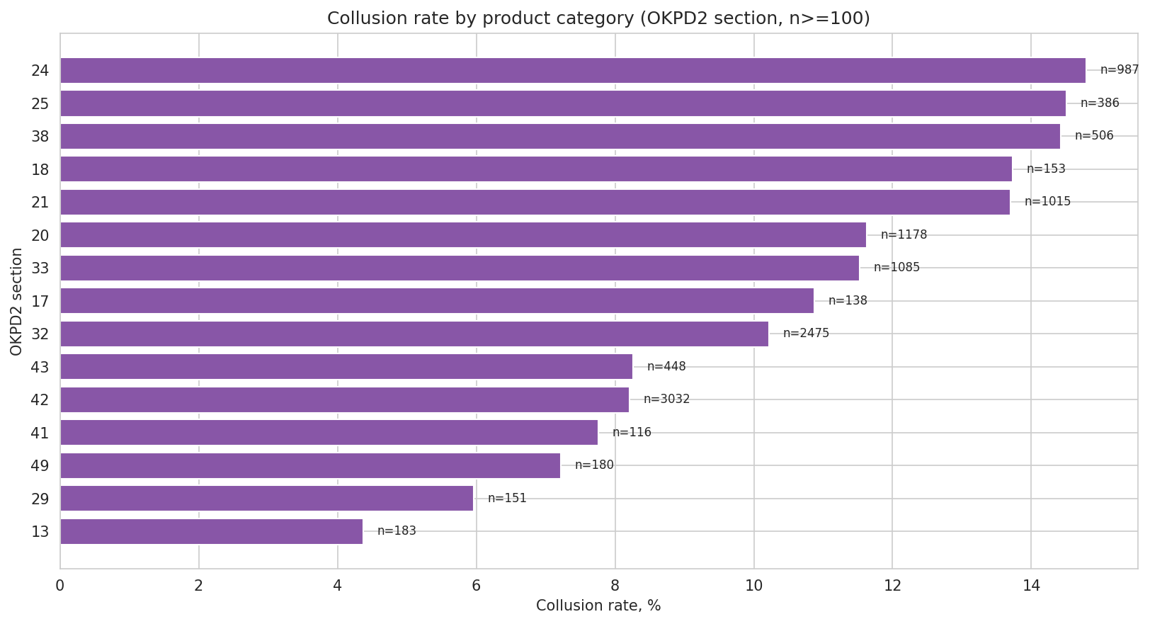
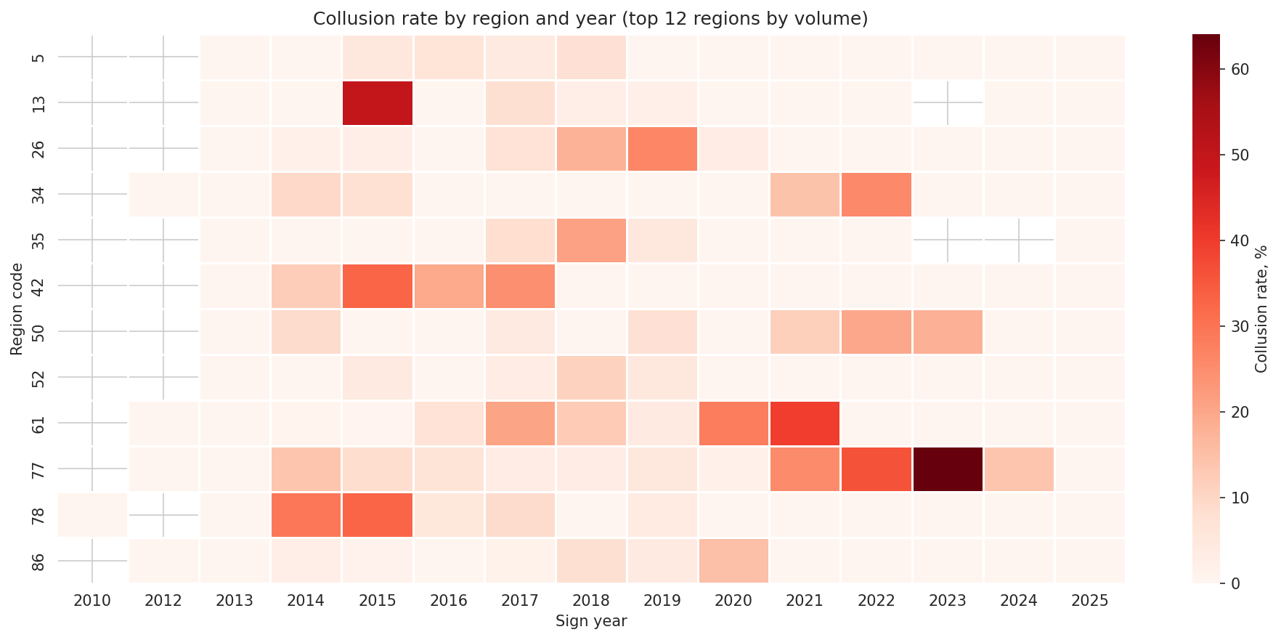
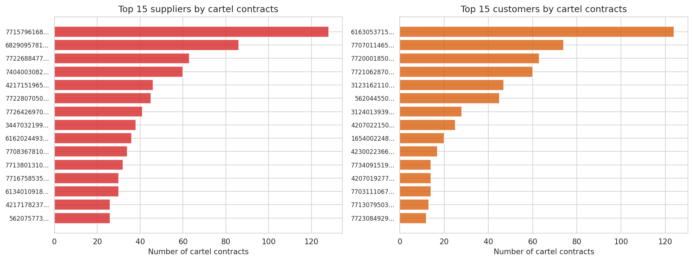
APPENDIX
Appendix — collusion by law, method & geography
18

