Slide 1
COMP4951 A Computer Model of Electrocardiogram Signals
By Andrew Au
Supervised by Socrates Dokos

Slide 2

Problem Formulation
There are different dynamic models for generating electrocardiogram signals that have been introduced over time.
Computer implementations of ECGs using a dynamic model is useful for both teaching and research purposes.
In teaching, dynamic models can be used to generate normal and abnormal ECG waveforms with parameter fitting, which means that you can make any ECG without real patient data or using an ECG machine.
For research a computer model can be used as a testing platform for new algorithms being used on ECG waveforms.

Slide 3
Problem Formulation
Current implementations of computer models are typically written in proprietary software like MATLAB and LabVIEW that are licensed and hard to distribute.
These implementations usually exist in a research context and do not perform parameter optimization to create various ECG waveforms.
My research topic is to address this issue and implement a computer model of ECGs that is open source, easy to distribute and that implements parameter optimization to create a variety of normal and abnormal ECGs.
Such an implementation can be used as a tool for learning or a tool for resource/testing algorithms in the future.

Slide 4
Background Information
An electrocardiogram (ECG) is a waveform generated by the electrical signal of the heart as it contracts and expands.
A single cycle of the ECG represents a single heartbeat.
An ECG is obtained by placing several electrodes onto a person’s body and limbs and recording the potential difference between the nodes with a machine.
The ECG is typically used in the medical field to diagnose heart disease and abnormalities.

Slide 5
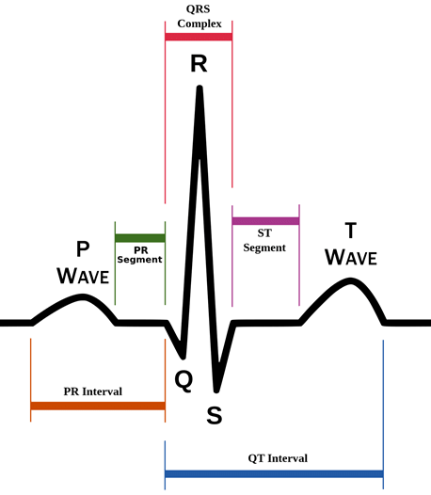
Background Information
An ECG taken from a healthy heart is characterized by a series of peaks and troughs.
These peaks and troughs are labelled PQRST.
P-Wave: Atrial depolarization (contraction of upper heart chambers)
QRS complex: Ventricular depolarization, atrial repolarization (contraction of lower and relaxation of upper heart chambers)
T-Wave: Ventricular repolarization (relaxation of lower heart chambers)
During the T-wave the heart prepares for the next heart cycle.

Slide 6
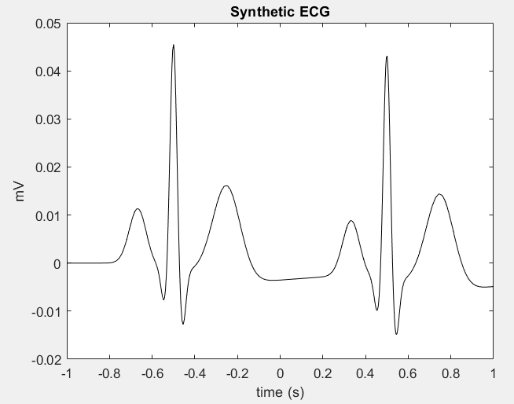
Background Information
ECGs are taken from a patient through the use of an ECG machine. However, acquiring a patient and an ECG machine can be difficult, in which case simulators are useful.
Simulators can be used to create any normal and abnormal ECG without having to use real patient data.
This means that we can simulate different heart conditions as well.
Simulators are implemented with mathematical models, of which there are different solutions.

Slide 7
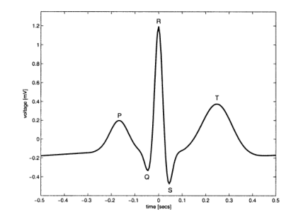
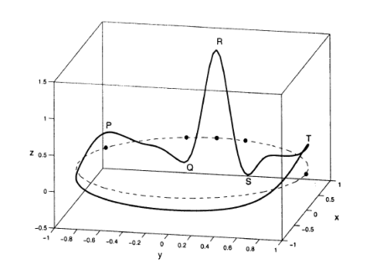
Background Information
One dynamic model is the one proposed by McSharry et al. in 2003.
This model generates a trajectory in 3D space which moves around a unit circle on the xy plane.
Events PQRST are placed along the unit circle. As the trajectory approaches an event it moves in the positive/negative position from the z-axis.
As the trajectory moves away from an event it settles back into a resting position.

Slide 8
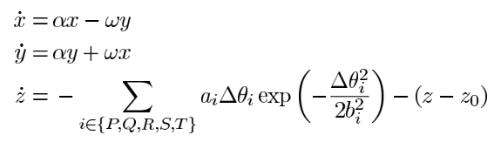
Background Information
The dynamic equations of motion are given by a set of three ordinary differential equations:
Where:
α= 1 − sqrt(x²+y²)
∆θ_{i} = (θ−θ_{i}) mod 2π
θ= atan2(y, x)
ω is angular velocity as it moves in the xy plane
The values of θ_{i}, a_{i} and b_{i} are a set of fixed values that are calculated to fit an ECG.

Slide 9
Literature Survey
Year | Author | Findings
2003 | McSharry et al. | A Dynamic model for generating electrocardiogram signals using a system of ordinary differential equations. Can be used as a testing platform for algorithms.
2004 | P McSharry, GD Clifford | Open source software for generating electrocardiogram signals implemented in C, Java, MATLAB and Octave.
2005 | P McSharry, GD. Clifford | Method to Filter ECGs and Evaluate Clinical Parameter Distortion using Realistic ECG Model Parameter Fitting.
2005 | R Sameni, MB Shamsollahi, C Jutten, M Babaie-Zadeh | Filtering Noisy ECG Signals Using the Kalman Filter Based on a Modified Dynamic ECG Model (based on McSharry model). Also introduces a method of parameter selection by taking the average of a phase wrapped graph (3D ECG plot).
2010 | O Sayadi, MB Shamsollahi, GD Clifford | Synthetic ECG generation and Bayesian filtering using a Gaussian wave-based dynamical model.

Slide 10
Literature Survey
Year | Author | Findings
2012 | P Kovacs | ECG Generator based on Geometrical features using polynomial approximation and rational functions.
2014 | J Kubicek, M Penhaker, R Kahankova | Design of a synthetic ECG signal based on the Fourier series.
2018 | I Andras, L Michaeli, D Grimaldi | Model for generating simple synthetic ECG signals using trigonometry and linear functions/derivation of Gaussian pulse.

Slide 11


Project Scope
The aim of this project is to implement the basic computer model of an ECG proposed by McSharry et al. with parameter fitting.
The implementation will include a user interface for inputting variables and data for parameter fitting.
It will NOT implement features of ECGs such as RSA, Mayer Waves and noise from real ECGs.
The implementation will be written in Python and SciPy, a library for math functions.

Slide 12
Timeline for Term 1
Week 1-2
Week 3-4
Week 5-6
Week 7-10
Understanding the problem
Related reading on ECGs
Implement model in MATLAB
Experience with using ODE Solvers and math required for basic model
Seminar Presentation
Prepare materials for presentation
Implement model in Python and End of Term Report
Implement basic model in Python using SciPy.
Write end of term report.

Slide 13
Timeline for Term 2
Week 1
Week 2-4
Week 5-8
Week 9-10
Learn components to implement user interface
Look up detail on how to implement user interface
Implement user interface
Implement user interface for reading data/inputting variables
Implement Parameter fitting
Implement some form of parameter fitting
Testing/Parameter fitting cont.
Continue implementing parameter fitting/other requirements or start on testing

Slide 14
Timeline for Term 3
Week 1-4
Week 5-6
Week 7
Week 8-10
Continue work from Term 2
Complete implementation from Term 2 and finish implementation.
Testing
Test features of implementation of parameter fitting.
Packaging/ distribution
Prepare everything for open source distribution
Final Report
Write final report

Slide 15
Thank you for listening
End of presentation.

