Slide 2
Customer Discount Group Automation
CDGA
Mateusz Wysocki
Stażysta
Łukasz Jessa
Opiekun stażu

Slide 3
Agenda
1. Story
2. Requirements
3. Solution
3.1. Concept
3.2. Application
3.3. Automated Tests
3.4. Documentation
3.5. Demo
4. Summary

Slide 4
Story
Sales Company with high volume of customers (grouped into 10 segments) needs to simplify the process of managing the sales discounts. Currently salespersons are responsibly to assign proper discount based on the customer turnover from the last 3 months. Unfortunately that is time-consuming and error prone process. Therefore Sales Company would like to improve that process by making it fully automated under Business Central platform they currently use.

Slide 5
Requirements
It should be possible to define a list of the pairs: turnover level and applicable discount group. It should not be possible to delete customer discount group if used in such setup.
Additionally It should be also possible to define the time period for which turnover should be taken into account when auto-applying proper customer discount group.
Solution needs to be enabled to affects Business Central standard logic. By default, after installation, functionality should be disabled.
User should be able to run feature auto-assign customer discount group for the specific customer.
Alternatively should be possible to run auto-assign as a report for the filtered customers (or schedule as a background task).
Auto-assigned customer discount group is valid only within defined period.
User should be able to access all previously auto-assigned customer discounts groups for the specific customer.
Information about who and when run last auto-assign discount group check should be easily access from the customer card.
Auto-assign should be skipped for the customer with valid auto-assign customer discount group.
Solution should auto-assign customer discount group for the newly created customers.
It should not be possible to issue a sales document for the customer with not valid auto-assign customer discount group.
It should not be possible to manually manipulate with customer discount group.

Slide 6
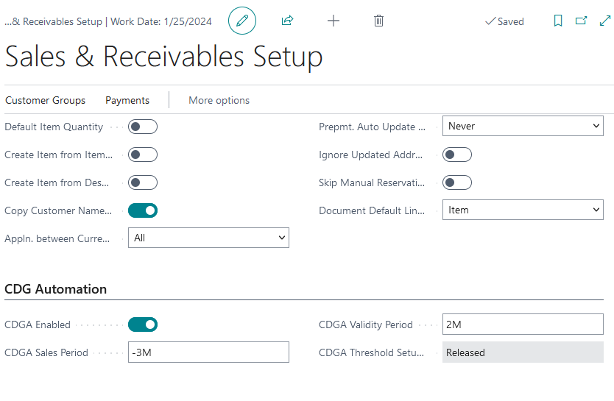
Application
Sales & Receivables Setup extension
4 new fields:
CDGA Enabled
CDGA Sales Period
CDGA Validity Period
CDGA Threshold Setup Status

Slide 7
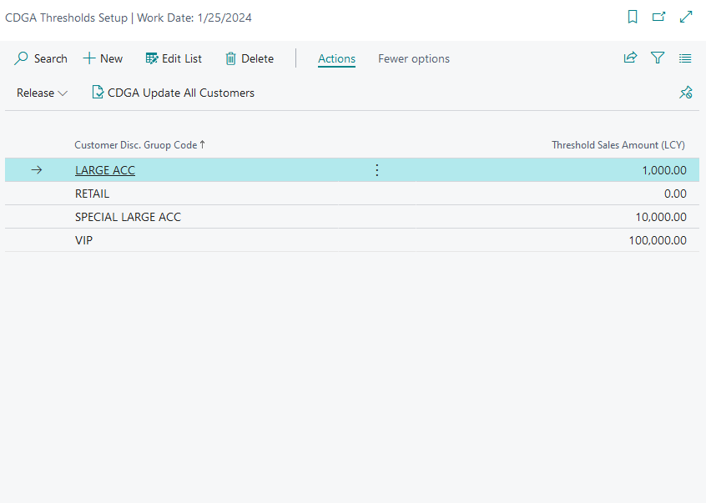
Application
New page CDGA Thresholds Setup
2 fields:
Customer Disc. Group Code
Threshold Sales Amount (LCY)

Slide 8
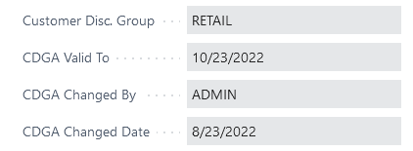
Application
Customer Card extension
3 new non-editable fields on the Customer Card:
CDGA Valid To
CDGA Changed By
CDGA Changed Date

Slide 9
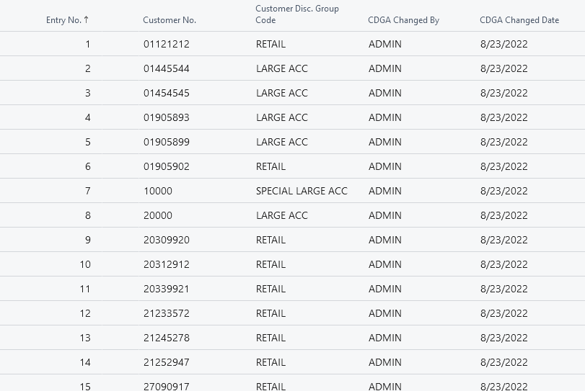
Application
New page CDGA Change Log
5 fields:
Entry No.
Customer No.
Customer Disc. Group Code
CDGA Changed By
CDGA Changed Date

Slide 10
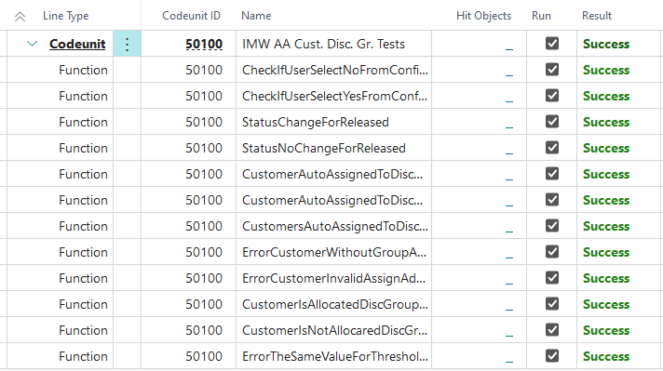
Automated Tests
Different tests for new functionality.

Slide 11
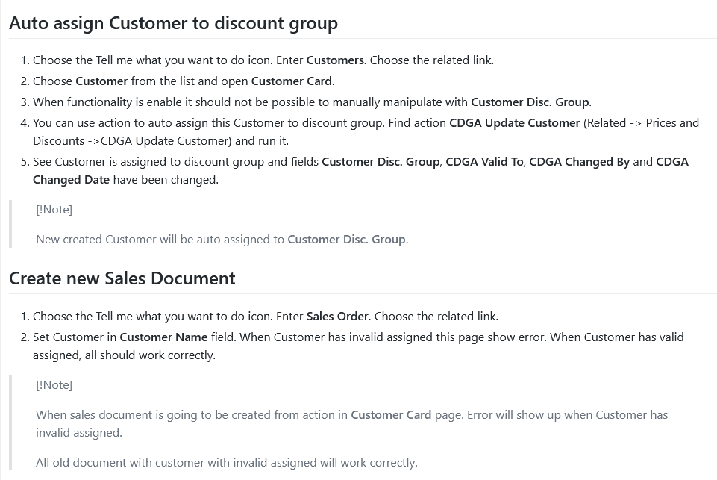
Documentation
2 documentations:
Admin
User

Slide 12
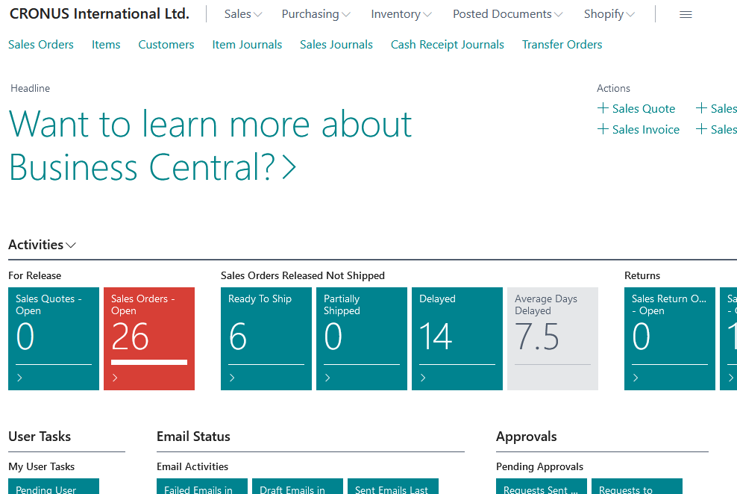
Demo
Real-time example

Slide 13
Summary
Question and answers time

Slide 14
Mateusz Wysocki
Stażysta
Tel.: +48 518 630 055
E-mail: Mateusz.Wysocki@it.integro.pl

