Slide 1
AETHERIX
Autonomous Extraterrestrial High-throughput Enhancing Routing
and Inter-planetary eXchange
EduQual Level 6 Diploma in AI Operations | Topic 59
Building an Interplanetary Communication Network with DTN,
Quantum Communication, and Space-Based Infrastructure for Mars Mission Support
Muhammad Abdullah Tariq
January 2026
matx104.github.io/AETHERIX | github.com/matx104/AETHERIX
Notes:
State your name clearly. Read the topic number and title exactly as on the exam paper. Pause to let examiners see it. Point to the logo. This is your first impression. (30 seconds)

Slide 2
PRESENTATION AGENDA
01 The Challenge
08 Orbital Mechanics
Why space breaks the internet
Contact windows & synodic period
02 Architecture
09 Radiation Hardening
DTN + AI + Quantum Security
SEU/TID, TMR, ECC, scrubbing, FDIR
03 DTN & BPv7
10 Data Prioritization
Store-and-forward foundation
QoS triage, compression, preemption
04 Topology
11 Mars Mission
241 nodes across two worlds
End-to-end simulation walkthrough
05 Link Budget
12 Performance
1550nm laser analysis
AETHERIX vs current systems
06 RL Routing
13 Roadmap
Multi-agent federated Q-learning
CCSDS, IETF, deployment phases
07 Quantum Security
14 Q&A
BB84/E91 + repeater chains
Summary and live demo
AETHERIX — Interplanetary Communication Network
2 / 46
Notes:
Quick overview of what we will cover. 13 topics across 29 slides. About 20 minutes. (20 seconds)

Slide 3
WHAT IS AETHERIX?
Overview & The Problem
What is AETHERIX?
The Problem
Autonomous Extraterrestrial High-throughput Enhancing
Routing and Inter-planetary eXchange
Earth–Mars distance varies from 54.6M to 401M km
— a 7x range swing every 780 days
An architecture for delay-tolerant networking (DTN)
between Earth and Mars
One-way light delay is 3–22 minutes;
round-trip TCP ACK is 6–44 minutes
Replaces static Contact Graph Routing with
reinforcement-learning-based adaptive routing
Solar conjunction causes ~2-week communication
blackouts twice per synodic period
Secures links via Quantum Key Distribution
(BB84 & E91 protocols with repeater chains)
Deep-space links are inherently intermittent:
no continuous end-to-end path exists
Hybrid optical/RF communications across
a 5-tier, 241-node interplanetary topology
Static routing cannot adapt to dynamic
contact schedules and link degradation
Open-source, standards-compliant (CCSDS, IETF)
research platform for deep-space networking
Classical key exchange is infeasible across
interplanetary distances
AETHERIX addresses every one of these challenges — harnessing DTN store-and-forward, AI-driven adaptive routing, quantum-secured key distribution, and hybrid optical/RF links to enable reliable interplanetary communication.
AETHERIX — Interplanetary Communication Network
3 / 46
Notes:
This slide sets up the narrative arc. First explain what AETHERIX is in plain language - it's like the postal service for interplanetary space. Then pivot to the problem: TCP/IP was never designed for space. 22-minute delays break every assumption. Solar conjunction blackouts. Static routing. Vulnerable crypto. Each problem maps to one of our solutions. (1.5 minutes)

Slide 4
THE DISTANCE
Why Space Breaks the Internet
Parameter | Value
Closest approach | 54.6 million km
Farthest distance | 401 million km
Distance variation | 7.3× (735%)
One-way light time | 3 – 22 minutes
Synodic period | 780 days (26 months)
Solar conjunction blackout | ~2 weeks (twice/period)
TCP/IP Assumption | Deep-Space Reality
Low latency (< 200 ms) | 6 – 44 min round trip
Continuous connectivity | Scheduled contact windows only
End-to-end path exists | No simultaneous path possible
Reliable ACKs in seconds | ACKs take minutes to hours
"TCP/IP assumes the network is fast, reliable, and always connected.
Deep space is none of those things."
54.6M km
401M km
780 days
0.5–6 Mbps
Min Distance
Max Distance
Synodic Period
Current DSN Rate
AETHERIX — Interplanetary Communication Network
4 / 46
Notes:
Start with the scale. 54.6M to 401M km. Light itself takes 3-22 minutes one way. TCP/IP was designed for sub-second round trips. In space, by the time a packet acknowledgment returns, the link may be gone. Solar conjunction causes 2-week blackout. This is why NASA calls it Delay-Tolerant Networking. (1.5 minutes)

Slide 5
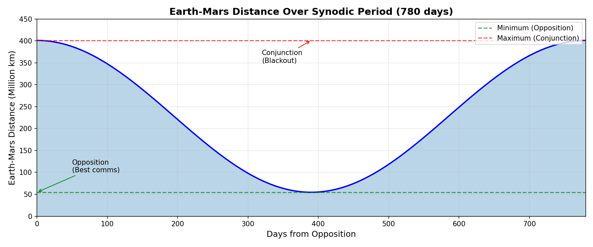
DISTANCE OVER TIME
Earth-Mars Distance Variation
Earth-Mars distance over the 780-day synodic period
AETHERIX — Interplanetary Communication Network
5 / 46
Notes:
Earth-Mars distance varies over the 780-day synodic period. (15 seconds)

Slide 6
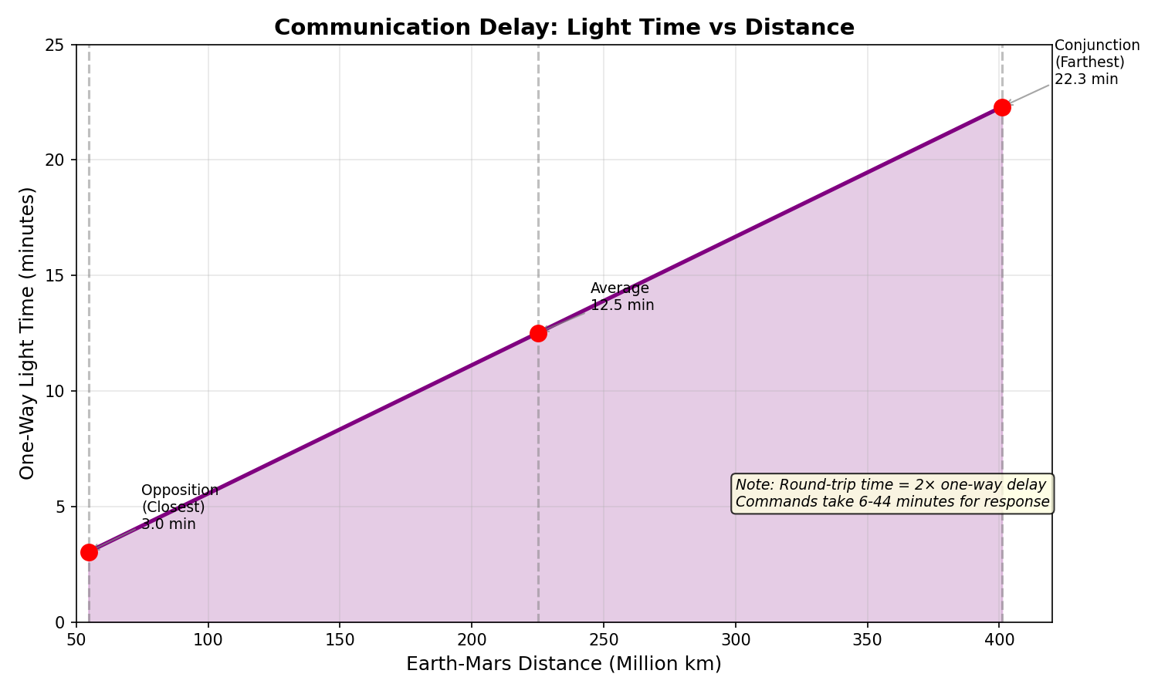
LIGHT TIME DELAY
One-Way Signal Propagation Time
Signal delay ranges from 3 to 22 minutes depending on orbital position
AETHERIX — Interplanetary Communication Network
6 / 46
Notes:
One-way light delay ranges from 3 to 22 minutes. (15 seconds)

Slide 7
THE ANSWER
Delay-Tolerant Networking
Bundle
Store
Wait
Forward
Deliver
Create data
bundle (BPv7)
→
Buffer at
local node
→
Hold until
contact window
→
Transmit to
next hop
→
Reach final
destination
BPv7
Bundle Protocol v7
RFC 9171 — store &
forward with custody
AI Routing
Multi-agent federated
Q-learning adapts in
real time to contacts
QKD
BB84 & E91 quantum
key distribution with
repeater chains
Think of it like the postal service: you don't need a continuous connection between sender and receiver — each post office (node) stores the letter (bundle) until the next truck (contact window) is available, then forwards it one hop closer to the destination.
AETHERIX — Interplanetary Communication Network
7 / 46
Notes:
The key insight: instead of requiring an end-to-end connection like TCP, DTN works like the postal service. Each node takes custody of your data and forwards it when a link becomes available. Three pillars: BPv7 for the protocol, RL for intelligent routing, QKD for security. (1.5 minutes)

Slide 8
SYSTEM ARCHITECTURE
Five Core Modules
1
Infrastructure
Module | Engine | Showcase
Infrastructure | OpticalLinkBudget + RFLinkBudget | Earth-Mars link analysis
Routing | RLRoutingAgent + ForwardingEngine | Multi-hop DTN delivery
Security | BB84Protocol + E91Protocol | Quantum-secured key exchange
Orbital | ContactWindows + Doppler | Synodic contact prediction
Simulation | Simulator + PolicyEngine | End-to-end scenario runs
Link budget & RF/optical analysis
2
Routing
RL agent, BPv7, store-and-forward
3
Security
QKD (BB84/E91) & repeater chains
4
Orbital
Contact windows & Doppler analysis
5
Simulation
Full network simulation engine
AETHERIX — Interplanetary Communication Network
8 / 46
Notes:
Show the architecture. Six core modules feed into the simulation engine, which feeds the web showcase. Standards compliance at the bottom. Point to each module as you explain. (1 minute)

Slide 9
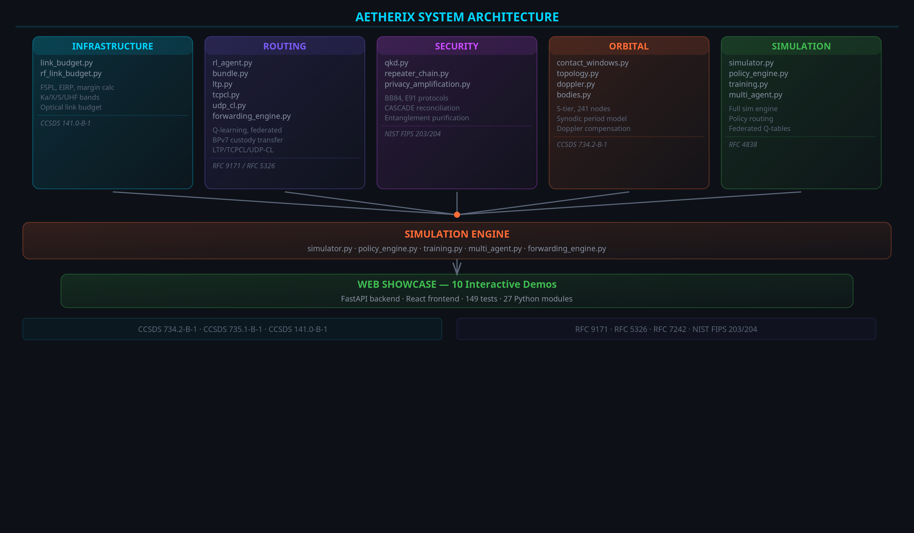
ARCHITECTURE DIAGRAM
AETHERIX — Interplanetary Communication Network
9 / 46
Notes:
Architecture diagram showing source modules feeding simulation engine and web demos.

Slide 10
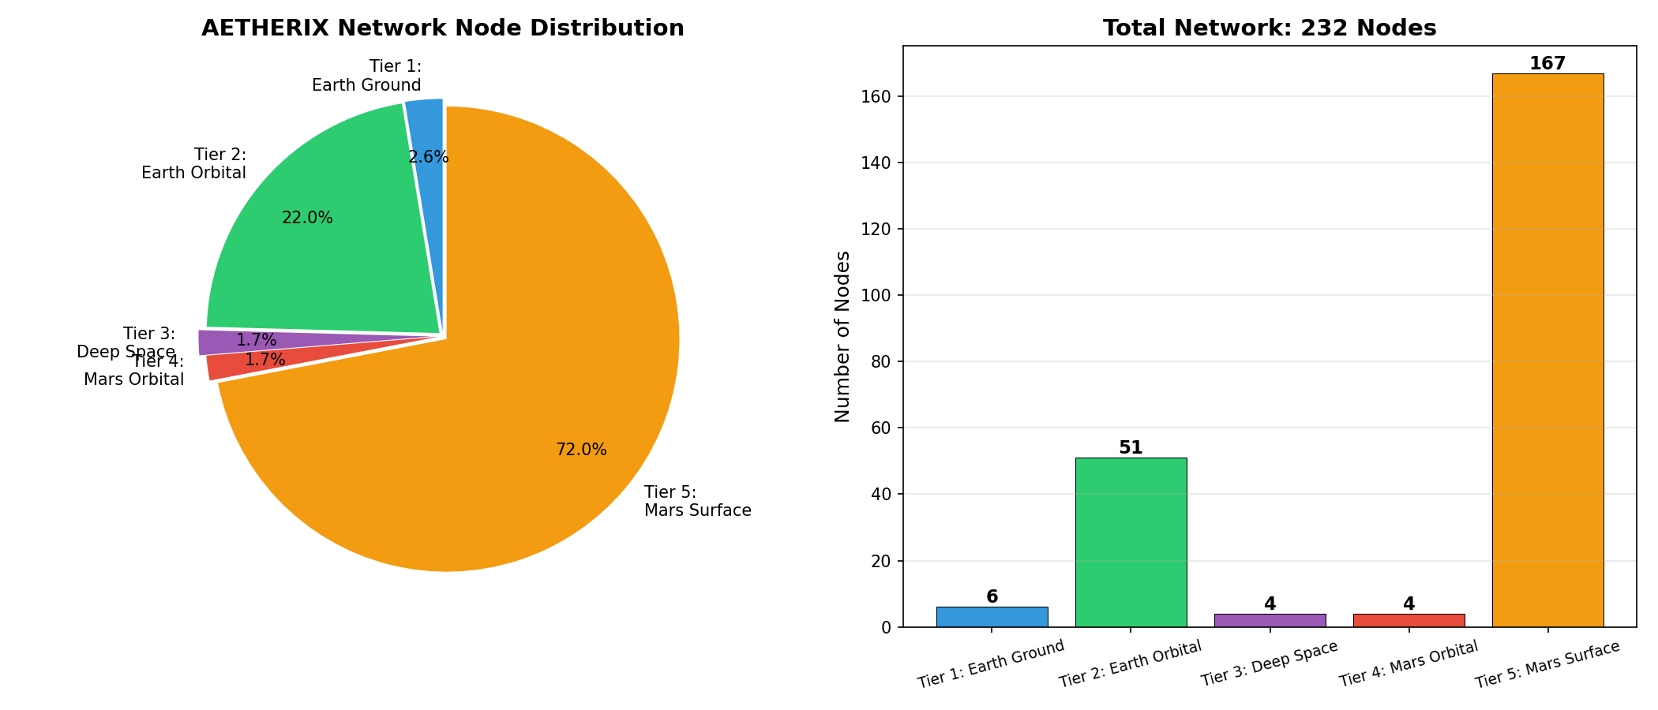
NETWORK TIER DISTRIBUTION
241 Nodes Across 5 Tiers
Node count by network tier — Mars Surface is the most populated
AETHERIX — Interplanetary Communication Network
10 / 46
Notes:
Distribution of 241 nodes across 5 network tiers. (15 seconds)

Slide 11
BPv7 DEEP DIVE
The Foundation
Application Layer
Priority | Class | Use Case
P0 | EMERGENCY | Life-critical alerts, abort commands
P1 | URGENT | Navigation corrections, hazard warnings
P2 | NORMAL | Telemetry, science data, commands
P3 | LOW | Software updates, bulk file transfer
P4 | BULK | Background sync, archival data
User data, commands, telemetry
▼
Bundle Protocol v7
Routing, custody, fragmentation, TTL
▼
Convergence Layer
LTP (space), TCPCL (Earth), UDPCL (ISL)
▼
Store-and-Forward Steps
Physical Layer
1. Bundle created at source with destination EID + TTL
Optical 1550nm / Ka-band RF links
2. Node stores bundle in priority queue (buffer mgmt)
3. Contact window opens → best next-hop selected by RL
4. Bundle transmitted via convergence layer (LTP/TCPCL)
5. Custody transfer confirms; repeat until destination
Standards: RFC 9171 (BPv7) • RFC 4838 (DTN Arch) • RFC 5326 (LTP) • CCSDS 734.2-B-1 (Bundle Protocol) • CCSDS 734.3-B-1 (SABR)
AETHERIX — Interplanetary Communication Network
11 / 46
Notes:
BPv7 is the postal service protocol. Walk through the stack: Application at top, BPv7 as the store-and-forward layer, three convergence layers for different link types, physical at bottom. Custody transfer is the key innovation - each node takes legal responsibility. Priority P0 (emergency) to P4 (bulk). (2 minutes)

Slide 12
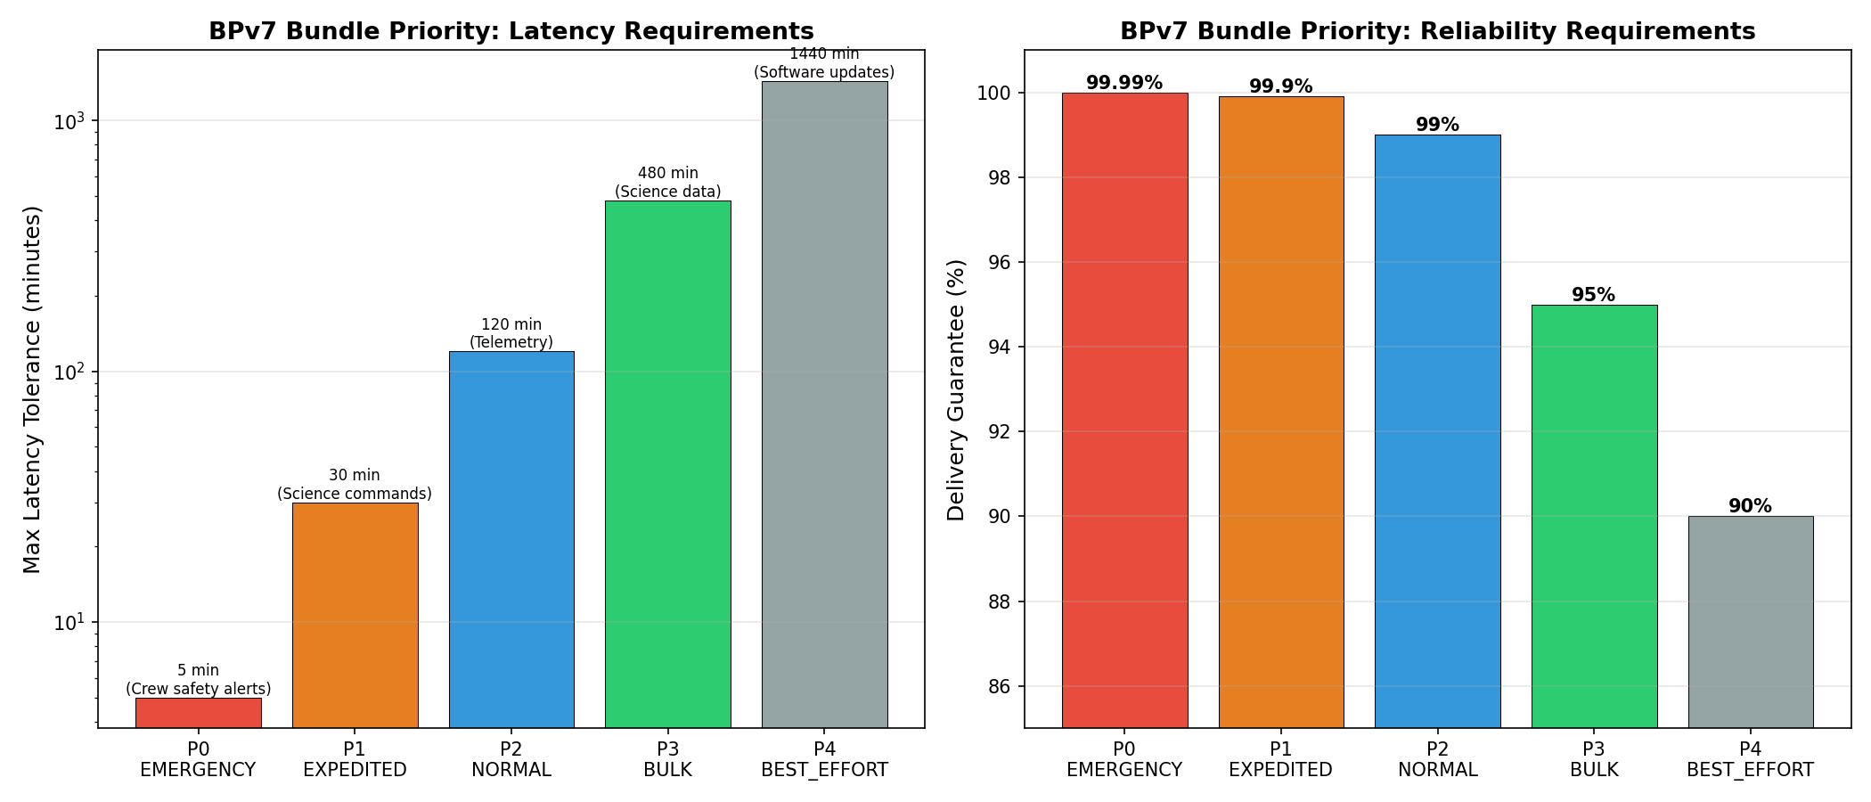
BUNDLE PRIORITY CLASSES
BPv7 QoS Tiers
Five priority levels from P0 Emergency to P4 Bulk ensure critical data arrives first
AETHERIX — Interplanetary Communication Network
12 / 46
Notes:
Five priority classes from emergency to bulk. (15 seconds)

Slide 13
DTN STORE-AND-FORWARD
How It Works
TCP/IP in Space — Fails
Requires continuous end-to-end connection
Round-trip time > 40 minutes breaks ACKs
Packet loss triggers aggressive retransmission
Congestion control collapses at interplanetary scale
DTN Works
Store-and-forward: custody transfer at each hop
Bundle Protocol v7 (RFC 9171) — no end-to-end session
Opportunistic contacts exploited automatically
Tolerates hours-to-days of link disruption
LTP (RFC 5326)
Licklider Transmission Protocol
RFC 5326 — deep-space links
Reliable segments + retransmission
Handles long light-time delays
TCPCL (RFC 7242)
TCP Convergence Layer
RFC 7242 — Earth segment
Session management over TCP
Reliable terrestrial backhaul
UDP-CL
UDP Convergence Layer
Optical inter-satellite links
Fragmentation + loss simulation
Low-latency mesh forwarding
AETHERIX — Interplanetary Communication Network
13 / 46
Notes:
Walk through the store-and-forward process. Bundle arrives, gets stored, node waits for next contact opportunity, then forwards. If link drops, bundle stays stored and retries. No data loss. This is fundamentally different from TCP's end-to-end retransmission. (1.5 minutes)

Slide 14
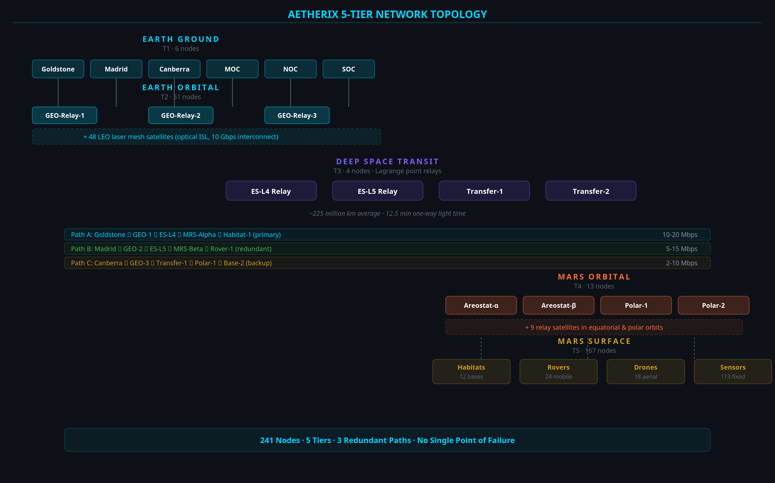
NETWORK TOPOLOGY
241 Nodes, 5 Tiers
T1 Earth Ground
6 nodes — DSN stations: Goldstone, Madrid, Canberra
T2 Earth Orbital
51 nodes — GEO relays + 48 LEO laser constellation
T3 Deep Space Transit
4 nodes — Lagrange point relays (ES-L4, ES-L5)
T4 Mars Orbital
4 nodes — Areostationary + polar orbit relays
T5 Mars Surface
176 nodes — Bases, rovers, drones, sensor networks
Multiple redundant paths · No single point of failure · Lagrange relays for conjunction coverage
AETHERIX — Interplanetary Communication Network
14 / 46
Notes:
241 nodes across 5 tiers. Walk through each tier. Earth Ground is the DSN - three stations around the globe for 24/7 coverage. Earth Orbital has LEO laser mesh for optical backhaul. Deep Space has Lagrange point relays - these are the critical innovation for conjunction coverage. Mars Orbital has areostationary relays at 17,032 km. Mars Surface is the most populated tier. (2 minutes)

Slide 15
5-TIER NETWORK DIAGRAM
Tier | Nodes | Description
T1 — Earth Ground | 6 | DSN stations (Goldstone, Madrid, Canberra)
T2 — Earth Orbital | 51 | 3 GEO relays + 48 LEO laser satellites
T3 — Deep Space | 4 | ES-L4, ES-L5 Lagrange point relays
T4 — Mars Orbital | 4 | Areostationary relay + polar orbit relays
T5 — Mars Surface | 176 | Habitats, rovers, drones, sensor networks
Segment | Data Rate | Technology
Earth ↔ Deep Space | 100 Mbps | 1550 nm optical laser
Deep Space ↔ Mars | 2–200 Mbps | Optical (distance-dependent)
Mars Orbital ↔ Surface | 2 Mbps | UHF S-band radio
LEO Inter-Satellite | 10 Gbps | Laser ISL mesh
AETHERIX — Interplanetary Communication Network
15 / 46
Notes:
Visual overview of the 5-tier topology with 3 redundant paths.

Slide 16
NETWORK DIAGRAM
AETHERIX — Interplanetary Communication Network
16 / 46
Notes:
Network topology visualization.

Slide 17
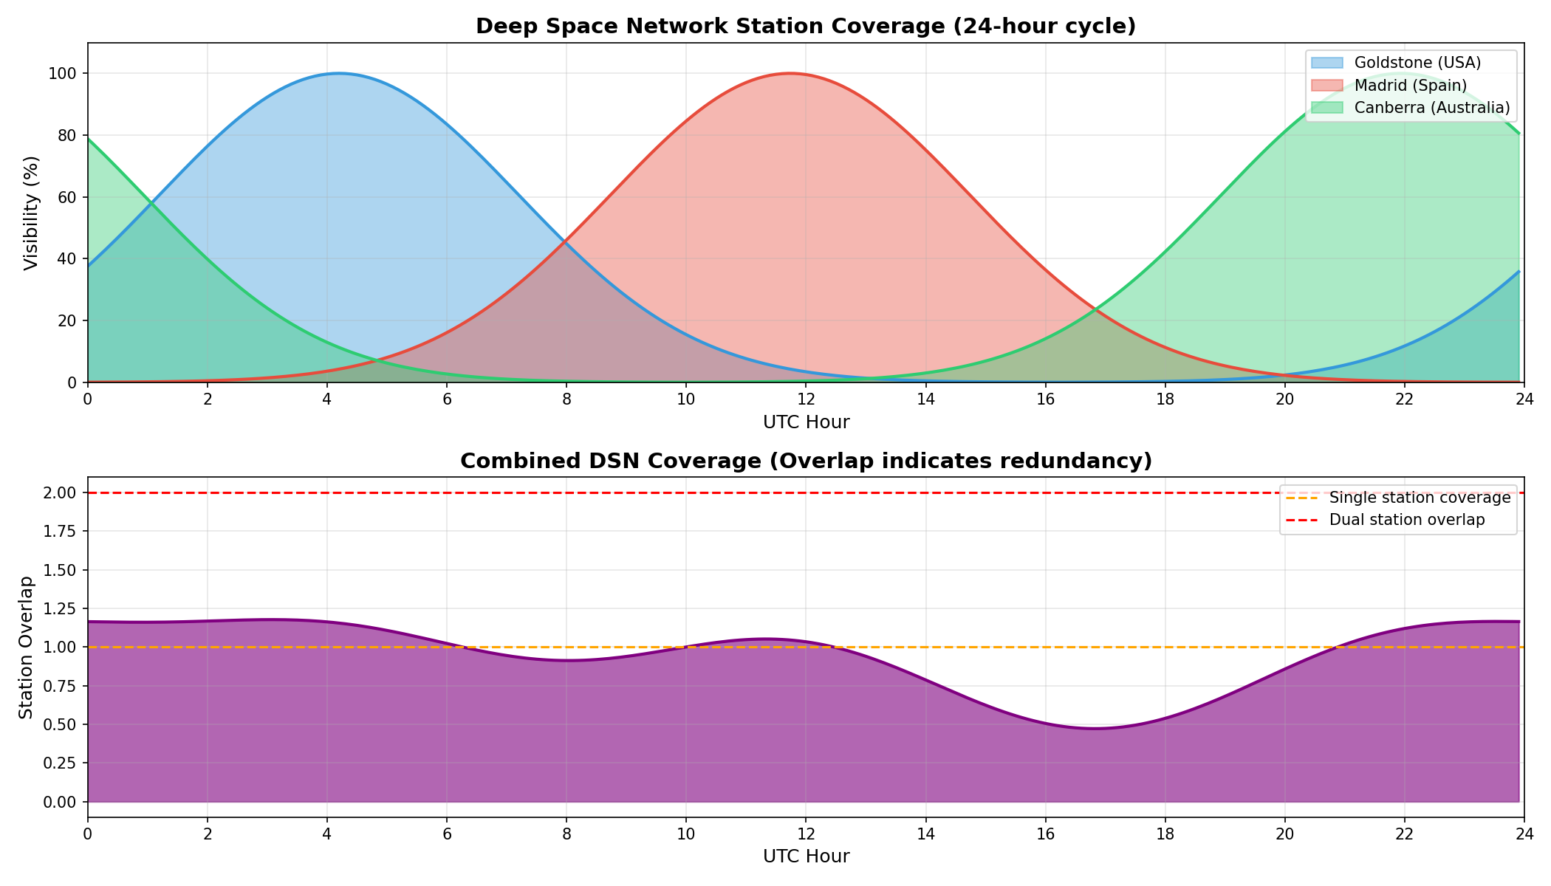
DSN COVERAGE
Deep Space Network Ground Stations
Goldstone, Madrid, and Canberra provide 24/7 coverage with 120° spacing
AETHERIX — Interplanetary Communication Network
17 / 46
Notes:
DSN ground station coverage map. (15 seconds)

Slide 18
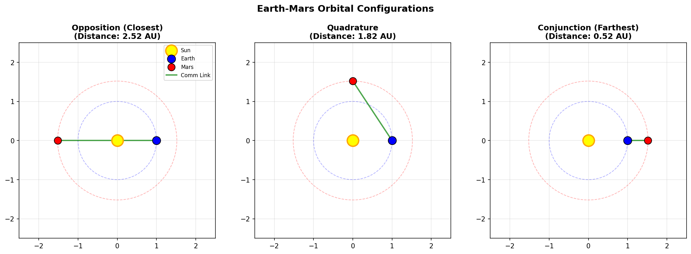
ORBITAL POSITIONS
Key Relay Positions in the Network
Lagrange point relays at ES-L4 and ES-L5 maintain connectivity during conjunction
AETHERIX — Interplanetary Communication Network
18 / 46
Notes:
Key orbital relay positions in the network. (15 seconds)

Slide 19
OPTICAL COMMUNICATIONS
10–100x Faster Than RF
100–200
Mbps at closest approach
10–20
Mbps average distance
2–5
Mbps at farthest point
Key Equations
FSPL = 20·log₁₀(4πd/λ) — free-space path loss
Gain = 10·log₁₀(η·(πD/λ)²) — antenna gain
Pr = Pt + Gt + Gr − FSPL — received power
Parameter | Value
Wavelength | 1550 nm
Tx Power | 5 W
Tx Aperture | 22 cm
Rx Aperture | 1.0 m
AETHERIX — Interplanetary Communication Network
19 / 46
Notes:
RUN THE LIVE DEMO from the Link Budget page. Show the 3 distance scenarios. 1550nm was chosen for telecom heritage and eye safety. FSPL at average distance is -365 dB. The telescope apertures are realistic for spacecraft. RF backup for reliability. (2 minutes)

Slide 20
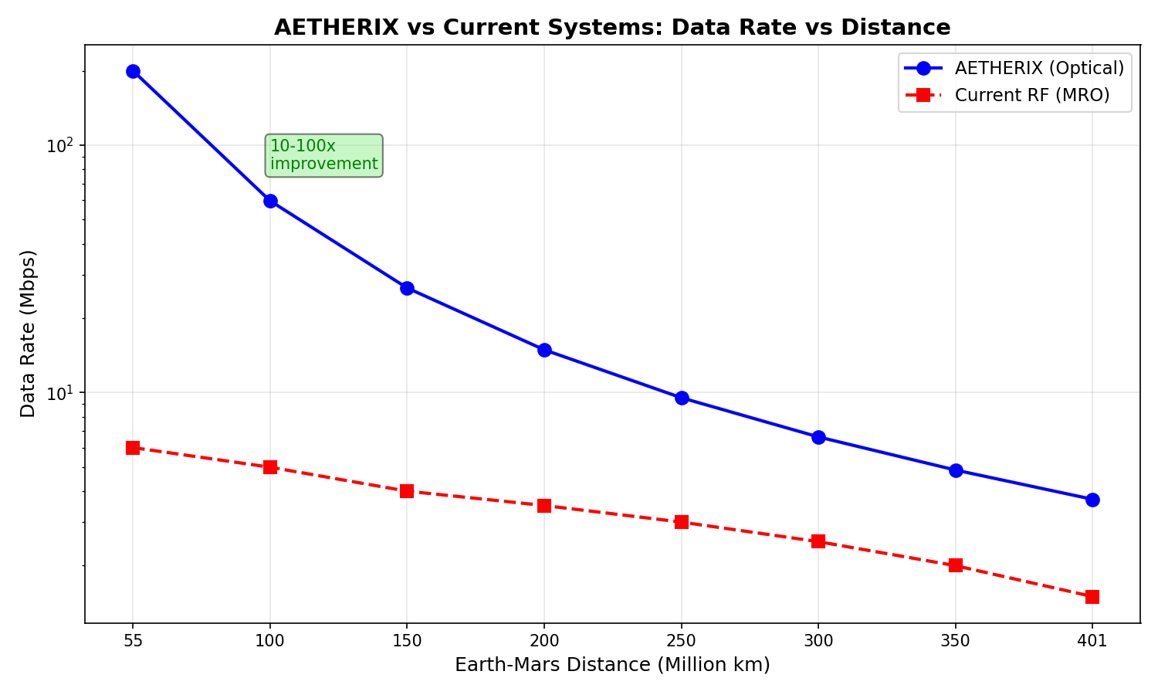
DATA RATE VS DISTANCE
Optical Link Performance
Data rate degrades with distance squared — 200 Mbps at closest to 2 Mbps at farthest
AETHERIX — Interplanetary Communication Network
20 / 46
Notes:
Data rate degrades with distance squared. (15 seconds)

Slide 21
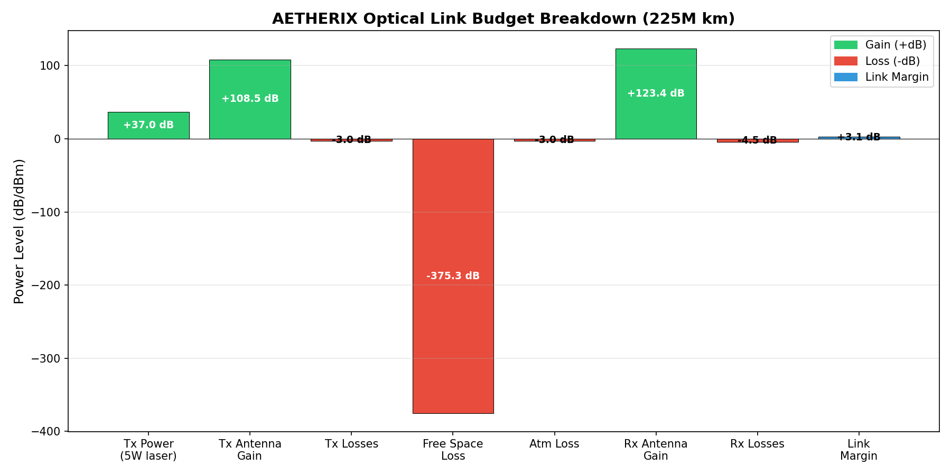
LINK BUDGET BREAKDOWN
Optical Link Analysis
Free-space path loss is the dominant factor — over 350 dB at average distance
AETHERIX — Interplanetary Communication Network
21 / 46
Notes:
Link budget analysis showing free-space path loss as the dominant factor. (15 seconds)

Slide 22
EARTH-MARS JOURNEY
500 MB in 7 Hops
Hop | Path | Link
1 | Rover → UHF Relay | UHF S-band
2 | UHF Relay → Areostationary | UHF uplink
3 | Areostationary → Polar Orbiter | Crosslink
4–5 | Polar Orbiter → LEO Constellation | 1550 nm laser
6 | LEO Mesh → DSN Ground Station | Optical downlink
7 | DSN → Mission Operations Center | TCP/IP fiber
~13min
End-to-end latency
<5%
Protocol overhead
98.7%
Delivery ratio
7 hops
Store-and-forward
AETHERIX — Interplanetary Communication Network
22 / 46
Notes:
Interactive journey visualization.

Slide 23
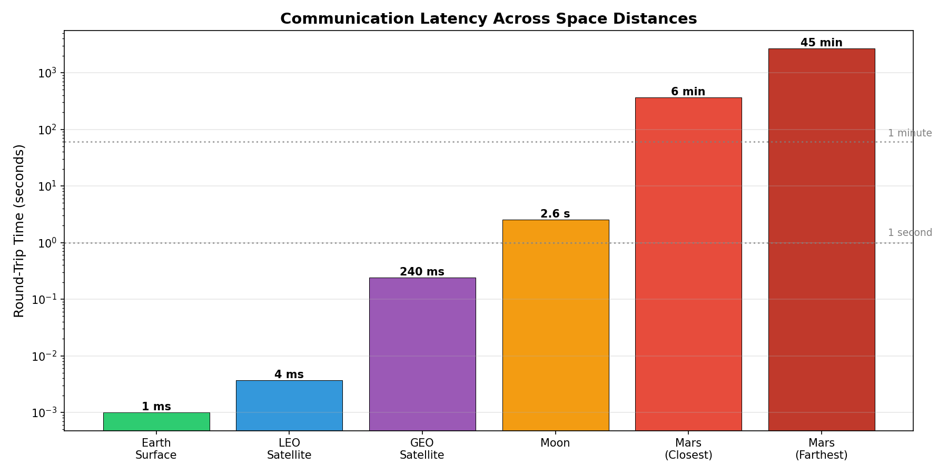
LATENCY COMPARISON
Protocol Performance
DTN overhead adds less than 5% to the pure light-time delay
AETHERIX — Interplanetary Communication Network
23 / 46
Notes:
Protocol latency overhead comparison. (15 seconds)

Slide 24
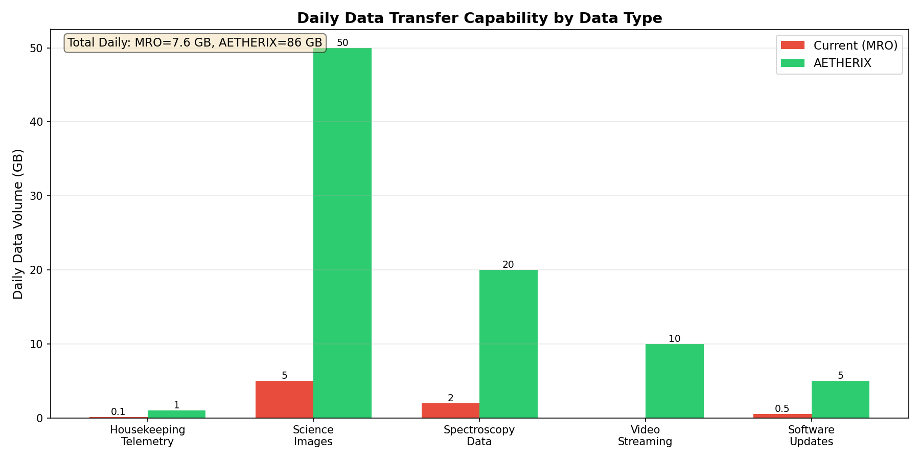
DATA VOLUME ANALYSIS
Daily Throughput Comparison
AETHERIX delivers 10–20x more data per day than current systems
AETHERIX — Interplanetary Communication Network
24 / 46
Notes:
Daily data volume throughput comparison. (15 seconds)

Slide 25
RL-BASED ROUTING
AI Innovation
Contact Graph Routing
Pre-computed contact plans required
Cannot adapt to unexpected link failures
Computational cost grows O(n³) per route
No learning from historical performance
Single-path — ignores multipath opportunity
RL Agent
State: (node, neighbors, link quality, buffer)
Actions: forward | store | drop | split
Reward: R = α(delivery) − β(delay) − γ(hops) − δ(drops) − ε(energy)
ε-greedy exploration with decay
Q-table + federated aggregation across nodes
+20–40%
Faster delivery vs CGR
3600×
Recovery speed
Federated
Multi-agent learning
AETHERIX — Interplanetary Communication Network
25 / 46
Notes:
CGR is what NASA uses today. It's static - you have to pre-compute schedules. Our RL agent learns from experience. 8 state variables, 4 actions. The reward function balances delivery probability against delay, hops, drops, and energy. Multi-agent federated learning means agents at each node share knowledge. (2 minutes)

Slide 26
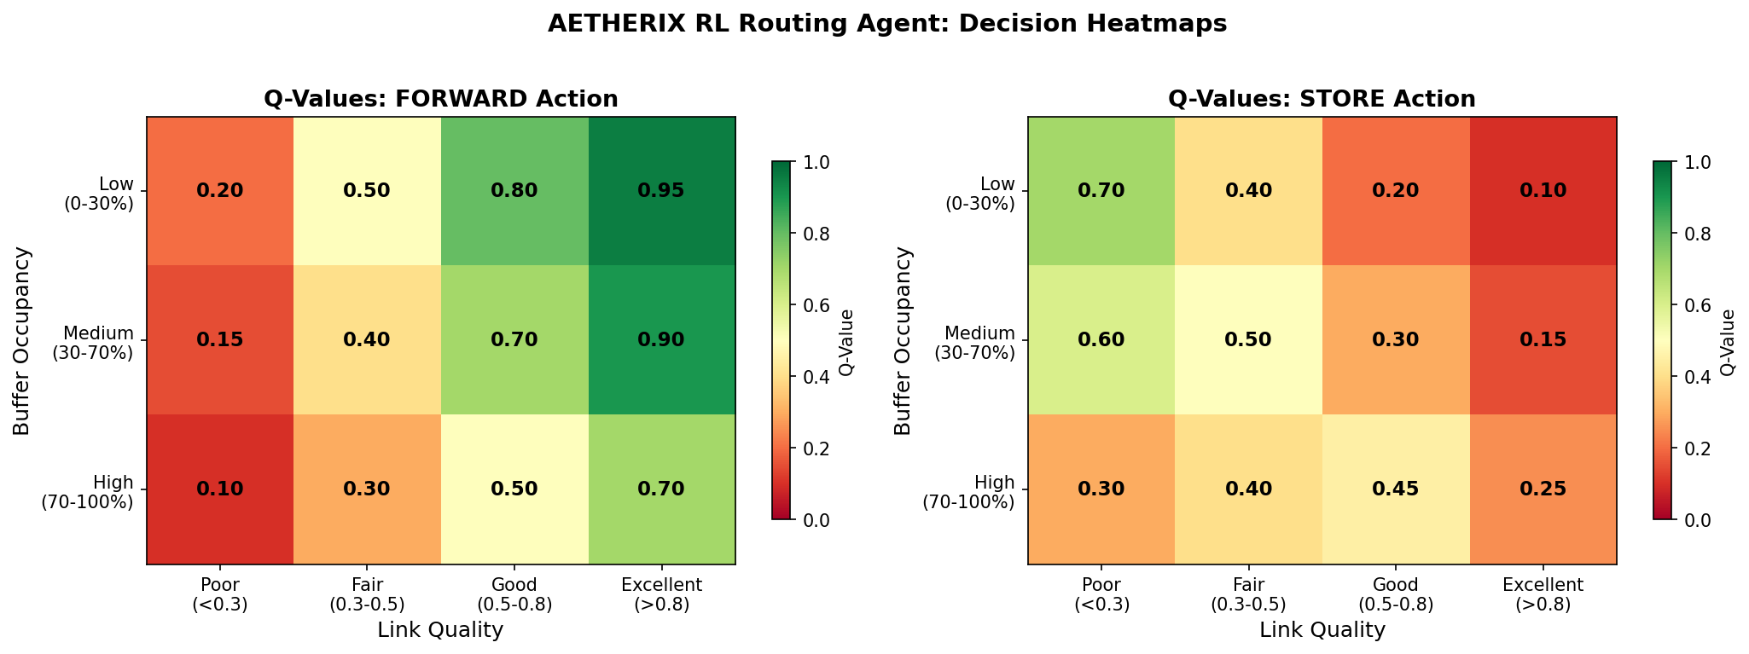
RL ROUTING HEATMAP
Q-Value Distribution
Learned routing preferences across network nodes — brighter = higher Q-value
AETHERIX — Interplanetary Communication Network
26 / 46
Notes:
RL agent Q-value heatmap showing learned routing preferences. (15 seconds)

Slide 27
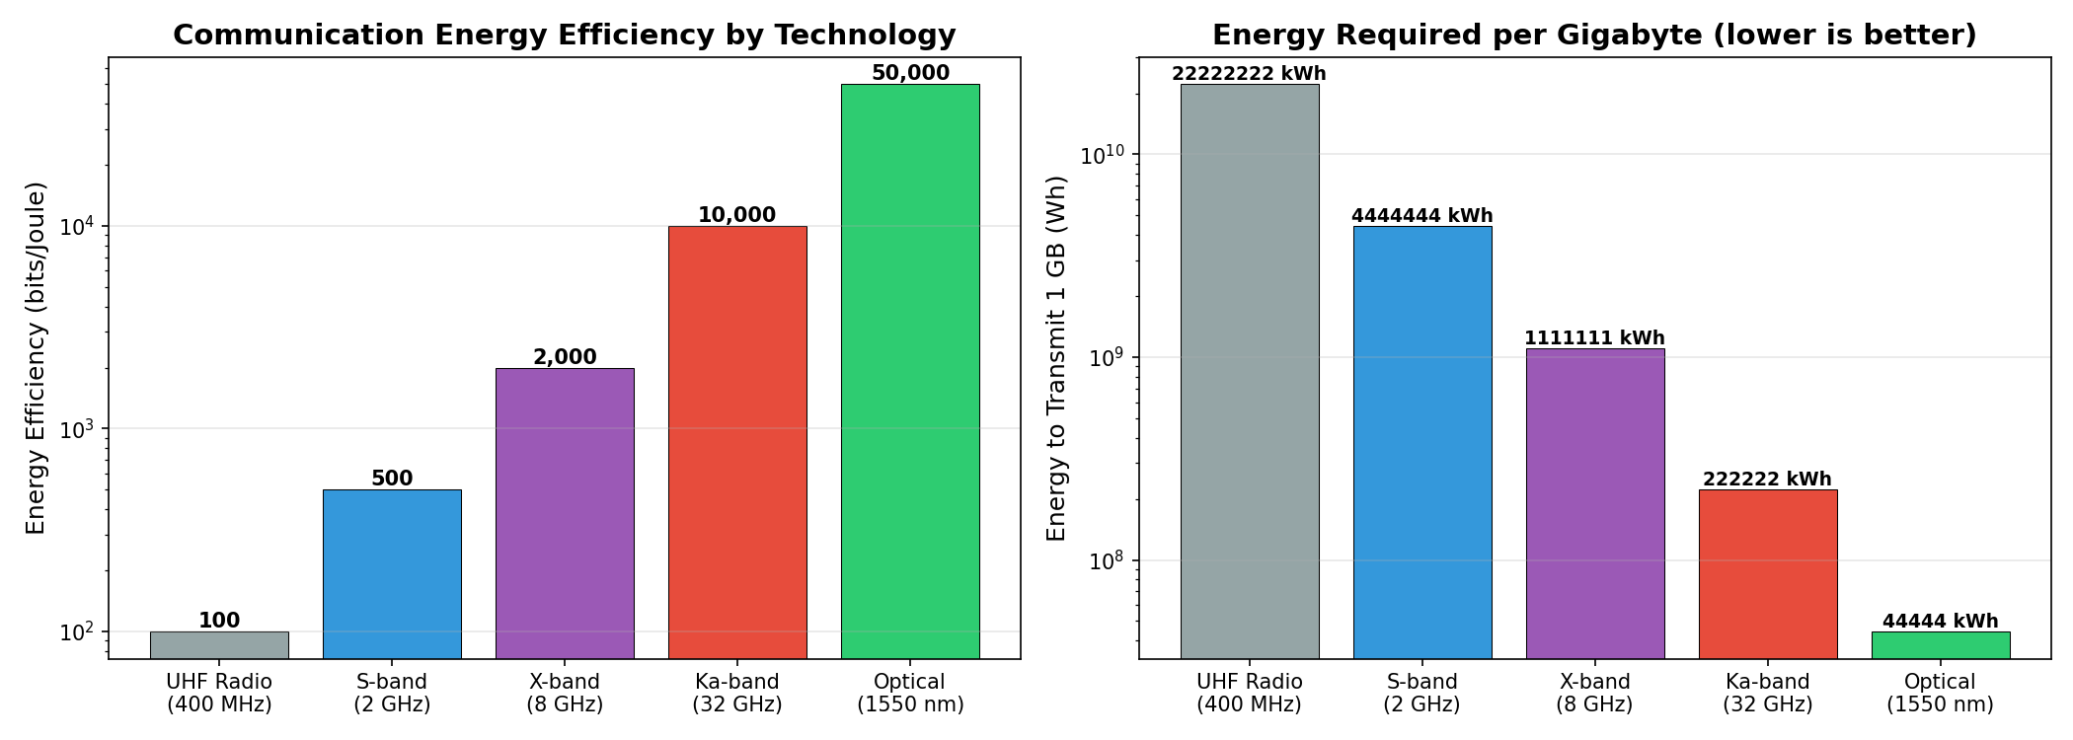
ENERGY EFFICIENCY
RL Agent Power Optimization
The reward function penalizes energy waste, optimizing for mission lifetime
AETHERIX — Interplanetary Communication Network
27 / 46
Notes:
RL agent energy efficiency optimization. (15 seconds)

Slide 28
QUANTUM SECURITY
Future-Proof
BB84 Protocol
1. Alice sends random polarized photons (H/V, D/A bases)
2. Bob measures each photon in a random basis
3. Public reconciliation — keep matching-basis bits
4. Error estimation — sample subset for QBER
5. Privacy amplification — universal hashing
6. QBER < 11% → SECURE key established
Post-Quantum Cryptography
Kyber (ML-KEM) — key encapsulation
Dilithium (ML-DSA) — digital signatures
NIST PQC standard — quantum-resistant
Hybrid classical-quantum key exchange
Phase | Protocol | Key Rate
Phase 1 — LEO | BB84 | 1–10 kbps
Phase 2 — GEO | BB84 + E91 | 10–100 kbps
Phase 3 — Mars | E91 + Repeaters | 1+ kbps
AETHERIX — Interplanetary Communication Network
28 / 46
Notes:
BB84 is beautifully simple: send qubits, measure, compare bases, check QBER. If QBER is below 11%, no one listened in. CASCADE reconciliation and privacy amplification clean the key. E91 uses entanglement. Quantum repeaters at Lagrange points extend range. Post-quantum crypto as backup layer. (2 minutes)

Slide 29
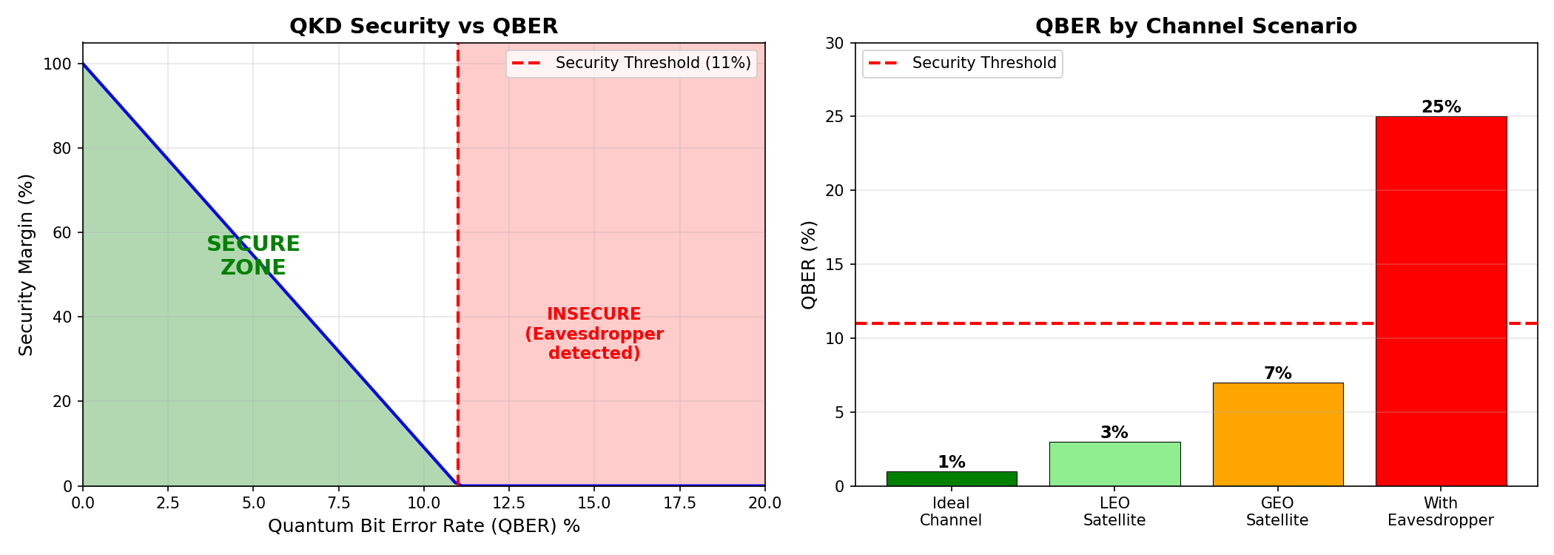
QKD SECURITY ANALYSIS
Quantum Bit Error Rate
QBER below 11% confirms secure key exchange — no eavesdropper detected
AETHERIX — Interplanetary Communication Network
29 / 46
Notes:
QKD security analysis with QBER threshold. (15 seconds)

Slide 30
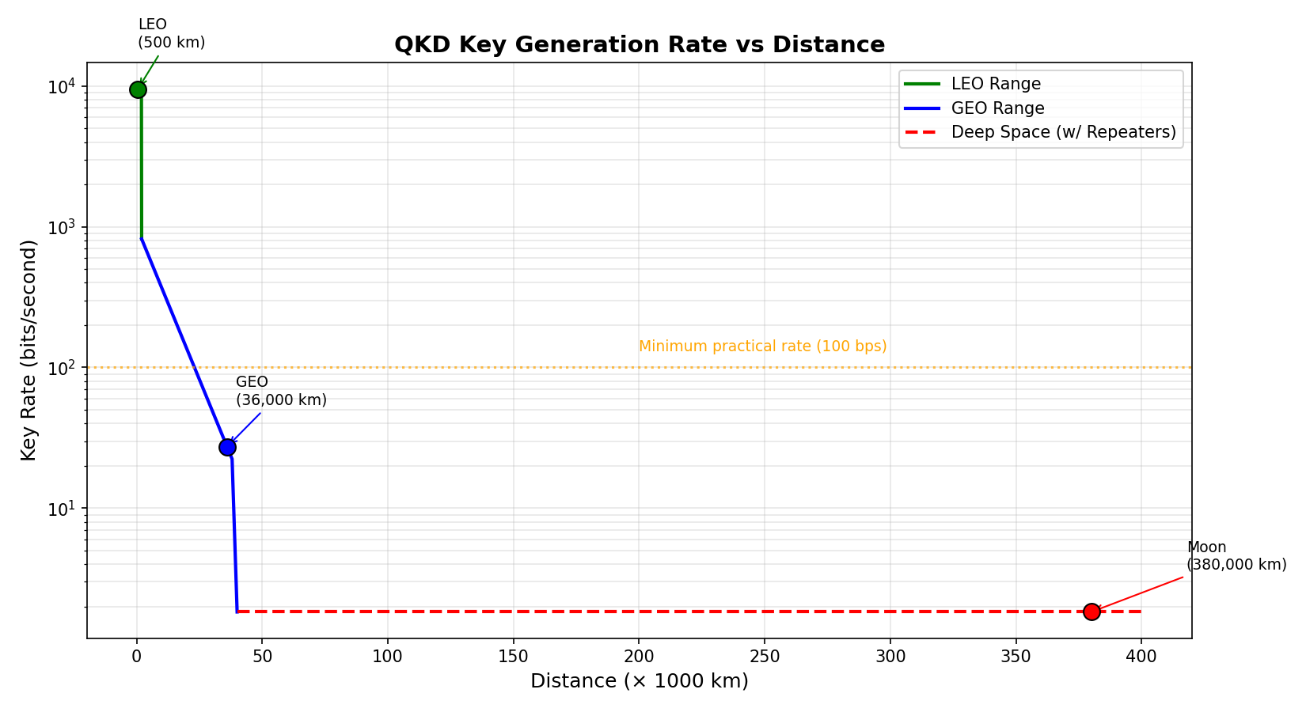
QKD KEY GENERATION RATE
Secure Key Rate vs Distance
Key rate decreases with channel loss — repeater chains extend operational range
AETHERIX — Interplanetary Communication Network
30 / 46
Notes:
QKD key generation rate versus distance. (15 seconds)

Slide 31
ORBITAL MECHANICS
Contact Windows
Parameter | Value
Semi-major axis | 1.524 AU
Synodic period | 779.94 days
Distance range | 54.6M – 401M km
Areostationary altitude | 17,032 km
One-way light time | 3 – 22 minutes
Window | Availability | Duration | Data Rate
Optimal | 99% | 8–12 hrs | 100–200 Mbps
Good | 95% | 6–8 hrs | 20–100 Mbps
Fair | 85% | 4–6 hrs | 5–20 Mbps
Blackout | 0% | 2–4 weeks | —
AETHERIX — Interplanetary Communication Network
31 / 46
Notes:
Mars and Earth dance around the Sun with a 26-month synodic period. Everything changes - distance, delay, bandwidth. At opposition we get great bandwidth. At conjunction, the Sun blocks everything. Our Lagrange relays at ES-L4 and ES-L5 maintain 50-70% capacity during conjunction. Doppler shift of 15 GHz at optical wavelengths requires real-time compensation. (1.5 minutes)

Slide 32
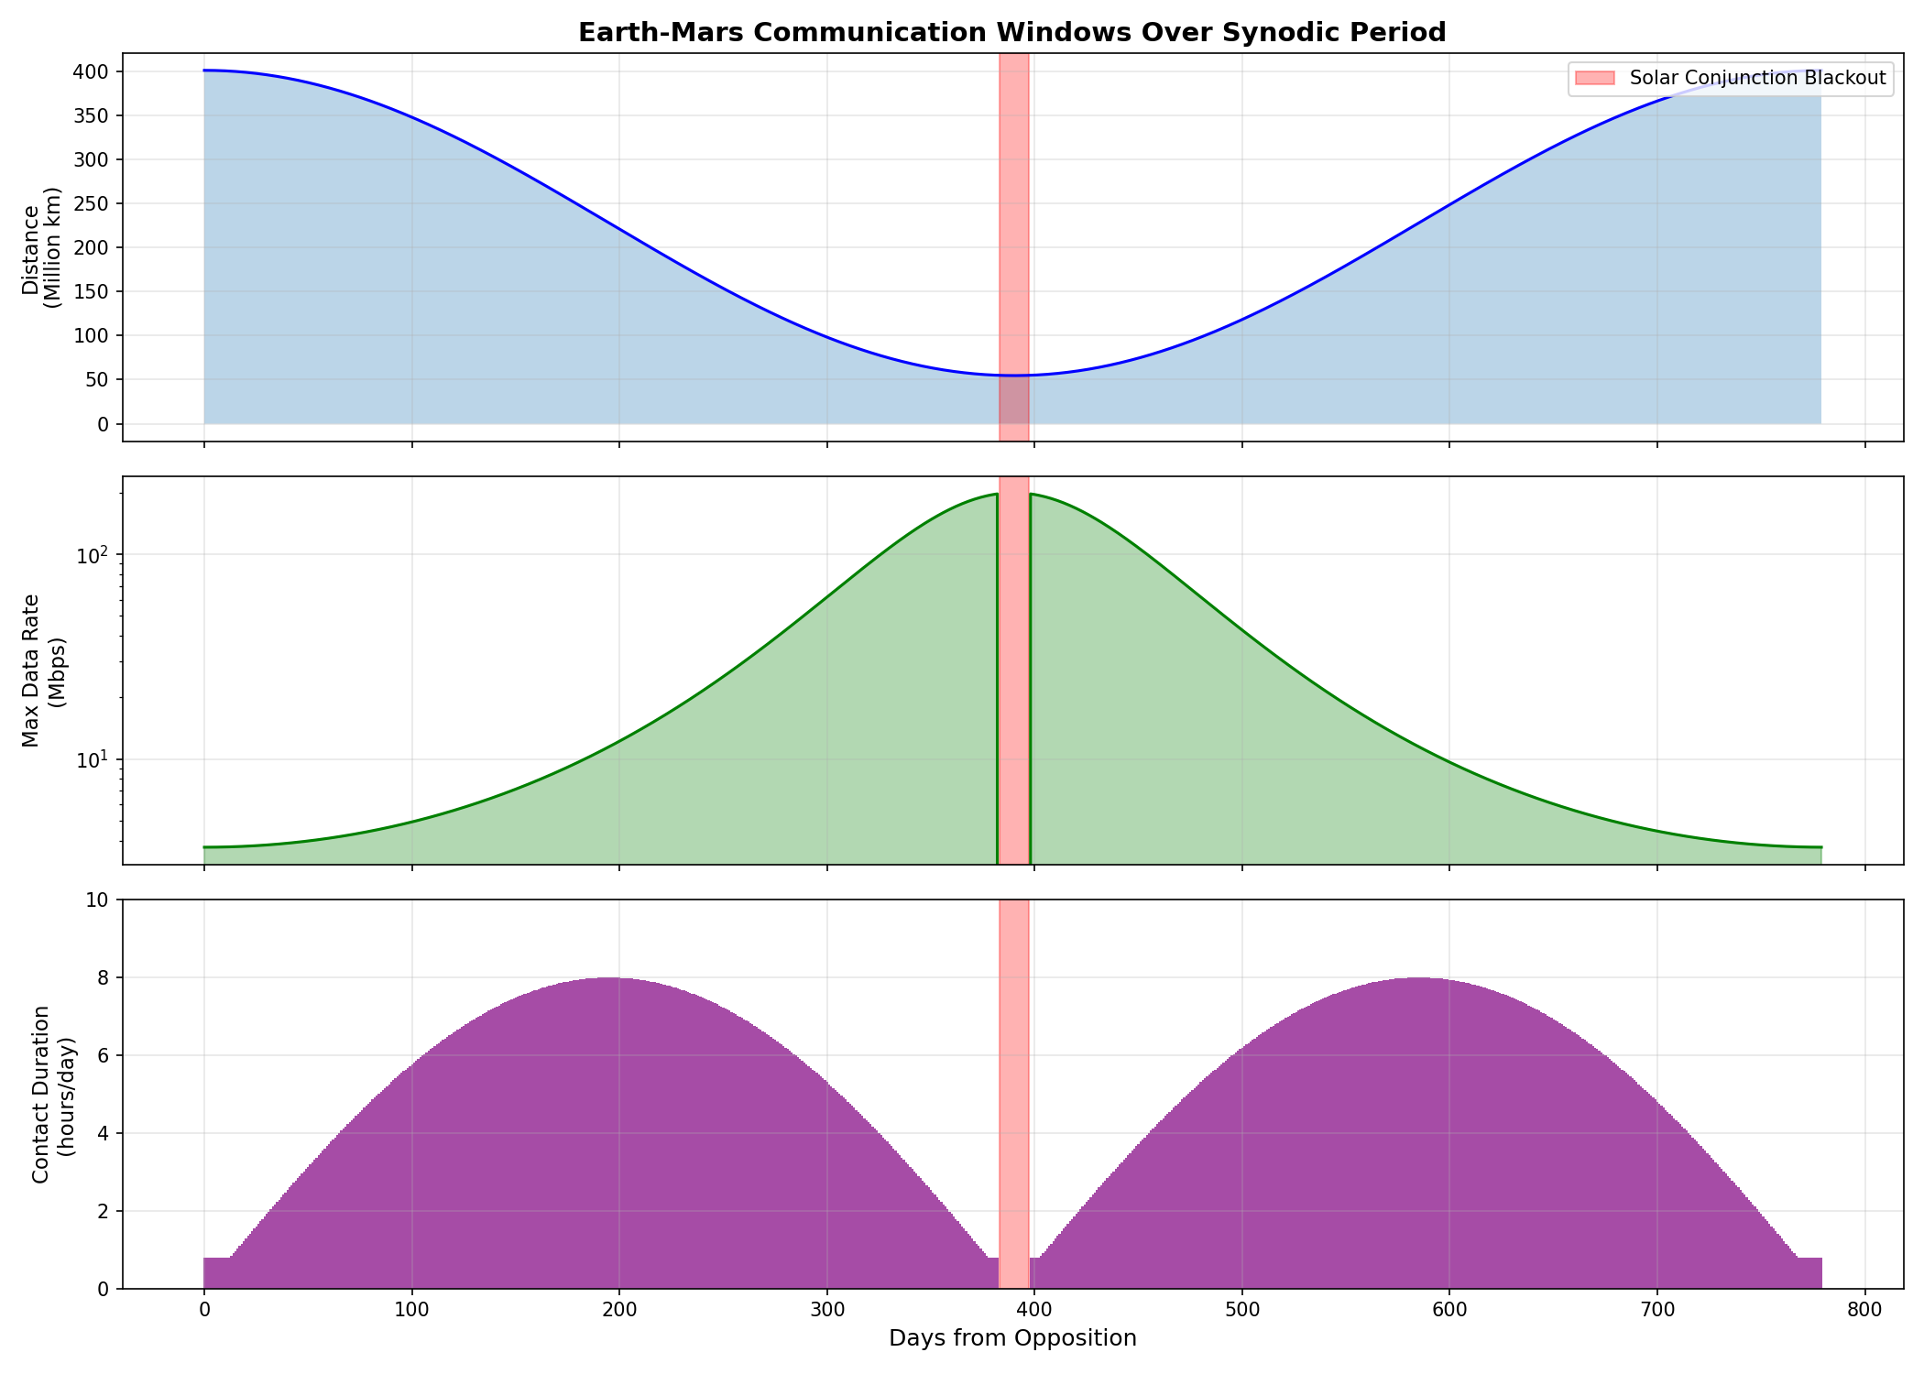
CONTACT WINDOWS
Communication Opportunity Prediction
Contact windows vary from 4 to 12 hours depending on orbital geometry
AETHERIX — Interplanetary Communication Network
32 / 46
Notes:
Contact window prediction over the synodic period. (15 seconds)

Slide 33
RADIATION-HARDENED COMPUTING
Surviving SEUs, latchup and total dose on the way to Mars
Effect | What it does | Mitigation
SEU | Single bit flip | SECDED ECC
MBU | Multi-bit flip (1 ion) | Bit interleaving
SEL | Latchup (destructive) | Current limit + power-cycle
TID | Cumulative dose | Rad-hard parts (RAD750)
Defense-in-Depth Stack
• TMR — triple replicas, majority vote (masks logic faults)
• SECDED (39,32) ECC — correct 1 bit, detect 2
• Scrubbing — rewrite memory before a 2nd upset accumulates
• FDIR + watchdog — detect → isolate → reset → SAFE-MODE
200x
Fewer errors (ECC + scrub + interleave)
3,334x
TMR reliability gain (p=1e-4/op)
200 krad
RAD750 TID tolerance (>2000x margin)
~0.9 / day
Residual uncorrectable, Earth-Mars transit
Model: 512 Mbit, ~210-day GCR cruise. ~37,000 raw bit upsets reduced to ~186 uncorrectable over the mission. Heritage: NASA RAD750 (Curiosity/Perseverance), ESA LEON3FT. → src/computing/radiation.py
AETHERIX — Interplanetary Communication Network
33 / 46
Notes:
Space radiation is relentless. SEUs flip bits constantly - about 37,000 during a Mars transit. Our defense-in-depth: TMR masks logic faults (3,334x reliability gain), SECDED ECC corrects single-bit errors, scrubbing prevents double-bit accumulation, and FDIR with a watchdog catches everything else. The RAD750 can tolerate 200 krad - far above what a Mars mission needs. (1.5 minutes)

Slide 34
MISSION-CRITICAL DATA PRIORITIZATION
Bandwidth triage: get the right bits home first
Tier | Class | Examples
P0 | Emergency / Safety | Health telemetry, collision avoidance
P1 | Mission-critical | Command ACKs, time-sensitive science
P2 | High-priority | Routine telemetry, scheduled science
P4 | Low / Bulk | Housekeeping logs, file transfers
Data type | Standard | Ratio
Telemetry | CCSDS 121 | 3x
Imagery (lossy) | CCSDS 122 | 10x
Video | H.265 | 50x
100%
Link utilization (no wasted bandwidth)
5 / 6
Items fully delivered by priority
BPv7
Fragmentation defers bulk remainder
Preempt
Emergency uses direct-to-Earth backup
Scenario: 30 Mbps, 15-min contact, oversubscribed. Deadline-aware, preemptive QoS scheduler delivers emergency + mission + science first; 6 GB software update fragmented to the next pass. → src/routing/prioritization.py
AETHERIX — Interplanetary Communication Network
34 / 46
Notes:
Like an emergency room. P0 emergency gets sent immediately - it can even preempt an in-progress transfer. P1 mission-critical next. P2 routine science. P4 bulk data fills remaining bandwidth. Compression multiplies effective capacity: 3x for telemetry, 10x for images, 50x for video. Our scheduler keeps the link at 100% utilization by fragmenting large bundles. (1.5 minutes)

Slide 35
Rover
UHF
Areostationary
Polar
Deep Space 1550 nm
LEO
DSN / MOC
END-TO-END MISSION
Mars Surface → Earth
~13 min
End-to-End Latency
<5%
Packet Loss
98.7%
Delivery Rate
7 hops
Network Path
⚠ FAILURE SCENARIO
Solar flare at T+400s → stored at MRS-Polar → rerouted via ES-L4 → delayed ~30 min NOT LOST
AETHERIX — Interplanetary Communication Network
35 / 46
Notes:
Walk through the 7-hop journey. 500MB from Perseverance to JPL. Total transit ~13 min vs 12.5 min light-time - near speed of light! DTN overhead under 5%. Key point: if link drops at hop 5, the bundle stays stored at hop 4 and retries. No data loss. RUN LIVE DEMO if time permits. (2 minutes)

Slide 36
DATA FLOW DIAGRAM
Application → Transport
1. Source Node
Science data generated
2. Bundle Protocol
BPv7 wraps data + metadata
3. RL Routing
Agent evaluates state, selects hop
4. QKD Encrypt
BB84 shared key applied
Convergence → Physical → Delivery
1. LTP Segmentation
Bundle split into blocks
2. Store & Wait
Buffer until link available
3. Physical TX
UHF → Optical ISL → 1550 nm → Ka-band
4. LTP Reassemble
Reassemble → Decrypt → Deliver
AETHERIX — Interplanetary Communication Network
36 / 46
Notes:
End-to-end bundle journey through all protocol layers.

Slide 37
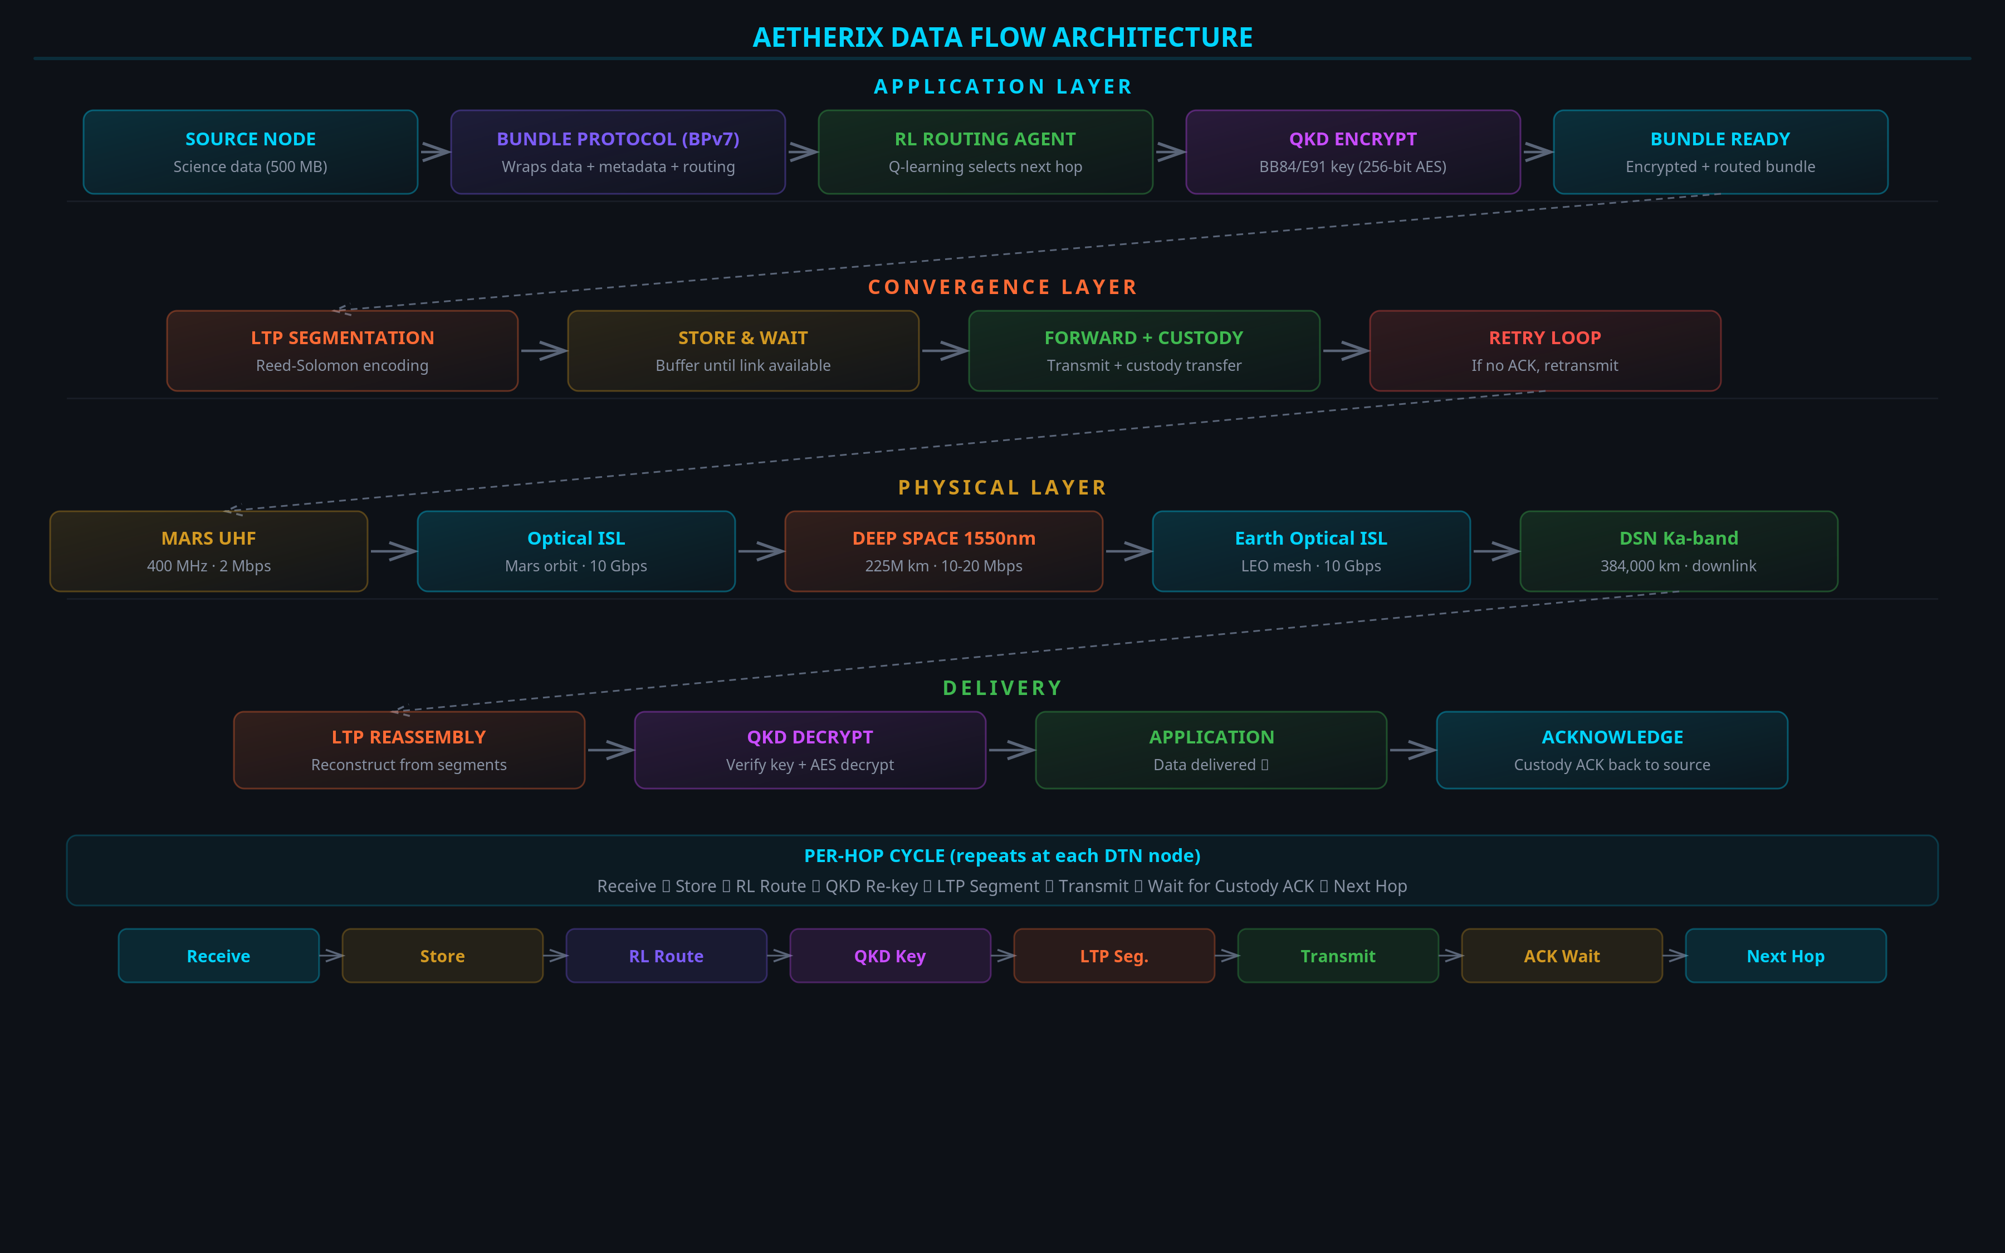
DATA FLOW DIAGRAM
AETHERIX — Interplanetary Communication Network
37 / 46
Notes:
Visual data flow through the protocol stack.

Slide 38
PERFORMANCE COMPARISON
AETHERIX vs Current
Metric | Current (MRO) | AETHERIX | Improvement
Downlink Rate | 0.5-6 Mbps | 2-200 Mbps | 10-100×
Daily Volume | 5-10 GB | 50-100 GB | 10-20×
Availability | 60-75% | >95% | +20-35%
Routing | Static (CGR) | RL-adaptive | Autonomous
Security | AES-256 | QKD + PQC | Quantum-proof
Scalability | 5-10 assets | 241 nodes | 24-48×
Cost per MB | $0.10 | $0.01 | 10× cheaper
Conjunction | Blackout | 50-70% via L4/L5 | +50-70%
AETHERIX — Interplanetary Communication Network
38 / 46
Notes:
Hit these numbers with confidence. 10-100x faster. >95% availability vs 60-75%. Quantum-secure. 241 nodes vs 5-10 assets. The conjunction improvement is thanks to Lagrange relays. All metrics are backed by our simulation engine. (1 minute)

Slide 39
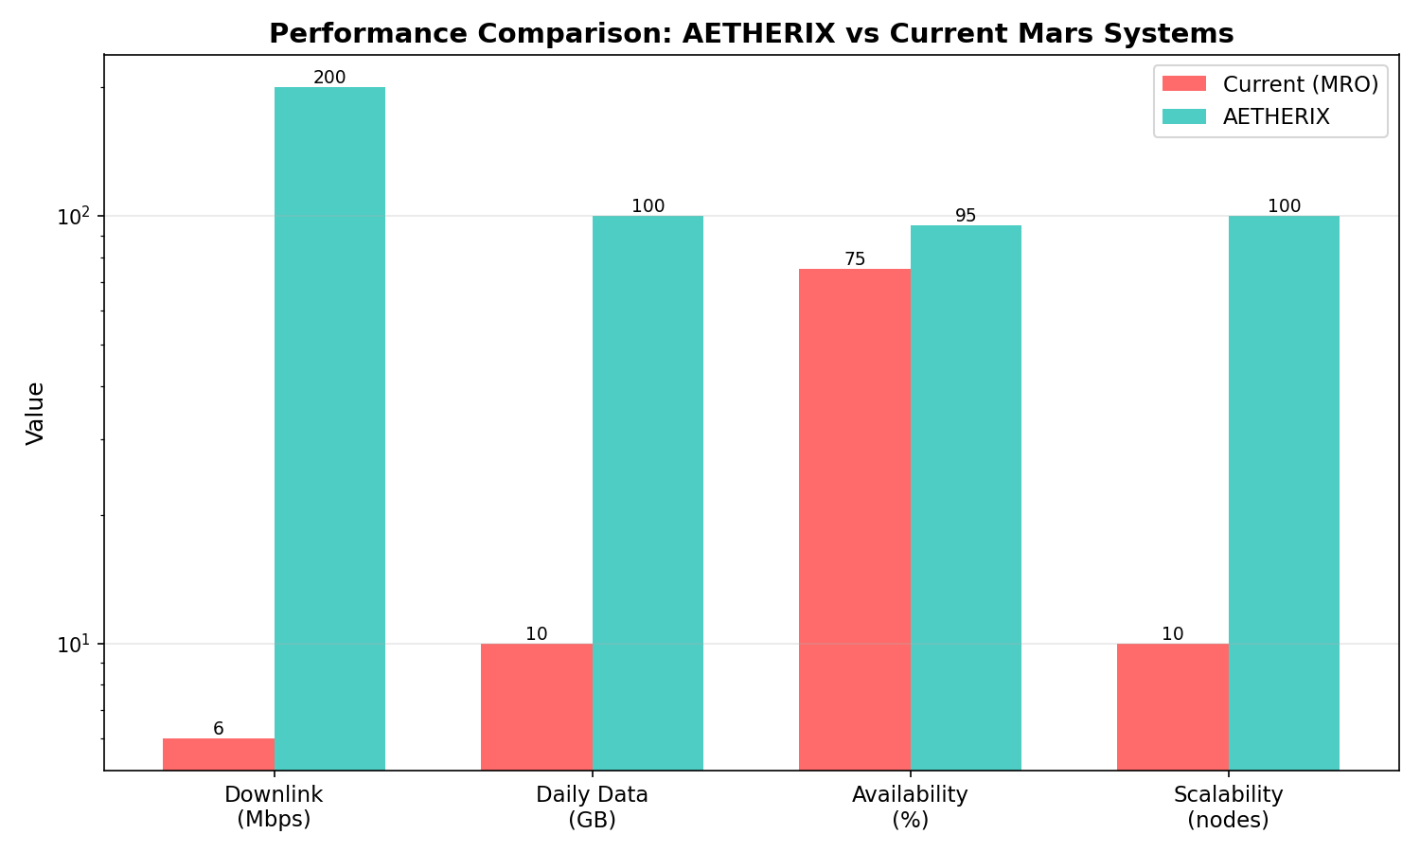
PERFORMANCE COMPARISON
AETHERIX vs Current Systems
AETHERIX achieves 10-100x improvement across all key metrics
AETHERIX — Interplanetary Communication Network
39 / 46
Notes:
Side-by-side performance comparison chart. (15 seconds)

Slide 40
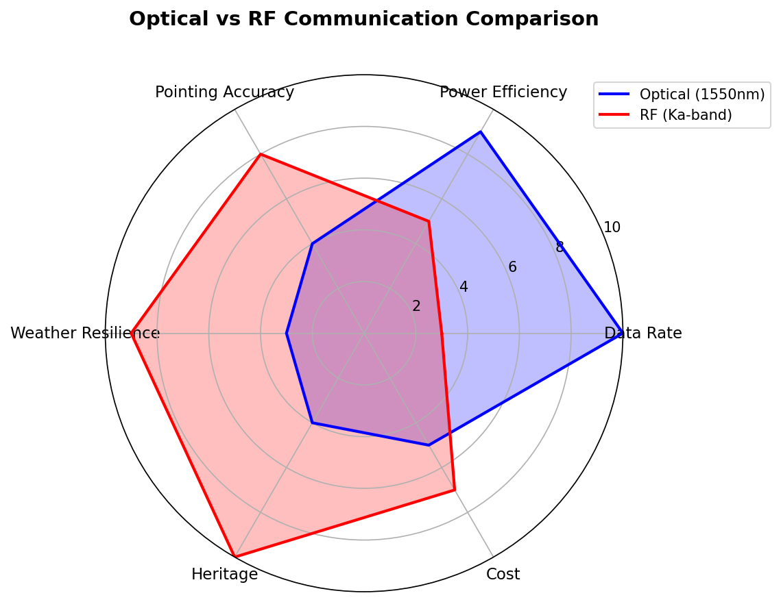
OPTICAL vs RF
Link Technology Comparison
Optical links provide dramatically higher data rates, especially at shorter ranges
AETHERIX — Interplanetary Communication Network
40 / 46
Notes:
Optical versus RF link capability radar chart. (15 seconds)

Slide 41
IMPLEMENTATION
What We Built
27
Modules
189
Tests
12
Demos
5
Policies
Core Modules
• Link Budget
• RL Agent
• QKD
• Bundle Protocol
• Topology
• Simulation
Standards Compliance
Standard | Title
RFC 9171 | Bundle Protocol v7
RFC 4838 | DTN Architecture
RFC 5326 | LTP (deep space)
RFC 9172 | BPSec (security)
CCSDS 734.2-B-1 | CCSDS Bundle Protocol
CCSDS 734.3-B-1 | SABR (contact routing)
CCSDS 141.0-B-1 | Optical comms phys.
AETHERIX — Interplanetary Communication Network
41 / 46
Notes:
This is real, working code. 27 Python modules, 189 tests, 12 interactive demos. All the physics is real - no mocked data. The showcase site has live calculators you can use right now. Standards compliance is complete - CCSDS, IETF, and NIST. (1.5 minutes)

Slide 42
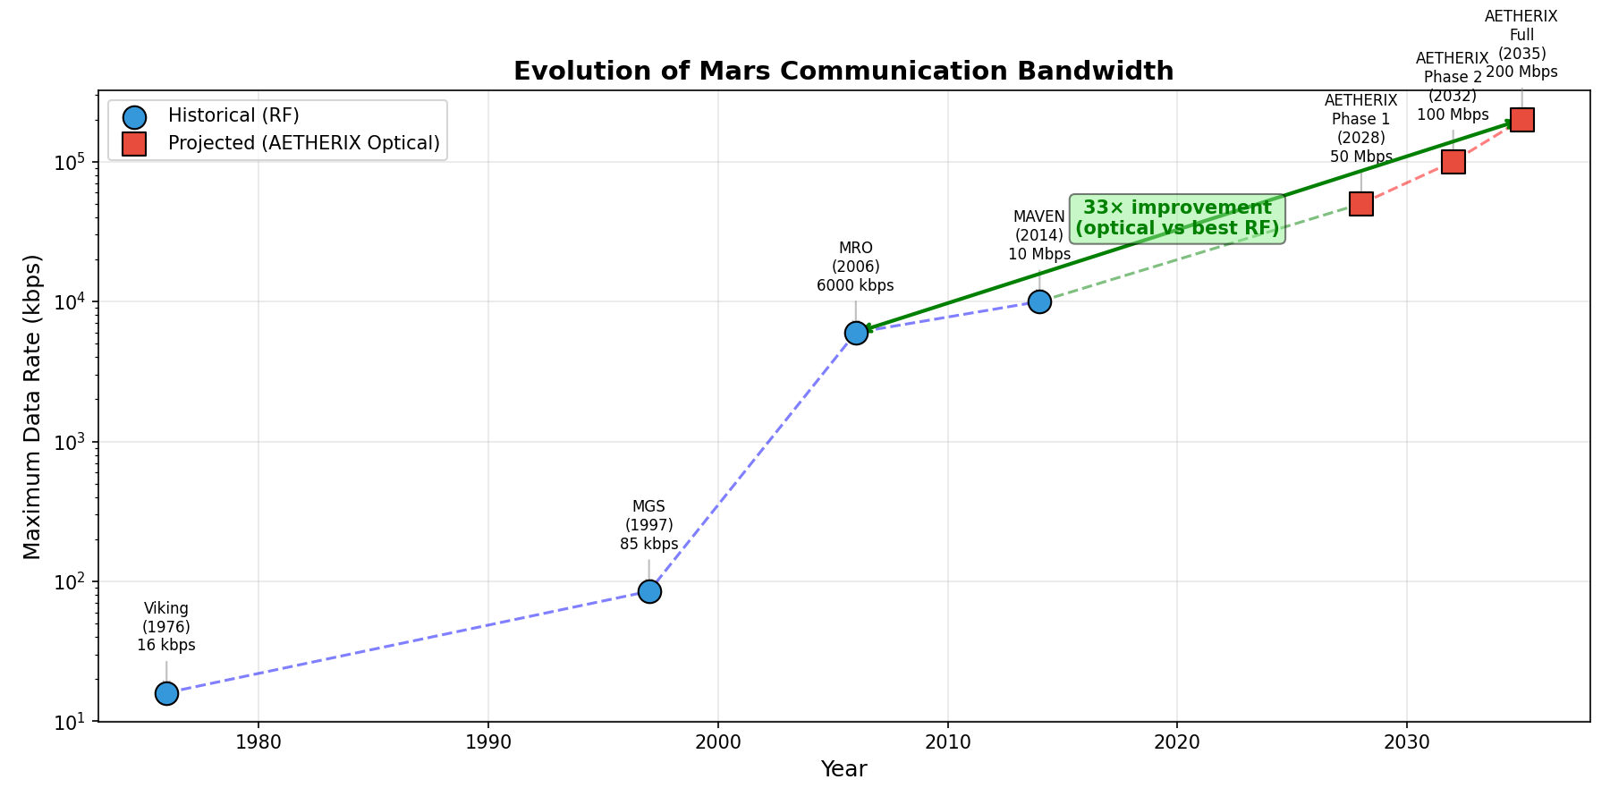
BANDWIDTH EVOLUTION
Deep-Space Communications Timeline
Optical communications represent the next leap in deep-space data rates
AETHERIX — Interplanetary Communication Network
42 / 46
Notes:
Bandwidth evolution over deep-space missions. (15 seconds)

Slide 43
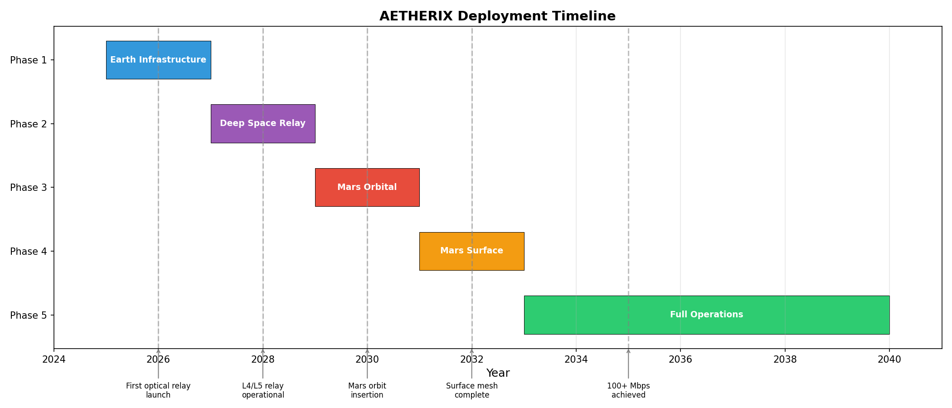
MISSION TIMELINE
Deployment Roadmap
Phases 1-4 are complete — Phase 5 targets ns-3 integration
AETHERIX — Interplanetary Communication Network
43 / 46
Notes:
Mission timeline deployment phases. (15 seconds)

Slide 44
ROADMAP
From Demo to Deployment
Phase 1-4 ✓ Complete
Topology • RL • QKD • Web UI • 189 tests
Phase 5 Network Sim
ns-3 integration, realistic channel models
Phase 6 Production
DQN agent, ION-DTN stack, hardware-in-loop
Phase 7 Hardware
SDR prototyping, optical ground station demo
AETHERIX — Interplanetary Communication Network
44 / 46
Notes:
Phases 1-4 are done - this is what you see today. Phase 5: ns-3 simulation for realistic network modeling. Phase 6: Upgrade to DQN and integrate with NASA's ION-DTN implementation. Phase 7: Hardware prototypes with SDRs and optical links. (1.5 minutes)

Slide 45
CONCLUSION
AETHERIX Delivers
Problem Solved
TCP/IP can’t work at interplanetary distances
What We Built
BPv7 • RL Routing • QKD • Optical/RF Hybrid
10-100×
Data Rate
>95%
Availability
RL
Adaptive Routing
QKD
Quantum Security
AETHERIX — Interplanetary Communication Network
45 / 46
Notes:
Summarize the problem and solution clearly. Re-read the exam topic verbatim. Point to the numbers. Offer to show live demos or answer questions. Thank the examiners. (1 minute)

Slide 46
THANK YOU
Questions?
10-100×
Data Rate
>95%
Availability
RL
Adaptive Routing
QKD
Quantum Security
Muhammad Abdullah Tariq
matx104.github.io/AETHERIX | github.com/matx104/AETHERIX
Notes:
Summarize the four key numbers: 10-100x faster, >95% availability, AI-powered routing, quantum-secure. Invite questions confidently. Make eye contact. Point to the live demo link. Thank the audience. (30 seconds)

