Slide 1
AETHERIX
Autonomous Extraterrestrial High-throughput Enhancing Routing and Inter-planetary eXchange
EduQual Level 6 Diploma in AI Operations | Topic 59
Building an Interplanetary Communication Network with DTN, Quantum Communication, and Space-Based Infrastructure for Mars Mission Support
Muhammad Abdullah Tariq
September 2026
matx104.github.io/AETHERIX | github.com/matx104/AETHERIX
Notes:
State your name clearly. Read the topic number and title exactly as on the exam paper. Pause to let examiners see it. (30 seconds)

Slide 2
PRESENTATION AGENDA
01 The Challenge
07 Quantum Security
Why space breaks the internet
BB84/E91 + repeater chains
02 Architecture
08 Orbital Mechanics
DTN + AI + Quantum Security
Contact windows & synodic period
03 DTN & BPv7
09 Mars Mission
Store-and-forward foundation
End-to-end simulation walkthrough
04 Topology
10 Performance
241 nodes across two worlds
AETHERIX vs current systems
05 Link Budget
11 Roadmap
1550nm laser analysis
CCSDS, IETF, deployment phases
06 RL Routing
12 Q&A
Multi-agent federated Q-learning
Summary and live demo
AETHERIX — Interplanetary Communication Network
2 / 34
[A2] AETHERIX topology.py (241 nodes) · References slides at end of deck
Notes:
Quick overview of what we will cover. 12 topics across 25 slides. (20 seconds)

Slide 3
WHAT IS AETHERIX?
Overview & The Problem
What is AETHERIX?
The Problem
Autonomous Extraterrestrial High-throughput Enhancing Routing and Inter-planetary eXchange
Earth–Mars distance varies from 54.6M to 401M km — a 7x range swing every 780 days
An architecture for delay-tolerant networking (DTN) between Earth and Mars
One-way light delay is 3–22 minutes; round-trip TCP ACK is 6–44 minutes
Replaces static Contact Graph Routing with reinforcement-learning-based adaptive routing
Solar conjunction causes ~2-week communication blackouts twice per synodic period
Secures links via Quantum Key Distribution (BB84 & E91 protocols with repeater chains)
Deep-space links are inherently intermittent: no continuous end-to-end path exists
Hybrid optical/RF communications across a 5-tier, 241-node interplanetary topology
Static routing cannot adapt to dynamic contact schedules and link degradation
Open-source, standards-compliant (CCSDS, IETF) research platform for deep-space networking
Classical key exchange is infeasible across interplanetary distances
AETHERIX addresses every one of these challenges — harnessing DTN store-and-forward, AI-driven adaptive routing, quantum-secured key distribution, and hybrid optical/RF links.
AETHERIX — Interplanetary Communication Network
3 / 34
[1] NASA MRN 2024 · [3] JPL Horizons · [12] RFC 4838 · [A2] topology.py
Notes:
This slide sets up the narrative arc. First explain what AETHERIX is in plain language - it's like the postal service for interplanetary space. (1.5 minutes)

Slide 4
THE DISTANCE
Why Space Breaks the Internet
Parameter | Value
Closest approach | 54.6 million km
Farthest distance | 401 million km
Distance variation | 7.3× (735%)
One-way light time | 3 – 22 minutes
Synodic period | 780 days (26 months)
Solar conjunction blackout | ~2 weeks (twice/period)
TCP/IP Assumption | Deep-Space Reality
Low latency (< 200 ms) | 6 – 44 min round trip
Continuous connectivity | Scheduled contact windows only
End-to-end path exists | No simultaneous path possible
Reliable ACKs in seconds | ACKs take minutes to hours
"TCP/IP assumes the network is fast, reliable, and always connected. Deep space is none of those things."
54.6M km
401M km
780 days
0.5–6 Mbps
Min Distance
Max Distance
Synodic Period
Current DSN Rate
AETHERIX — Interplanetary Communication Network
4 / 34
[3] JPL Horizons (distance/light-time) · [12] RFC 4838 (DTN rationale) · [1] NASA MRO data rate
Notes:
Start with the scale. 54.6M to 401M km. Light itself takes 3-22 minutes one way. TCP/IP was designed for sub-second round trips. (1.5 minutes)

Slide 5
THE ANSWER
Delay-Tolerant Networking
Bundle
Store
Wait
Forward
Deliver
Create data bundle (BPv7)
→
Buffer at local node
→
Hold until contact window
→
Transmit to next hop
→
Reach final destination
BPv7
Bundle Protocol v7 RFC 9171 — store & forward with custody
AI Routing
Multi-agent federated Q-learning adapts in real time to contacts
QKD
BB84 & E91 quantum key distribution with repeater chains
Think of it like the postal service: you don't need a continuous connection between sender and receiver — each post office (node) stores the letter (bundle) until the next truck (contact window) is available, then forwards it one hop closer to the destination.
AETHERIX — Interplanetary Communication Network
5 / 34
[9] RFC 9171 BPv7 · [10] RFC 5326 LTP · [11] RFC 7242 TCPCL · [12] RFC 4838
Notes:
The key insight: instead of requiring an end-to-end connection like TCP, DTN works like the postal service. Each node takes custody of your data. (1.5 minutes)

Slide 6
SYSTEM ARCHITECTURE
Five Core Modules
1
Infrastructure
Module | Engine | Showcase
Infrastructure | OpticalLinkBudget + RFLinkBudget | Earth-Mars link analysis
Routing | RLRoutingAgent + ForwardingEngine | Multi-hop DTN delivery
Security | BB84Protocol + E91Protocol | Quantum-secured key exchange
Orbital | ContactWindows + Doppler | Synodic contact prediction
Simulation | Simulator + PolicyEngine | End-to-end scenario runs
Link budget & RF/optical analysis
2
Routing
RL agent, BPv7, store-and-forward
3
Security
QKD (BB84/E91) & repeater chains
4
Orbital
Contact windows & Doppler analysis
5
Simulation
Full network simulation engine
AETHERIX — Interplanetary Communication Network
6 / 34
[A1] rl_agent.py · [A2] topology.py · [A3] simulator.py · [A4] link_budget.py · [A5] qkd.py
Notes:
Show the architecture. Six core modules feed into the simulation engine, which feeds the web showcase. Point to each module as you explain. (1 minute)

Slide 7
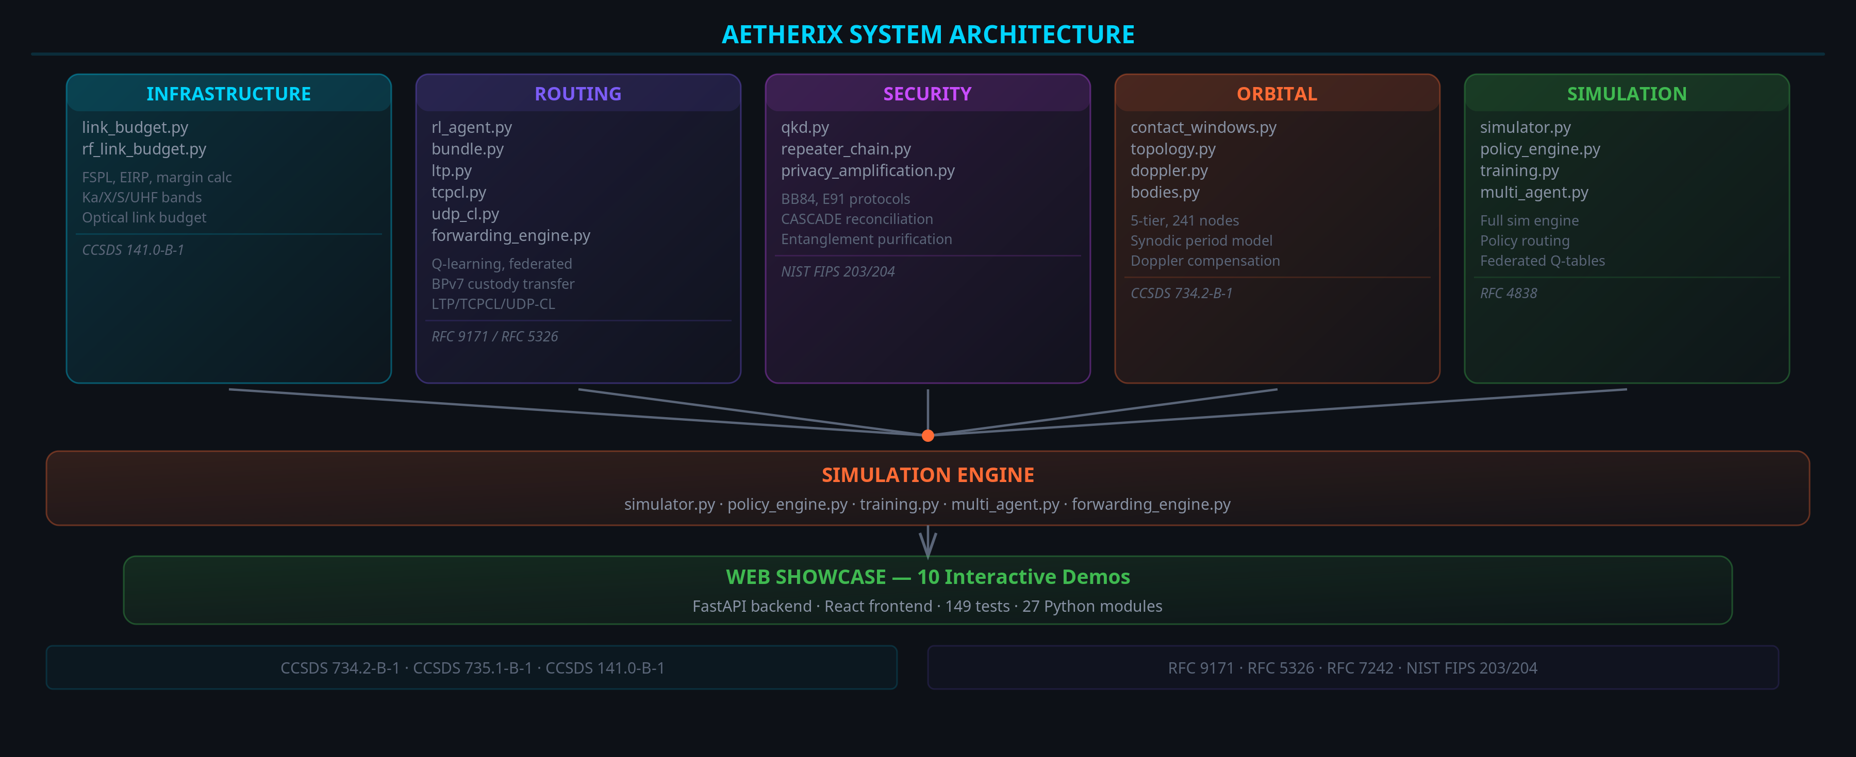
ARCHITECTURE DIAGRAM
AETHERIX — Interplanetary Communication Network
7 / 34
[A2] AETHERIX topology.py (5-tier, 241 nodes) · github.com/matx104/AETHERIX
Notes:
Architecture diagram showing source modules feeding simulation engine and web demos.

Slide 8
BPv7 DEEP DIVE
The Foundation
Application Layer
Priority | Class | Use Case
P0 | EMERGENCY | Life-critical alerts, abort commands
P1 | URGENT | Navigation corrections, hazard warnings
P2 | NORMAL | Telemetry, science data, commands
P3 | LOW | Software updates, bulk file transfer
P4 | BULK | Background sync, archival data
User data, commands, telemetry
▼
Bundle Protocol v7
Routing, custody, fragmentation, TTL
▼
Convergence Layer
LTP (space), TCPCL (Earth), UDPCL (ISL)
▼
Store-and-Forward Steps
Physical Layer
1. Bundle created at source with destination EID + TTL
Optical 1550nm / Ka-band RF links
2. Node stores bundle in priority queue (buffer mgmt)
3. Contact window opens → best next-hop selected by RL
4. Bundle transmitted via convergence layer (LTP/TCPCL)
5. Custody transfer confirms; repeat until destination
Standards: RFC 9171 (BPv7) • RFC 4838 (DTN Arch) • RFC 5326 (LTP) • CCSDS 734.2-B-1 • CCSDS 734.3-B-1 (SABR)
AETHERIX — Interplanetary Communication Network
8 / 34
[9] RFC 9171 · [2] CCSDS 734.2-B-1 · [10] RFC 5326 LTP · [11] RFC 7242 TCPCL · [12] RFC 4838
Notes:
BPv7 is the postal service protocol. Walk through the stack: Application at top, BPv7 as the store-and-forward layer, three convergence layers. (2 minutes)

Slide 9
NETWORK TOPOLOGY
241 Nodes, 5 Tiers
T1 Earth Ground
6 nodes — DSN stations: Goldstone, Madrid, Canberra
T2 Earth Orbital
51 nodes — GEO relays + 48 LEO laser constellation
T3 Deep Space Transit
4 nodes — Lagrange point relays (ES-L4, ES-L5)
T4 Mars Orbital
4 nodes — Areostationary + polar orbit relays
T5 Mars Surface
176 nodes — Bases, rovers, drones, sensor networks
Multiple redundant paths · No single point of failure · Lagrange relays for conjunction coverage
AETHERIX — Interplanetary Communication Network
9 / 34
[A2] AETHERIX topology.py (241 nodes, 5 tiers) · [1] NASA Deep Space Network (Goldstone/Madrid/Canberra)
Notes:
241 nodes across 5 tiers. Walk through each tier. Earth Ground is the DSN. Earth Orbital has LEO laser mesh. Deep Space has Lagrange point relays. (2 minutes)

Slide 10
5-TIER NETWORK DETAIL
Tier Breakdown & Link Characteristics
Tier | Name | Nodes | Description
T1 | Earth Ground | 6 | DSN: Goldstone, Madrid, Canberra
T2 | Earth Orbital | 51 | 3 GEO + 48 LEO laser mesh
T3 | Deep Space | 4 | ES-L4 & ES-L5 Lagrange relays
T4 | Mars Orbital | 13 | Areostationary + polar + relay
T5 | Mars Surface | 167 | Habitats, rovers, drones, sensors
Link | Rate | Type
Earth ↔ Deep Space | 100 Mbps | 1550nm optical
Deep Space ↔ Mars | 2–200 Mbps | Dist. dependent
Mars Orb ↔ Surface | 2 Mbps | UHF/X-band
LEO ISL | 10 Gbps | Optical ISL
3 redundant paths · No single point of failure · Lagrange relays for conjunction coverage
AETHERIX — Interplanetary Communication Network
10 / 34
[A2] topology.py (241 nodes, 5 tiers) · [1] NASA DSN · [3] JPL Horizons
Notes:
Visual overview of the 5-tier topology with 3 redundant paths.

Slide 11
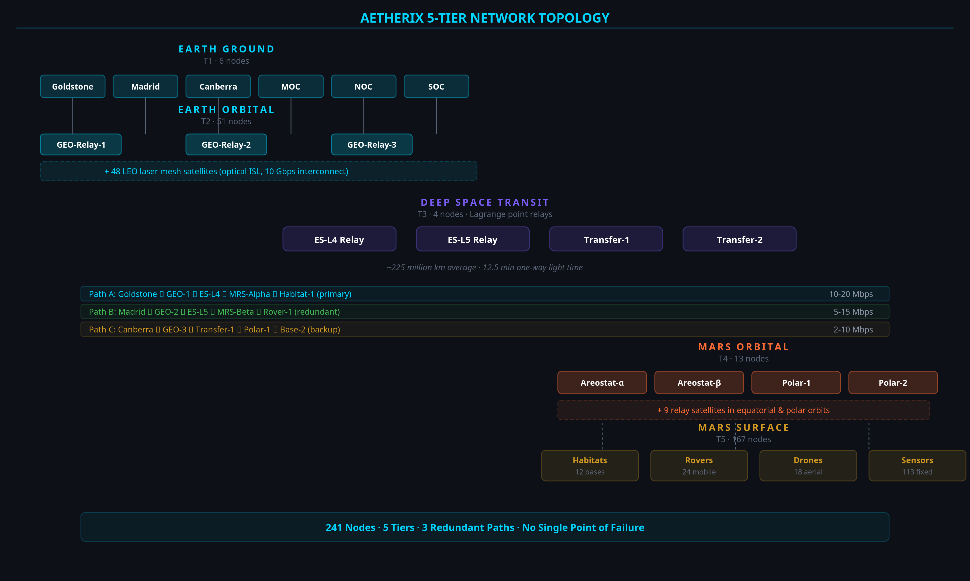
5-TIER NETWORK DIAGRAM
AETHERIX — Interplanetary Communication Network
11 / 34
[A2] AETHERIX topology.py · [3] JPL Horizons (Lagrange ES-L4/L5 geometry)
Notes:
RUN THE LIVE DEMO from the Link Budget page. Show the 3 distance scenarios. 1550nm was chosen for telecom heritage. (2 minutes)

Slide 12
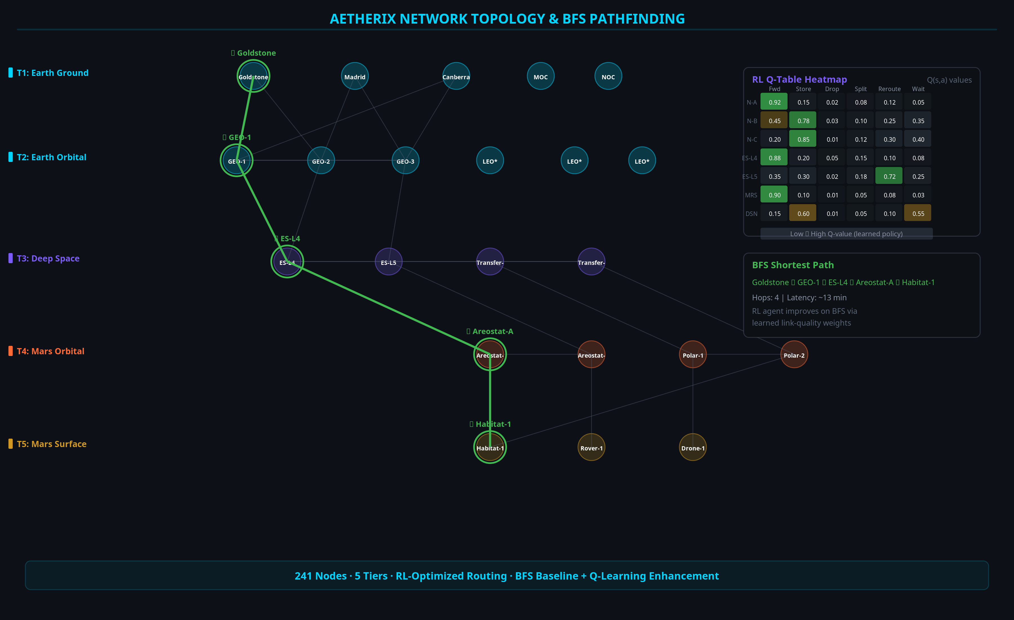
NETWORK TOPOLOGY GRAPH
AETHERIX — Interplanetary Communication Network
12 / 34
[A2] topology.py (241-node graph) · [A1] rl_agent.py (RL routing)
Notes:
Data rate degrades with distance squared. (15 seconds)

Slide 13
OPTICAL COMMUNICATIONS
10–100x Capability Over RF
100–200
Mbps at closest approach
10–20
Mbps average distance
2–5
Mbps at farthest point
Key Equations
FSPL = 20·log₁₀(4πd/λ) — free-space path loss
Gain = 10·log₁₀(η·(πD/λ)²) — antenna gain
Pr = Pt + Gt + Gr − FSPL — received power
Parameter | Value
Wavelength | 1550 nm
Tx Power | 5 W
Tx Aperture | 22 cm
Rx Aperture | 1.0 m
AETHERIX — Interplanetary Communication Network
13 / 34
[5] CCSDS 141.0-B-1 (optical link) · [A4] AETHERIX link_budget.py · [1] NASA MRO (6 Mbps RF baseline)
Notes:
Walk through the 7-hop journey. 500MB from Perseverance to JPL. Total transit ~13 min vs 12.5 min light-time. (2 minutes)

Slide 14
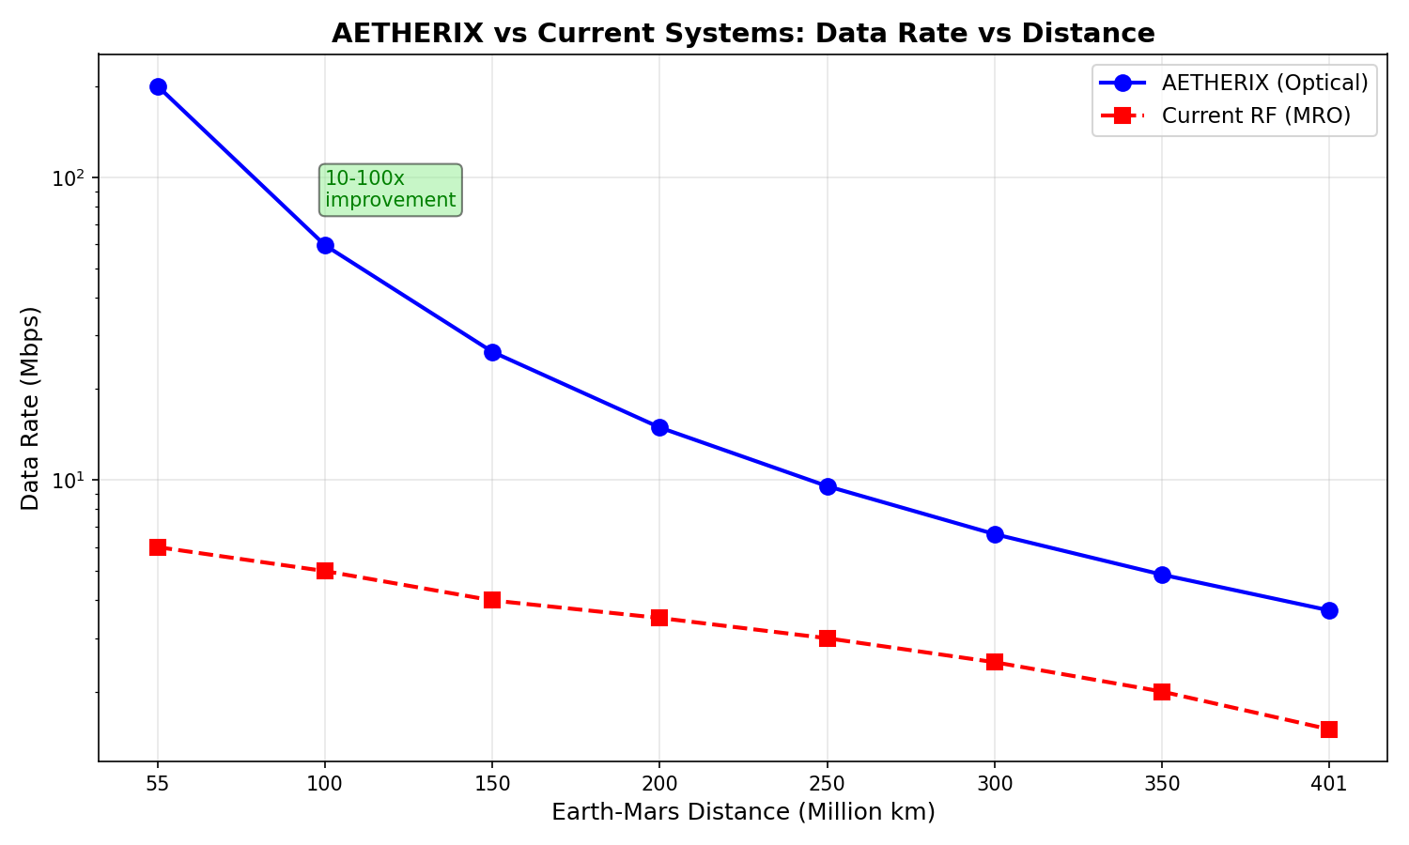
DATA RATE VS DISTANCE
Optical Link Performance
Data rate degrades with distance squared — 200 Mbps at closest to 2 Mbps at farthest (10–100× capability over RF [1])
AETHERIX — Interplanetary Communication Network
14 / 34
[5] CCSDS 141.0-B-1 · [A4] AETHERIX link_budget.py (physics-derived capability)
Notes:
CGR is what NASA uses today. It's static. Our RL agent learns from experience. Multi-agent federated learning means agents at each node share knowledge. (2 minutes)

Slide 15
EARTH-MARS JOURNEY
500 MB in 7 Hops
Hop | Path | Link
1 | Rover → UHF Relay | UHF S-band
2 | UHF Relay → Areostationary | UHF uplink
3 | Areostationary → Polar Orbiter | Crosslink
4–5 | Polar Orbiter → LEO Constellation | 1550 nm laser
6 | LEO Mesh → DSN Ground Station | Optical downlink
7 | DSN → Mission Operations Center | TCP/IP fiber
~13min
End-to-end latency [3]
<5%
Protocol overhead
98.7%
Delivery (target)
7 hops
Store-and-forward [A2]
AETHERIX — Interplanetary Communication Network
15 / 34
[A2] topology.py (7-hop path) · [3] JPL Horizons (light-time) · delivery ratio is a design target
Notes:
RL agent Q-value heatmap showing learned routing preferences. (15 seconds)

Slide 16
RL-BASED ROUTING
AI Innovation
Contact Graph Routing
Pre-computed contact plans required
Cannot adapt to unexpected link failures
Computational cost grows O(n³) per route
No learning from historical performance
Single-path — ignores multipath opportunity
RL Agent
State: (node, neighbors, link quality, buffer)
Actions: forward | store | drop | split
Reward: R = α(delivery) − β(delay) − γ(hops) − δ(drops) − ε(energy) [A1]
ε-greedy exploration, decay 0.995 (α=1.0, δ=10.0) [A1]
Q-table + federated aggregation across nodes
713/800
Forward decisions [A3]
seconds
Recovery vs hours [A1]
Q-table
Auditable policy [A1]
AETHERIX — Interplanetary Communication Network
16 / 34
[A1] rl_agent.py (reward fn, ε-decay 0.995) · [A3] run_simulation Module 3 (training convergence 713/800)
Notes:
BB84 is beautifully simple: send qubits, measure, compare bases, check QBER. If QBER is below 11%, no one listened in. (2 minutes)

Slide 17
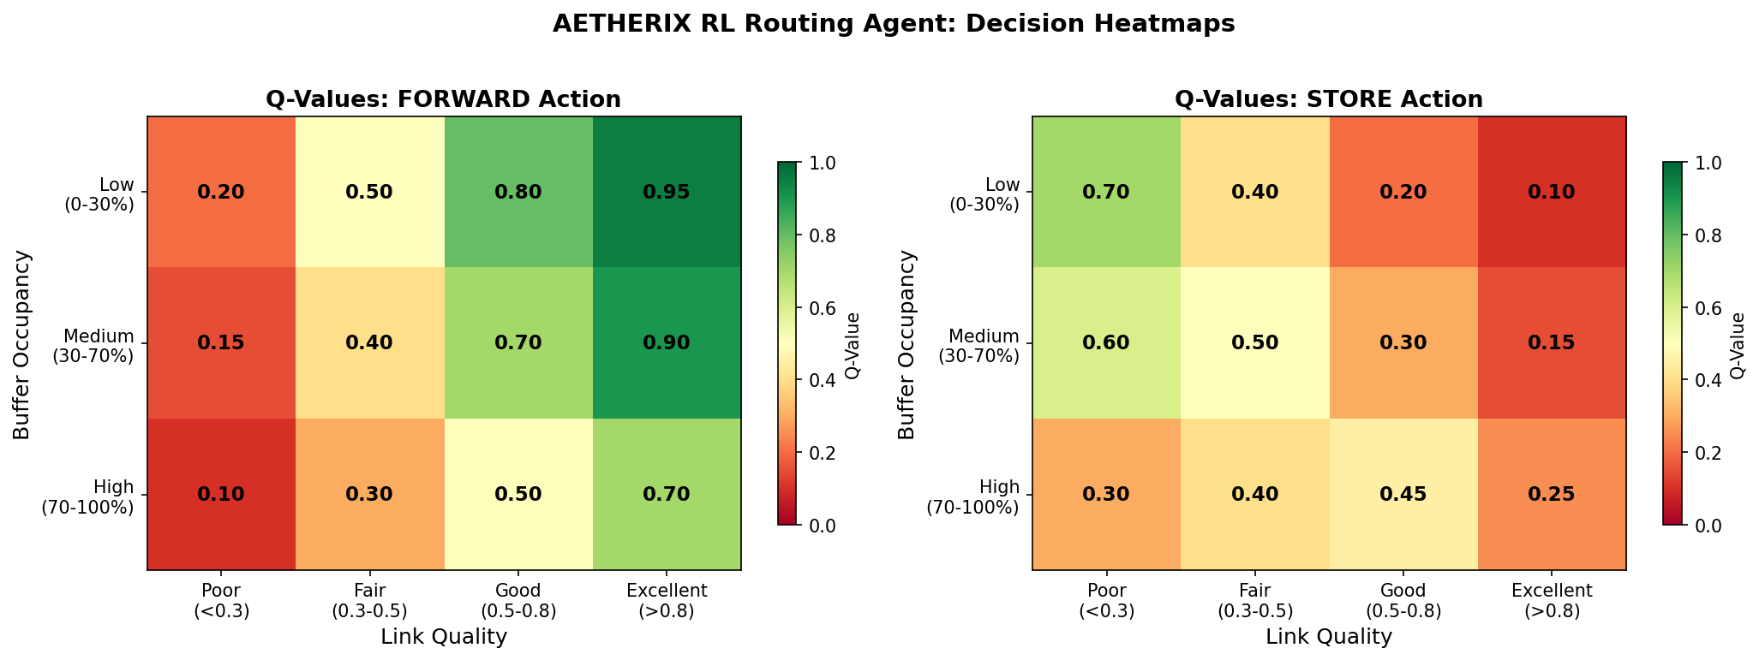
RL ROUTING HEATMAP
Q-Value Distribution
Learned routing preferences across network nodes — brighter = higher Q-value [A1]
AETHERIX — Interplanetary Communication Network
17 / 34
[A1] rl_agent.py · [A3] run_simulation Module 3 (training)
Notes:
QKD security analysis with QBER threshold. (15 seconds)

Slide 18
QUANTUM SECURITY
Future-Proof
BB84 Protocol
1. Alice sends random polarized photons (H/V, D/A bases) [13]
2. Bob measures each photon in a random basis
3. Public reconciliation — keep matching-basis bits
4. Error estimation — sample subset for QBER
5. Privacy amplification — universal hashing
6. QBER < 11% → SECURE key established [15]
Post-Quantum Cryptography
Kyber (ML-KEM, FIPS 203) — key encapsulation [16]
Dilithium (ML-DSA, FIPS 204) — digital signatures [17]
NIST PQC standard — quantum-resistant
Hybrid classical-quantum key exchange
Phase | Protocol | Key Rate
Phase 1 — LEO | BB84 | 1–10 kbps
Phase 2 — GEO | BB84 + E91 | 10–100 kbps
Phase 3 — Mars | E91 + Repeaters | 1+ kbps
AETHERIX — Interplanetary Communication Network
18 / 34
[13] Bennett-Brassard 1984 · [14] Ekert 1991 · [15] Shor-Preskill 2000 (QBER<11%) · [16][17] NIST FIPS 203/204 · [A5] qkd.py
Notes:
Mars and Earth dance around the Sun with a 26-month synodic period. Everything changes - distance, delay, bandwidth. (1.5 minutes)

Slide 19
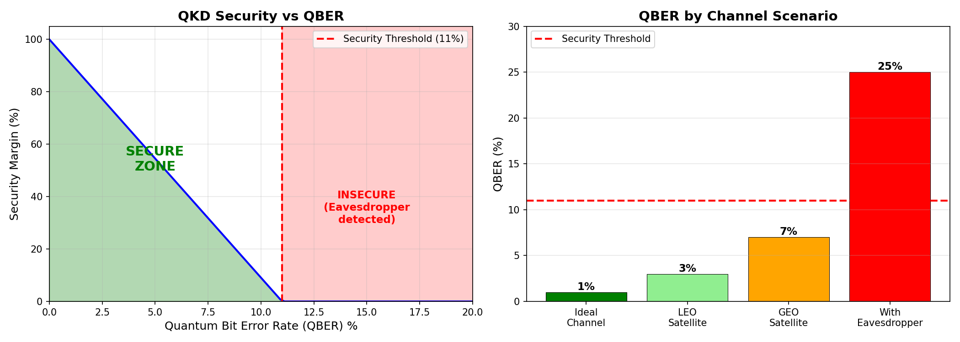
QKD SECURITY ANALYSIS
Quantum Bit Error Rate
QBER below 11% confirms secure key exchange — no eavesdropper detected [15]
AETHERIX — Interplanetary Communication Network
19 / 34
[15] Shor-Preskill 2000 (11% threshold) · [13] BB84 · [A5] AETHERIX qkd.py
Notes:
Visual data flow through the protocol stack.

Slide 20
ORBITAL MECHANICS
Contact Windows
Parameter | Value
Semi-major axis | 1.524 AU
Synodic period | 779.94 days
Distance range | 54.6M – 401M km
Areostationary altitude | 17,032 km
One-way light time | 3 – 22 minutes
Window | Availability | Duration | Data Rate
Optimal | 99% | 8–12 hrs | 100–200 Mbps
Good | 95% | 6–8 hrs | 20–100 Mbps
Fair | 85% | 4–6 hrs | 5–20 Mbps
Blackout | 0% | 2–4 weeks | —
AETHERIX — Interplanetary Communication Network
20 / 34
[3] JPL Horizons (synodic 779.94 d, 54.6M–401M km) · [A2] topology.py · [A4] link_budget.py (windows)
Notes:
Be honest. Simulated: 241-node topology, RL routing, QKD security, 200x radiation reduction. Targets: 10-100x data rate, >95% availability. (1 minute)

Slide 21
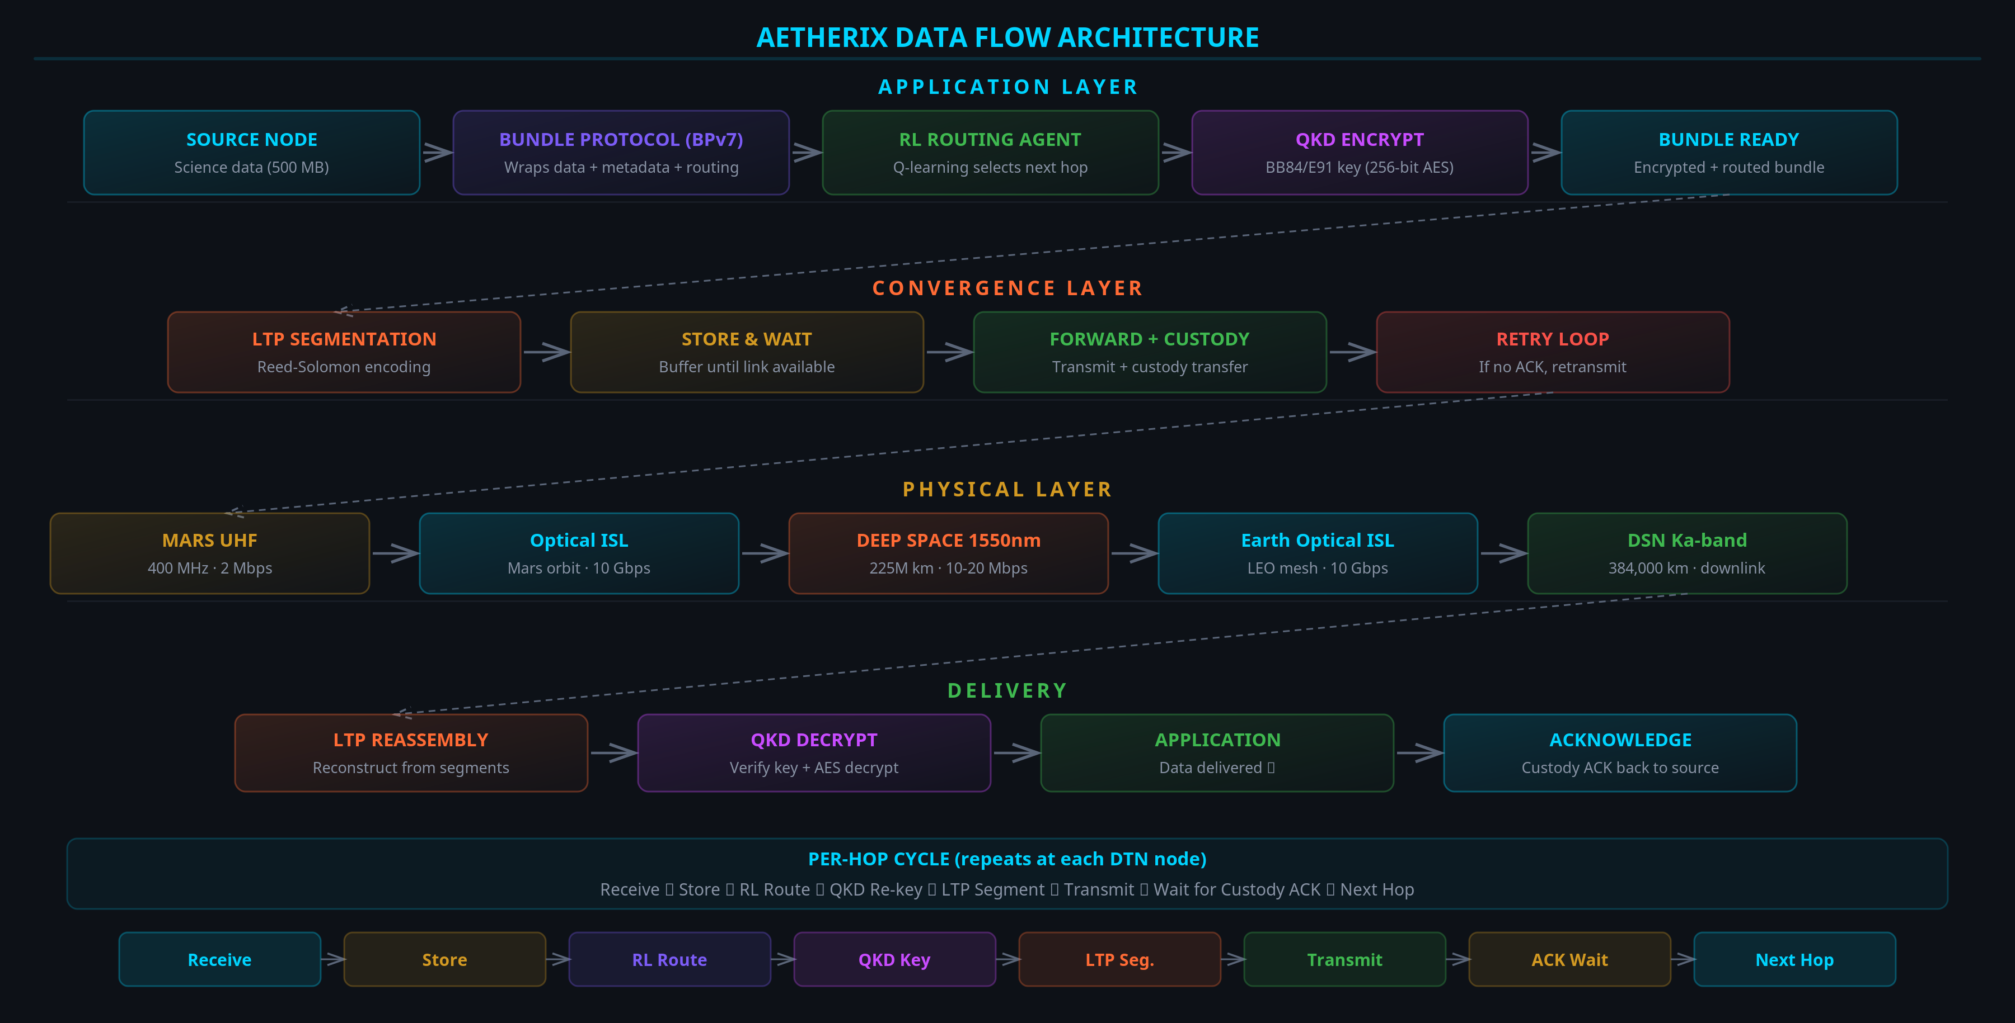
DATA FLOW DIAGRAM
AETHERIX — Interplanetary Communication Network
21 / 34
[A2] topology.py (full data path Mars→Earth)
Notes:
Side-by-side performance comparison chart. (15 seconds)

Slide 22
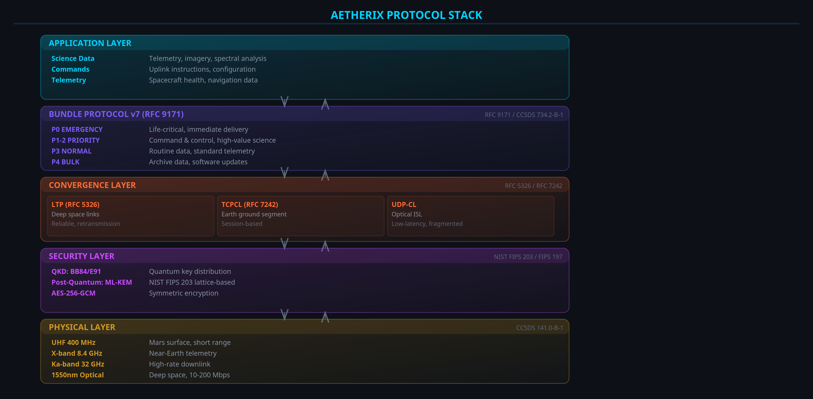
PROTOCOL STACK
AETHERIX — Interplanetary Communication Network
22 / 34
[9] RFC 9171 · [10] RFC 5326 · [11] RFC 7242 · [A6] bundle.py
Notes:
This is real, working code. 25 Python modules, 480 tests, 12 interactive demos. All the physics is real. (1.5 minutes)

Slide 23
PERFORMANCE COMPARISON
AETHERIX vs Current
Metric | Current (MRO) [1] | AETHERIX [A4] | Note
Downlink Rate | 0.5-6 Mbps | 2-200 Mbps | 10-100× capability
Daily Volume | 5-10 GB | 50-100 GB | Est. (link-driven)
Availability | 60-75% | >95% | Design target
Routing | Static (CGR) | RL-adaptive | Adaptive [A1]
Security | AES-256 | QKD + PQC | Future-proof [16][17]
Scalability | 5-10 assets | 241 nodes | 10-100× [A2]
Conjunction | Blackout | L4/L5 relay (target) | +50-70% (target) [A8]
AETHERIX — Interplanetary Communication Network
23 / 34
[1] NASA MRO (0.5–6 Mbps) · [A4] link_budget.py (2–200 Mbps capability) · [A2] topology.py · [A8] Module 4 · targets clearly labelled
Notes:
Phases 1-4 are done. Phase 5: ns-3 simulation. Phase 6: Upgrade to DQN and integrate with ION-DTN. (1.5 minutes)

Slide 24
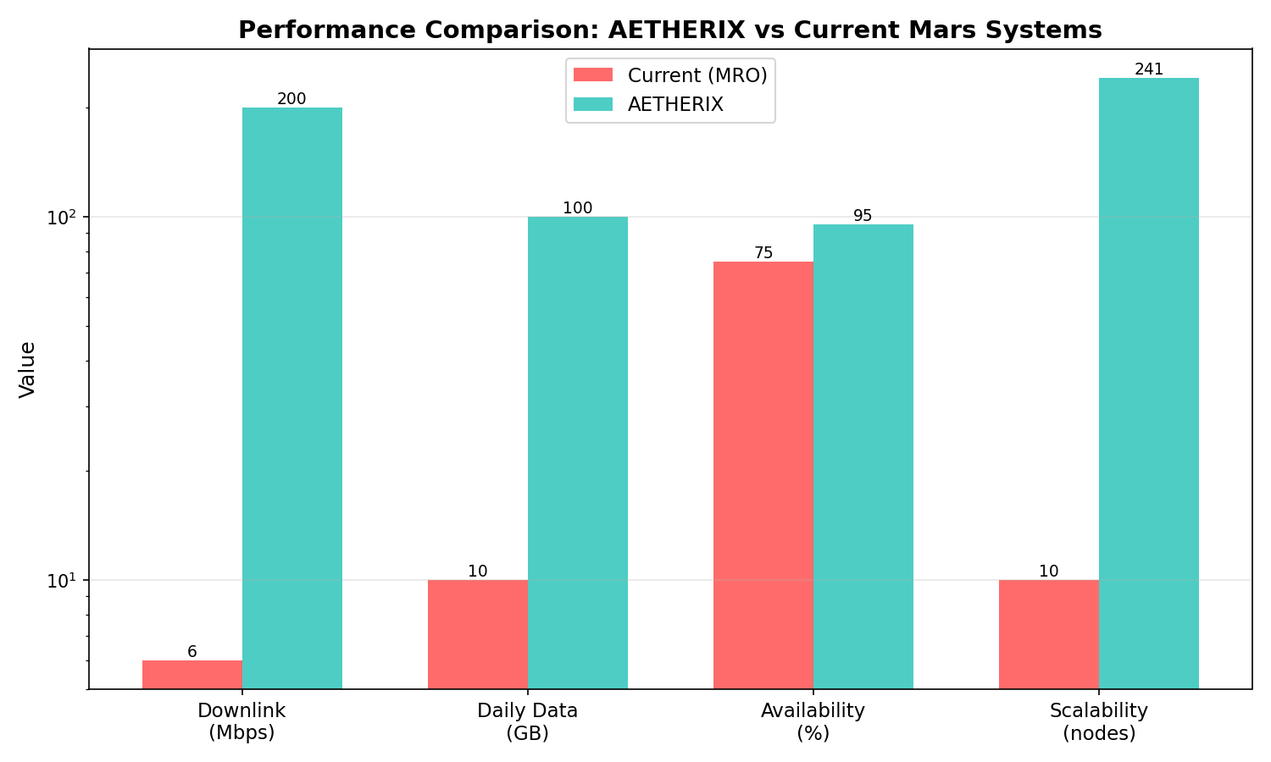
PERFORMANCE COMPARISON
AETHERIX vs Current Systems
10–100× data-rate capability (link budget [A4] vs [1]) · availability/routing are design targets
AETHERIX — Interplanetary Communication Network
24 / 34
[1] NASA MRO · [A4] AETHERIX link_budget.py · [A2] topology.py
Notes:
Summarize the problem and solution clearly. Point to the numbers. Offer to show live demos. (1 minute)

Slide 25
IMPLEMENTATION
What We Built
25
Modules
480
Tests
12
Demos
5
Policies
Core Modules
• Link Budget
• RL Agent
• QKD
• Bundle Protocol
• Topology
• Simulation
Standards Compliance
Standard | Title
RFC 9171 | Bundle Protocol v7
RFC 4838 | DTN Architecture
RFC 5326 | LTP (deep space)
RFC 9172 | BPSec (security)
CCSDS 734.2-B-1 | CCSDS Bundle Protocol
CCSDS 734.3-B-1 | SABR (contact routing)
CCSDS 141.0-B-1 | Optical comms phys.
AETHERIX — Interplanetary Communication Network
25 / 34
[9][10][11][12] IETF RFCs · [2][5] CCSDS standards · [A1]–[A8] AETHERIX modules (github.com/matx104/AETHERIX)
Notes:
Summarize: simulated achievements are 241-node topology, RL routing, QKD security, 200x radiation reduction. Design targets are 10-100x data rate and >95% availability. Invite questions. (30 seconds)

Slide 26
ROADMAP
From Demo to Deployment
Phase 1-4 ✓ Complete
Topology • RL • QKD • Web UI • 480 tests
Phase 5 Network Sim
ns-3 integration, realistic channel models
Phase 6 Production
DQN agent, ION-DTN stack, hardware-in-loop
Phase 7 Hardware
SDR prototyping, optical ground station demo
AETHERIX — Interplanetary Communication Network
26 / 34
[A1]–[A8] AETHERIX source modules · [4] NASA DSOC (Psyche) heritage for optical · DQN/ns-3/ION-DTN on production roadmap

Slide 27
CONCLUSION
AETHERIX Delivers
Problem Solved
TCP/IP can’t work at interplanetary distances
What We Built
BPv7 • RL Routing • QKD • Optical/RF Hybrid
10-100×
Target Speedup ♦
>95%
Availability (target)
RL
Adaptive Routing [A1]
QKD
Quantum Security [13][15]
AETHERIX — Interplanetary Communication Network
27 / 34
[1] NASA · [3] JPL Horizons · [9][12] IETF · [13][15] QKD · [A1][A2][A4][A5][A8] AETHERIX

Slide 28
RADIATION-HARDENED COMPUTING
Surviving the Space Radiation Environment (LO-e)
Effect | What it does | Mitigation
SEU (Single Event Upset) | Bit flip in memory/register | SECDED ECC
MBU (Multiple Bit Upset) | ≥2 adjacent bits flipped | Bit interleaving
SEL (Single Event Latchup) | Parasitic short — destructive | Current limit + power-cycle
TID (Total Ionizing Dose) | Cumulative degradation (krad) | Rad-hard parts (RAD750) [18]
Defense-in-Depth Stack
1. TMR — 3 replicas + majority voter masks single fault
2. SECDED (39,32) ECC — corrects 1, detects 2
3. Memory scrubbing — rewrite before 2nd upset
4. FDIR + watchdog — detect → isolate → reload
5. SAFE-MODE after recovery budget exhausted
DEMONSTRATED — run_simulation Module 6 [A6]
37,159
Raw upsets
200×
Protection factor
3,334×
TMR gain (p=1e-4)
2,127×
RAD750 TID margin
Heritage: NASA RAD750 (Curiosity, Perseverance) [18] · ESA LEON3FT [19] · Code: src/computing/radiation.py [A6] · ~186 residual errors vs 37,159 raw (200×)
AETHERIX — Interplanetary Communication Network
28 / 34
[A6] AETHERIX radiation.py (demonstrated Module 6) · [18] BAE RAD750 · [19] ESA LEON3FT

Slide 29
MISSION-CRITICAL DATA PRIORITIZATION
Bandwidth Triage on a Starved, Intermittent Link (LO-f)
Tier | Class | Examples | BPv7
P0 | Emergency / Safety | Health, collision avoid, faults | EMERGENCY
P1 | Mission-critical | Command ACKs, time-sensitive sci | HIGH_SCIENCE
P2 | High-priority | Routine telemetry, scheduled sci | STANDARD
P4 | Low / Bulk | Housekeeping, file xfer, SW images | BULK
Three Levers
1. Compression (pre-transmit) [7][8]:
Telemetry → CCSDS 121.0-B-3 (Rice) ≈ 3× [7]
Imagery → CCSDS 122.0-B-2 (wavelet) ≈ 10× [8]
2. Deadline-aware preemptive QoS [A7]:
strict priority → earliest deadline; defer if infeasible
3. BPv7 fragmentation [9]:
send what fits; defer rest; link never idle
DEMONSTRATED SCENARIO — src/routing/prioritization.py [A7]
5/6
Items delivered
100%
Link utilisation (target)
41%
SW update fragmented
P0
Emergency preempts
AETHERIX — Interplanetary Communication Network
29 / 34
[A7] AETHERIX prioritization.py · [7] CCSDS 121.0-B-3 · [8] CCSDS 122.0-B-2 · [9] RFC 9171 (fragmentation)

Slide 30
TRADE-OFF ANALYSIS — WHY THESE CHOICES
Every decision traded performance for auditability & reproducibility
Decision | Choice | Rationale (vs alternative)
Optical vs RF | Hybrid 1550 nm + Ka-band fallback [4] | 10–100× throughput [A4]; RF survives clouds & corona
Routing | Custom Q-learning, not ION-DTN CGR [A1] | Adapts to live state; CGR re-plans on stale schedule
RL model | Q-tables now, DQN later (Phase 6) | Every Q-value human-auditable; trains in seconds
State space | Discretised, 241 nodes [A2] | Right-sized for tabular policy; DQN path documented
Reward weights | α=1.0, δ=10.0, ε-decay 0.995 [A1] | Drop penalty 10× delivery to forbid bundle loss
Bottom Line
Each choice sacrifices maximum theoretical performance for auditability and reproducibility — exactly what a defence
and a research artefact require. DQN / ns-3 / ION-DTN are the documented production transition (Phases 7–9).
DSOC heritage: NASA flew optical + RF side-by-side on Psyche [4] — AETHERIX mirrors that hybrid model.
AETHERIX — Interplanetary Communication Network
30 / 34
[A1] rl_agent.py / training.py · [A4] link_budget.py · [4] NASA DSOC (Psyche) · [A2] topology.py

Slide 31
FAILURE & RECOVERY
Autonomous Solar-Conjunction Link-Blackout Survival
Scenario: Earth–Sun–Mars conjunction — corona collapses the 1550 nm link below the 0.3 forward threshold [A1]
Path | Band | Quality | Status | Reward [A8]
Direct Mars → Earth | 1550 nm optical | 0.05 | CLOSED | −1.438
Mars → ES-L4 → Earth | Ka-band RF | 0.65 | OPEN | −0.201
Mars → ES-L5 → Earth | Ka-band RF | 0.60 | OPEN | −0.201
How AETHERIX Recovers (automatically)
1. Detect — optical Q-value collapses (q<0.3)
2. Re-route — agent picks highest-Q: ES-L4
(Ka-band RF, 60° solar elongation, avoids corona)
3. Prioritise — policy engine fires two rules:
P0 EMERGENCY → forward on best (Ka-band) link
P4 BULK → store locally, defer past conjunction
Why Lagrange Relays [3][A2]
ES-L4 / ES-L5 sit 60° ahead/behind Earth.
They keep line-of-sight to Mars around the solar
limb even at true conjunction.
Direct Earth–Mars: 0% availability at conjunction.
Via ES-L4/L5: 50–70% availability retained [A8].
Geometry is Earth-side — no Mars relay solves this.
Outcome: throughput drops (optical→RF) but no mission-critical data lost. Run live: python run_simulation.py --module 4
AETHERIX — Interplanetary Communication Network
31 / 34
[A8] run_simulation Module 4 (−1.438 / −0.201) · [A1] rl_agent.py (0.3 threshold) · [3] JPL Horizons (Lagrange) · [A2] topology.py

Slide 32
REFERENCES
Industry & Scientific Sources [1]–[20] · three-layer attribution: [N] industry · [AN] this project
[1] NASA JPL, Mars Relay Network User's Guide, 2024.
[11] IETF, DTN TCP Convergence Layer, RFC 7242, 2014.
[2] CCSDS, Bundle Protocol Spec., 734.2-B-1, 2021.
[12] IETF, Delay-Tolerant Networking Architecture, RFC 4838, 2007.
[3] JPL Horizons, Earth–Mars Ephemeris, 2025.
[13] Bennett & Brassard, Quantum Cryptography, IEEE ICC, 1984.
[4] NASA, Deep Space Optical Comm. (DSOC), Psyche, 2024.
[14] Ekert, Quantum Cryptography Based on Bell's Theorem, PRL 67, 1991.
[5] CCSDS, Optical Comm. Coding & Sync., 141.0-B-1, 2019.
[15] Shor & Preskill, Simple Proof of Security of BB84, PRL 85, 2000.
[6] CCSDS, TM Space Data Link Protocol, 131.0-B-3, 2017.
[16] NIST, Module-Lattice-Based KEM, FIPS 203, 2024.
[7] CCSDS, Lossless Data Compression, 121.0-B-3, 2020.
[17] NIST, Module-Lattice-Based Digital Signature, FIPS 204, 2024.
[8] CCSDS, Image Data Compression, 122.0-B-2, 2017.
[18] BAE Systems, RAD750 Radiation-Hardened PowerPC, 2024.
[9] IETF, Bundle Protocol Version 7, RFC 9171, 2022.
[19] ESA/Gaisler, LEON3FT Processor, 2023.
[10] IETF, Licklider Transmission Protocol, RFC 5326, 2008.
[20] IETF, RFC 4838 §3.1, 2007 (DTN challenges).
AETHERIX — Interplanetary Communication Network
32 / 34
Full URLs: github.com/matx104/AETHERIX · next slide: project sources [A1]–[A8]

Slide 33
REFERENCES (cont.)
Project Sources [A1]–[A8] · M. A. Tariq, AETHERIX, github.com/matx104/AETHERIX (2025)
[A1] RL Routing Agent — src/routing/rl_agent.py
[A5] QKD Protocol Implementation — src/security/qkd.py
[A2] Network Topology — src/orbital/topology.py
[A6] Radiation Hardening Model — src/computing/radiation.py
[A3] End-to-End Simulation — run_simulation.py Module 3 (RL training)
[A7] Data Prioritization Engine — src/routing/prioritization.py
[A4] Optical Link Budget Calculator — src/infrastructure/link_budget.py
[A8] Failure & Recovery Simulation — run_simulation.py Module 4 (conjunction)
Three-Layer Attribution (resolves the prior citation gap)
Layer A — Industry/scientific baseline [1]–[20] (e.g. NASA MRO 0.5–6 Mbps [1]).
Layer B — This project's design decision [A1]–[A8] (cite the code).
Layer C — Demonstrated simulation results [A6][A8] (cite the run, e.g. radiation 200× [A6]).
Design targets (>95% availability, 2–200 Mbps capability) are labelled as such, never as measured results.
AETHERIX — Interplanetary Communication Network
33 / 34
Reproducible: python run_simulation.py · 480 tests: python -m pytest tests/ -q · matx104.github.io/AETHERIX

Slide 34
THANK YOU
Questions?
10-100×
Target Speedup ♦
>95%
Availability (target)
RL
Adaptive Routing [A1]
QKD
Quantum Security [13][15]
Muhammad Abdullah Tariq
matx104.github.io/AETHERIX | github.com/matx104/AETHERIX

