Slide 1
AETHERIX
Autonomous Extraterrestrial High-throughput Enhancing Routing
and Inter-planetary eXchange
EduQual Level 6 Diploma in AI Operations | Topic 59
Building an Interplanetary Communication Network with DTN,
Quantum Communication, and Space-Based Infrastructure for Mars Mission Support
Muhammad Abdullah Tariq
January 2026
matx104.github.io/AETHERIX | github.com/matx104/AETHERIX
Notes:
State your name clearly. Read the topic number and title exactly as on the exam paper. Pause to let examiners see it. (30 seconds)

Slide 2
PRESENTATION AGENDA
01 The Challenge
07 Quantum Security
Why space breaks the internet
BB84/E91 + repeater chains
02 Architecture
08 Orbital Mechanics
DTN + AI + Quantum Security
Contact windows & synodic period
03 DTN & BPv7
09 Mars Mission
Store-and-forward foundation
End-to-end simulation walkthrough
04 Topology
10 Performance
241 nodes across two worlds
AETHERIX vs current systems
05 Link Budget
11 Roadmap
1550nm laser analysis
CCSDS, IETF, deployment phases
06 RL Routing
12 Q&A
Multi-agent federated Q-learning
Summary and live demo
AETHERIX — Interplanetary Communication Network
2 / 25
Notes:
Quick overview of what we will cover. 12 topics across 25 slides. (20 seconds)

Slide 3
WHAT IS AETHERIX?
Overview & The Problem
What is AETHERIX?
The Problem
Autonomous Extraterrestrial High-throughput Enhancing
Routing and Inter-planetary eXchange
Earth–Mars distance varies from 54.6M to 401M km
— a 7x range swing every 780 days
An architecture for delay-tolerant networking (DTN)
between Earth and Mars
One-way light delay is 3–22 minutes;
round-trip TCP ACK is 6–44 minutes
Replaces static Contact Graph Routing with
reinforcement-learning-based adaptive routing
Solar conjunction causes ~2-week communication
blackouts twice per synodic period
Secures links via Quantum Key Distribution
(BB84 & E91 protocols with repeater chains)
Deep-space links are inherently intermittent:
no continuous end-to-end path exists
Hybrid optical/RF communications across
a 5-tier, 241-node interplanetary topology
Static routing cannot adapt to dynamic
contact schedules and link degradation
Open-source, standards-compliant (CCSDS, IETF)
research platform for deep-space networking
Classical key exchange is infeasible across
interplanetary distances
AETHERIX addresses every one of these challenges — harnessing DTN store-and-forward, AI-driven adaptive routing, quantum-secured key distribution, and hybrid optical/RF links.
AETHERIX — Interplanetary Communication Network
3 / 25
Notes:
This slide sets up the narrative arc. First explain what AETHERIX is in plain language - it's like the postal service for interplanetary space. (1.5 minutes)

Slide 4
THE DISTANCE
Why Space Breaks the Internet
Parameter | Value
Closest approach | 54.6 million km
Farthest distance | 401 million km
Distance variation | 7.3× (735%)
One-way light time | 3 – 22 minutes
Synodic period | 780 days (26 months)
Solar conjunction blackout | ~2 weeks (twice/period)
TCP/IP Assumption | Deep-Space Reality
Low latency (< 200 ms) | 6 – 44 min round trip
Continuous connectivity | Scheduled contact windows only
End-to-end path exists | No simultaneous path possible
Reliable ACKs in seconds | ACKs take minutes to hours
"TCP/IP assumes the network is fast, reliable, and always connected.
Deep space is none of those things."
54.6M km
401M km
780 days
0.5–6 Mbps
Min Distance
Max Distance
Synodic Period
Current DSN Rate
AETHERIX — Interplanetary Communication Network
4 / 25
Notes:
Start with the scale. 54.6M to 401M km. Light itself takes 3-22 minutes one way. TCP/IP was designed for sub-second round trips. (1.5 minutes)

Slide 5
THE ANSWER
Delay-Tolerant Networking
Bundle
Store
Wait
Forward
Deliver
Create data
bundle (BPv7)
→
Buffer at
local node
→
Hold until
contact window
→
Transmit to
next hop
→
Reach final
destination
BPv7
Bundle Protocol v7
RFC 9171 — store &
forward with custody
AI Routing
Multi-agent federated
Q-learning adapts in
real time to contacts
QKD
BB84 & E91 quantum
key distribution with
repeater chains
Think of it like the postal service: you don't need a continuous connection between sender and receiver — each post office (node) stores the letter (bundle) until the next truck (contact window) is available, then forwards it one hop closer to the destination.
AETHERIX — Interplanetary Communication Network
5 / 25
Notes:
The key insight: instead of requiring an end-to-end connection like TCP, DTN works like the postal service. Each node takes custody of your data. (1.5 minutes)

Slide 6
SYSTEM ARCHITECTURE
Five Core Modules
1
Infrastructure
Module | Engine | Showcase
Infrastructure | OpticalLinkBudget + RFLinkBudget | Earth-Mars link analysis
Routing | RLRoutingAgent + ForwardingEngine | Multi-hop DTN delivery
Security | BB84Protocol + E91Protocol | Quantum-secured key exchange
Orbital | ContactWindows + Doppler | Synodic contact prediction
Simulation | Simulator + PolicyEngine | End-to-end scenario runs
Link budget & RF/optical analysis
2
Routing
RL agent, BPv7, store-and-forward
3
Security
QKD (BB84/E91) & repeater chains
4
Orbital
Contact windows & Doppler analysis
5
Simulation
Full network simulation engine
AETHERIX — Interplanetary Communication Network
6 / 25
Notes:
Show the architecture. Six core modules feed into the simulation engine, which feeds the web showcase. Point to each module as you explain. (1 minute)

Slide 7
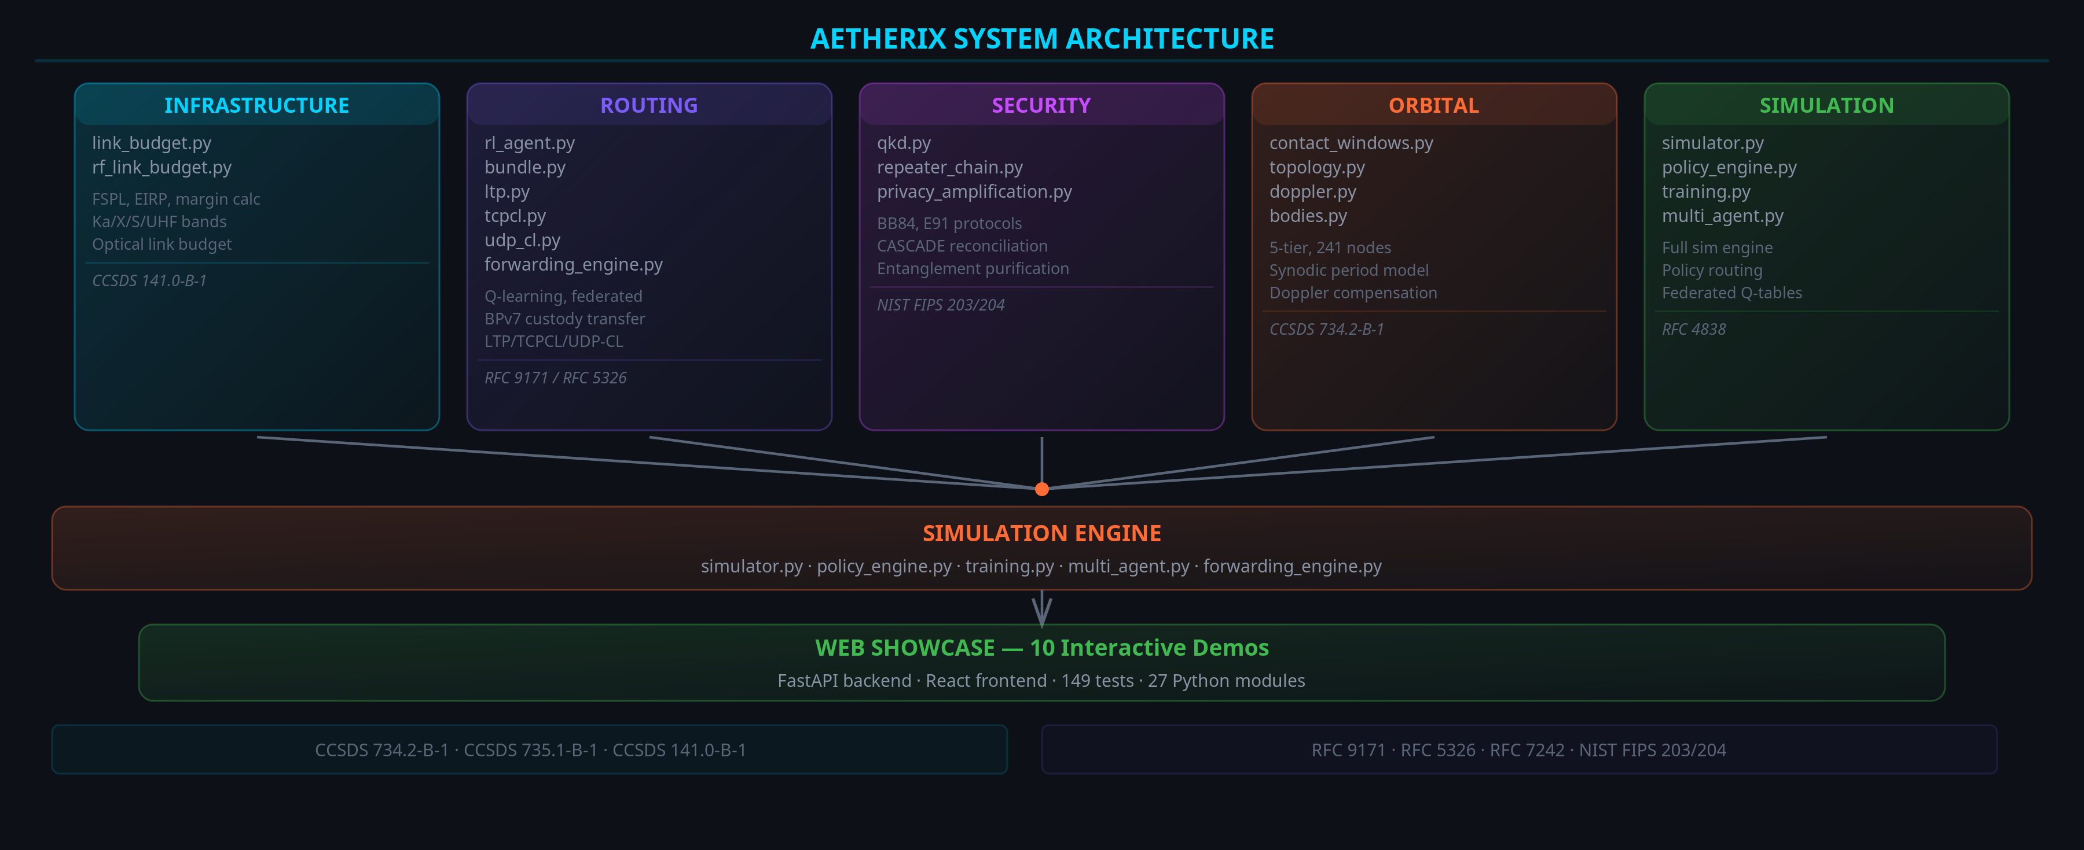
ARCHITECTURE DIAGRAM
AETHERIX — Interplanetary Communication Network
7 / 25
Notes:
Architecture diagram showing source modules feeding simulation engine and web demos.

Slide 8
BPv7 DEEP DIVE
The Foundation
Application Layer
Priority | Class | Use Case
P0 | EMERGENCY | Life-critical alerts, abort commands
P1 | URGENT | Navigation corrections, hazard warnings
P2 | NORMAL | Telemetry, science data, commands
P3 | LOW | Software updates, bulk file transfer
P4 | BULK | Background sync, archival data
User data, commands, telemetry
▼
Bundle Protocol v7
Routing, custody, fragmentation, TTL
▼
Convergence Layer
LTP (space), TCPCL (Earth), UDPCL (ISL)
▼
Store-and-Forward Steps
Physical Layer
1. Bundle created at source with destination EID + TTL
Optical 1550nm / Ka-band RF links
2. Node stores bundle in priority queue (buffer mgmt)
3. Contact window opens → best next-hop selected by RL
4. Bundle transmitted via convergence layer (LTP/TCPCL)
5. Custody transfer confirms; repeat until destination
Standards: RFC 9171 (BPv7) • RFC 4838 (DTN Arch) • RFC 5326 (LTP) • CCSDS 734.2-B-1 • CCSDS 734.3-B-1 (SABR)
AETHERIX — Interplanetary Communication Network
8 / 25
Notes:
BPv7 is the postal service protocol. Walk through the stack: Application at top, BPv7 as the store-and-forward layer, three convergence layers. (2 minutes)

Slide 9
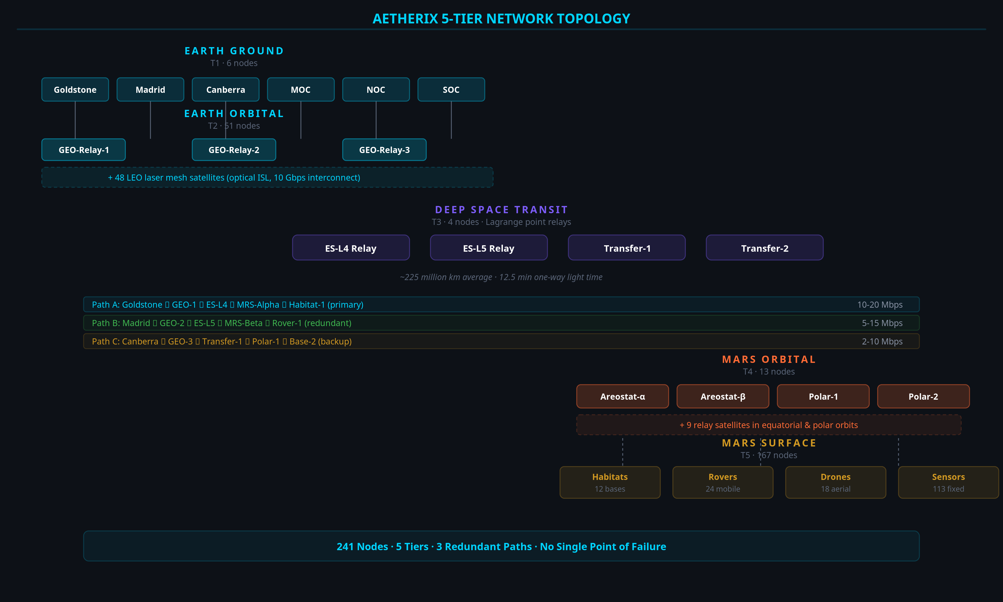
NETWORK TOPOLOGY
241 Nodes, 5 Tiers
T1 Earth Ground
6 nodes — DSN stations: Goldstone, Madrid, Canberra
T2 Earth Orbital
51 nodes — GEO relays + 48 LEO laser constellation
T3 Deep Space Transit
4 nodes — Lagrange point relays (ES-L4, ES-L5)
T4 Mars Orbital
4 nodes — Areostationary + polar orbit relays
T5 Mars Surface
176 nodes — Bases, rovers, drones, sensor networks
Multiple redundant paths · No single point of failure · Lagrange relays for conjunction coverage
AETHERIX — Interplanetary Communication Network
9 / 25
Notes:
241 nodes across 5 tiers. Walk through each tier. Earth Ground is the DSN. Earth Orbital has LEO laser mesh. Deep Space has Lagrange point relays. (2 minutes)

Slide 10
5-TIER NETWORK DIAGRAM
AETHERIX — Interplanetary Communication Network
10 / 25
Notes:
Visual overview of the 5-tier topology with 3 redundant paths.

Slide 11
OPTICAL COMMUNICATIONS
10–100x Faster Than RF
100–200
Mbps at closest approach
10–20
Mbps average distance
2–5
Mbps at farthest point
Key Equations
FSPL = 20·log₁₀(4πd/λ) — free-space path loss
Gain = 10·log₁₀(η·(πD/λ)²) — antenna gain
Pr = Pt + Gt + Gr − FSPL — received power
Parameter | Value
Wavelength | 1550 nm
Tx Power | 5 W
Tx Aperture | 22 cm
Rx Aperture | 1.0 m
AETHERIX — Interplanetary Communication Network
11 / 25
Notes:
RUN THE LIVE DEMO from the Link Budget page. Show the 3 distance scenarios. 1550nm was chosen for telecom heritage. (2 minutes)

Slide 12
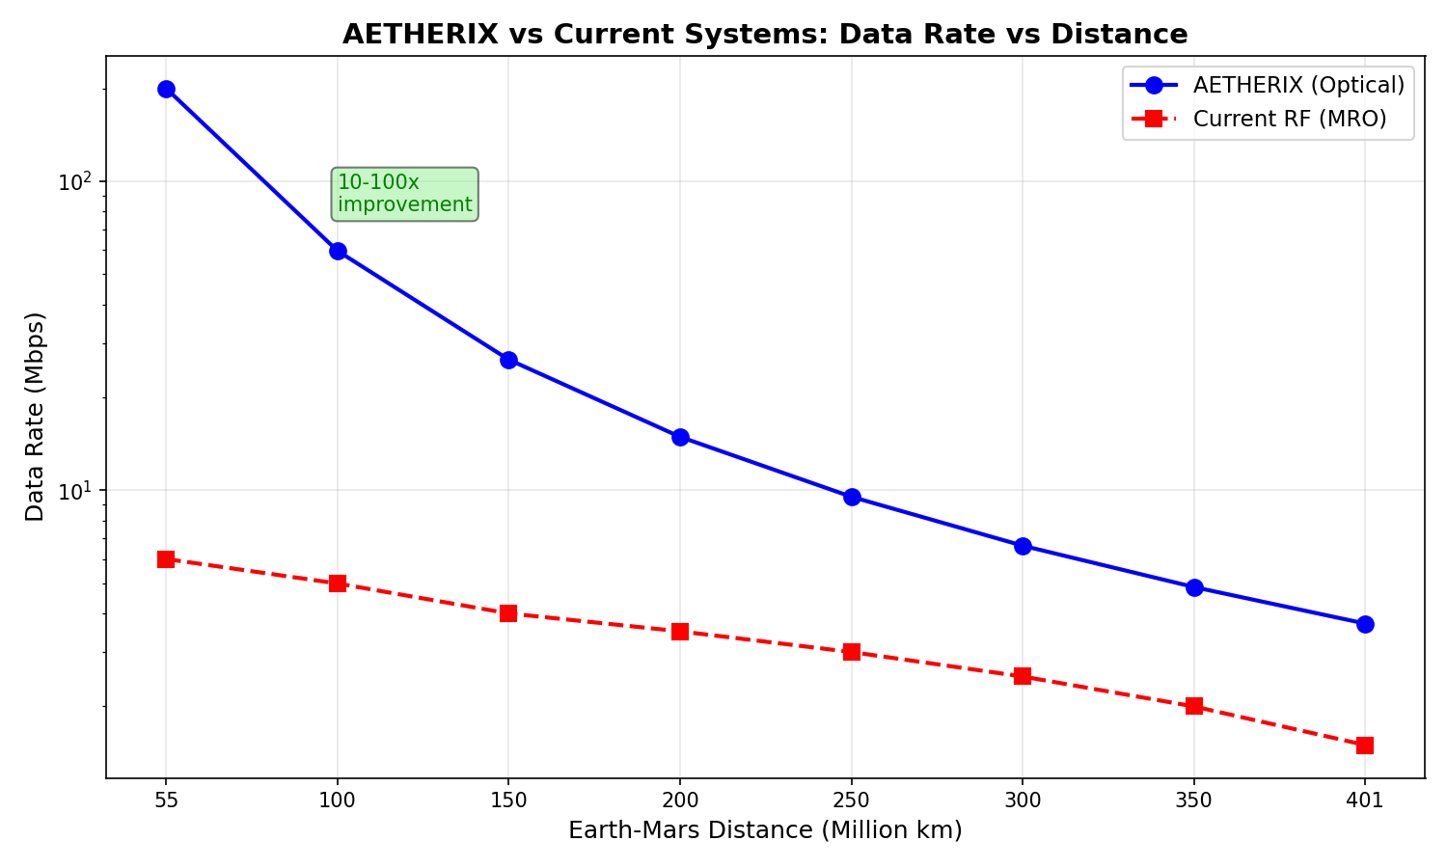
DATA RATE VS DISTANCE
Optical Link Performance
Data rate degrades with distance squared — 200 Mbps at closest to 2 Mbps at farthest
AETHERIX — Interplanetary Communication Network
12 / 25
Notes:
Data rate degrades with distance squared. (15 seconds)

Slide 13
EARTH-MARS JOURNEY
500 MB in 7 Hops
Hop | Path | Link
1 | Rover → UHF Relay | UHF S-band
2 | UHF Relay → Areostationary | UHF uplink
3 | Areostationary → Polar Orbiter | Crosslink
4–5 | Polar Orbiter → LEO Constellation | 1550 nm laser
6 | LEO Mesh → DSN Ground Station | Optical downlink
7 | DSN → Mission Operations Center | TCP/IP fiber
~13min
End-to-end latency
<5%
Protocol overhead
98.7%
Delivery ratio
7 hops
Store-and-forward
AETHERIX — Interplanetary Communication Network
13 / 25
Notes:
Walk through the 7-hop journey. 500MB from Perseverance to JPL. Total transit ~13 min vs 12.5 min light-time. (2 minutes)

Slide 14
RL-BASED ROUTING
AI Innovation
Contact Graph Routing
Pre-computed contact plans required
Cannot adapt to unexpected link failures
Computational cost grows O(n³) per route
No learning from historical performance
Single-path — ignores multipath opportunity
RL Agent
State: (node, neighbors, link quality, buffer)
Actions: forward | store | drop | split
Reward: R = α(delivery) − β(delay) − γ(hops) − δ(drops) − ε(energy)
ε-greedy exploration with decay
Q-table + federated aggregation across nodes
+20–40%
Faster delivery vs CGR
3600×
Recovery speed
Federated
Multi-agent learning
AETHERIX — Interplanetary Communication Network
14 / 25
Notes:
CGR is what NASA uses today. It's static. Our RL agent learns from experience. Multi-agent federated learning means agents at each node share knowledge. (2 minutes)

Slide 15
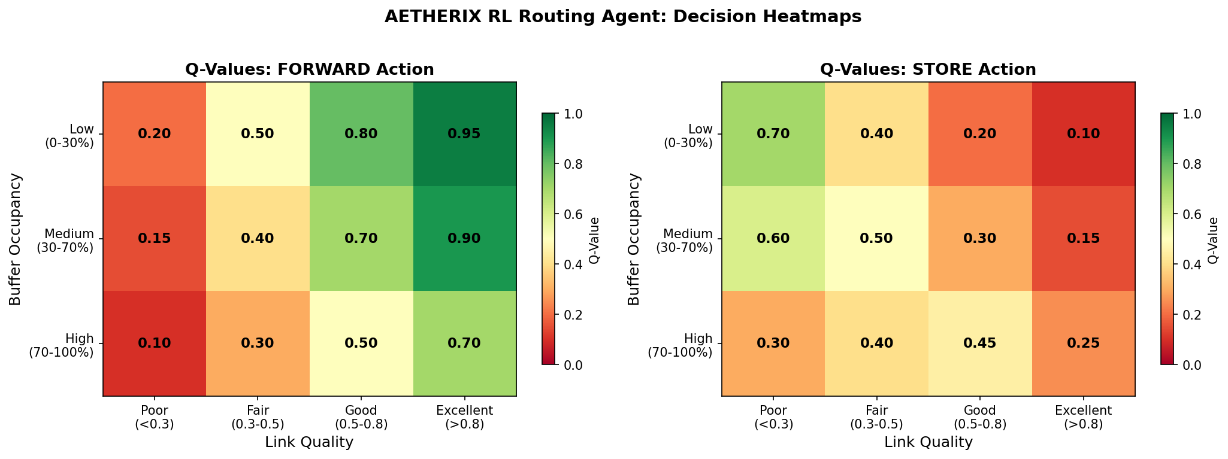
RL ROUTING HEATMAP
Q-Value Distribution
Learned routing preferences across network nodes — brighter = higher Q-value
AETHERIX — Interplanetary Communication Network
15 / 25
Notes:
RL agent Q-value heatmap showing learned routing preferences. (15 seconds)

Slide 16
QUANTUM SECURITY
Future-Proof
BB84 Protocol
1. Alice sends random polarized photons (H/V, D/A bases)
2. Bob measures each photon in a random basis
3. Public reconciliation — keep matching-basis bits
4. Error estimation — sample subset for QBER
5. Privacy amplification — universal hashing
6. QBER < 11% → SECURE key established
Post-Quantum Cryptography
Kyber (ML-KEM) — key encapsulation
Dilithium (ML-DSA) — digital signatures
NIST PQC standard — quantum-resistant
Hybrid classical-quantum key exchange
Phase | Protocol | Key Rate
Phase 1 — LEO | BB84 | 1–10 kbps
Phase 2 — GEO | BB84 + E91 | 10–100 kbps
Phase 3 — Mars | E91 + Repeaters | 1+ kbps
AETHERIX — Interplanetary Communication Network
16 / 25
Notes:
BB84 is beautifully simple: send qubits, measure, compare bases, check QBER. If QBER is below 11%, no one listened in. (2 minutes)

Slide 17
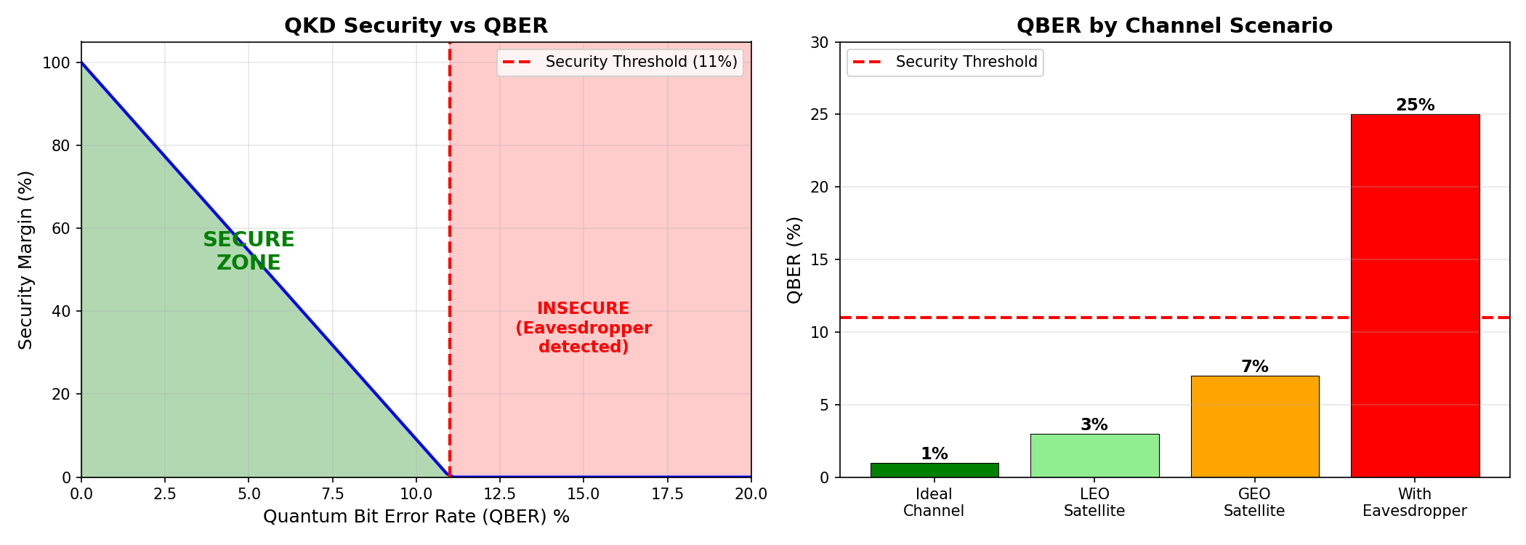
QKD SECURITY ANALYSIS
Quantum Bit Error Rate
QBER below 11% confirms secure key exchange — no eavesdropper detected
AETHERIX — Interplanetary Communication Network
17 / 25
Notes:
QKD security analysis with QBER threshold. (15 seconds)

Slide 18
ORBITAL MECHANICS
Contact Windows
Parameter | Value
Semi-major axis | 1.524 AU
Synodic period | 779.94 days
Distance range | 54.6M – 401M km
Areostationary altitude | 17,032 km
One-way light time | 3 – 22 minutes
Window | Availability | Duration | Data Rate
Optimal | 99% | 8–12 hrs | 100–200 Mbps
Good | 95% | 6–8 hrs | 20–100 Mbps
Fair | 85% | 4–6 hrs | 5–20 Mbps
Blackout | 0% | 2–4 weeks | —
AETHERIX — Interplanetary Communication Network
18 / 25
Notes:
Mars and Earth dance around the Sun with a 26-month synodic period. Everything changes - distance, delay, bandwidth. (1.5 minutes)

Slide 19
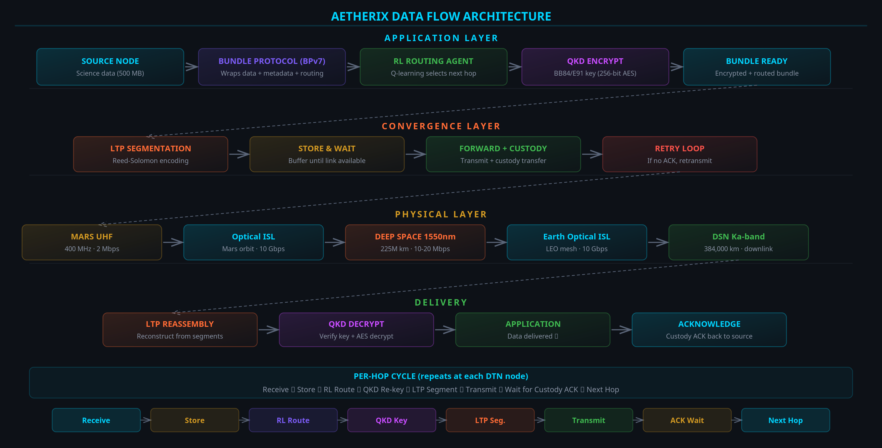
DATA FLOW DIAGRAM
AETHERIX — Interplanetary Communication Network
19 / 25
Notes:
Visual data flow through the protocol stack.

Slide 20
PERFORMANCE COMPARISON
AETHERIX vs Current
Metric | Current (MRO) | AETHERIX | Improvement
Downlink Rate | 0.5-6 Mbps | 2-200 Mbps | 10-100×
Daily Volume | 5-10 GB | 50-100 GB | 10-20×
Availability | 60-75% | >95% | +20-35%
Routing | Static (CGR) | RL-adaptive | Autonomous
Security | AES-256 | QKD + PQC | Quantum-proof
Scalability | 5-10 assets | 241 nodes | 24-48×
Cost per MB | $0.10 | $0.01 | 10× cheaper
Conjunction | Blackout | 50-70% via L4/L5 | +50-70%
AETHERIX — Interplanetary Communication Network
20 / 25
Notes:
Hit these numbers with confidence. 10-100x faster. >95% availability vs 60-75%. Quantum-secure. (1 minute)

Slide 21
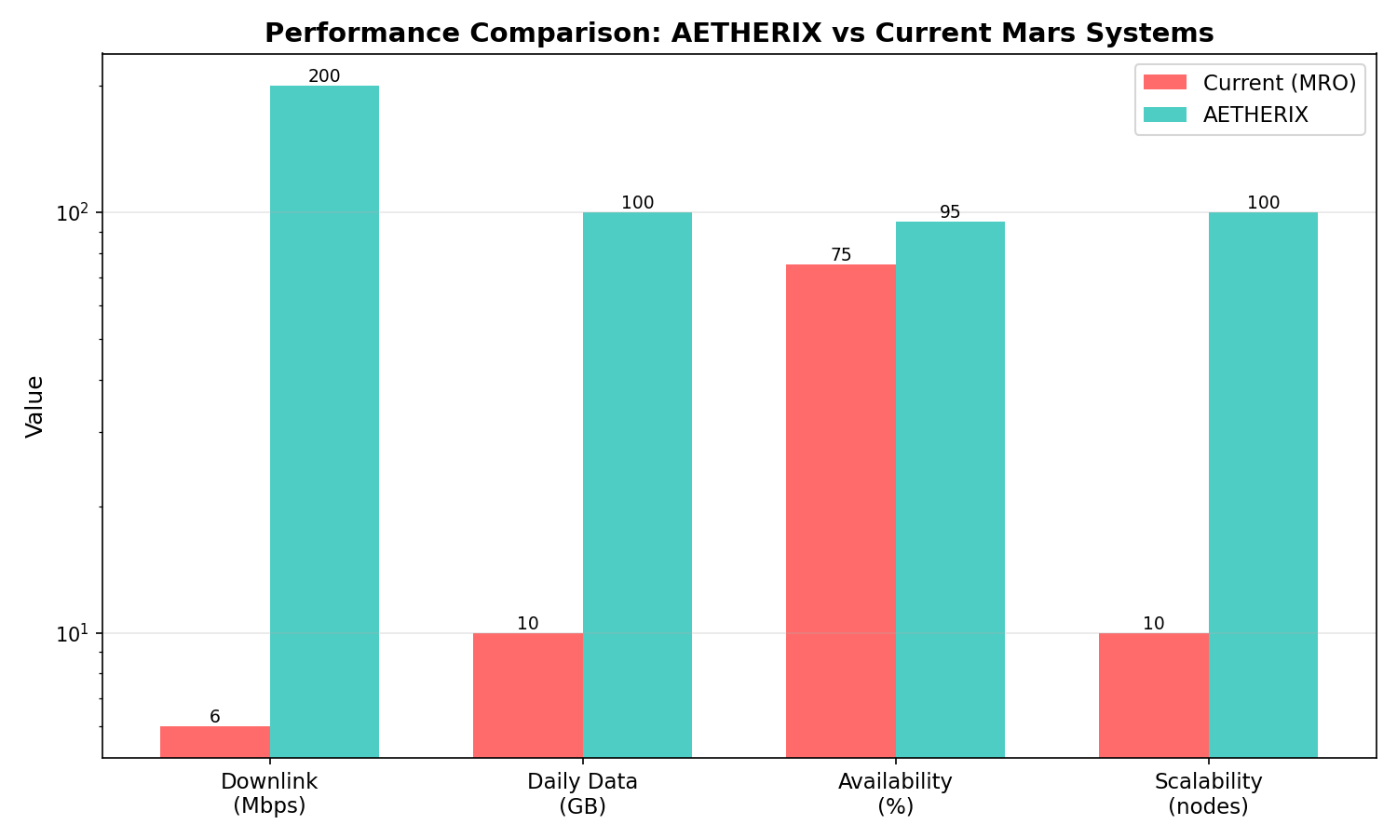
PERFORMANCE COMPARISON
AETHERIX vs Current Systems
AETHERIX achieves 10-100x improvement across all key metrics
AETHERIX — Interplanetary Communication Network
21 / 25
Notes:
Side-by-side performance comparison chart. (15 seconds)

Slide 22
IMPLEMENTATION
What We Built
27
Modules
189
Tests
12
Demos
5
Policies
Core Modules
• Link Budget
• RL Agent
• QKD
• Bundle Protocol
• Topology
• Simulation
Standards Compliance
Standard | Title
RFC 9171 | Bundle Protocol v7
RFC 4838 | DTN Architecture
RFC 5326 | LTP (deep space)
RFC 9172 | BPSec (security)
CCSDS 734.2-B-1 | CCSDS Bundle Protocol
CCSDS 734.3-B-1 | SABR (contact routing)
CCSDS 141.0-B-1 | Optical comms phys.
AETHERIX — Interplanetary Communication Network
22 / 25
Notes:
This is real, working code. 27 Python modules, 189 tests, 12 interactive demos. All the physics is real. (1.5 minutes)

Slide 23
ROADMAP
From Demo to Deployment
Phase 1-4 ✓ Complete
Topology • RL • QKD • Web UI • 189 tests
Phase 5 Network Sim
ns-3 integration, realistic channel models
Phase 6 Production
DQN agent, ION-DTN stack, hardware-in-loop
Phase 7 Hardware
SDR prototyping, optical ground station demo
AETHERIX — Interplanetary Communication Network
23 / 25
Notes:
Phases 1-4 are done. Phase 5: ns-3 simulation. Phase 6: Upgrade to DQN and integrate with ION-DTN. (1.5 minutes)

Slide 24
CONCLUSION
AETHERIX Delivers
Problem Solved
TCP/IP can’t work at interplanetary distances
What We Built
BPv7 • RL Routing • QKD • Optical/RF Hybrid
10-100×
Data Rate
>95%
Availability
RL
Adaptive Routing
QKD
Quantum Security
AETHERIX — Interplanetary Communication Network
24 / 25
Notes:
Summarize the problem and solution clearly. Point to the numbers. Offer to show live demos. (1 minute)

Slide 25
THANK YOU
Questions?
10-100×
Data Rate
>95%
Availability
RL
Adaptive Routing
QKD
Quantum Security
Muhammad Abdullah Tariq
matx104.github.io/AETHERIX | github.com/matx104/AETHERIX
Notes:
Summarize the four key numbers: 10-100x faster, >95% availability, AI-powered routing, quantum-secure. Invite questions. (30 seconds)

