Slide 1
Industrial Control System:
Attack & Defence on Modbus and HTTP
Ziyao Wang
Notes:
Purpose and background

Slide 2
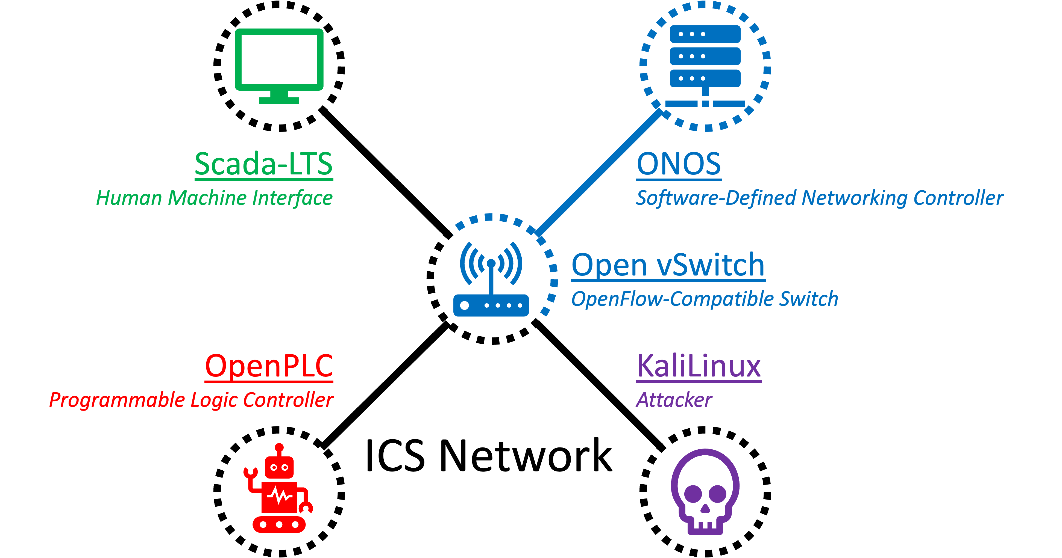
Industrial Control System: Attack & Defence on Modbus and HTTP
1.1 Purpose and Background
Notes:
Purpose and background

Slide 3
Industrial Control System: Attack & Defence on Modbus and HTTP
Machine Learning
Multipath Routing
Moving Target Defence
Deliwala, P. et al. purposed an SDN approach using machine learning to detect the link flooding attack in ICS.
Ndonda, GK. and Sadre, R. put forward an SDN-based multipath routing algorithm to prevent eavesdropping in ICS.
Wang, F. et al. presented an active SDN countermeasure based on moving target defence.
Inspection-based Slow HTTP Defence
Hong, K. et al. designed a countermeasure against slow HTTP attack based on incomplete HTTP requests with long timeout.
Flow-based Traffic Blocking Criteria
Byun, M. et al. discussed the traffic blocking based on IP and ingress port against IP spoofing.
1.2 Prior Work
Notes:
Their prior work is too generalised without specific consideration of Modbus/TCP protocol, or too complex for slow HTTP attack.

Slide 4
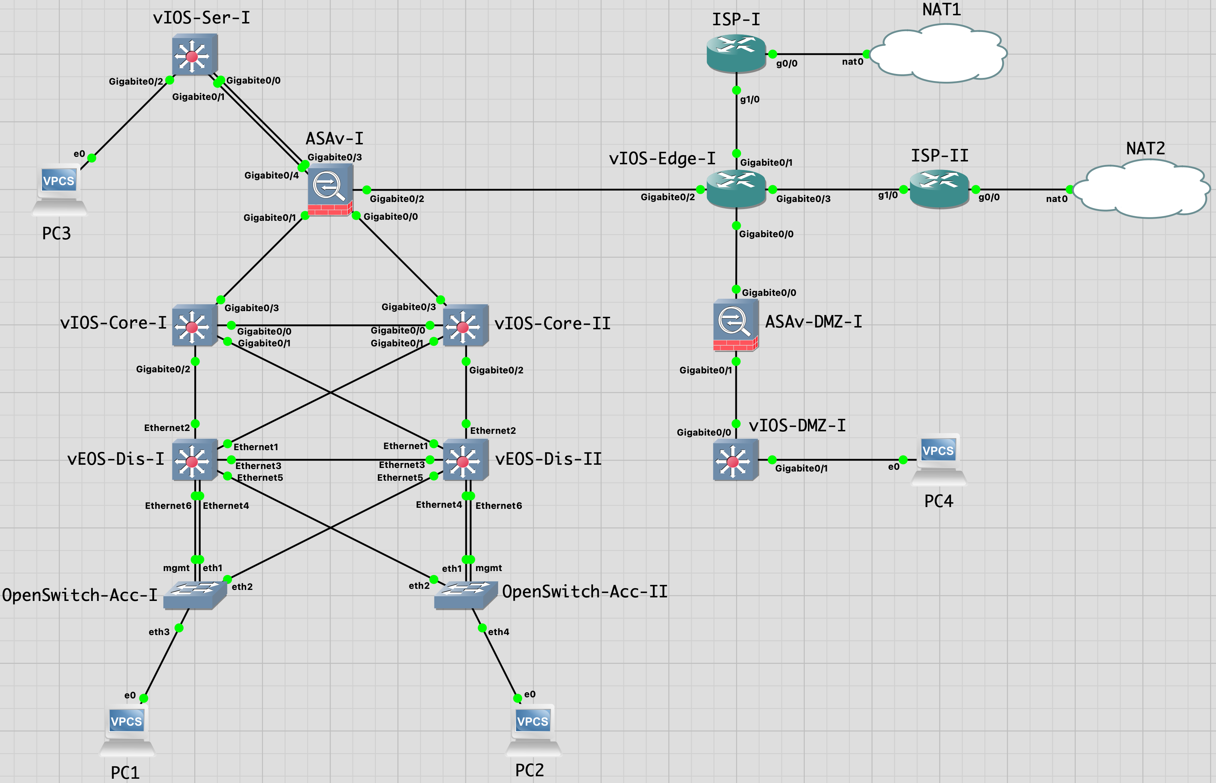
Data Centre
ASAv
Firewall
2.1 Construction of Base Network
Demilitarised Zone (DMZ)
Core
Generic Base Network
Notes:
Finished work: 1. ICS network appliances, deployment, and configuration; 2. Scada-LTS controls OpenPLC; 3. KaliLinux attacks OpenPLC via Modbus/TCP;
ASAv: OSPF, ACLs

Slide 5
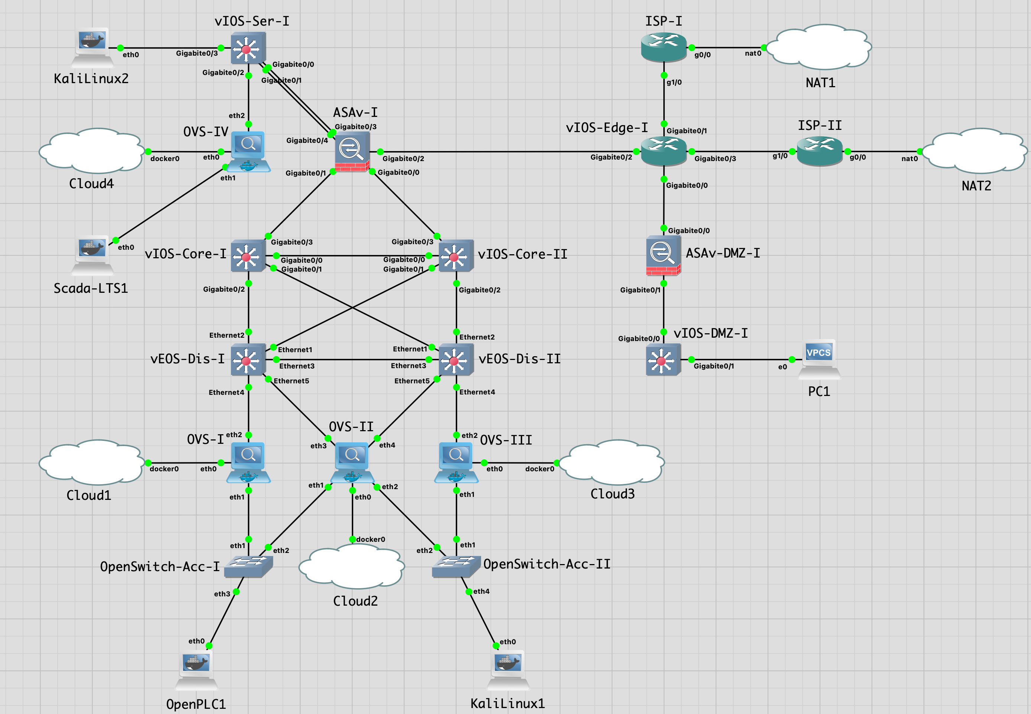
(i) Location of OpenPLC and Scada-LTS
KaliLinux2
Attacker
(ii) Possible Location of KaliLinux (Attacker)
Open vSwitch-IV
Switch
(iii) Location of Open vSwitch (Defender)
Scada-LTS
Monitor
2.2 Construction of ICS Network
Open vSwitch-I
Switch
Open vSwitch-III
Switch
ICS Network
Open vSwitch-II
Switch
OpenPLC
Controller
KaliLinux1
Attacker
Notes:
Consider location of KaliLinux and OVSes

Slide 6
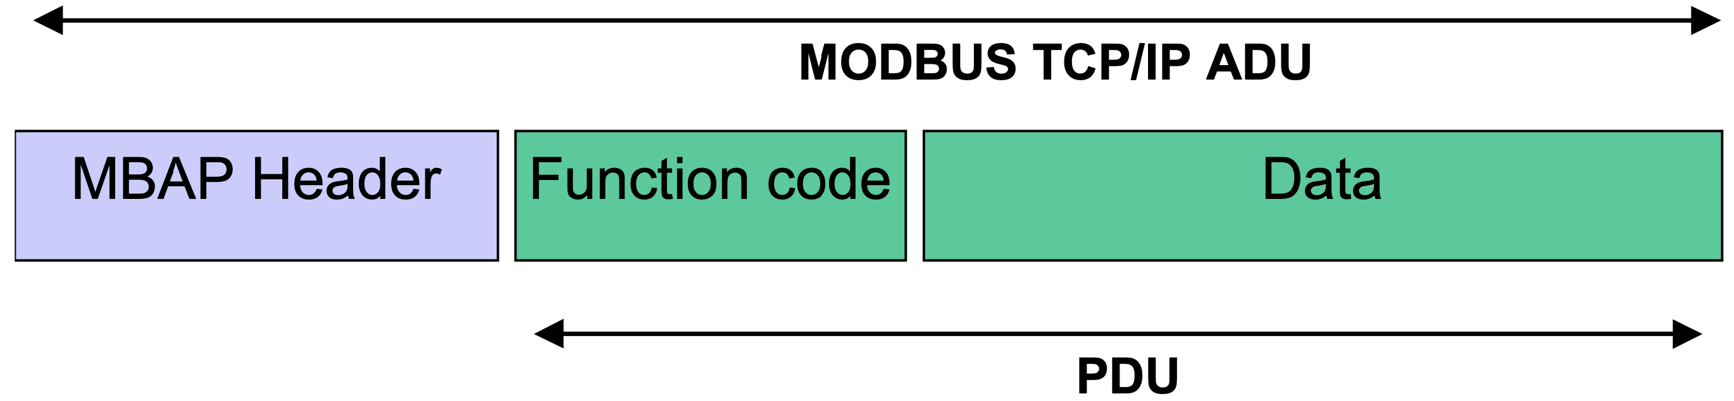
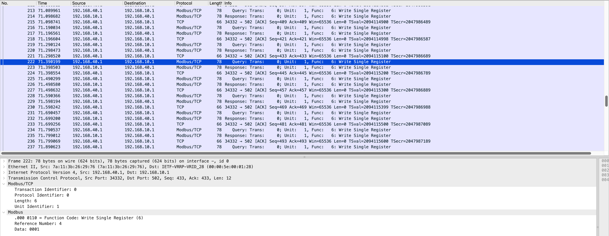
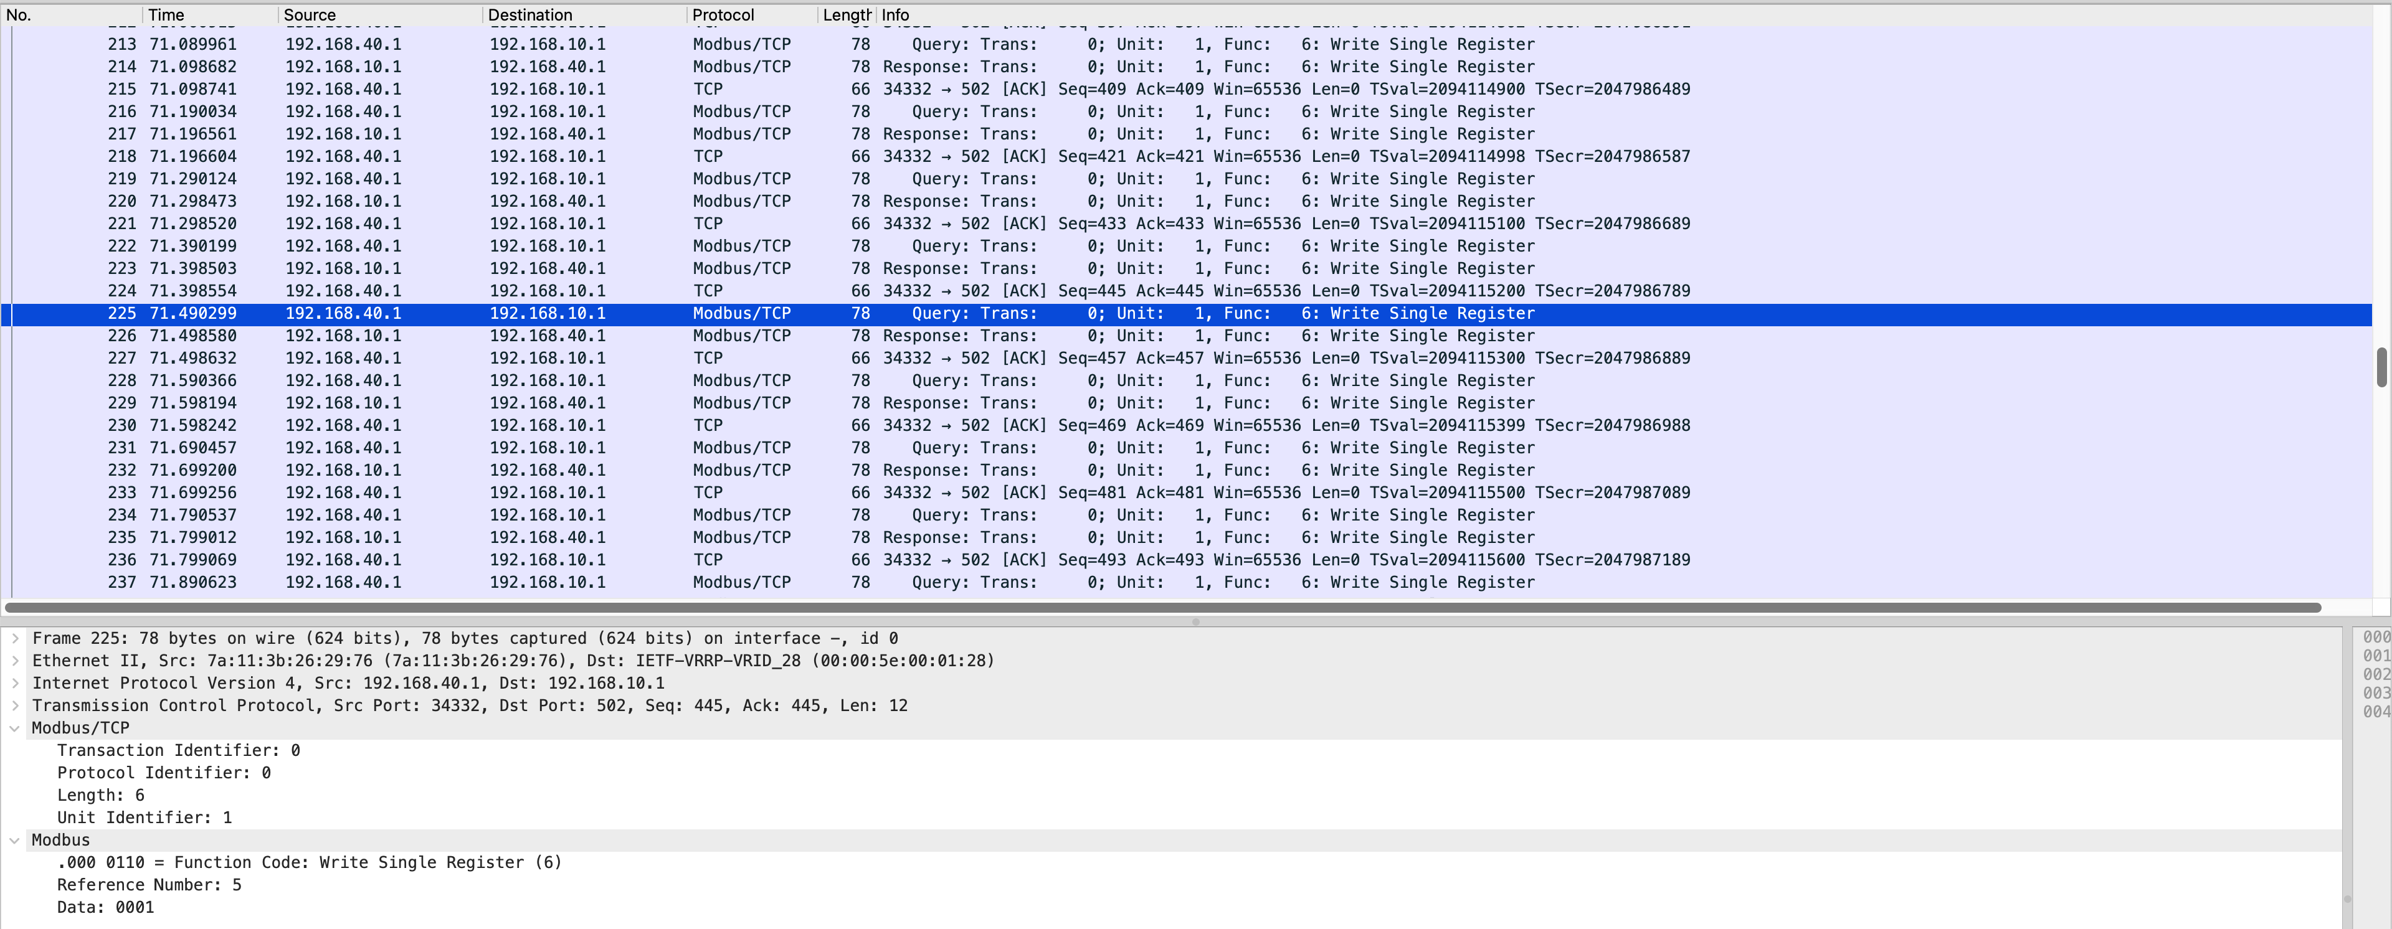
3.1 Modbus Attack
(i) Mechanism of Modbus Attack
(ii) Countermeasure against Modbus Attack
(iii) Implementation of the Countermeasure
Notes:
Ref 4 Data 0001 -> manual mode; Ref 5 Data 0001 -> heater on

Slide 7
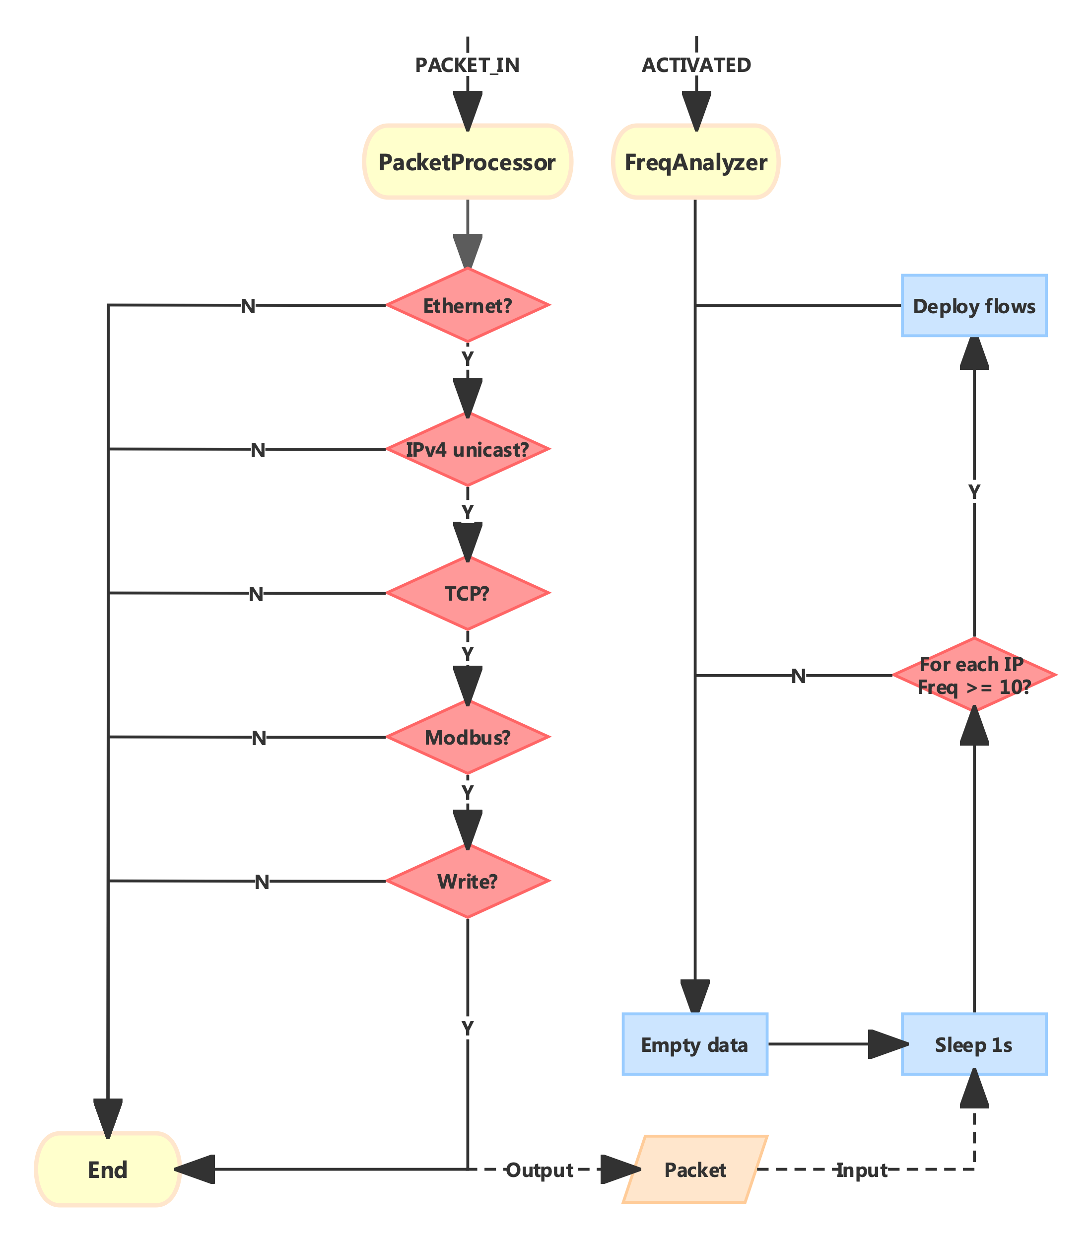
SDN Defence App:
Modbus Attack
Packet Processor
Frequency Analyser
Notes:
Consider detection interval between cycles, threshold, and flow matching criteria

Slide 8
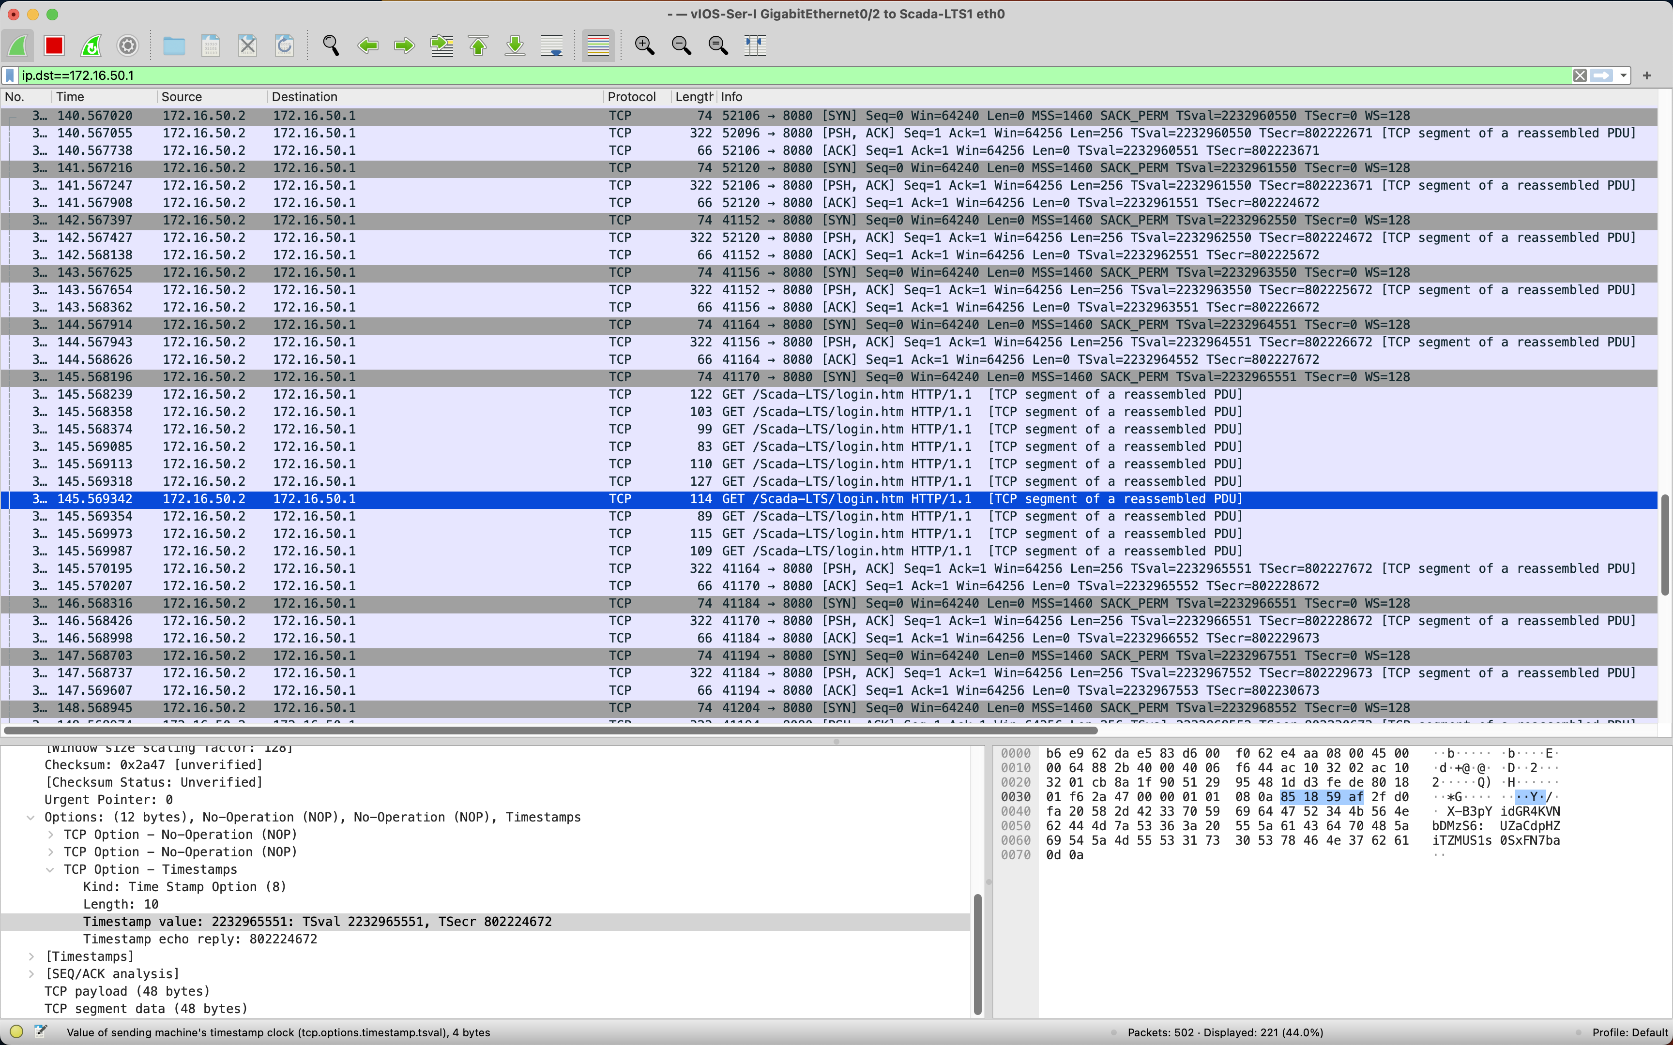
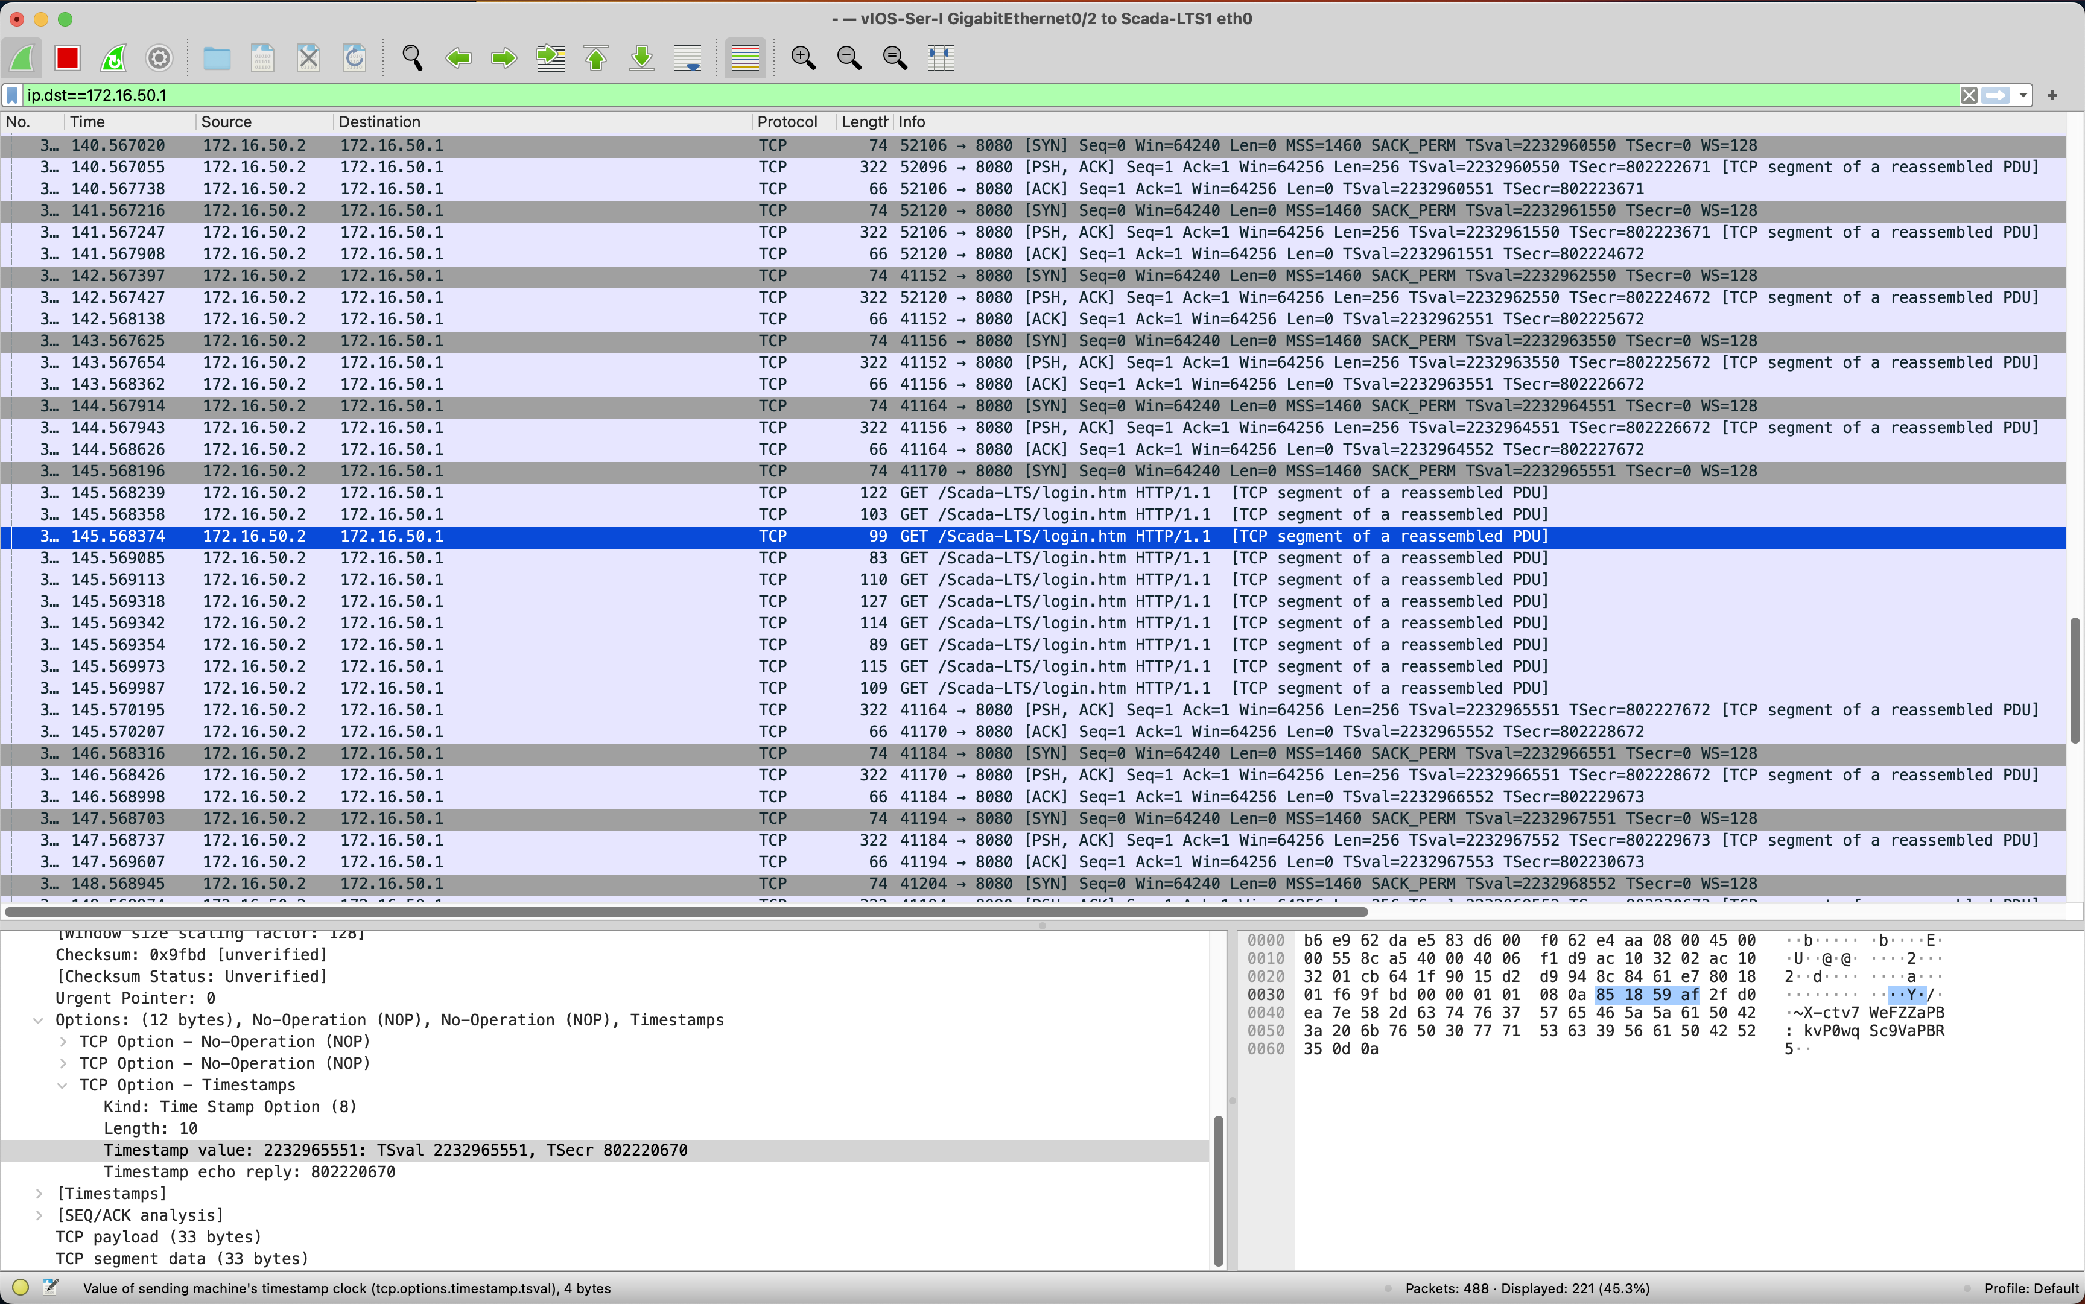

3.2 HTTP Attack
(i) Mechanism of HTTP Attack
(ii) Countermeasure against HTTP Attack
(iii) Implementation of the Countermeasure
Notes:
Ref 4 Data 0001 -> manual mode; Ref 5 Data 0001 -> heater on

Slide 9
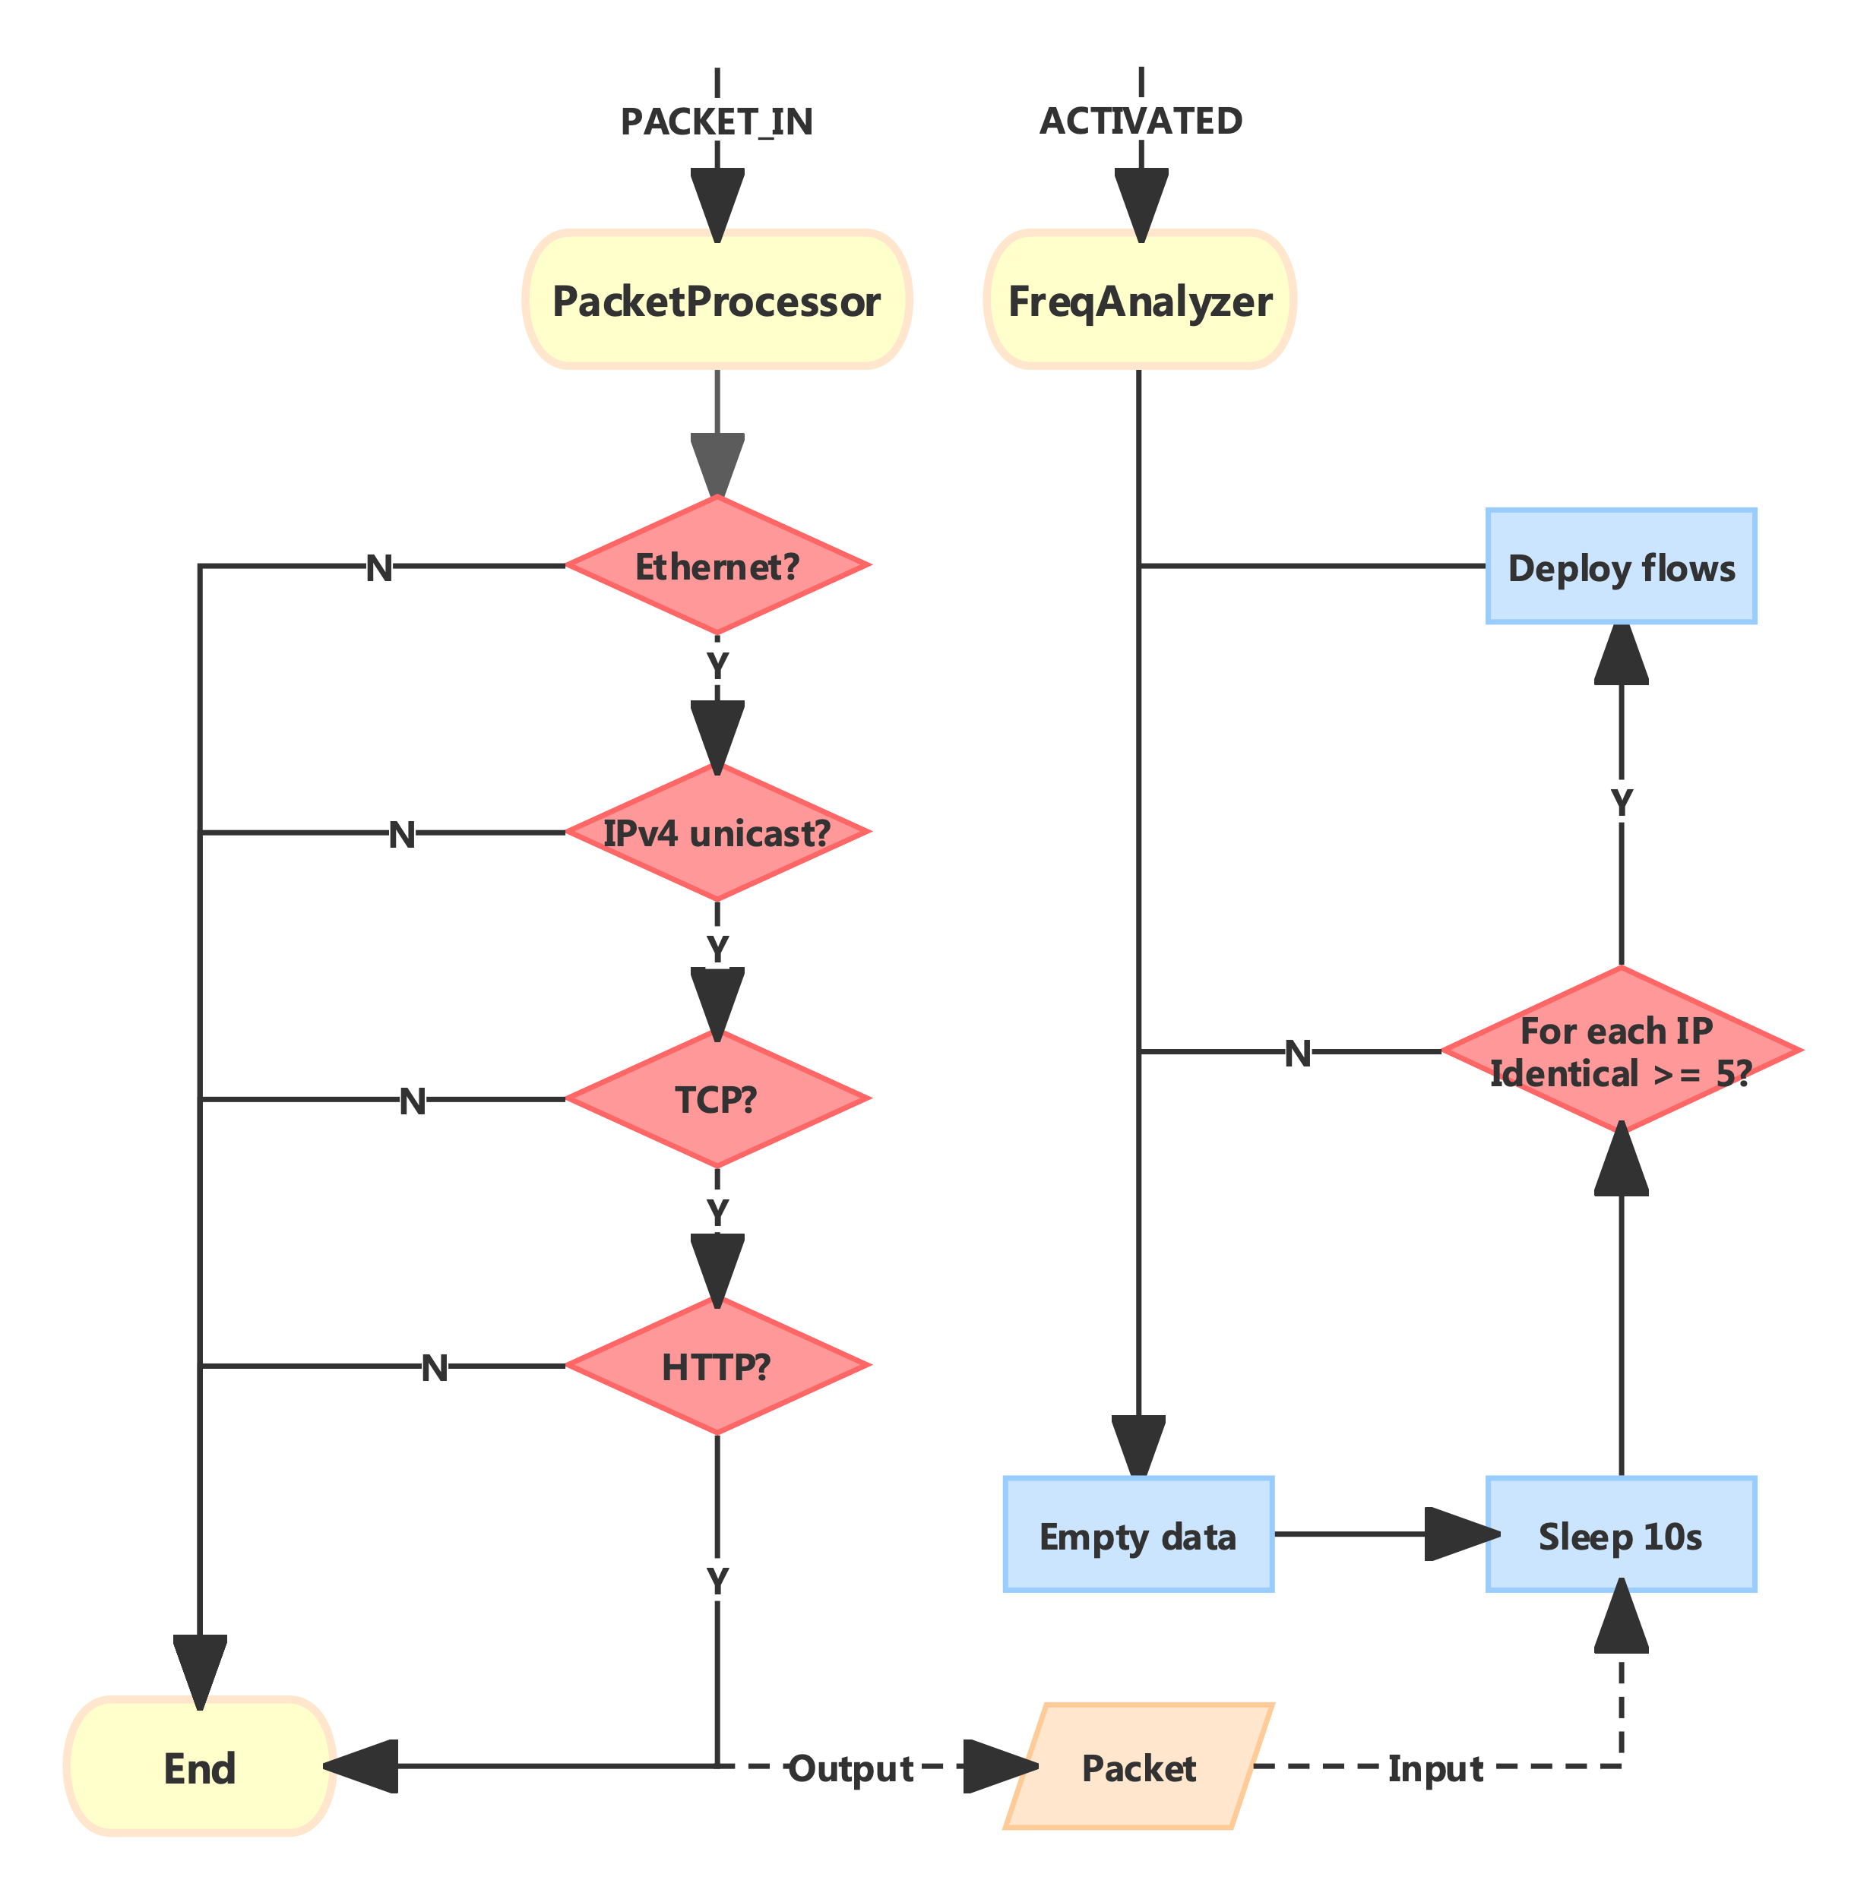
SDN Defence App:
HTTP Attack
Packet Processor
Frequency Analyser
Notes:
Consider detection interval between cycles, threshold, and flow matching criteria

Slide 10
Slides
Demonstration
Purpose and background
Prior work
Construction of base network
Construction of ICS network
location of devices
Modbus attack
mechanism and countermeasure
HTTP attack
mechanism and countermeasure
Interaction between Scada-LTS and OpenPLC
Attack & defence on Modbus
Attack & defence on HTTP

Slide 11
Thanks!

