Slide 1
The Monetary–Financial–Fiscal Macromodel (MFFM)
A global projection and scenario tool — one coherent “what-if” for 50 economies, and its policy implications.
Mátyás Farkas
International Monetary Fund
Senior Management briefing • [date / venue]
Views expressed are my own and do not necessarily represent the IMF.

Slide 2
Why now: the next generation of the Fund's global macro-financial model
Today: the GMF (Vitek)
What surveillance now needs
Served the Fund well as a global macro-financial workhorse.
– Not updated in estimation — [MF/Jesper: specifics]
– Missing FSAP / Article IV features — [MF/Jesper: list the needs]
– [MF/Jesper: any further gaps]
+ Current estimates, refreshed each cycle.
+ Fast, transparent scenarios for FSAP & Article IV.
+ Genuine cross-border transmission — shocks travel and feed back across economies.
+ [MF/Jesper: the specific FSAP/AIV features]
The case: [MF/Jesper: one-line motivation — e.g. “The MFFM supersedes the GMF: re-estimated, scenario-ready, and built for FSAP–Article IV work.”]

Slide 3
What the MFFM adds — five things it does that a static model cannot
+ Re-estimated and current. Bayesian VAR baselines re-estimated on the latest data, for 50 economies — one consistent methodology everywhere.
+ Interactive scenarios. Build a “what-if” by hand, or from an outside forecast, in minutes — the model keeps every variable mutually consistent.
+ Real cross-border amplification. A coupled global solve — a shock in one economy travels through trade and finance to the rest, not a sum of separate country runs.
+ Uses what we already produce. WEO, consensus and desk forecasts enter as ingredients, at a trust level you choose.
+ Honest and reproducible. Uncertainty bands throughout; a whole session — every country, every assumption — saved and shared as a single file.
In one line: The same trusted models, made current, interactive, global, and shareable.

Slide 4
One tool: a coherent global scenario, its spillovers, and the policy trade-offs
A point-and-click platform for 50 economies — the Fund’s workhorse models (Bayesian VAR baselines, a cross-country GVAR, DSGE policy) behind a single interface. Today’s tour, in five steps:
Baseline
data-driven forecast, 50 economies
Conditioning
drag a path, or import a forecast
Global solve
one country moves the rest
Extensions
policy, anchors, external forecasts
Conclusion
bands · export · share · decide
Why it matters
What you can ask it
+ Speed — a coherent global “what-if” in an afternoon, not a forecasting round.
+ Coherence — every number is mutually consistent, at home and across borders.
+ Reuse — folds in the forecasts we already produce (WEO, SPF, desk).
▸ If US growth surprises — who else moves, and by how much?
▸ If the Fed holds rates higher for longer, what happens here?
▸ If we take the WEO as given, what does it imply for everything else?

Slide 5
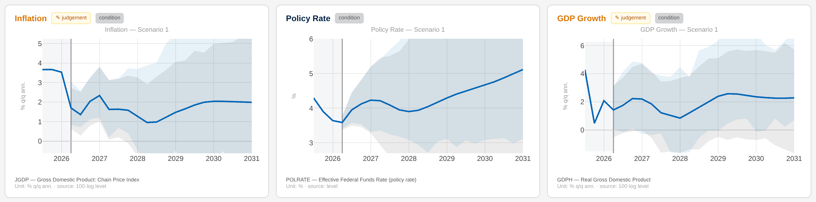
① Start with the baseline — no inputs, the model’s own read of every economy
Baseline
Conditioning
Global solve
Extensions
Conclusion
No assumptions required. Each economy is a Bayesian VAR, linked into one global system.
US inflation, policy rate and GDP — one consistent forecast, with uncertainty bands.
The baseline: A ready-made, internally consistent forecast for all 50 economies — the common starting point every scenario departs from.

Slide 6
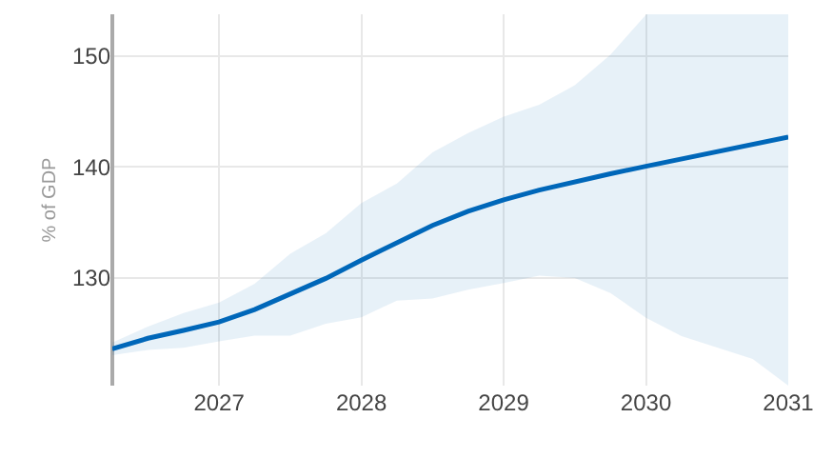
① Fiscal accounting, built in — the debt path drops out of the same run
Baseline
Conditioning
Global solve
Extensions
Conclusion
Revenue, spending, the interest bill and the deficit are projected together — and debt-to-GDP follows from the budget identity.
No separate spreadsheet: the fiscal story is consistent with the macro forecast by construction.
The debt dynamics, one line:
d_{t} = d_{t−1} · (1+i_{t}) / (1+g_{t}) − pb_{t} + sfa_{t}
d = debt/GDP · i = eff. interest rate · g = nominal GDP growth · pb = primary balance · sfa = stock-flow adj.
US debt-to-GDP rises to 143% by 2031, with band.
Why it matters: Debt sustainability drops out of the same run — the macro and fiscal stories can never contradict each other.

Slide 7
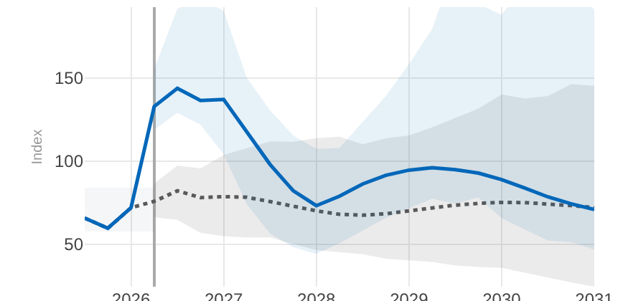
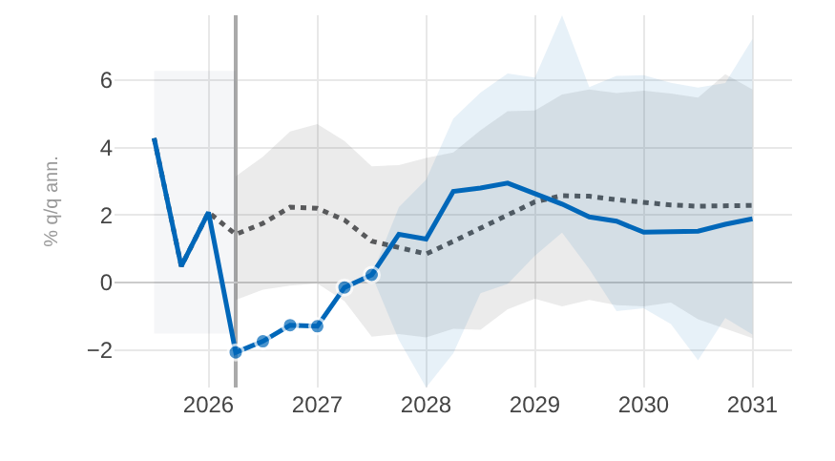
② Tell it what you believe — the model works out the rest, consistently
Baseline
Conditioning
Global solve
Extensions
Conclusion
You pin
Out comes
An oil-price path — the size and shape of the spike.
US stagflation: prices up, output down.
The power move: State a couple of things you believe — the model works out a full, model-consistent response across every variable, no re-estimation.

Slide 8
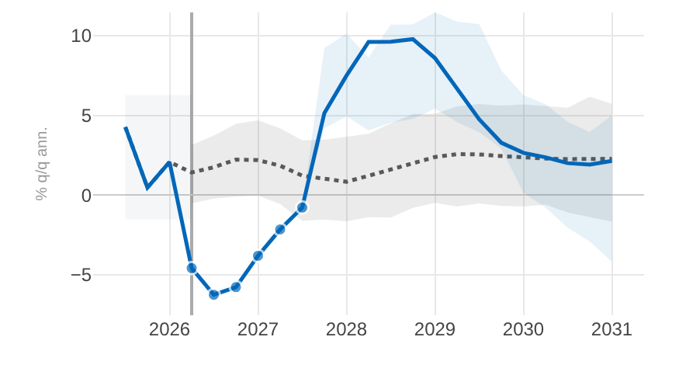
② Another shock, the same move — a credit crunch
Baseline
Conditioning
Global solve
Extensions
Conclusion
Recipe · Credit crunch
1. Pin spreads jump.
2. Pin lending falls.
Two pins in; the model works out a full, coherent response across every variable.
US GDP response to the two credit pins, with bands.
Fit the pins to the story: Two pins for a crunch, a few more for a richer scenario — either way the model keeps everything else consistent.

Slide 9
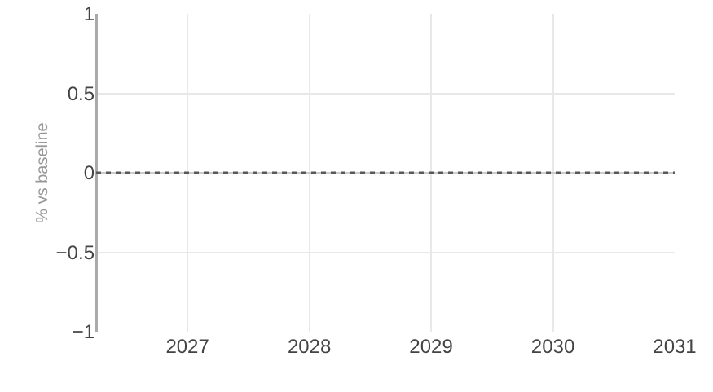
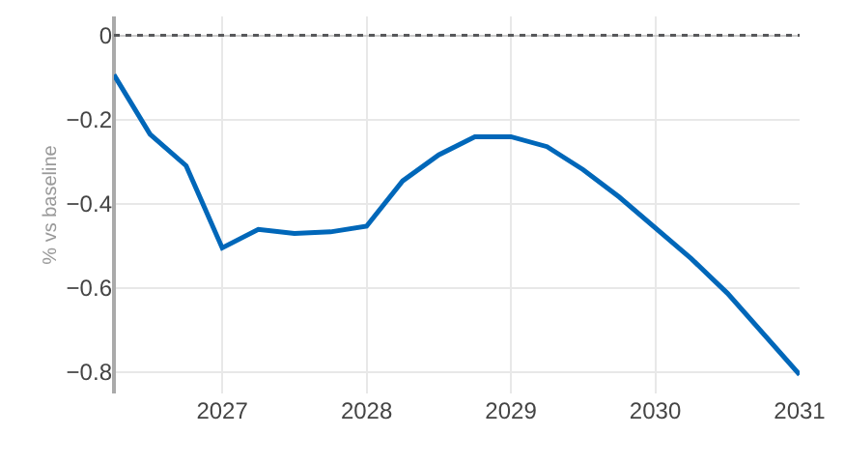
③ A shock abroad, a hit at home — the part a country-only read cannot see
Baseline
Conditioning
Global solve
Extensions
Conclusion
Country-only read
Global solve
Euro-area GDP vs baseline: flat.
The same shock arrives: −0.8pp by 2031.
Why the tool earns its keep: Read one economy at a time and this hit is invisible; only the coupled solve makes the cross-border spillover show up — and sizes it.

Slide 10
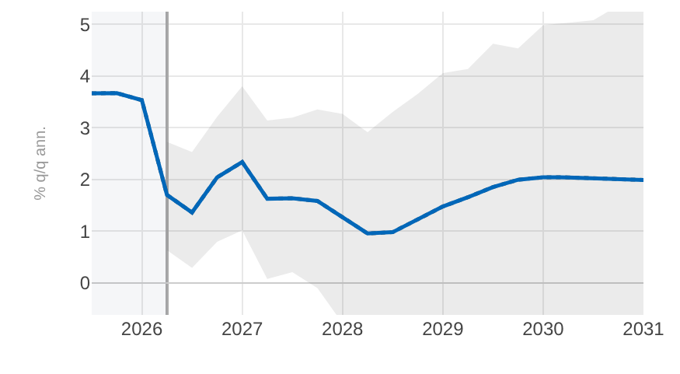
④ Pin the destination — and the whole path tilts toward it
Baseline
Conditioning
Global solve
Extensions
Conclusion
Know only where things should end up — the inflation target, potential growth, the neutral rate?
Set that long-run anchor; the model tilts the path toward it, gently, without breaking the near term.
US inflation: the tail lands on the anchor (dashed); near term untouched.
Long-run anchors: Set where a variable settles; the path re-shapes to reach it, near term intact.

Slide 11
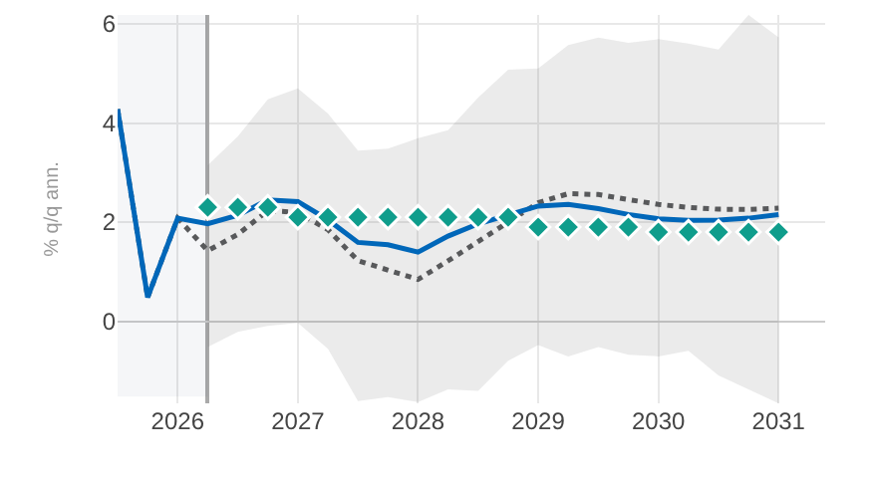
④ Fold in an outside forecast as an ingredient — at a trust level you choose
Baseline
Conditioning
Global solve
Extensions
Conclusion
A WEO number, a consensus figure, a desk view? Import it directly — as one more ingredient, not a hard override.
You set the trust dial: from “just a hint” to “pin it exactly”. Everything else stays consistent around it.
US GDP: teal diamonds are the imported WEO path.
External forecasts: Reuse the WEO and desk forecasts we already produce — as inputs, at a trust level you control.

Slide 12
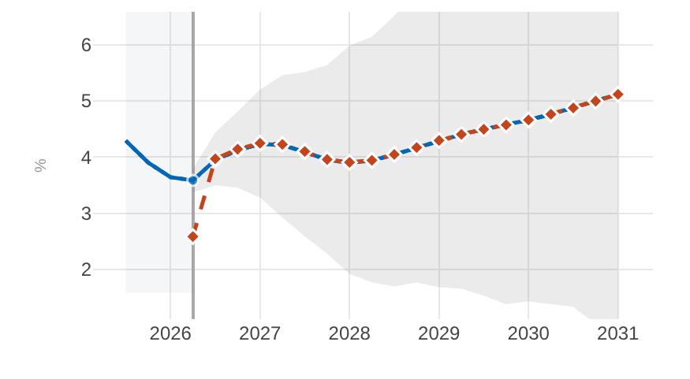
④ Ask “what if the central bank does X?” — a genuine policy counterfactual
Baseline
Conditioning
Global solve
Extensions
Conclusion
This tells you what a policy choice does — a structural answer from a fully specified DSGE model.
Layer a policy shock on any scenario; the model traces the counterfactual path.
US policy rate: counterfactual vs. baseline scenario.
Policy counterfactuals: From “what will happen” to “what should we do” — a structural (MMB/DSGE) policy experiment.
[on the roadmap: deeper MMB library, cross-country WEO propagation, external-balance/NFA satellite]

Slide 13
⑤ One tool now gives us a current, global, and shareable read on policy — we ask you to adopt it
Baseline
Conditioning
Global solve
Extensions
Conclusion
What we built, in three lines:
The arc: a live baseline → condition it on the story you care about → let it propagate globally → layer in policy and external-balance extensions.
The ask: [MF/Jesper: endorse the tool, resource the last-mile hardening, and adopt it into the FSAP / Article IV workflow.]
It is live today, covering 50 economies — ready to pilot on the next surveillance cycle.
+ Current & consistent — every economy sits on the same up-to-date vintage, so the numbers add up across desks
+ Genuinely global — shocks travel across 50 economies through trade and finance, not one country at a time
+ Our forecasts, built in — WEO and staff views enter as dials, and any run is one-click shareable and reproducible
The one line: One live, shareable tool turns scattered forecasts into a single consistent, global answer to “what if?”.

Slide 14
Background — how the coupled global solve works (GVAR)
The idea
▸ Each economy is estimated with its own variables PLUS a set of trade-weighted “foreign” variables — its partners’ activity, prices and rates.
▸ Stacking all 50 economies, those foreign links tie every model to every other into one big system.
▸ We then solve for the one state where every economy’s forecast is mutually consistent with its partners’ — the fixed point.
▸ Computed once from a pre-built inverse (fast), or iterated to convergence — either way, no country is solved in isolation.
Foreign (trade-weighted) variables
x_{i}* = Σ_{j} w_{ij} x_{j}
Stack every economy + its links
x = a + M x
Solve the fixed point (mutually consistent world)
x = (I − M)⁻¹ a
M holds the trade-weighted cross-country links; a is each economy’s own dynamics.
In plain terms: No country moves alone — the solve finds the world path where every economy’s reaction to its partners is mutually consistent.

