Slide 1
The Global Solve, Two Ways
EM-Bayesian G-BVAR vs. the classical Pesaran GVAR
Same skeleton — country VARX* models linked by trade-weighted foreign variables — two ways to estimate it and to solve the coupled global system.
Mátyás Farkas
International Monetary Fund
Technical background note — MFFM global solve
Views expressed are my own and do not necessarily represent the IMF.

Slide 2
Executive summary — both are GVARs; the tool generalizes the classical one
▸ Both are GVARs. Every economy is a VAR in its own variables plus trade-weighted foreign “stars” (partners’ activity, prices, rates); the country models are stacked and solved into one global system.
▸ (a) Bayesian, not OLS. Each bloc is a GLP hierarchical-Minnesota BVAR (shrunk toward a random walk, tightness λ / sum-of-coefficients μ sampled) — not the classical per-bloc OLS VARX* / reduced-rank VECMX*.
▸ (b) It completes the data. An EM loop with a Durbin–Koopman simulation smoother fills ragged edges and COVID-as-missing macros (financials kept observed) — the classical GVAR estimates each bloc on its own span, then couples on a common window (truncate / dummy, no imputation).
▸ (c) The US is endogenous. It carries its own ROW*_US stars (n 37→40) so the world feeds back onto it; the classical GVAR treats the US as the dominant source of the weakly-exogenous global commons.
▸ (d) An affine fixed point. The coupled solve reduces to x = Mx + d ⇒ x = (I−M)⁻¹d with a pre-shipped inverse, coupling by projection step; the classical solve stacks and inverts the contemporaneous matrix G₀ once.
In one line: A superset, not a rewrite: the same VARX* + trade-weighted-star GVAR skeleton, made Bayesian, gap-tolerant, US-endogenous, and solved as an affine deviation fixed point.

Slide 3
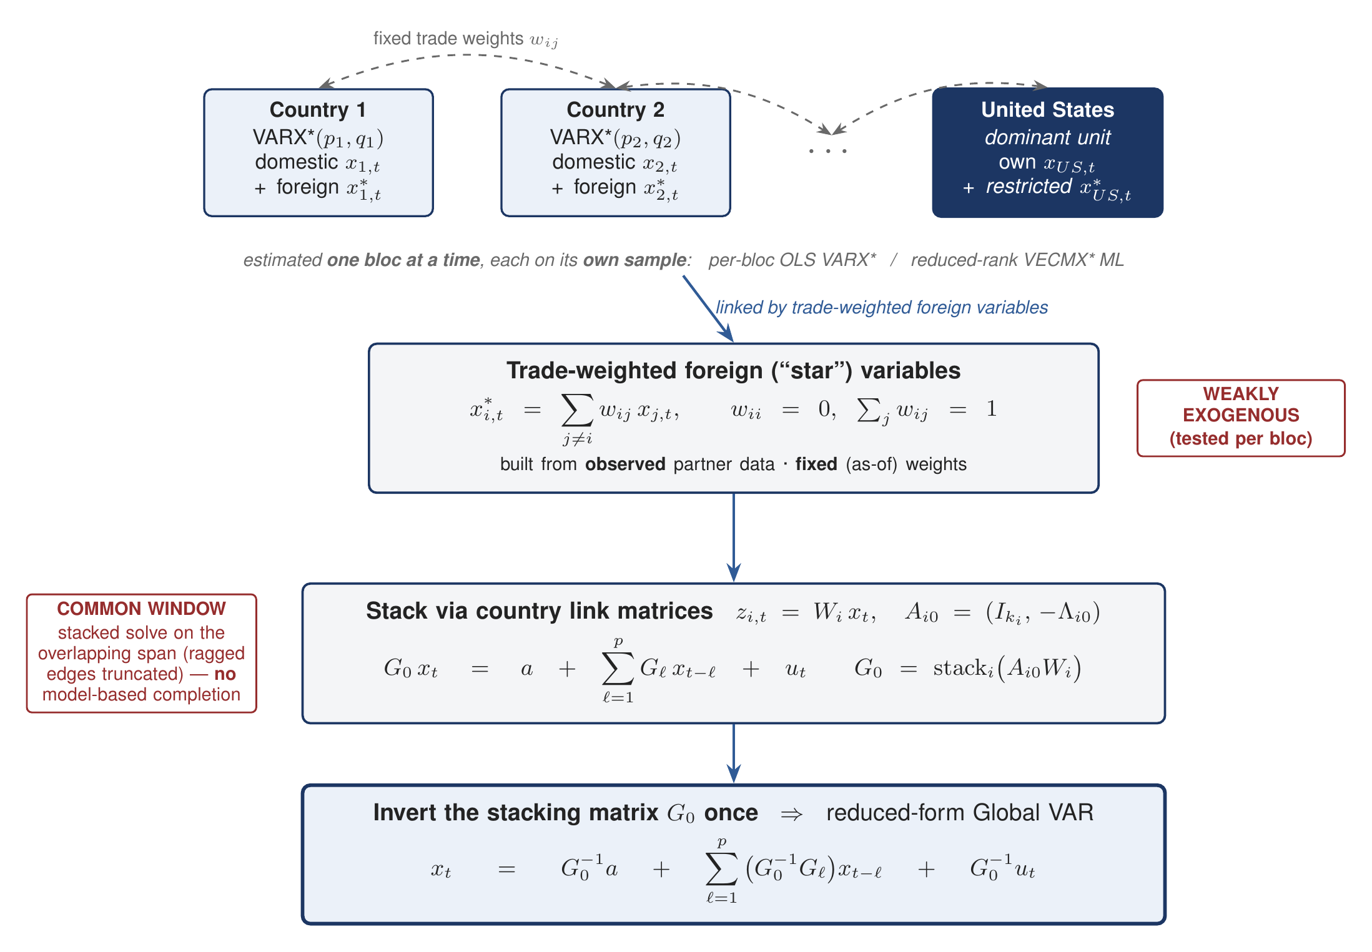
What the classical GVAR does (Pesaran–Schuermann–Weiner; Dees–di Mauro–Pesaran–Smith)
Estimate each country separately, build weakly-exogenous stars from observed partners, then stack and invert G₀ once.
The classical recipe: N separate VARX* / VECMX* blocs, each on its own sample · fixed-weight, weakly-exogenous stars · a common solve window (ragged edges truncated, no imputation) · US a source · one G₀ inversion.

Slide 4
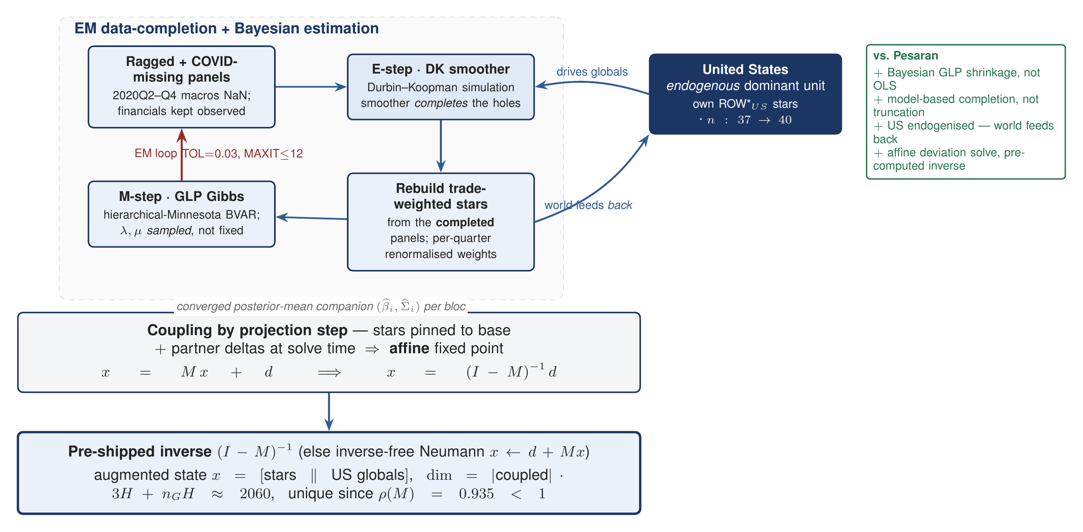
How the EM-Bayesian G-BVAR differs — completion loop, Bayesian blocs, endogenous US
An EM + DK-smoother loop completes the panels and rebuilds the stars; GLP-Bayesian blocs; the US is endogenous; the coupled solve is an affine fixed point with a pre-computed inverse.
The four generalizations: + Bayesian GLP shrinkage · + EM/DK data completion · + endogenous US (world feeds back) · + affine (I−M)⁻¹d solve.

Slide 5
Side by side — the same GVAR skeleton, five points of departure
Classical Pesaran GVAR
EM-Bayesian G-BVAR (this tool)
Estimation
Each country separately: per-bloc OLS VARX* — or reduced-rank VECMX* ML. Fixed weights, no shrinkage prior.
GLP hierarchical-Minnesota BVAR per bloc; shrunk to a random walk; λ, μ sampled, not fixed; posterior-mean companion exported.
Foreign variables
Stars x*_i = Σ w_ij x_j over partners j≠i; from observed data; weakly exogenous (tested per bloc).
3 stars per bloc (DEM / INF / FIN); per-quarter renormalised weights; estimated as ordinary columns, pinned affinely at solve.
Missing data
Each bloc on its own span; the coupled solve uses a common window (ragged edges truncated); COVID dummied — no model-based imputation.
EM + DK simulation smoother completes ragged & COVID-missing macros; financials kept observed; coupling by projection step.
Dominant unit (US)
US = dominant unit — source of the weakly-exogenous global commons. Its foreign financial stars are restricted (x*_US restricted), so the financial channel is one-directional — the world does not feed back through finance.
US endogenous: own ROW*_US stars, n 37→40; world feeds back; US drives the 4 global commons.
Global solve
Stack G₀ x_t = a + Σ Gℓ x_(t−ℓ) + u; invert G₀ once → reduced-form GVAR (GIRFs).
Affine deviation x = Mx + d ⇒ x = (I−M)⁻¹d; pre-shipped inverse; unique since ρ(M) = 0.947.
Read the columns: Left = the textbook GVAR; right = the same construction made Bayesian, gap-tolerant, US-endogenous and affine.

Slide 6
The shipped numbers, and what the generalization buys
The shipped 33-bloc coupled system
What it buys
▸ ρ(M) = 0.946626 < 1 → the fixed point is unique (frozen-anchor legacy: ρ ≈ 0.70).
▸ Augmented state dim = 2060 = 33·3·20 + 4·20 (stars stacked with US-global deltas) — verified against the shipped artifact.
▸ 50 economies = 33 GVAR-coupled blocs + 17 euro members; lags p = 3, horizon H = 20.
▸ EM loop: MAXIT ≤ 12, TOL = 0.03; GLP Gibbs nDraws = 1000, nBurn = 500.
▸ Pre-shipping the M + (I−M)⁻¹ artifact skips the ≈19-min in-browser smoother-probe M-build (24 blocs; more at 33) and the ≈46-min in-JS inverse — offline the inverse itself is ≈1 s (BLAS). Warm in-browser solve ≈4.5 s; a US-pinned structure falls back to the inverse-free Neumann path (fresh M).
+ Current, shrunk estimates on ragged, COVID-scarred data — no common-window truncation.
+ A genuine world→US feedback channel the classical GVAR excludes by construction.
+ One affine solve, computed once from a pre-built inverse, reused for every scenario.
+ Coupling by projection step, not calendar date — a bloc ending a quarter early is completed, not dropped everywhere.
Bottom line: The classical GVAR is the fixed-weight, common-window, exogenous-US special case; the tool relaxes all three and keeps the solve linear.

