Slide 1
MFFM A global projection and scenario tool
MCM Strategic FosS meeting
16th July 2026
The views expressed here are those of the authors and do not necessarily represent the views of the IMF, its Executive Board, or IMF management.
Mátyás Farkas and Jesper Lindé Monetary Modelling Unit

Slide 2
Agenda
Background: BVARs replacing GFM in FSAPs
Forecasting and scenario analysis made easy: MFFM
MFFM = Monetary-Financial-Fiscal Macromodel tool
Forecasting and scenario with MFFM for US
MFFM is a GVAR: Showcase Global Solve: Putting all countries together
Extensions: Long-run targets, external forecasts, structural identification including policy counterfactuals
In sum: MFFM is a simple to use tool for all

Slide 3
Background: BVARs replacing GFM in FSAPs

Slide 4
Background: Need to phase out GFM
Global Macrofinancial Model (GFM):
An Estimated Global DSGE (by F. Vitek)
BVARs to complement GFM based on stakeholder needs:
Operationally heavy
Complex workflow
Cannot be updated
Easy to use
One interface
Data dependent, re-estimated
Scenario tool for FSAPs & Article IV.
Integrated fiscal block
Flexible to incorporate external forecasts

Slide 5

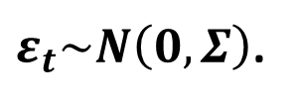
Time series model – Bayesian VAR
The underlying model is a large-scale Bayesian VAR
The BVAR is estimated with Giannonne/Lenza/Primiceri (2012)-type prior:
“Maximizing hyperparameters corresponds to minimizing the one-step-ahead out-of-sample forecast error.”
Marginal Likelihood is Inverse Wishart-Normal distributed conditional on hyperpriors.
Given initial state in e.g. 2026Q2, model can be used to calculate unconditional forecast distribution 2026Q3-.
By conditioning on certain variables in the BVAR 2026Q3- (interest rate spreads or higher energy prices), model can be used to calculate a conditional forecast distribution.
Following Waggoner-Zha (1998, ReStat), the conditioning variables explained by the most likely set of shocks driving them.
Variables we do not condition on forecasted endogenously, conditional on the paths for the subset of variables we specify certain paths for.
$$y_{t}=C+B_{1}y_{t−1}+…+B_{p}y_{t−p}+ε_{t},$$
$ε_{t}\sim N\left(0,Σ\right)$.

Slide 6
The US data – 32 variables following Crump et al. (2024)
S&P CoreLogic Case-Shiller U.S. National Home Price Index Standard & Poor’s SA, Jan 2000 =1 100 x log
Source: Crump, R. K., Eusepi, S., Giannone, D., Qian, E., & Sbordone, A. M. (2024): A large Bayesian VAR of the United States economy. IJCB

Slide 7
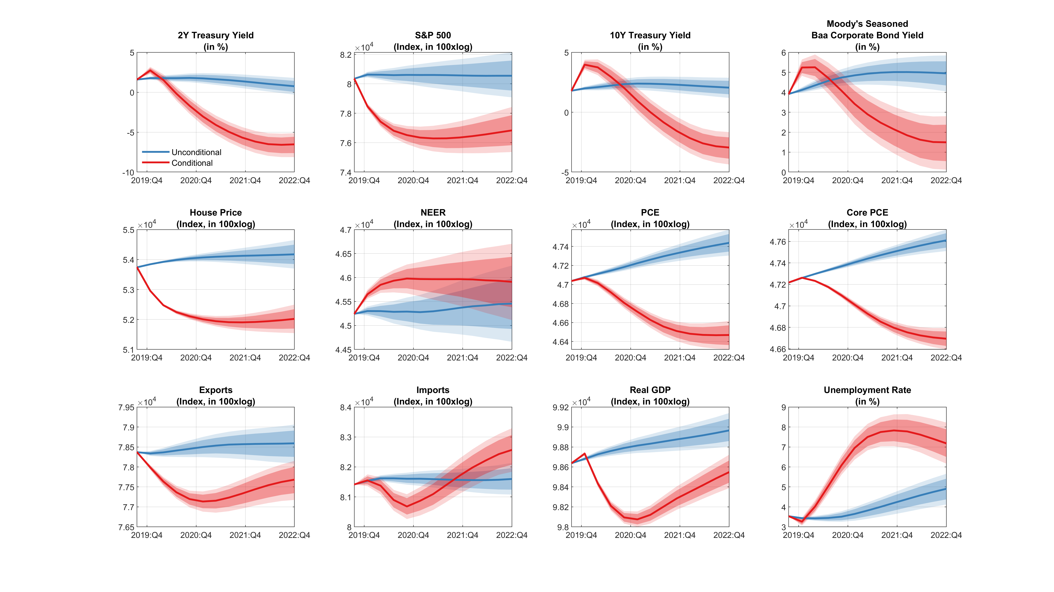
Unconditional vs. Conditional BVAR forecasts

Slide 8
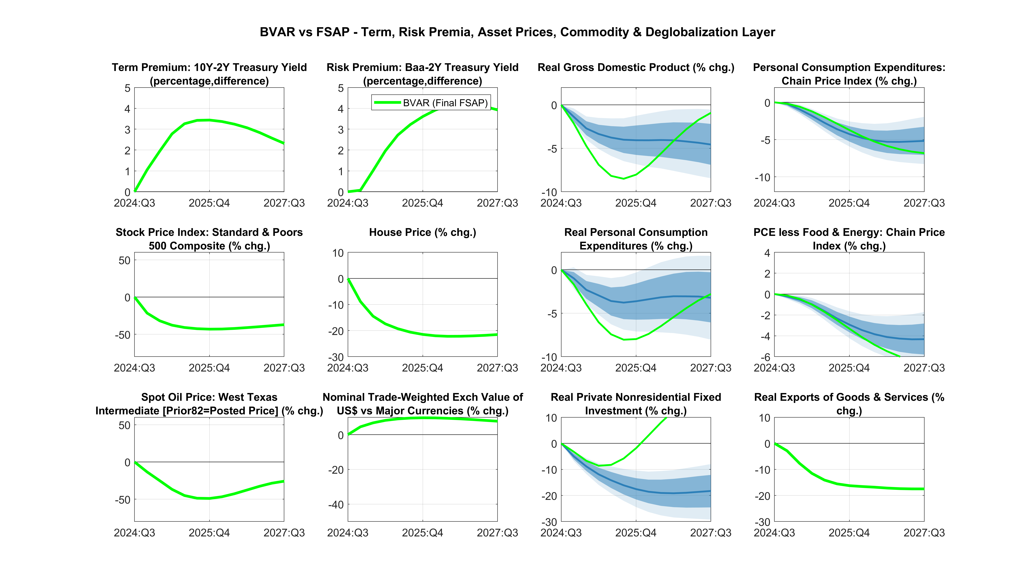
Comparison of BVAR and GFM scenarios

Slide 9
The new MFFM tool

Slide 10
Monetary-Financial-Fiscal Model: A global projection and scenario tool
A point-and-click platform - combining the Fund’s workhorse models (Bayesian VAR baselines, a cross-country GVAR, DSGE policy) behind a single interface. Today’s tour, in five steps:
Baseline
data-driven forecast, 50 economies
Conditioning
drag a path, or import a forecast
Global solve
one country moves the rest
Extensions
Long-run targets, policy counterfactual, external forecasts
Conclusion
bands · export · share · decide
Key advantages
Main questions to answer:
+ Speed - a coherent global “what-if” live tool.
+ Accessible - simple is beautiful
+ Coherence - every number is globally consistent
+ Reuse - folds in the insights we already have (WEO, SPF, desk)
▸ What is the new global scenario with updated WEO forecast?
▸ If US growth surprises, who else moves, and by how much?
▸ If the Fed holds rates higher for longer, what happens here?
▸ If we take the WEO as given, what does it imply for RoW?

Slide 11
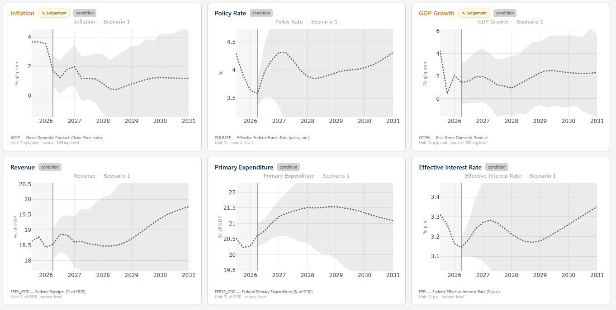
Baseline: API data inputs + BVAR estimates
Baseline
Conditioning
Global solve
Extensions
Conclusion
US inflation, policy rate and GDP
One consistent forecast, with uncertainty bands.
Source: IMF staff calculations.
The baseline: A ready-made, internally consistent forecast - the common starting point every scenario departs from (for all 50 economies).

Slide 12
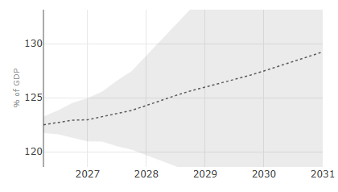
Baseline: Fiscal block and fiscal accounting
Baseline
Conditioning
Global solve
Extensions
Conclusion
Revenue, spending, the interest bill and debtresid (share of GDP) are included as observables in BVAR.
Given the four endogenous fiscal variables, Debt-to-GDP follows from the debt accumulation equation (satellite model).
No separate spreadsheet: the fiscal story is consistent with the macro forecast.
US debt-to-GDP rises to 128% by 2031, with CI band.
Government Debt Flow Accounting
d_{t} = d_{t−1} · (1+i_{t}) / (1+g_{t}) − rev_{t} + exp_{t} + sfa_{t}
Source: IMF staff calculations.
d = debt/GDP · i = eff. interest rate · g = nominal GDP growth · rev = revenue/GDP exp = Primary Expenditure/GDP,· sfa = stock-flow adjustment/GDP
Debt sustainability analysis is integrated into the scenario analysis.

Slide 13
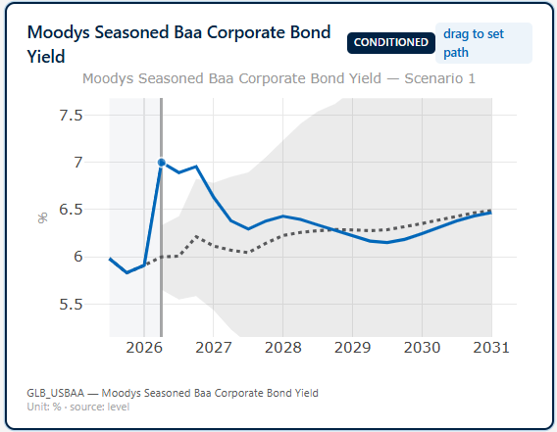
Conditioning: A naïve spread shock
Baseline
Conditioning
Global solve
Extensions
Conclusion
Financial shock – A naïve spread shock
Simply pin
10Y BAA Corporate Yield
nowcast
to increase by 100 bps.
Conditioning: The most likely outcome given the data and the model.

Slide 14
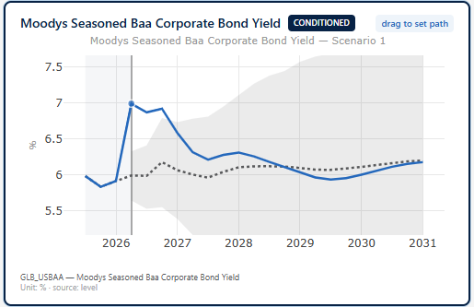
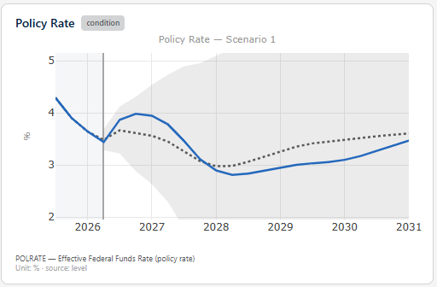
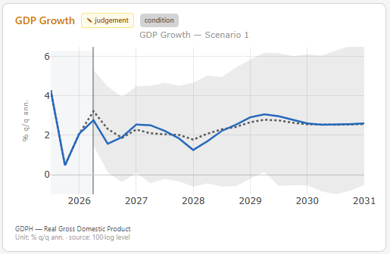
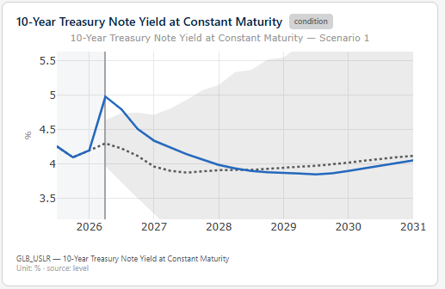
Conditioning: Most likely path is not sufficiently precise
Baseline
Conditioning
Global solve
Extensions
Conclusion
Private yields up, GDP declines X Policy rate and 10-year government yield increase

Slide 15
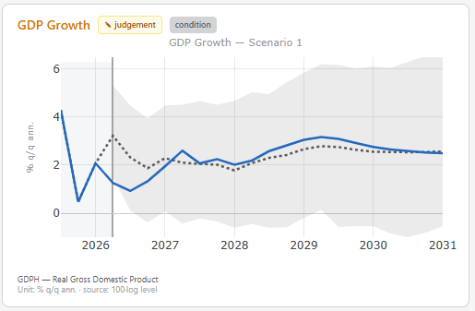
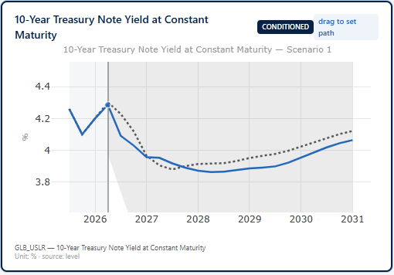
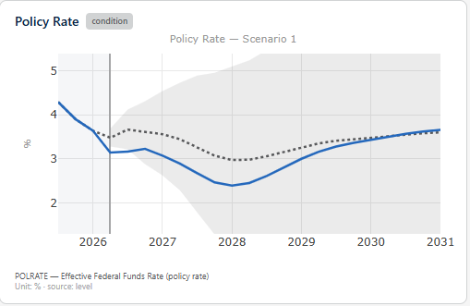
Conditioning: True spread shock
Baseline
Conditioning
Global solve
Extensions
Conclusion
Financial shock – A true spread shock
Pin BAA Corporate Yield NC to +100bps
+
Pin 10Y Gov Yield NC to 0 first period
= “true spread shock”
Fit the pins to the story: Two pins are sufficient a spread shock scenario,
the model keeps everything else consistent.

Slide 16
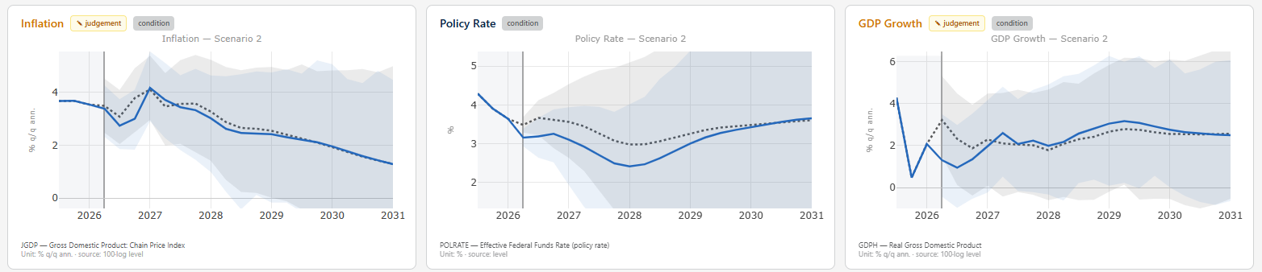
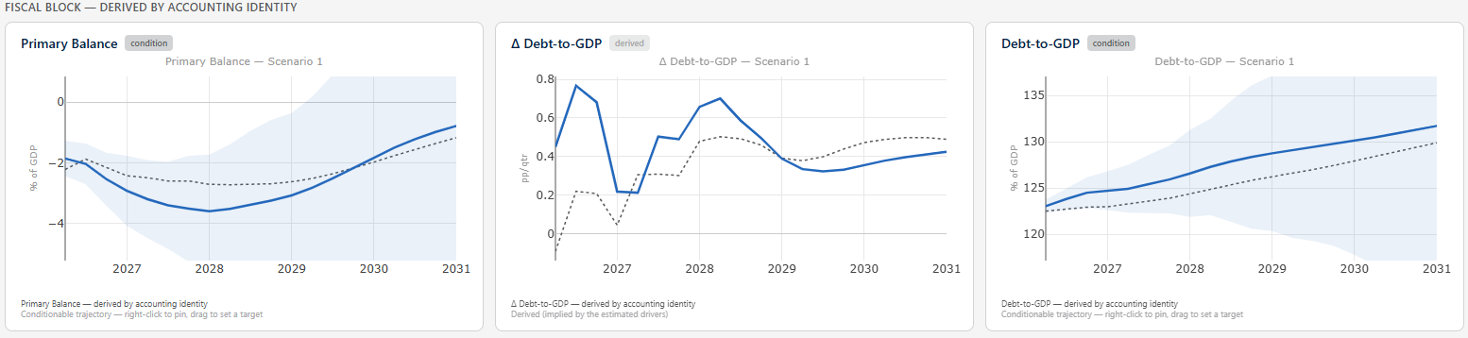
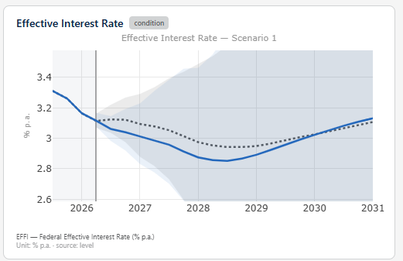
Conditioning: True spread shock
Baseline
Conditioning
Global solve
Extensions
Conclusion
Fit the pins to the story: Two pins for a true spread shock.

Slide 17
Global Solve with the MFFM tool

Slide 18
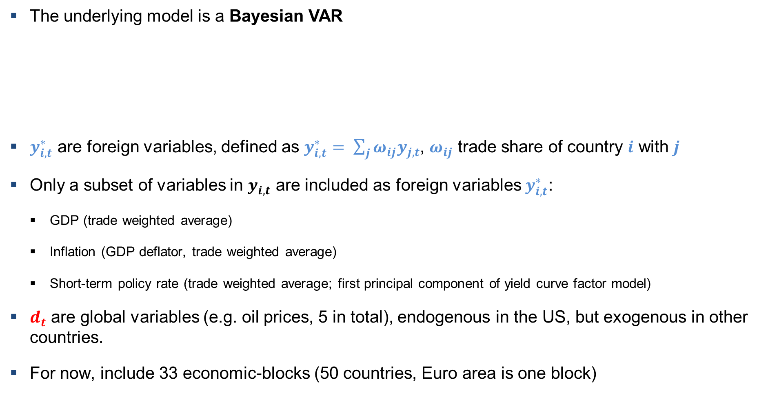
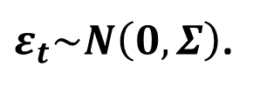
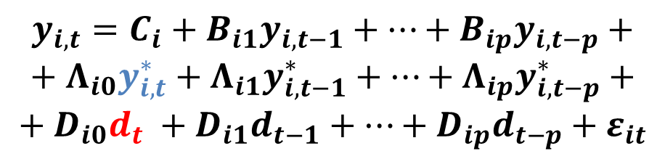
The MFFM GBVAR Model
The underlying model is a Bayesian VAR
$y_{i,t}^{∗}$ are foreign variables, defined as $y_{i,t}^{∗}= \sum_{j}{{ω_{ij}y}_{j,t}}$, $ω_{ij}$ trade share of country $i$ with $j$
Only a subset of variables in $y_{i,t}$ are included as foreign variables $y_{i,t}^{∗}$:
GDP (trade weighted average)
Inflation (GDP deflator, trade weighted average)
Short-term policy rate (trade weighted average; first principal component of yield curve factor model)
$d_{t}$ are global variables (e.g. oil prices, 5 in total), endogenous in the US, but exogenous in other countries.
For now, include 33 economic-blocks (50 countries, Euro area is one block)
$$y_{i,t}=C_{i}+B_{i1}y_{i,t−1}+…+B_{ip}y_{i,t−p}+$$
$$+{{ Λ}_{i0}y_{i,t}^{∗}+Λ}_{i1}y_{i,t−1}^{∗}+…+Λ_{ip}y_{i,t−p}^{∗}+$$
$$+{ D}_{i0}d_{t} +D_{i1}d_{t−1}+…+D_{ip}d_{t−p}+ε_{it}$$
$ε_{t}\sim N\left(0,Σ\right)$.

Slide 19
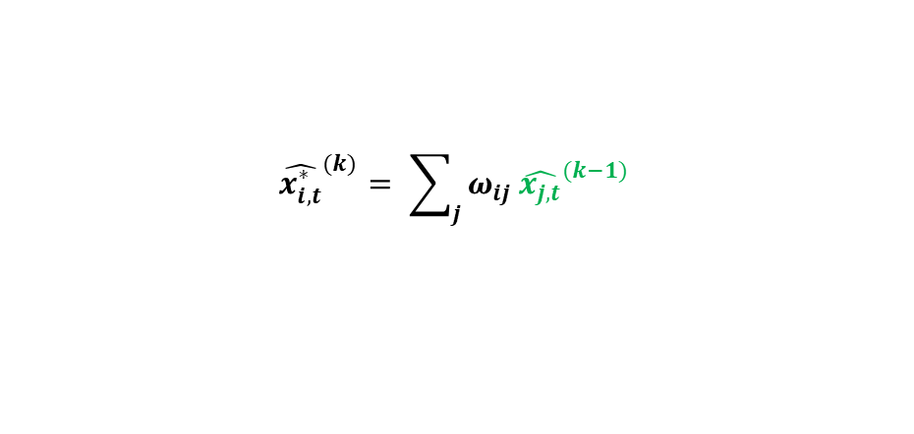

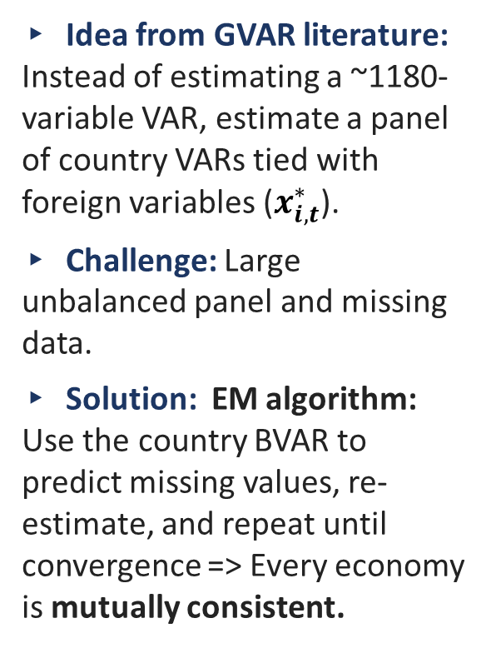

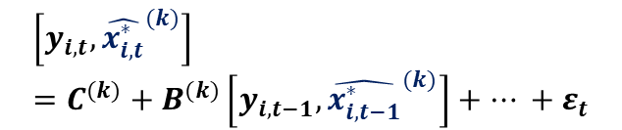
Methodology: How the MFFM GBVAR is solved and estimated
(Re)Build foreign variables
▸ Idea from GVAR literature: Instead of estimating a ~1180-variable VAR, estimate a panel of country VARs tied with foreign variables ($x_{i,t}^{∗}$).
▸ Challenge: Large unbalanced panel and missing data.
▸ Solution: EM algorithm: Use the country BVAR to predict missing values, re- estimate, and repeat until convergence => Every economy is mutually consistent.
$$k=k+1$$
$${\hat{x_{i,t}^{∗}}}^{(k)}= \sum_{j}{ω_{ij}}{\hat{x_{j,t}}}^{(k−1)}$$
$$for each country i$$
Predict missing values
Estimate country BVAR with GLP
$$\left[y_{i,t},{\hat{x_{i,t}^{∗}}}^{(k)}\right]=C^{(k)}+B^{(k)}\left[y_{i,t−1},{\hat{x_{i,t−1}^{∗}}}^{(k)}\right]+… +ε_{t}$$
$${\hat{x_{i,t}^{∗}}}^{(k+1)}=BVAR\left(y_{i,t},{\hat{x_{i,t}^{∗}}}^{\left(k\right)}\right)$$
Global solve ensures that every country's forecast is internally and externally consistent.

Slide 20
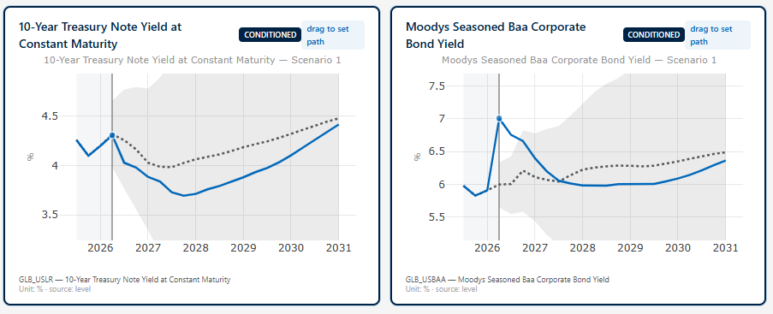
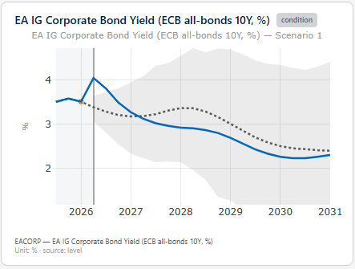
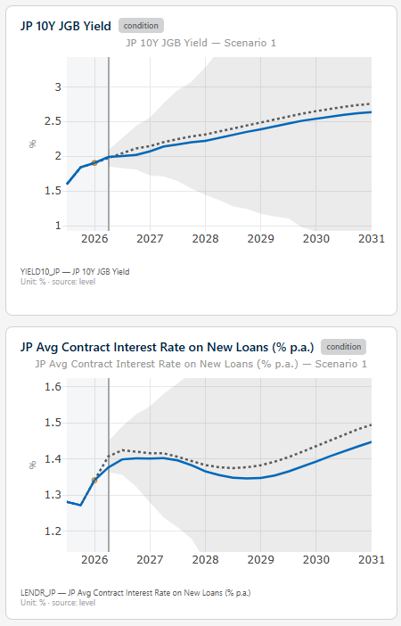
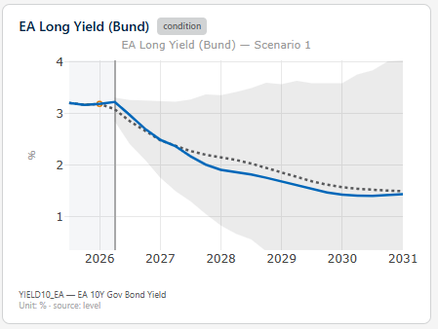
Global solve: Assess impact on other economies of US conditioning…
Baseline
Conditioning
Global solve
Extensions
Conclusion
US
Euro Area
Japan

Slide 21
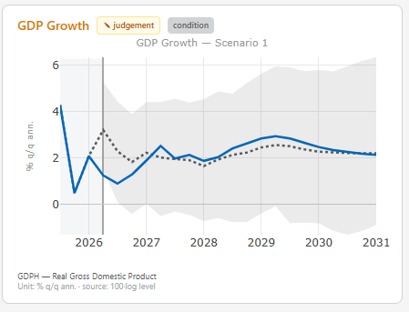
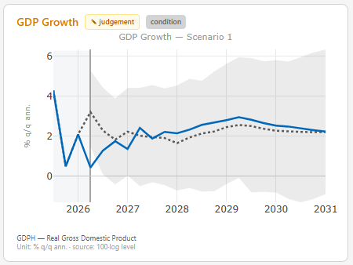
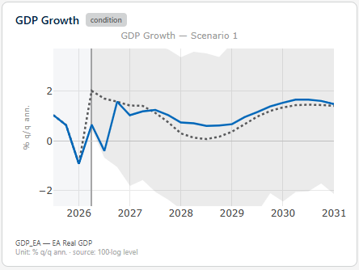
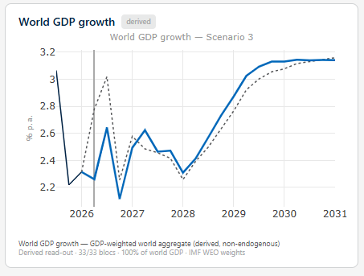
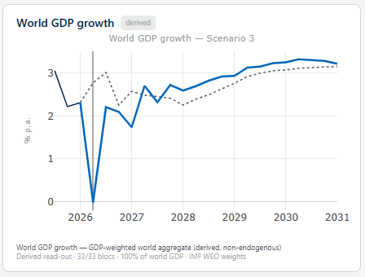
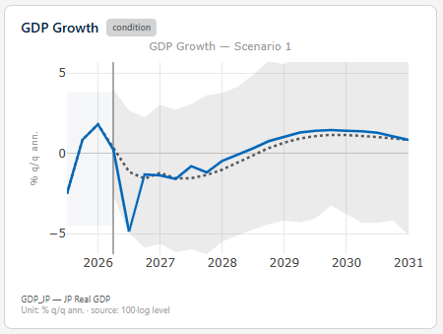
US only versus Global solve: US conditioning only
Baseline
Conditioning
Global solve
Extensions
Conclusion
US
Euro Area
US
World GDP
Global solve
Country block – No feedback
Japan
World
World

Slide 22
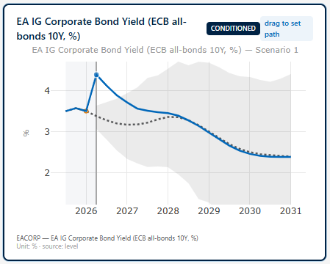
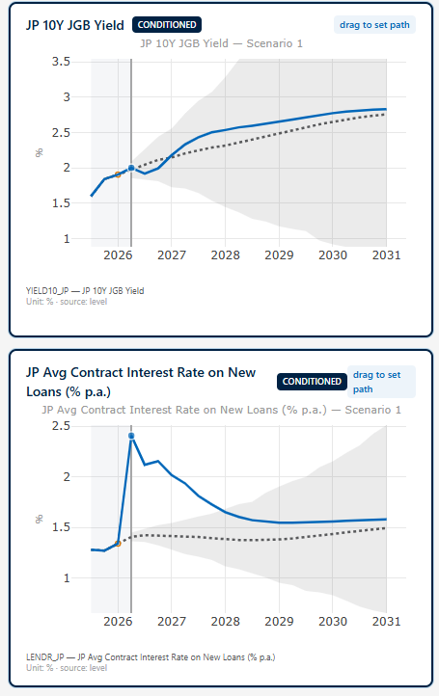
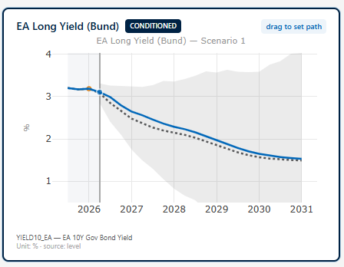
Global solve: Conditioning on Spreads in US, EA and Japan
Baseline
Conditioning
Global solve
Extensions
Conclusion
US
Euro Area
Japan

Slide 23
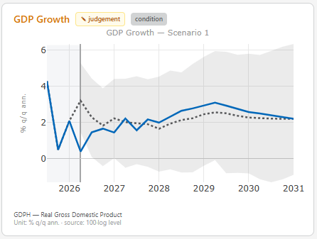
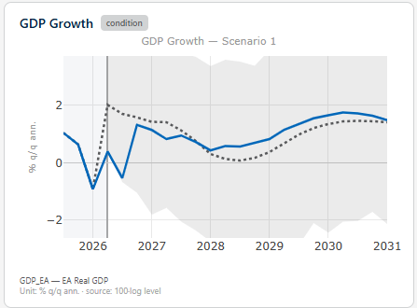
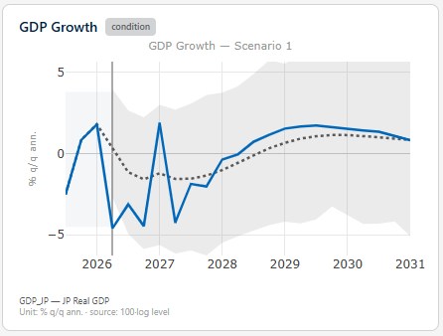
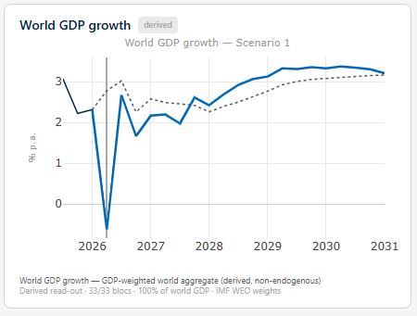
Country scenario vs Global scenario: US only versus Global conditioning
Baseline
Conditioning
Global solve
Extensions
Conclusion
US
Euro Area
Japan
World GDP
US only spread
Global spreads

Slide 24
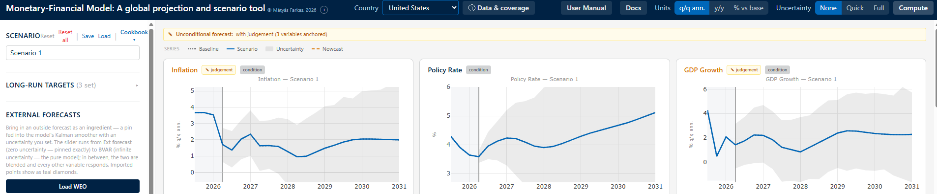
Monetary-Financial-Fiscal Model: A global projection and scenario tool II
+ Re-estimated and current. Bayesian VAR baselines re-estimated on the latest data, for 50 economies - one consistent methodology everywhere.
+ Monetary, financial and fiscal in one model. Monetary, financial and fiscal variables all endogenous.
+ Interactive scenarios. Build a “what-if” by hand, or from an outside forecast, in minutes - the model keeps every variable mutually consistent.
+ Real cross-border amplification. A coupled global solve - a shock in one economy travels through trade and finance to the rest, not a sum of separate country runs.
+ Uses what we already produce. WEO, consensus and desk forecasts can enter as ingredients, at a trust level you choose.
Global modelling made easy, interactive, and accessible.

Slide 25
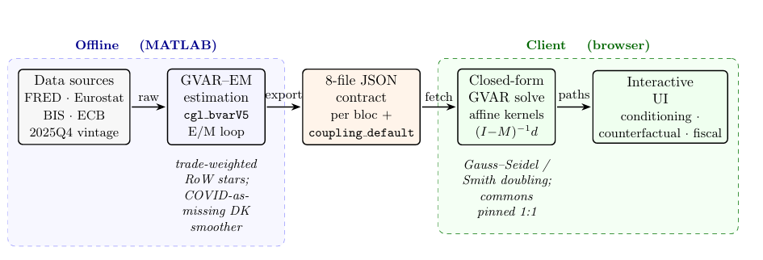
How is this done in practice – and how can teams retrieve the results
Results in figures exported to excel file – one file per country

Slide 26
(Future) Extensions

Slide 27
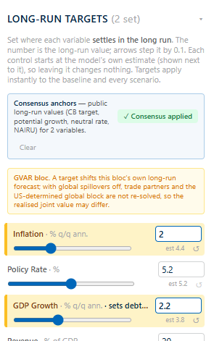
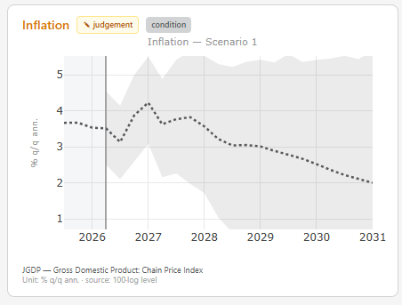
Extensions I: Long-run targets
Baseline
Conditioning
Global solve
Extensions
Conclusion
Know only where things should end up - the inflation target, potential growth, the neutral rate?
Set that long-run anchor; the model tilts the path toward it, gently, without breaking the near term.
US inflation: the tail lands on the anchor (dashed); near term untouched.
Long-run targets = time trend: forecasts settles; all variable paths re-shaped to reach it.

Slide 28
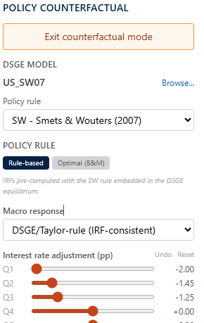
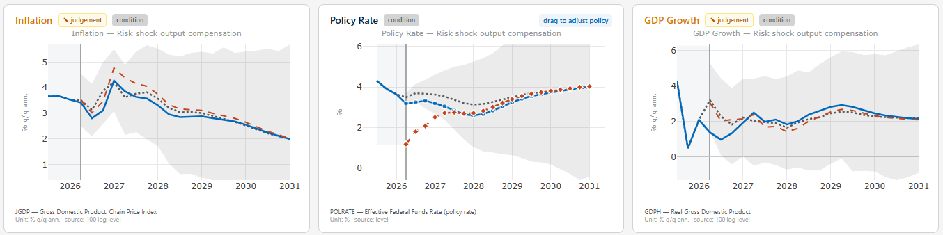
Extensions II: Policy counterfactuals
Baseline
Conditioning
Global solve
Extensions
Conclusion
Delta-method of the MMB on top of the scenario.
This tells you what a policy choice does - a structural answer from a fully specified DSGE model.
Layer a policy shock on any scenario; the model traces the counterfactual path.
Policy counterfactuals: From “what will happen” to “what should we do” - a structural (MMB/DSGE) policy experiment.

Slide 29
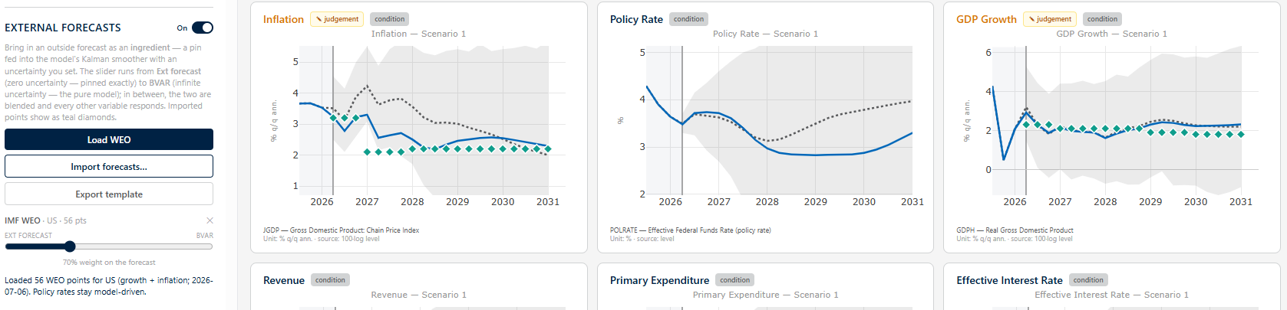
Extensions III: External forecast conditioning
Baseline
Conditioning
Global solve
Extensions
Conclusion
Soft-conditioning on external forecasts.
Slider sets the weight attached to G-BVAR compared to external forecast.
External forecast can be imported from Excel based on provided template.
Country desks: I have my own model and what is a consistent scenario?

Slide 30
Conclusions

Slide 31
Conclusions
Baseline
Conditioning
Global solve
Extensions
Conclusion
+ MFFM a new point and click scenario model tool - Build a “what-if” by hand, or from an outside forecast, in minutes
+ Current & consistent - every economy sits on the same up-to-date vintage, so the numbers add up across desks
+ Genuinely global - shocks travel across 50 economies through trade and finance, not one country at a time
+ Our forecasts, built in - WEO and staff views enter as dials, and any run is one-click shareable and reproducible

Slide 32
Technical Information

Slide 33
Background: How the coupled global solve works (G-BVAR)
The idea
▸ Each economy is estimated with its own variables PLUS a set of trade-weighted “foreign” variables - its partners’ activity, prices and rates.
▸ Stacking all 50 economies, those foreign links tie every model to every other into one big system.
▸ We then solve for the one state where every economy’s forecast is mutually consistent with its partners’ - the fixed point.
▸ Computed once from a pre-built inverse (fast), or iterated to convergence - either way, no country is solved in isolation.
Foreign (trade-weighted) variables
x_{i}* = Σ_{j} w_{ij} x_{j}
Stack every economy + its links
x = a + M x
Solve the fixed point
x = (I − M)⁻¹ a
M holds the trade-weighted cross-country links; a is each economy’s own dynamics.
In plain terms: No country moves alone - the solve finds the world path where every economy’s reaction to its partners is mutually consistent.

Slide 34
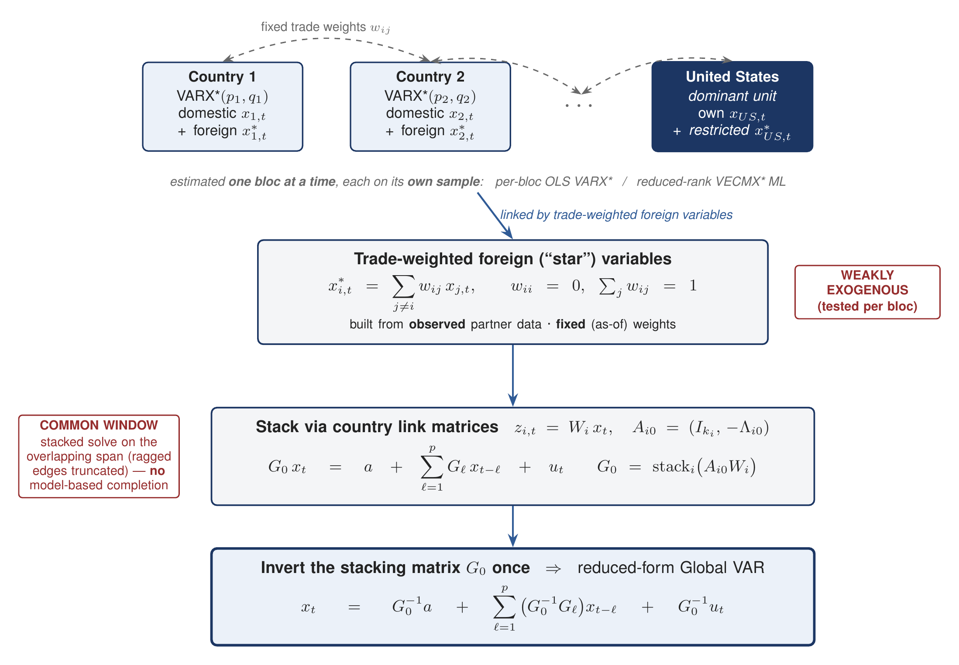
Classical GVAR (Dees–di Mauro–Pesaran–Smith, Pesaran–Schuermann–Weiner)
Estimate each country separately, build weakly-exogenous stars from observed partners, then stack and invert G₀ once.
The classical recipe: N separate VARX* / VECMX* blocs, each on its own sample · fixed-weight, weakly-exogenous stars · a common solve window (ragged edges truncated, no imputation) · US a source · one G₀ inversion.

Slide 35
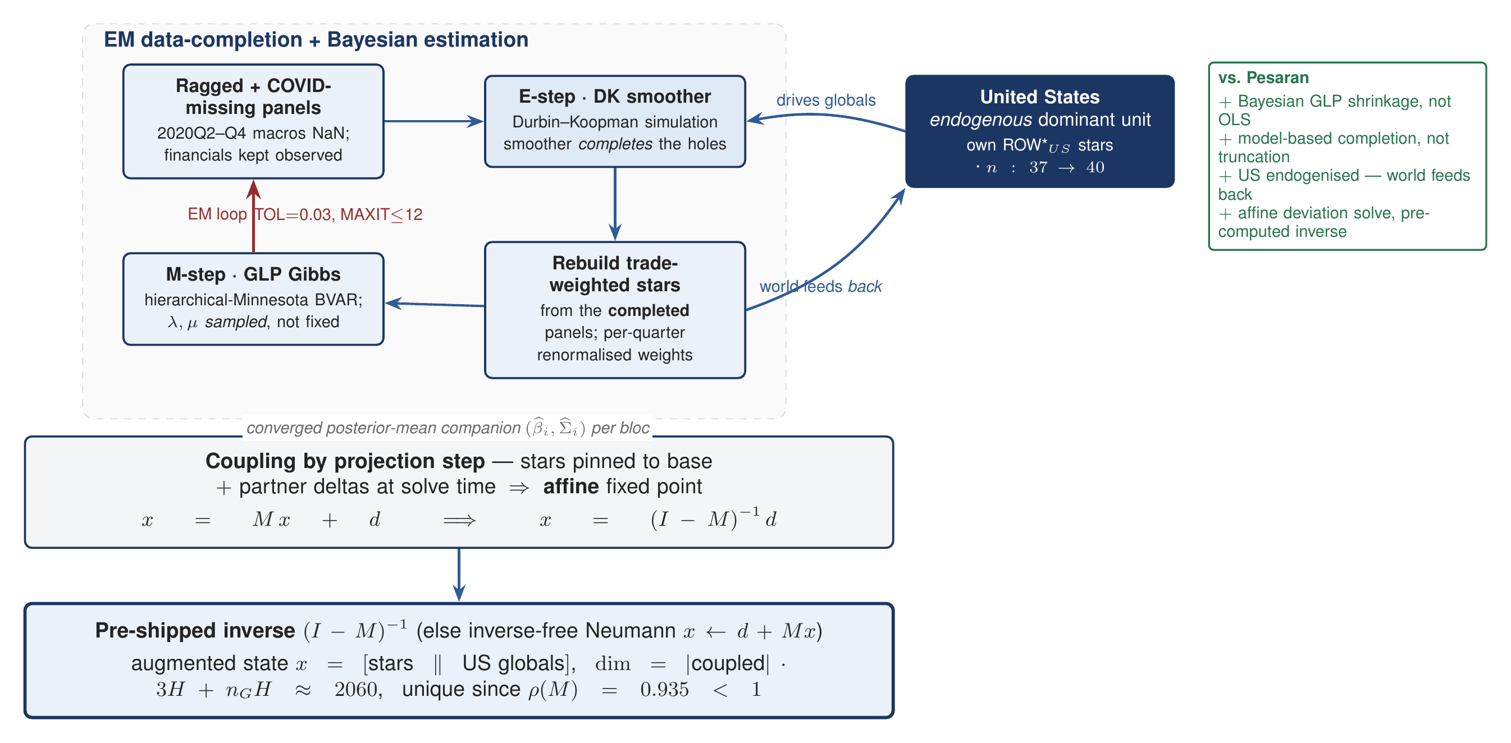
EM-Bayesian G-BVAR
An EM + DK-smoother loop completes the panels and rebuilds the stars; GLP-Bayesian blocs; the US is endogenous; the coupled solve is an affine fixed point with a pre-computed inverse.
The four generalizations: + Bayesian GLP shrinkage · + EM/DK data completion · + endogenous US (world feeds back) · + affine (I−M)⁻¹d solve.

Slide 36
Side by side - the same GVAR skeleton, five points of departure
Classical Pesaran GVAR
EM-Bayesian G-BVAR (this tool)
Each country separately: per-bloc OLS VARX* - or reduced-rank VECMX* ML. Fixed weights, no shrinkage prior.
GLP hierarchical-Minnesota BVAR per bloc; shrunk to a random walk; λ, μ sampled, not fixed; posterior-mean companion exported.
Estimation
Stars x*_i = Σ w_ij x_j over partners j≠i; from observed data; weakly exogenous (tested per bloc).
3 stars per bloc (DEM / INF / FIN); per-quarter renormalised weights; estimated as ordinary columns, pinned affinely at solve.
Foreign variables
Each bloc on its own span; the coupled solve uses a common window (ragged edges truncated); COVID dummied - no model-based imputation.
EM + DK simulation smoother completes ragged & COVID-missing macros; financials kept observed; coupling by projection step.
Missing data
US = dominant unit - source of the weakly-exogenous global commons. Its foreign financial stars are restricted, so the financial channel is one-directional - the world does not feed back through finance.
US endogenous: own ROW*_US stars, n 37→40; world feeds back; US drives the 4 global commons.
Dominant unit (US)
Global solve
Stack G₀ x_t = a + Σ Gℓ x_(t−ℓ) + u; invert G₀ once → reduced-form GVAR (GIRFs).
Affine deviation x = Mx + d ⇒ x = (I−M)⁻¹d; pre-shipped inverse; unique since ρ(M) = 0.935.
Read the columns: Left = the textbook GVAR; right = the same construction made Bayesian, gap-tolerant, US-endogenous and affine.

Slide 37
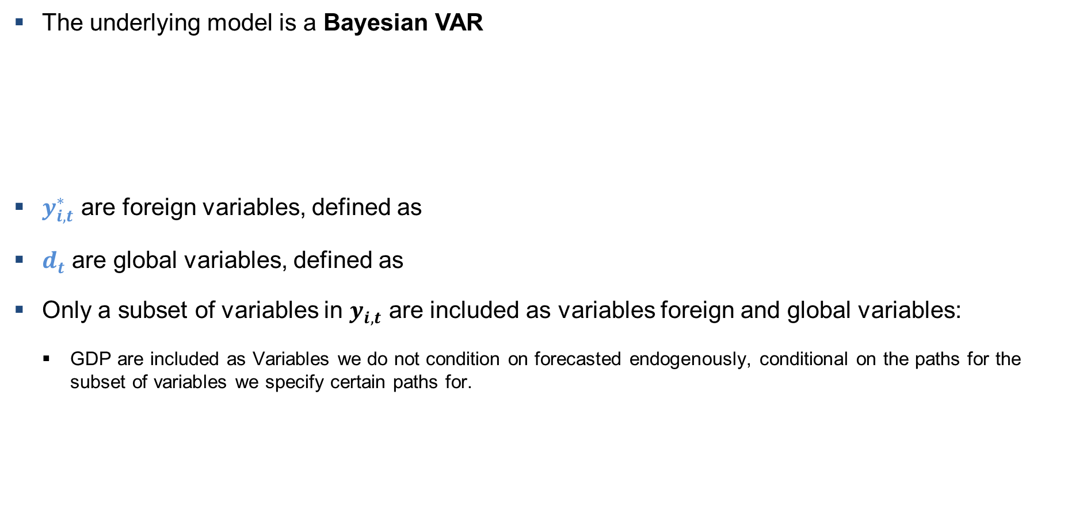
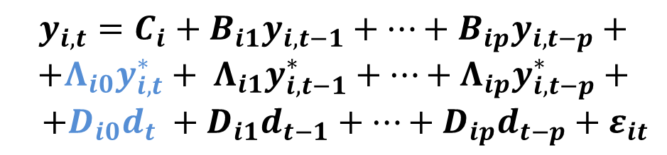
GVAR
The underlying model is a Bayesian VAR
$y_{i,t}^{∗}$ are foreign variables, defined as
$d_{t}$ are global variables, defined as
Only a subset of variables in $y_{i,t}$ are included as variables foreign and global variables:
GDP are included as Variables we do not condition on forecasted endogenously, conditional on the paths for the subset of variables we specify certain paths for.
$$y_{i,t}=C_{i}+B_{i1}y_{i,t−1}+…+B_{ip}y_{i,t−p}+$$
$$+Λ_{i0}y_{i,t}^{∗}+ Λ_{i1}y_{i,t−1}^{∗}+…+Λ_{ip}y_{i,t−p}^{∗}+$$
$$+D_{i0}d_{t} +D_{i1}d_{t−1}+…+D_{ip}d_{t−p}+ε_{it}$$
$ε_{t}\sim N\left(0,Σ\right)$.

