Slide 1
Sociodynamics of Emutopia and Kiwiland relations
Decoy saturation: when do cheap decoys break an air defence?
Story: Emutopia keeps sending “airborne humanitarian food deliveries” to Kiwiland, which would rather not receive them
Question: how do the decoy share and decoy recognition decide if the defence holds?
Hypothesis: above some decoy share the magazines run dry and losses jump
Note: from here on we use military terms, as the situation is surprisingly close to a scenario of that type.
Matyas Patacsi (YA1O1L) · Collective Intelligence, Assignment 1

Slide 2
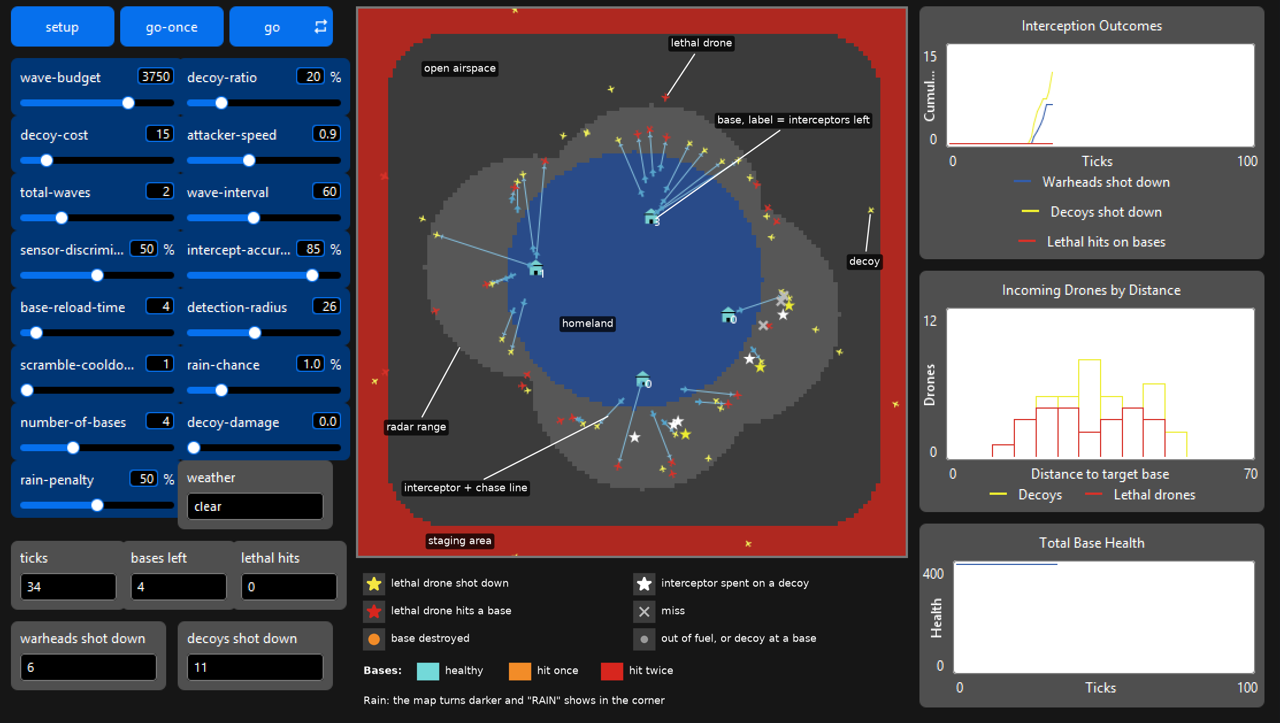
Model
Breeds
Bases 10 interceptors, slow reload
Drones lethal (red) or decoy (yellow)
Interceptors chase one drone, 85% kill
Rules
Decoy recognition aim at a lethal drone, or the nearest
Saturation no ammo, no launch
Rain halves the kill chance

Slide 3
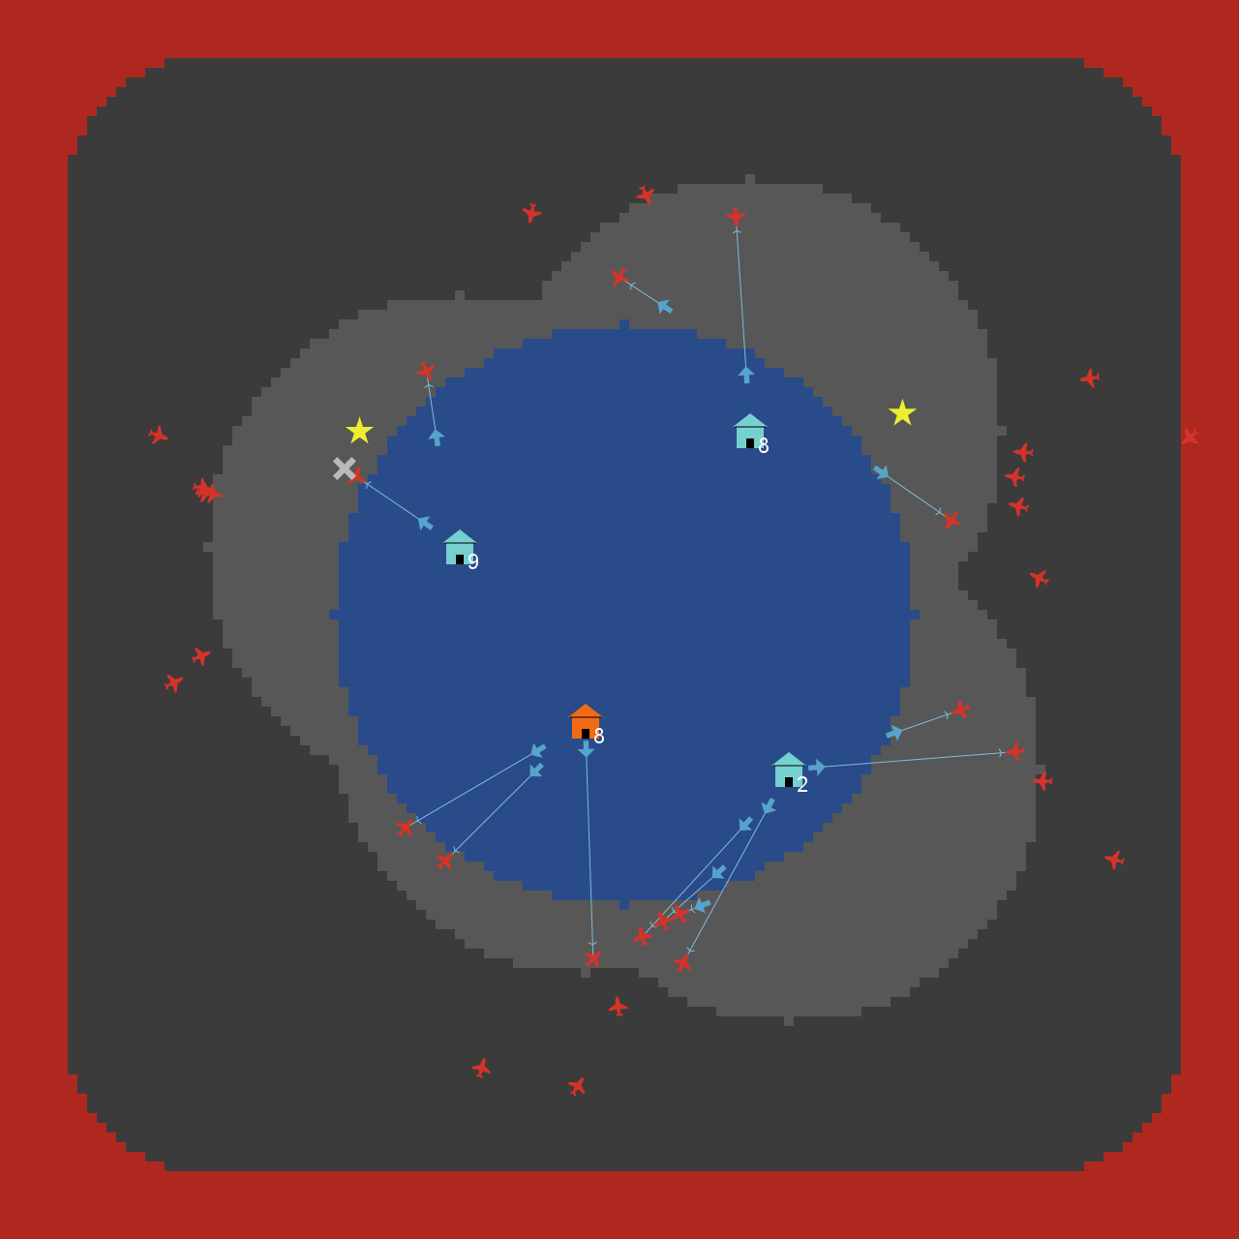
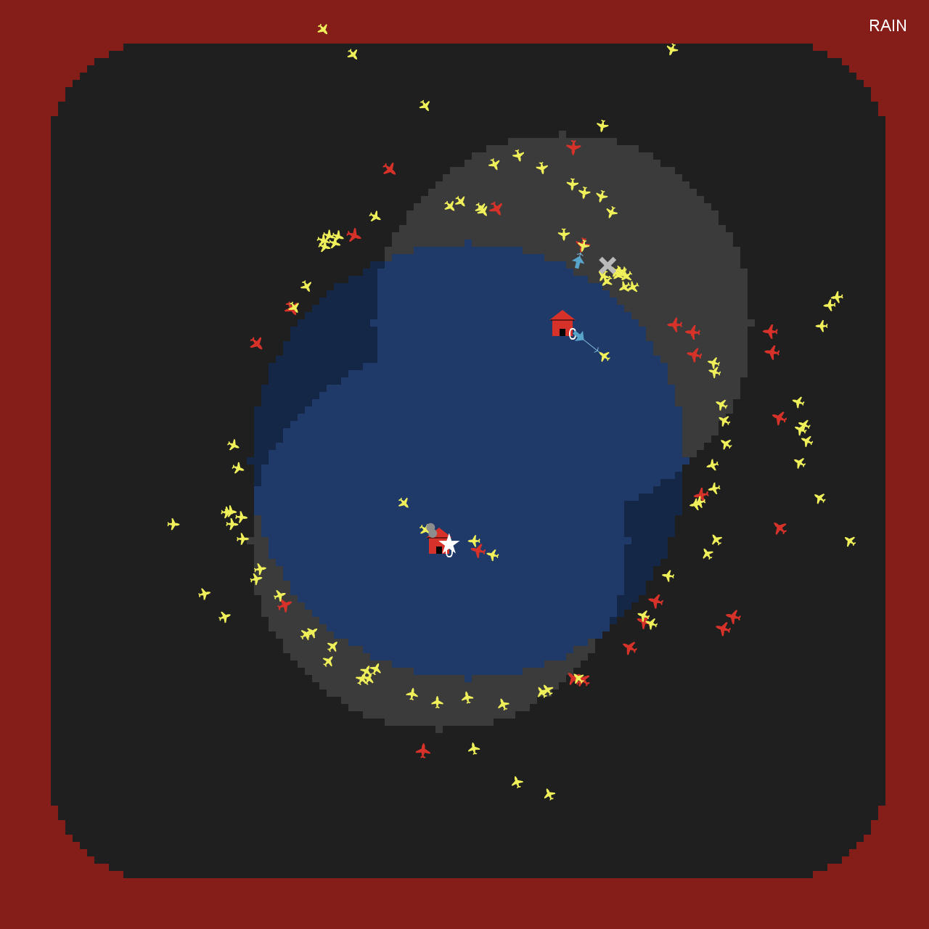
Simulation Snapshots
0% decoys
36% decoys

Slide 4
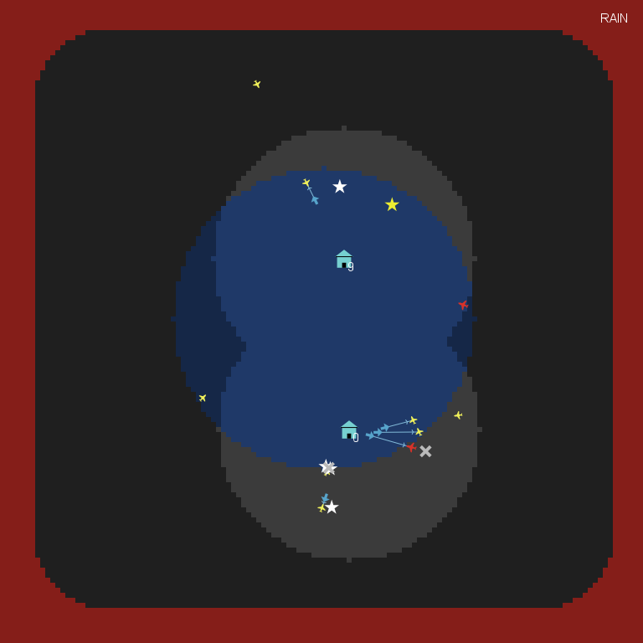

Slide 5
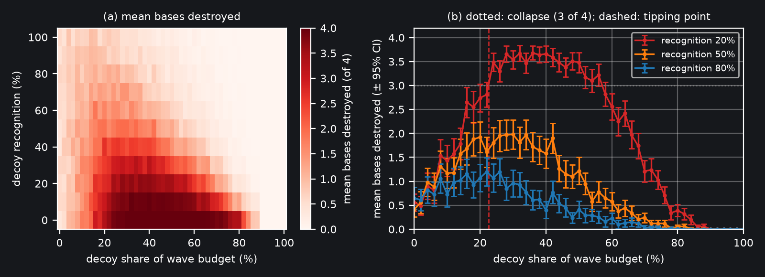
Experiment: decoy share × decoy recognition
BehaviorSpace · 561 settings × 100 runs · bases destroyed, mean ± 95% CI
Tipping point: 22.6% decoys at 20% recognition

Slide 6
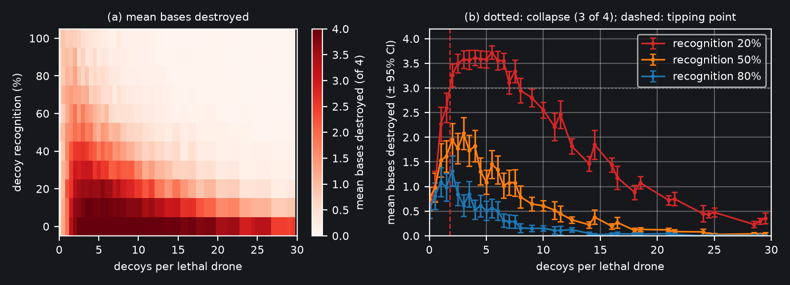
Experiment: decoy share × decoy recognition
BehaviorSpace · 671 settings × 100 runs · bases destroyed, mean ± 95% CI
Tipping point: about 1.8 decoys per armed drone at 20% recognition

Slide 7
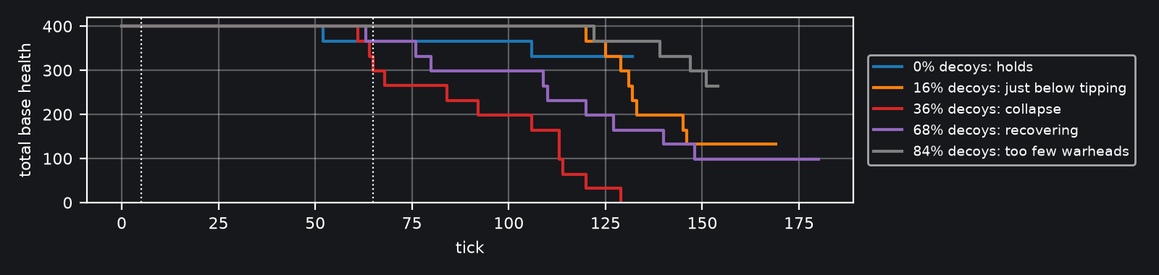
Conclusions
Takeaway: the defense does not degrade slowly, it collapses once ~20% of the budget goes to decoys; after a certain point, there are not enough lethal drones for collapsing the defence
Limitations: straight-flying drones, simple fixed tactics on both sides, no adaptation or dynamic resource management

Slide 8
Thank you for your attention!
Questions?

