Slide 1

Paweł Gągała pawelgagala@gmail.com

Slide 2
About me
Paweł Gągała:
Developer & team lead in Roche
In past worked also in Lufthansa, Jeppesen

Slide 3
Agenda
Why database ?
Why JPA (Java Persistence API) ?
Why Hibernate ?
Hibernate architecutre

Slide 4
Agenda
How use hibernate ?
States of entity
Detais about session interaction
Integration with JEE

Slide 5
Agenda
HQL
Named query
Collection mappings
Validation

Slide 6
Agenda
Inheritance
Criteria
Cache

Slide 7

Feel free to interrupt anytime You
have a questions or doubts :)

Slide 8


Why database ?
We want to store somewhere persistently data
db is just stored collection of information
db can be relational (e.g. MySQL, Oracle) - used by most companies and non relational (e.g. MongoDB)

Slide 9
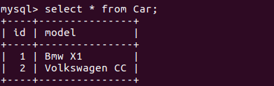
Why database ?
Relational db storing data in tables made of rows and columns
Rows

Slide 10
Why database ?
Relational db storing data in tables made of rows and columns
Rows
Columns

Slide 11
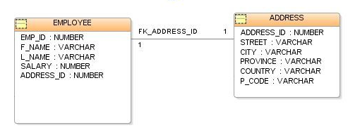
Why database ?
Primary Key
Data in tables are identified by primary keys
Relationships between tables use foreign keys

Slide 12
Why database ?
Primary Key
Data in tables are identified by primary keys
Relationships between tables use foreign keys
Foreign key

Slide 13
Why JPA ?
Database vocabulary is unknown for Java (in java we have inheritence, abstract classes, collections etc. in db relational world we don't have such a structures)
When JVM stops or garbage collector cleans memory content - object and his state disappear

Slide 14
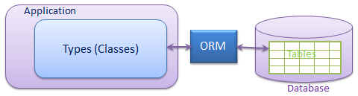
Why JPA ?
JPA brings standard - ORM (object relational mapping). ORM connects world of database and java objects

Slide 15

Why JPA ?
The example of implementation ORM standard is hibernate (there are others like TopLink, JDO – Java data objects)

Slide 16
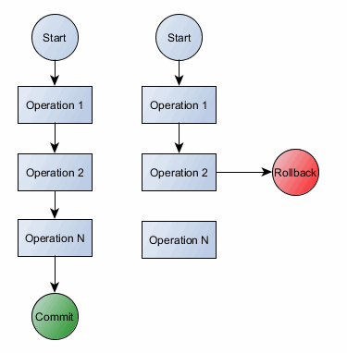
Why Hibernate ?
Remove JDBC boiler-plate code, we can focus on business logic (less code == better)
Supports transaction management - - no inconsistency in data
Transaction

Slide 17
Why Hibernate ?
Transaction – couple of operations gathered together they can be processed all or not processed at all ( provide an "all-or-nothing" proposition)
Transaction

Slide 18
Why Hibernate ?
Transaction can be commited or rollbacked
Commit – all changes are accepted
Rollback – all changes are reverted
Transaction

Slide 19

Why Hibernate ?
Easy to integrate with JEE, other frameworks (e.g. Spring)
Widely used in companies
HQL - powerful query language similar to SQL (but fully object oriented), cache, criteria etc. etc.

Slide 20
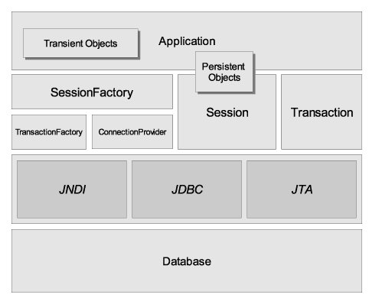
Hibernate Architecutre
org.hibernate.SessionFactory - thread-safe cache with mappings for database, it provides Session instance

Slide 21
Hibernate Architecutre
org.hibernate.Session - represents conversion between application and persistent store. Wraps JDBC Connection object. Factory for Transaction object

Slide 22
Hibernate Architecutre
Persistent objects – Java objects connected with session
Transient objects - Java objects not connected with session (e.g. if session was closed)

Slide 23
Hibernate Architecutre
org.hibernate.Transaction-Factory - provides transactin instance
org.hibernate.Connection-Provider - factory for jdbc connection
org.hibernate.Transaction - atomic units of work

Slide 24
How use hibernate ?
Database installation (we will use MySQL)
Add hibernate-core dependency to Maven
Add database connector dependency to Maven (we will use mysql-connector-java dependency)

Slide 25
How use hibernate ?
Add hibernate config file
Add Entity (Java class) with special annotations which will reflects Your table in database

Slide 26
How use hibernate ?
Add hibernate config file
Add Entity (Java class) with special annotations which will reflects Your table in database

Slide 27
How use hibernate ? - MySQL installation
Open terminal and type "sudo apt-get update"
Type "sudo apt-get install mysql-server"

Slide 28
How use hibernate ? - MySQL installation
Type "sudo mysql_secure_installation" :
  install validation password plugin
  set password validation policy for 0
  don't change password for root
  don't remove annymous user
  don't disallow root login remotely
  remove test database and access to it
  reload privilege tables now

Slide 29
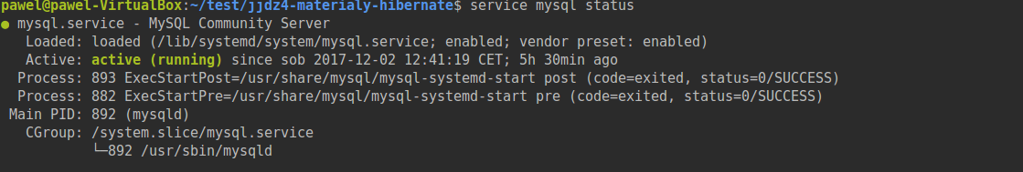
How use hibernate ? - MySQL installation
Check if mysql is running by typing : "service mysql status"

Slide 30
How use hibernate ? - MySQL installation
Login to db using "mysql -u root -p"
Create own user typing: "create user my_username identified by 'my_password';"
Create database by typing: "CREATE DATABASE my_user_databse";

Slide 31
How use hibernate ? - MySQL installation
Grant access to database for own user typing: "grant all on my_user_databse.* to 'my_username' with grant option;"
Type "exit" and login as own user (mysql -u root -p my_username)
Switch to created table by typing: "use my_user_databse"

Slide 32
How use hibernate ? - MySQL installation
Create table by typing:
CREATE TABLE Car (
id bigint(5) NOT NULL AUTO_INCREMENT,
model varchar(50) DEFAULT NULL,
PRIMARY KEY(id)
);

Slide 33
How use hibernate ? - MySQL installation
Primary key with integer type
Create table by typing:
CREATE TABLE Car (
id bigint(5) NOT NULL AUTO_INCREMENT,
model varchar(50) DEFAULT NULL,
PRIMARY KEY(id)
);

Slide 34
How use hibernate ? - MySQL installation
Cannot be null
Create table by typing:
CREATE TABLE Car (
id bigint(5) NOT NULL AUTO_INCREMENT,
model varchar(50) DEFAULT NULL,
PRIMARY KEY(id)
);

Slide 35
How use hibernate ? - MySQL installation
Value of id will be automatically
incremented with new record
Create table by typing:
CREATE TABLE Car (
id bigint(5) NOT NULL AUTO_INCREMENT,
model varchar(50) DEFAULT NULL,
PRIMARY KEY(id)
);

Slide 36
How use hibernate ? - MySQL installation
model column with varchar type (String)
and default value null if we won't provide
any
Create table by typing:
CREATE TABLE Car (
id bigint(5) NOT NULL AUTO_INCREMENT,
model varchar(50) DEFAULT NULL,
PRIMARY KEY(id)
);

Slide 37
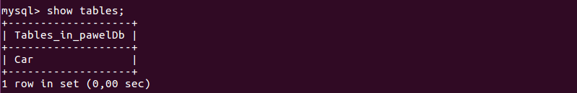
How use hibernate ? - MySQL installation
Verify created table by typing: "show tables;"

Slide 38
Simple Example
We will connect our Car table with java code through Hibernate

Slide 39
Simple Example
We will connect our Car table with java code through Hibernate
Add java class reflecting Car table - entity

Slide 40
Simple Example
We will connect our Car table with java code through Hibernate
Add java class reflecting Car table - entity
Add util service for managing session

Slide 41
Simple Example
We will connect our Car table with java code through Hibernate
Add java class reflecting Car table - entity
Add util service for managing session
Add service with logic responsible for adding records to db / printing records

Slide 42
Excercise 1
Clone repository
Create table "Webpage" which will contain id, address
Add entity reflecting Webpage table
Add service with logic responsible for adding records to db / printing records

Slide 43

More complex example

Slide 44
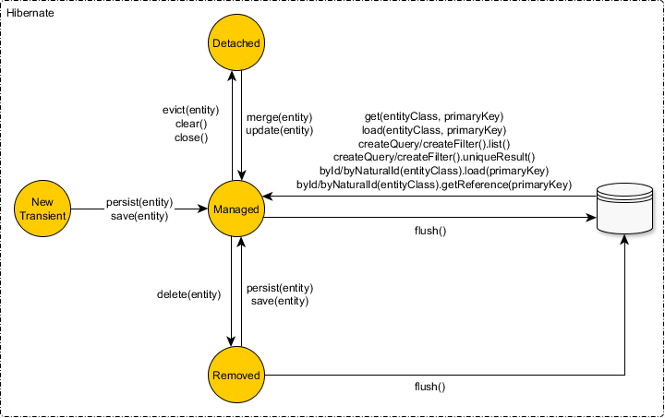
States of entity
Entity not connected with session (persistence context) anyhow

Slide 45
States of entity
Entity connected with particular row in table (persistence context). Any changes will be propagate to connected row

Slide 46
States of entity
When session connected with entity will be closed. Any changes won't be propagate to connected row. Detached entity state can be changed to persistent when we merge entity

Slide 47
States of entity
Entity removed from db

Slide 48
Detais about session interaction – obtaining session
getCurrentSession - fetches session bound to the context. We don't have to explicitly close it (it will be closed when sessionFactory will be closed). As session is not thread safe getCurrentSession shouldn't be use in multi threaded environment

Slide 49
Detais about session interaction – obtaining session
openSession - creates new session and open it. It should be always close after database operations will be done. It should be used in multi threaded application (e.g. in web appliaction for every request)

Slide 50
Detais about session interaction – obtaining session
openStatelessSession - don't use first lvl cache, second lvl cache, doesn't support dirty checking, cascading operations, transactional write-behind. Useful when someone have lots of records and very less memory (otherways out of memory error in cache can occurs)

Slide 51
Detais about session interaction – obtaining session
Dirty checking - auto-detect incoming changes of entity
Transactional write-behind - optimize performance (e.g. every property change in the entity does not cause a separate sql update to be executed)
Caches - in hibernate exists first lvl cache and second - will be explained later in separate chapter

Slide 52
Detais about session interaction – saving/updating table
save - return generated id of entity after call, can be call without transaction
update - transforms passed object from detached state to persistent and update its state in db. Throws error if passed entity is in transient state

Slide 53
Detais about session interaction – saving/updating table
merge - method conforming jpa specification (EJB persistence), same as update but return managed object
saveOrUpdate – as name suggest combination of save or update

Slide 54
Detais about session interaction – fetching data
get - return object from hibernate cache or from db - using when we want make sure that data exists
load - return reference to object which can not exists at all. It loading object from cache or db when its properties will be accessed. Return immediately object with id. It should be used if it is known that data exists

Slide 55
Integration with JEE
We should use standards and standard is entity manager
Hibernate is easy to integrate with JEE, Spring
Interaction with entity manager is really similar to Session object, but easier and less code need to achieve that

Slide 56
Integration with JEE
Entity manager under the hood use Hibernate Session

Slide 57
Integration with JEE - steps
Open JEE project
Add following dependencies to maven file:
<dependency>
<groupId>org.hibernate</groupId>
<artifactId>hibernate-core</artifactId>
<version>5.2.12.Final</version>
<scope>provided</scope>
</dependency>

Slide 58
Integration with JEE - steps
Add following dependencies to maven file:
<dependency>
<groupId>mysql</groupId>
<artifactId>mysql-connector-java</artifactId>
<version>8.0.8-dmr</version>
</dependency>
Run maven „mvn package” command form jee project

Slide 59
Integration with JEE - steps
Create account for wildfly („sh add-user.sh” in wildfly/bin folder)
Start Wildfly („sh standalone.sh” in wildfly/bin folder)
Login to admin panel (http://localhost:9990/) using created account

Slide 60
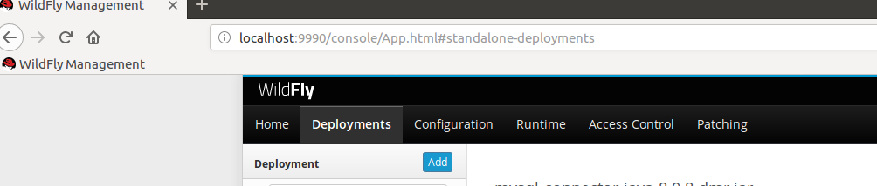
Integration with JEE - steps
Deploy MySQL connector (mysql-connector-java-8.0.8-dmr.jar) – can be taken from target folder created earlier via maven package command

Slide 61
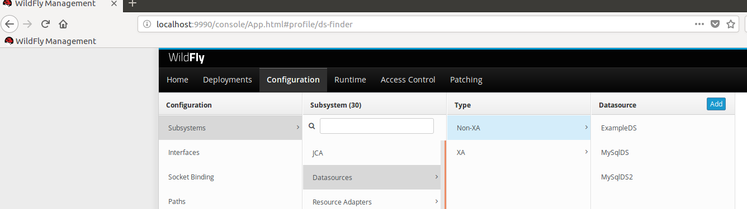
Integration with JEE - steps
Add datasource connected with Your database

Slide 62
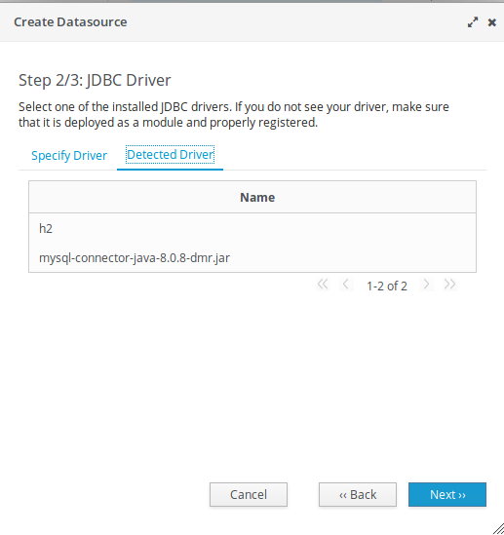
Integration with JEE - steps
Use detected mysql driver in second step

Slide 63
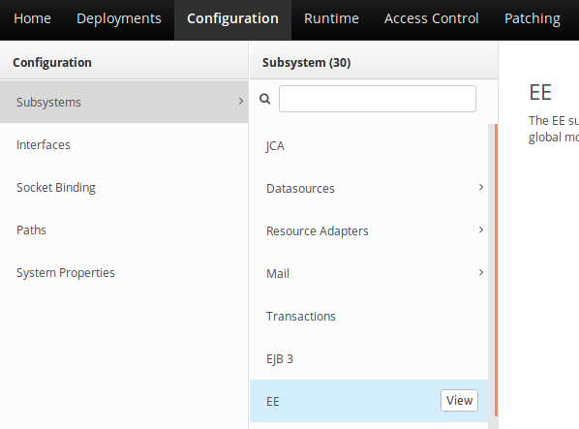
Integration with JEE - steps
Change container default datasource settings

Slide 64
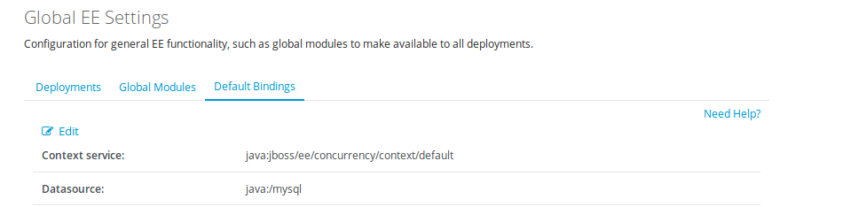
Integration with JEE - steps
Change container default datasource settings

Slide 65
Integration with JEE - steps
Copy hibernate.cfg.xml from hibernate project src/main/resources to JEE project src/main/resources/META-INF

Slide 66
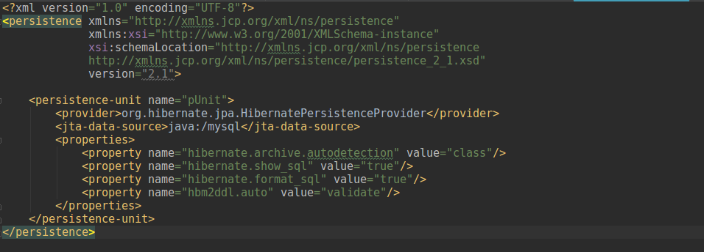
Integration with JEE - steps
Rename hibernate configuration to persistence.xml and adjust it:
Unit which will be used to connect EntityManager to out datasource

Slide 67
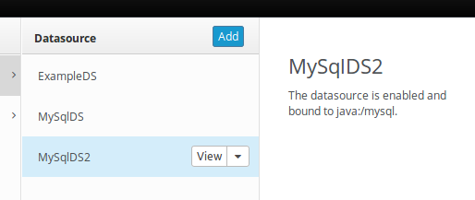
Integration with JEE - steps
Rename hibernate configuration to persistence.xml and adjust it:
Data source added in Wildfly

Slide 68
Integration with JEE - steps
Rename hibernate configuration to persistence.xml and adjust it:
Automatically detectes all entities in project (less code comparing with hibernate config)

Slide 69
HQL
HQL - Hibernate Query Language, object oriented query language of Hibernate. It is very similar to SQL but it based on objects not on tables
Case insensitive – in HQL select it the same as SeLeCt

Slide 70
HQL
Aggtegate functions – min(), max(), avg(), count()
Expressions – arighmetic expressions, binary comparison operators, logical operators (and, or, not)

Slide 71
HQL
Supports order by, group by clauses
You can even execute stored procedures

Slide 72
HQL – basic syntax
Simple query - „from Car” instead SQL native „select * from Car”
Adding attributes - „from Car where model= :model”
Update etc. queries can be constructed using hql as wellll

Slide 73
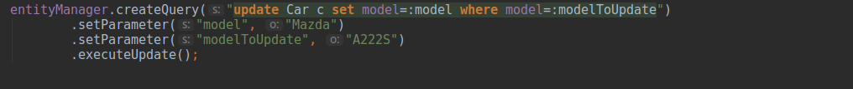
HQL – using with entity manager

Slide 74
Continuation soon...

Slide 75

Thanks!!
Questions?

