Slide 1
Hendrik Borgelt, Alexander Behr ReacOntology
TU Dortmund University
03.11.2023

Slide 2
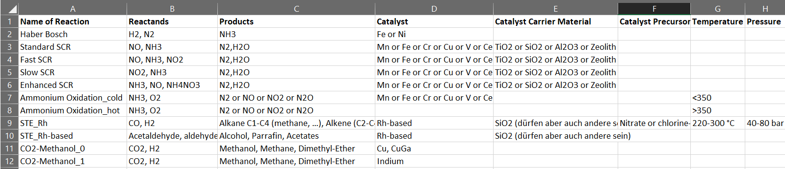
Working Principle of Reac4Cat Ontology
Just once get information on necessary participants in reaction:
Information needed like this ONCE: e.g.: Haber Bosch reaction has N₂ and H₂ as Educts, produces NH₃ and uses Iron or Nickel as catalyst
{HaberBosch:{Educts:[Dinitrogen, Hydrogen],
Products:[Ammonia],
Catalyst:[Iron, Nickel]},
Methanation:{Educts:[Carbon Dioxide, Hydrogen],
Products:[Methane],
Catalyst:[Platinum]},
...}

Slide 3
Working Principle of Reac4Cat Ontology
Just once get information on necessary participants in reaction:
Information needed like this ONCE: e.g.: Haber Bosch reaction has N₂ and H₂ as Educts, produces NH₃ and uses Iron or Nickel as catalyst
{HaberBosch:{Educts:[Dinitrogen, Hydrogen],
Products:[Ammonia],
Catalyst:[Iron, Nickel]},
Methanation:{Educts:[Carbon Dioxide, Hydrogen],
Products:[Methane],
Catalyst:[Platinum]},
...}
Neccessary input from researcher to make use of Reac4Cat Ontology:
„I put in a reactor a mixture containing - among others – Iron, N2, H2, CO2,… and have in my outlet of the Reactor some NH3. What reactions could have caused this?“
{Reaction_reactorXYZ:{Educt mixture:[N2, H2, CO2, Fe],
Product mixture:[NH3, H2O]}

Slide 4
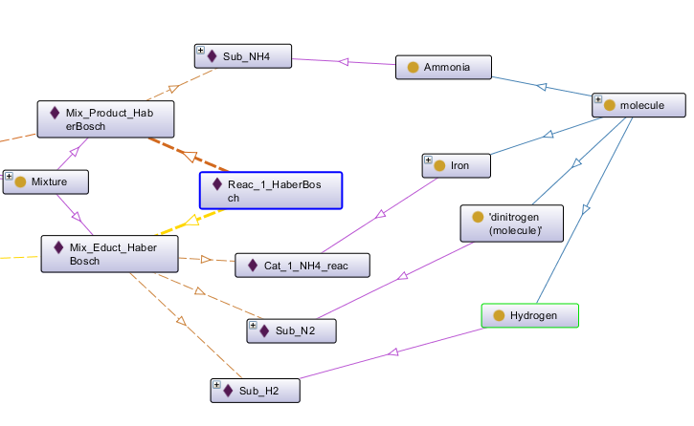
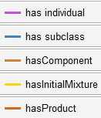
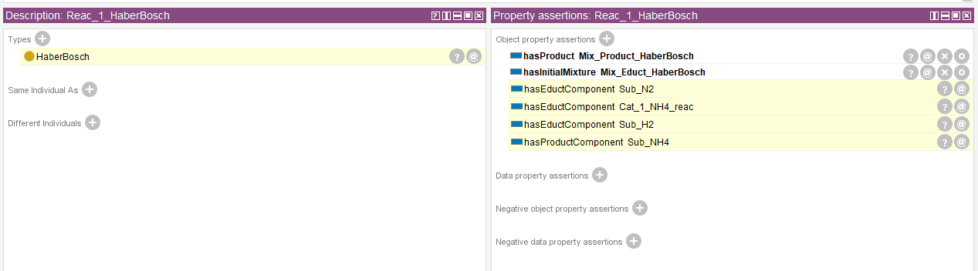
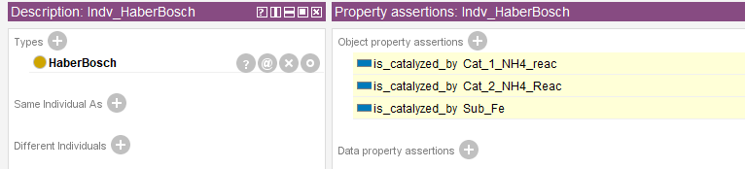
How can this help?
Ontology classifies the Reaction as HaberBosch reaction, also allowing for further investigations into similar reactions
Reasoning yields:

