Slide 1
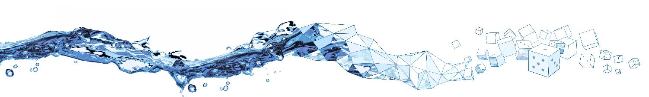

Learning a contaminant transport solver for PFAS with FINN
Introduction
Goals
Done so far
Outlook
Mini-Milestone presentation
Matthias Gültig

Slide 2

Introduction
Basic information
Per- and Polyfluoroalykl substances (PFASs)
Problematic for the environment
Overall objective: Understand mechanisms and processes of PFASs in soil
Collaboration with VEGAS
https://www.mn-net.com/media/image/b6/6e/47/PFAS-sources-wheel-EN.jpg

Slide 3
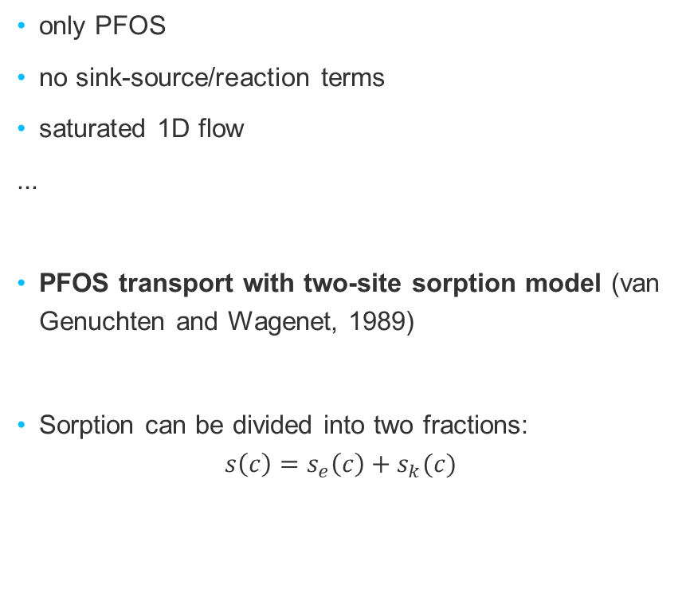

Introduction
Constraints in my thesis
only PFOS
no sink-source/reaction terms
saturated 1D flow
...
PFOS transport with two-site sorption model (van Genuchten and Wagenet, 1989)
Sorption can be divided into two fractions:
$$s\left(c\right)=s_{e}\left(c\right)+s_{k}(c)$$
?
$$c$$

Slide 4





Introduction and Problem Definition
Advection-Dispersion equation with 2SS (AD2SS)
$$s\left(c\right)=k_{d}⋅c^{β}$$
$$\frac{∂c}{∂t}+ρ_{s}\frac{∂s_{e}}{∂t}+ρ_{s}\frac{∂s_{k}}{∂t}=D_{e}\frac{∂^{2}c}{∂x^{2}}−v_{e}\frac{∂c}{∂x}$$
instantaneous
$$s_{e}$$
$$\frac{∂s_{e}}{∂t}=f\frac{∂s\left(c\right)}{∂t}$$
$$c$$
kinetic
$$s_{k}$$
$$\frac{∂s_{k}}{∂t}=α∙\left[\left(1−f\right)s(c)−s_{k}\right]$$
Notes:
Freundlich sorption isotherm

Slide 5
Goals of my thesis
Implementation of solver for AD2SS equation to generate training data for FINN

Slide 6
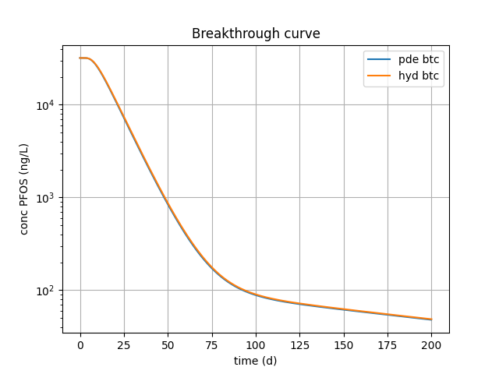
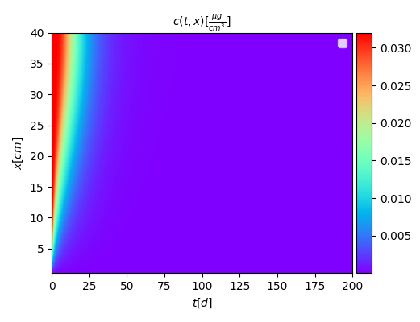
Goals of my thesis – done so far

Slide 7
Goals of my thesis - outlook
Implementation of solver for AD2SS equation to generate training data for FINN
Implementation of AD2SS model in FINN
Perform tests with FINN

Slide 8
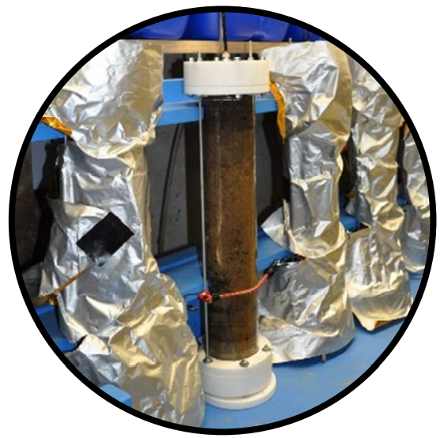
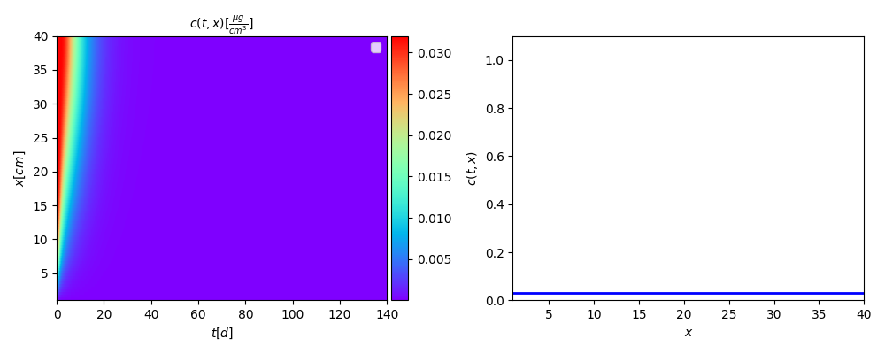
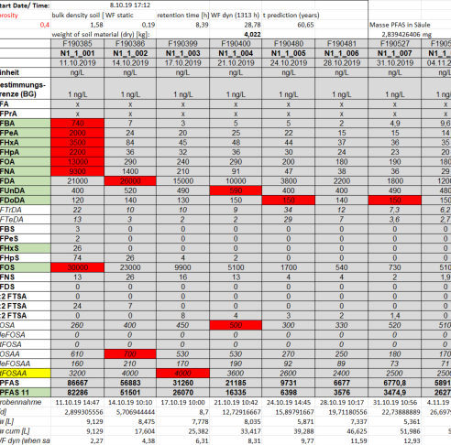
Goals of my thesis - outlook
Experimental data
Depth of column
sand
soil
© Thomas Bierbaum
sand
Time
flux

Slide 9


Thank you!
Matthias Gültig
matthiasgueltig@outlook.de
University of Stuttgart
Stochastic Simulation and Safety Research for Hydrosystems (LS³)
iws-ls3.uni-stuttgart.de

Slide 10
Status so far
Simulated Data – Hydrus 1D
used to validate PDE solver before include into FINN
soil
Time
flux

Slide 11
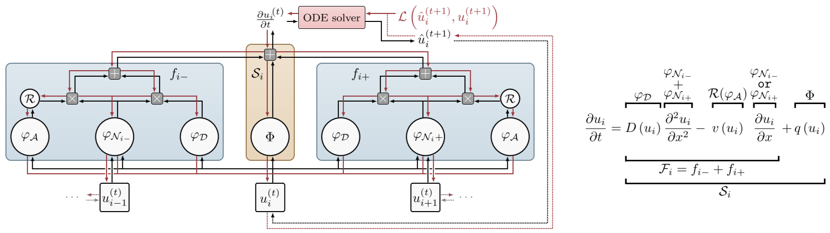
FINN (Finite volume Neural Network)
powerful tool for learning spatiotemporal advection-diffusion processes

Slide 12

Done so far
Diffusion sorption model in FINN so far:
$$\frac{∂c}{∂t}=\frac{D_{e}}{R}\frac{∂^{2}c}{∂x^{2}} \left(1\right), \frac{∂c_{t}}{∂t}=Dn_{e}\frac{∂^{2}c}{∂x^{2}} (2)$$
AD2SS
$$\frac{∂c}{∂t}+ρ_{s}\frac{∂s_{e}}{∂t}+ρ_{s}\frac{∂s_{k}}{∂t}=D_{e}\frac{∂^{2}c}{∂x^{2}}−v_{e}\frac{∂c}{∂x}$$

Slide 13

Done so far
with
$$R=\frac{1}{n_{e}}\frac{∂c_{t}}{∂c}, c_{t}=n_{e}c+ρ_{s}s(c)$$
Transformation into:
$$R\left(c,\frac{∂c}{∂t}\right)⋅\frac{∂c}{∂t}=D_{e}\frac{∂^{2}c}{∂x^{2}}−v_{e}\frac{∂c}{∂x}−f\left(c,c_{t}\right) (3)$$
$$\frac{∂c_{t}}{∂t}=g\left(c,\frac{∂c}{∂t},c_{t}\right) (4)$$

