Slide 1
Project 1

Slide 2
Overview of the evaluated models
k-nearest neighbours (k = 3) (kNN)
Quadratic Discrimamant Analysis (QDA)
Logistic Regression (LR)

Slide 3
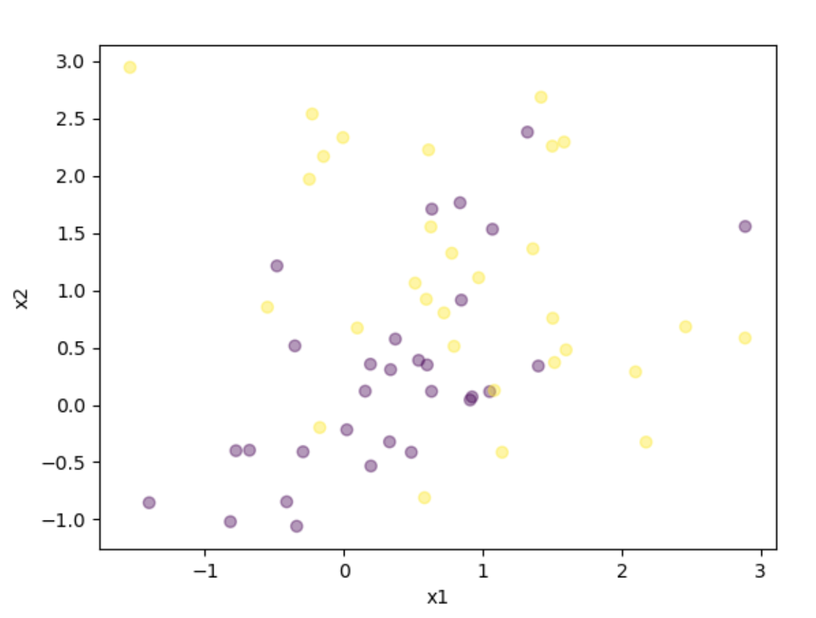
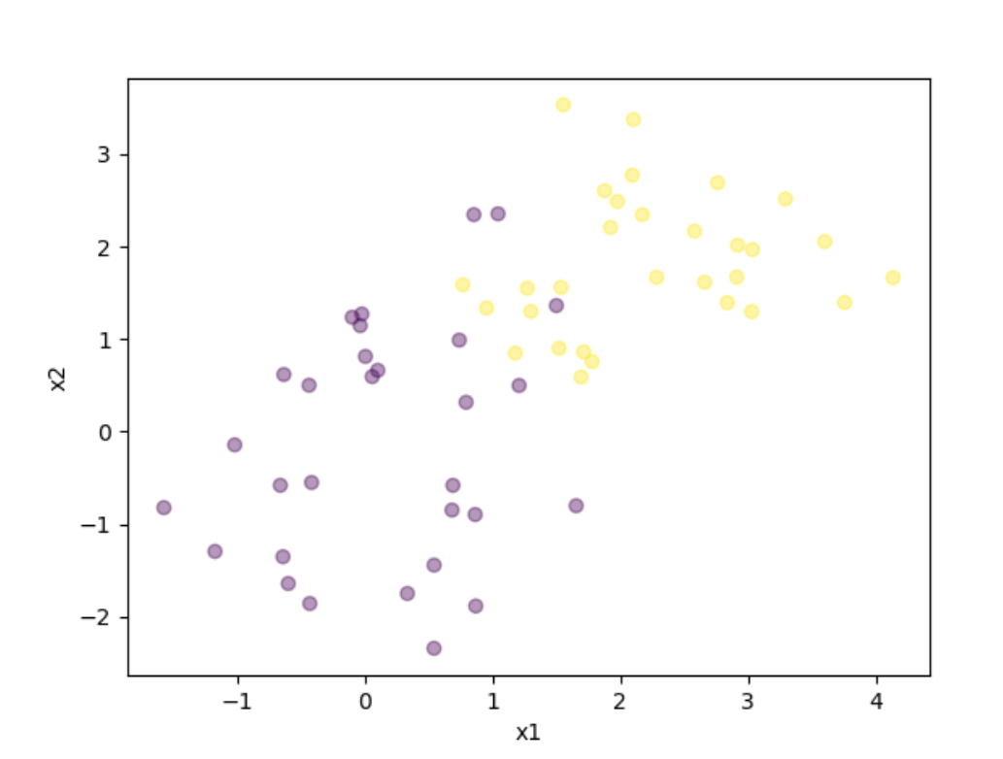
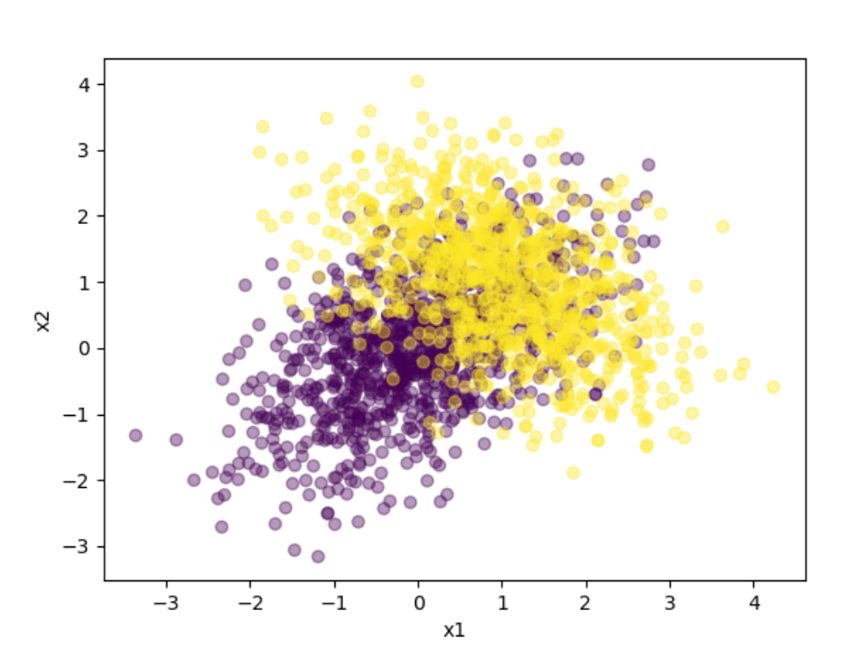
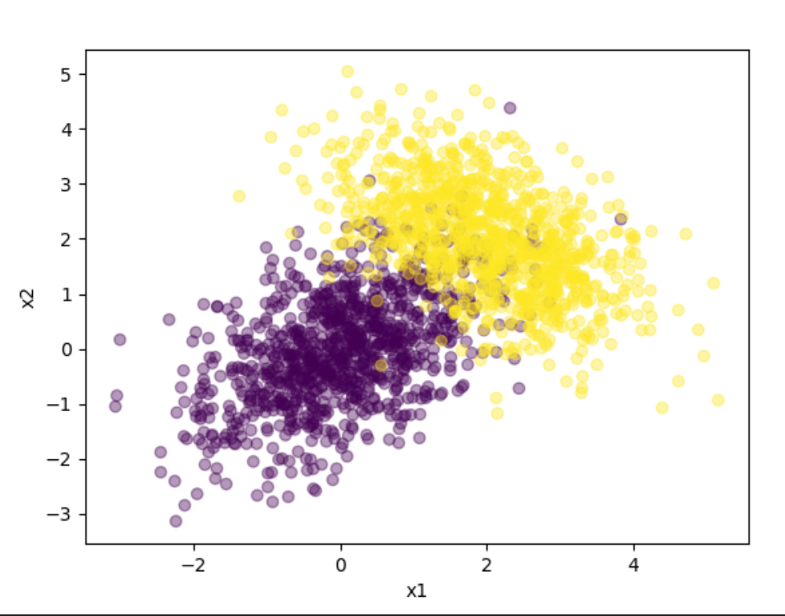
Q1: Assumptions for the datasets
less data, hard boundary
less data, simple boundary
much data, hard boundary
much data, simple boundary
Expectations (JUSTIFY!!!?)
kNN
QDA
LR
kNN
QDA
LR
kNN
QDA
LR
kNN
QDA
LR

