Slide 1
recruiter-in-a-box
How I used Claude AI to help find a job search make my application process a little easier.
Michael Aubry
www.linkedin.com/in/aubjobm/
https://github.com/maubryPython/recruiter-in-a-box

Slide 2
Job Hunting is the worst
Endless searching across too many websites
Stale, out-of-date job application links
Redundant data entry
Hurry up and wait
Notes:
Endless searching across too many websites.
Stale, out-of-date job application links.
Redundant data entry.
Ex: Do not list addresses or exact dates on your resume, but do manually reenter them in Workday.
Conflicting job application advice
Use AI, but don’t look like you use AI.
Ex: List the exact skills the posts list that you have, but not unless you have five years of experience in that exact thing listed as bullet on your resume.
Hurry up and wait.
Apply. Wait a month. Recruiter schedules an interview… in two weeks. Pass. Schedule next interview… next week. Repeat until disqualified.

Slide 3
I can’t help with all that, but…
I can:
Encourage you. (Keep going!)
Reassure you. (You will get through this!)
Show you what I’ve learned. (Use this!)
Most of the interviews I received were through networking.
But this method is what actually got me a job.

Slide 4



This is how I search for jobs:
Claude
jobSearch
resumeStart
Launch Claude. ($20/month)
“Use jobSearch to find 5 jobs to apply for”
“Use resumeStart to for <insert job post>”

Slide 5
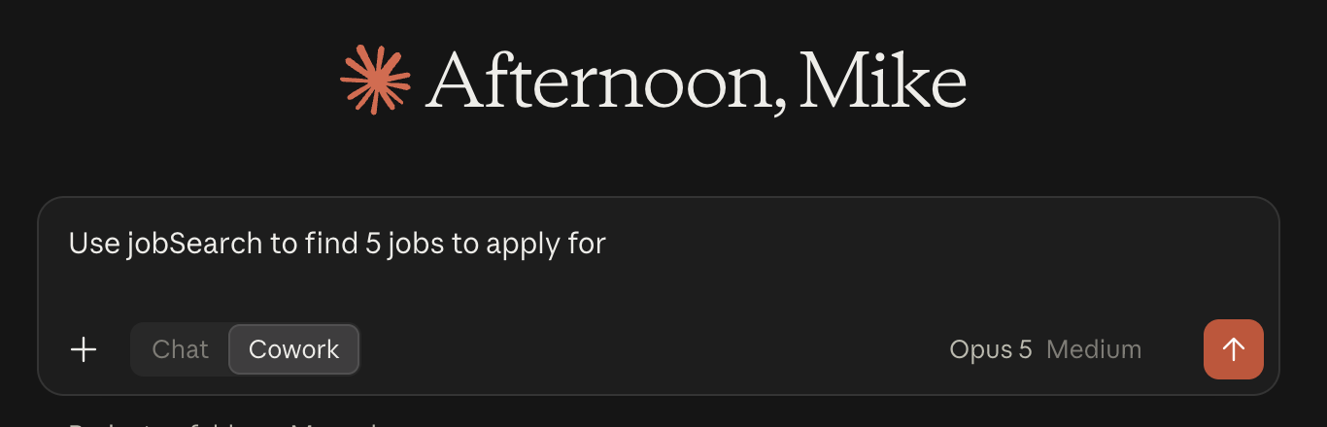
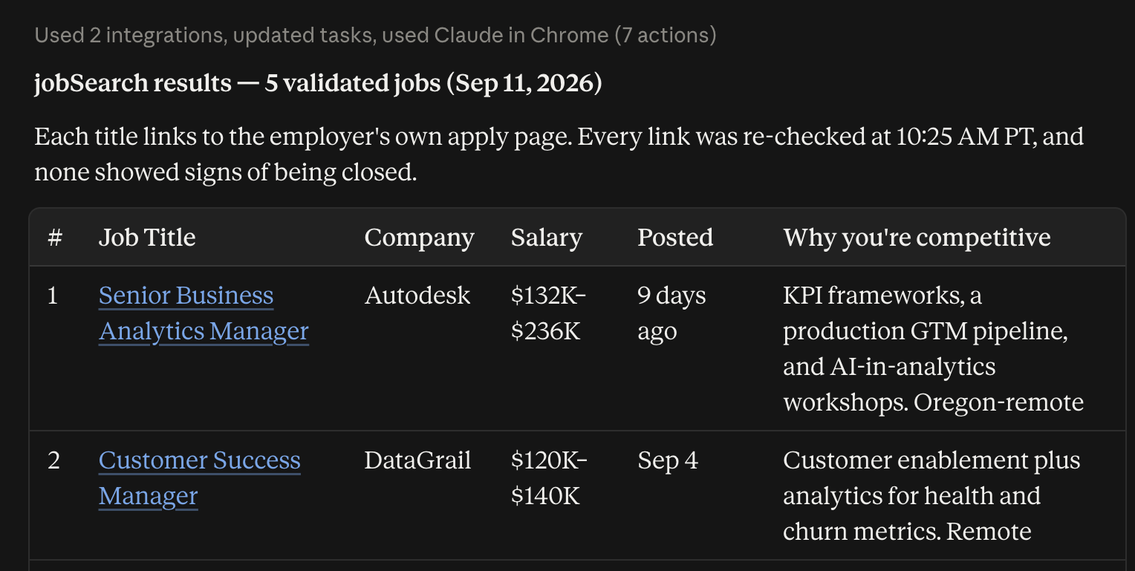
First, I search for jobs:
jobSearch
“Use jobSearch to find 5 jobs to apply for”

Slide 6
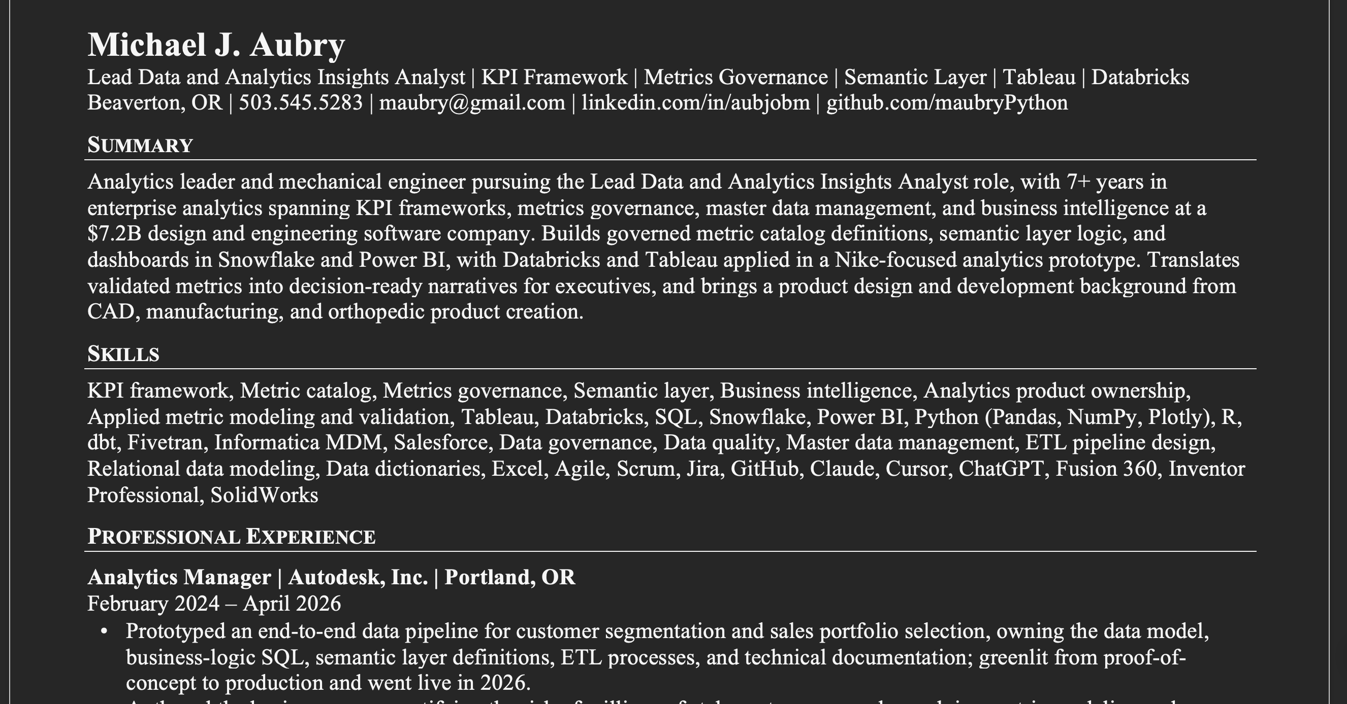
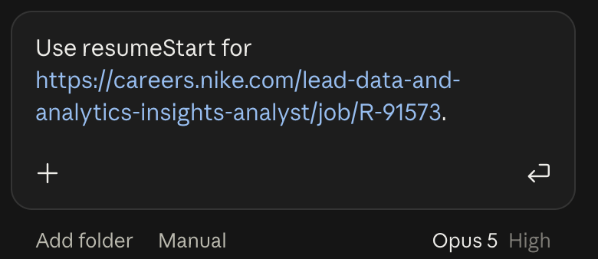
Then, I convert posts to resumes:
resumeStart
“Use resumeStart to for <insert job post>”

Slide 7
This method is not magic:
Treat this as a supplemental job search and application tool. It isn’t automatic.
Do not stop networking. This helps, but most of my opportunities came from my network.
Don’t blindly trust it.
  Don’t submit slop.
  Always proofread whatever you submit. It’s rare, but it will hallucinate qualifications.
Sometimes the validation links fail. Update as is relevant.
(It will get you started though!)

Slide 8
Demo

Slide 9
Step 1 — Ask jobSearch
1
One sentence starts it
No filters to fill in. The skill already knows the target roles, the Portland-or-remote rule, the 14-day window and the $90k floor.

Slide 10
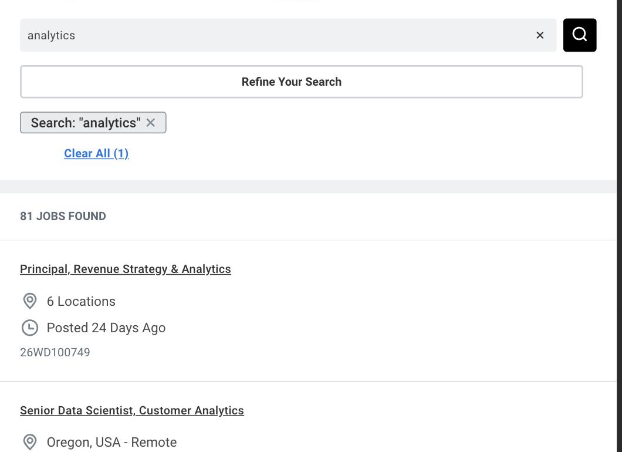
Step 2 — It searches employer sites first
2
Not the job boards
Autodesk, Trimble and Nike every run, in their vocabulary as well as mine. Their sites show the true posted date.

Slide 11
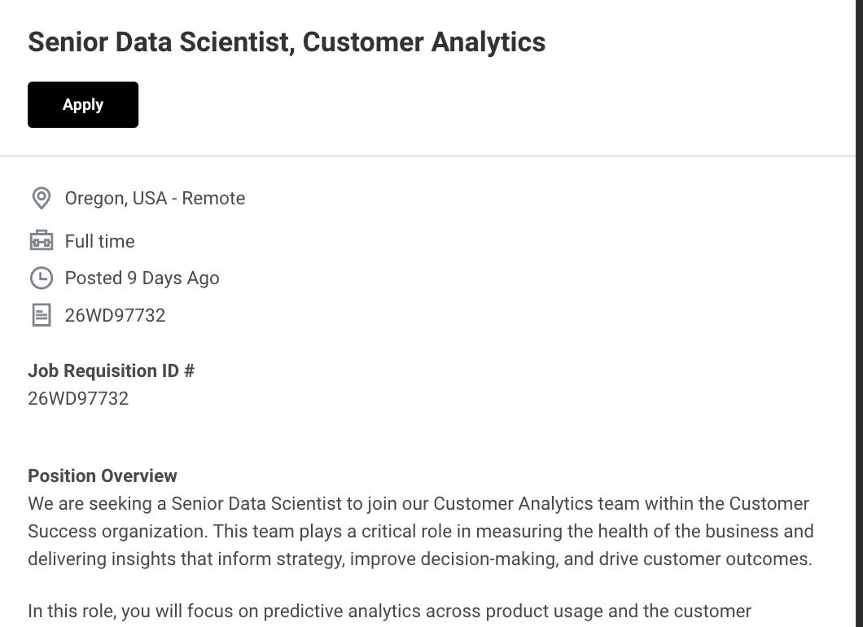
Step 3 — Every posting gets checked
3
Live, on the employer’s page
Fetch the page, scan it for “no longer accepting” and “page not found”, and take the posted date from the employer.

Slide 12
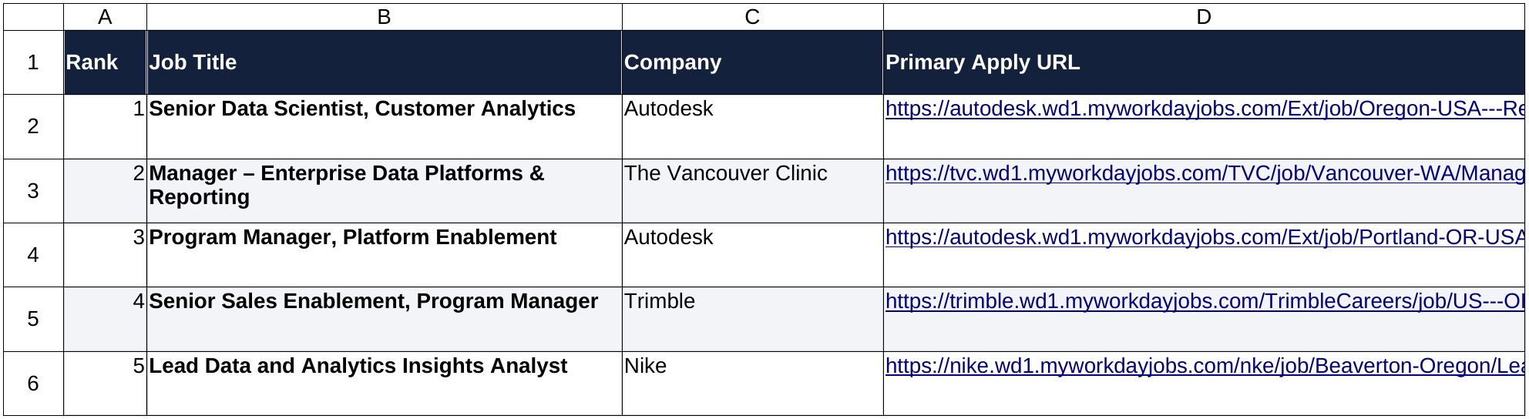
Step 4 — Results output to a spreadsheet
4
Apply links you can click
Ranked by pay, fit and recency, with what got filtered out and why. Column 4 is always the employer’s own application link.

Slide 13
Step 5 — Hand the job to resumeStart
5
Point it at the posting
“Prepare a resume for #1”, or paste the job URL. It asks: ATS or human-readable, IC or manager, which themes, cover letter?

Slide 14
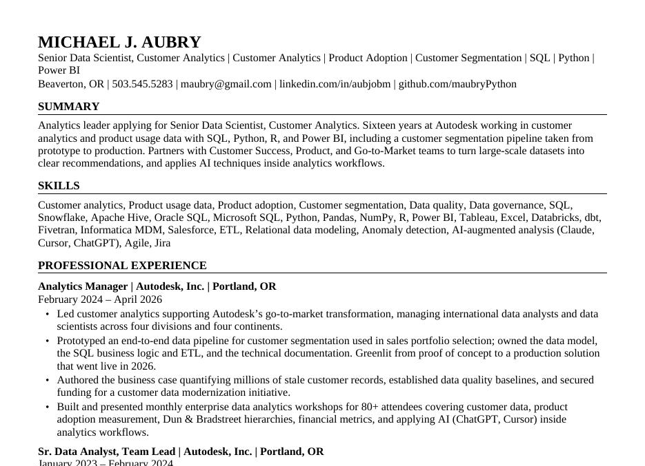
Step 6 — A tailored resume
6
Built for either a human or a parser
Each resume strives to use the posting’s exact words and apply to my real experience. Gaps are left out, not invented.

Slide 15
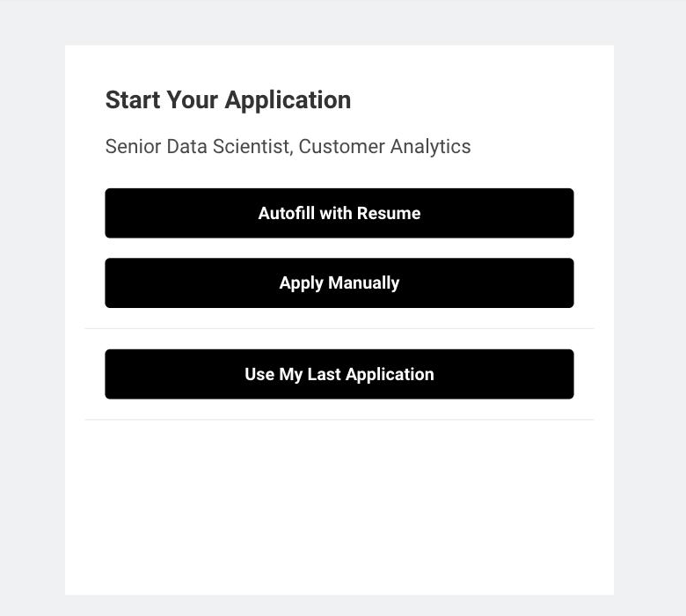
Step 7 — Apply
7
Autofill with Resume
Single column, no tables, a company name in every role block — so Workday fills the employer fields instead of leaving them blank.

Slide 16
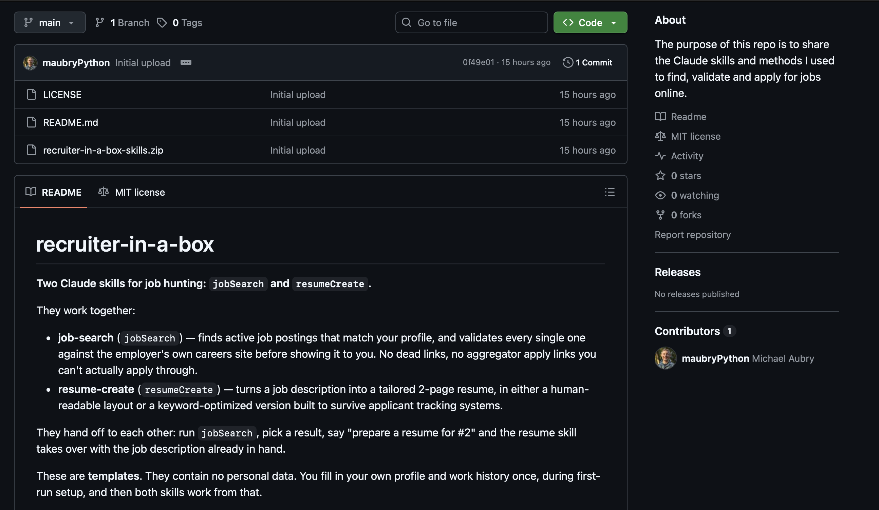
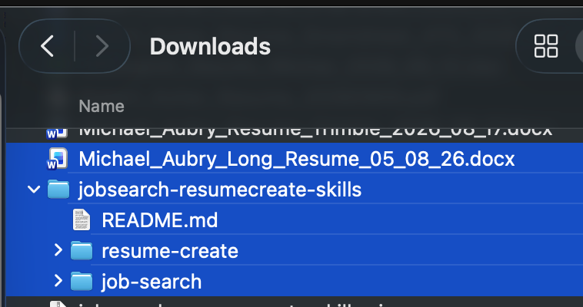
Where to download: https://github.com/maubryPython/recruiter-in-a-box

Slide 17
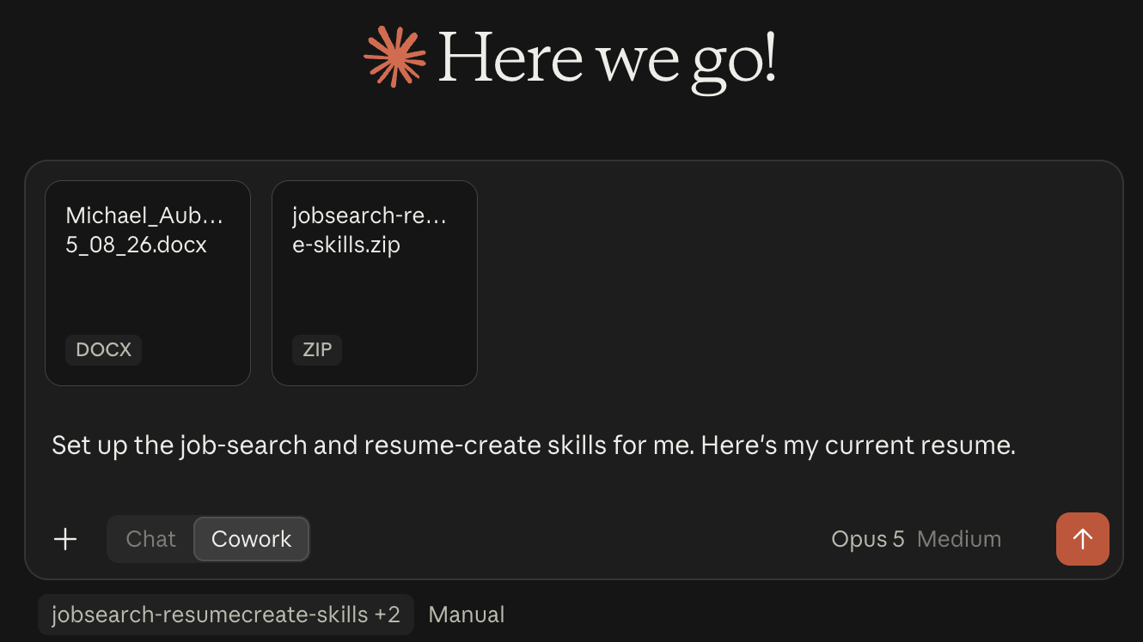
How to Start: https://github.com/maubryPython/recruiter-in-a-box

