Slide 1
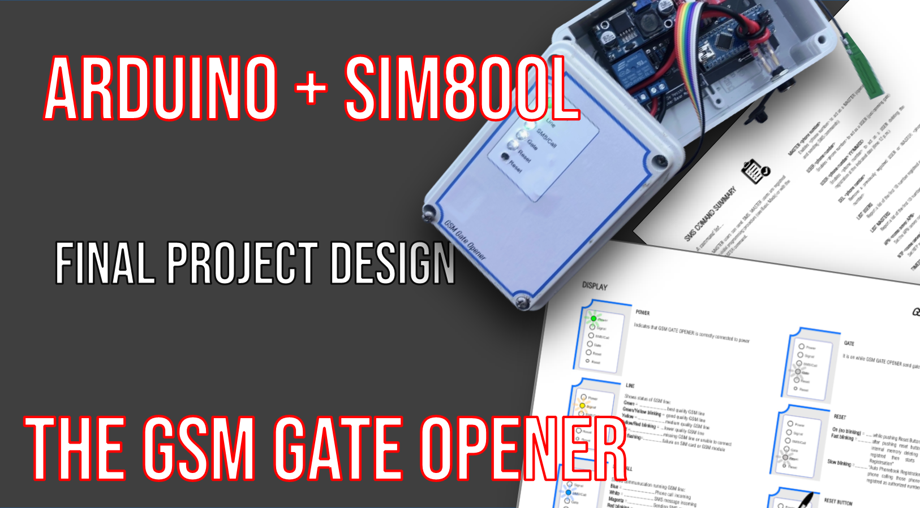

Slide 2
Arduino + SIM800L = Apricancello GSM
EXTENDING design SPECIFICATIONS
3 operating modes
basIC
Configuration setting with no SMS
For “easier” user needs
EXTENDED
“Extending” use of gate opener to
“authorized” people. Using SMS.
PRO
Needing recurring authorization updates (B&B, holiday homes)
Using SMS and calendar.

Slide 3
“BASIC” MODE
Configuration settings without commands: no SMS Ref.: WPS tool over domestic WiFi setup
USE
Push a button on gate opener module
Gate opener enters in «registration mode» for 5 minutes
Calling phones are registred as authorized numbers enabled to open the gate
Gate opener deletes previously stored phone numbers

Slide 4
“EXTENDED” MODE
Using SMS, add authorization without whole phonebook reset
Two kind of users: «MASTER» can open the gate and add new authorizations, «USER» can only open the gate
Start configuration storing at least 1 Master with reset button (Base mode)
SMS commands:
USER <phone number> - registers USER user MASTER <ph.num.> - registers MASTER user DEL < phone number > - delete a user LIST USER/MASTER- list registred users

Slide 5
“PRO” MODE
Let masters register phone numbers with a «expiration date». After that date phone number is removed from phonebook.
Need to set GPRS e NTP parameters.
More commands:
USER <phone number> YY/MM/DD APN <server name> NTP <server name> TIMEZONE snn CONFIG – current configuration list

Slide 6
LED: checking running activities
POWER Led
power on (check 4V line)
Line status Led
shows GSM signal level or network errors
Calling Led
shows incoming calls, incoming/outgoing SMS
Gate Led
shows sending gate command
Reset push-button
starting phonebook reset procedure
Reset led
shows status of reset procedure

Slide 7
Remote monitoring Arduino activities
Every SMS makes gate opener to send a reply SMS
Check each Arduino activity working time
Average time
Max time
Added command:
STATS – Send the times report

Slide 8
Riepilogo comandi
SMS (only for master)
a- USER <phone_number>
a- USER <ph_number> AA/MM/GG
a- MASTER <phone_number>
a- DEL <phone_number>
b- LIST USERS
b- LIST MASTERS
c- APN <APN_server_name>
c- NTP <NTP_server_name>
c- TIMEZONE <sxx>
d- CONFIG
e- STATS
INCOMING CALL(for master and user)
Apertura del cancello
RESET PUSH_BUTTON
Phonebook reset and initial masters registration

Slide 9
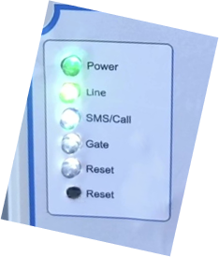
Display
W: quando il tasto è premuto
bl. W - fast: reset started, emptying phonebook
bl. W - slow: waiting calls for master registration
(5 minutes time)
G: If powered
G: max GSM signal level
G/Y: good level
Y: average level
Y/R: blow GSM level
R: no GSM/no network connection
bl. R: SIM card or SIM800L failure
Reset button: keeping pushing for 5 sec, starts phonebook reset and new masters registration
B: incoming phone call
W: incoming SMS
M: outgoing SMS
bl. R: APN/TIMEZONE/NTP not set
slow: RTC unused
fast: needing RTC but unset
Startup
Testing leds turning all on
legenda
G = green
Y = yellow
R = rosso
B = blue
M = magenta
W = white
bl. = blinking
W: quando apre

