Slide 1
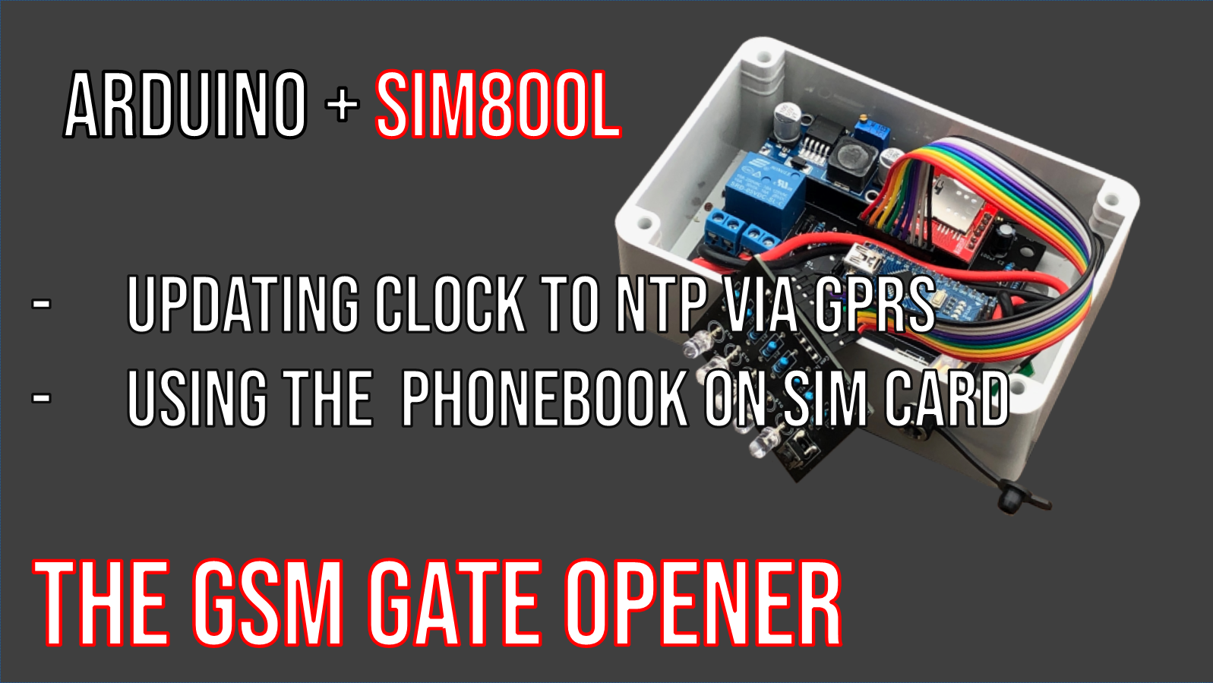

Slide 2
SIM800 clock
AT+CCLK?
Get date/time from SIM800 clock
AT+CCLK= "yy/MM/dd,hh:mm:sS±zz"
Set SIM800 clock (ZZ is time zone multiplied by 4)

Slide 3
SIM800 GPRS
AT+SAPBR=3,1,"Contype","GPRS” GPRS request «declaration»
AT+SAPBR=3,1,"APN","wap.tim.it” defining APN of the service provider
AT+SAPBR=1,1 start GPRS data communication
AT+SAPBR=2,1 verify GPRS communication
AT+SAPBR=0,1 close GPRS communication

Slide 4
Sync SIM800 clock via SNTP
AT+CCLK= " 01/01/01,01:01:01±08
Set SIM800 clock with a known date and Italy TZ (+2)
(While GPRS is ON)
AT+CNTPCID=1 activate «bearer 1»
AT+CNTP="time.inrim.it",8 defining NTP server and timezone
AT+CNTP clock syncronization
AT+CCLK? If returning "01/01/01.." syncronization went wrong

Slide 5
Warnings
No automatic adjust for daylight saving
You need to manage in your sketch the need the adjust the clock
Synchronization may fail
There is a non-zero possibility that SNTP sync fails: clock may be unchanged or set to 0.

Slide 6
SIM card phonebook
AT+CPBW=<index>,<ph_num>,,<name>
Stores <ph_num> and <name> in the <index> phonebook position.
- using the first free location if <index> not indicated
- if only <index> in command, it delete content
AT+cpBr=<index>
Returns data in <index> pos. in phonebook.
AT+cpBF=<text>
Find recordings having <text> in number or name

Slide 7
Automatic caller recognition
if AT+CLIP…
Setting AT+CLIP=1, SIM800 notifies caller info on phone call or SMS income
… notification reports even the name
“+CLIP” (incoming call notification) e “+CMTI” (incoming SMS notification) report both caller phone number and related name stored in phonebook.
Name is blank id caller is not in phonebook

Slide 8
Syncing SIM800 clock to NTP server
Managing phonebook on SIM card
// set clock to a known date
AT+CCLK="01/01/01,01:01:01+08”
//starting GPRS
AT+SAPBR=3,1,"Contype","GPRS"
AT+SAPBR=3,1,"APN","wap.tim.it"
AT+SAPBR=1,1
AT+SAPBR=2,1
// syncing clock to NTP
AT+CNTPCID=1
AT+CNTP="time.inrim.it",8
AT+CNTP
AT+SAPBR=0,1
// verify
AT+CCLK?
// storing in phonebook
AT+CPBW=,11223344,,Nome
// listing phonebook content
AT+CPBF
// caller control
Incoming “+CLIP” e “+CMTI” report number and name

