Slide 1
API Example Setup Guide

Slide 2
Hardware and software requirements
Hardware requirements:
Nucleo F401RE
X-NUCLEO-53L1A1
Windows PC
SW requirements
STSW-XXX
Nucleo F401RE
X-NUCLEO-53L1A1

Slide 3
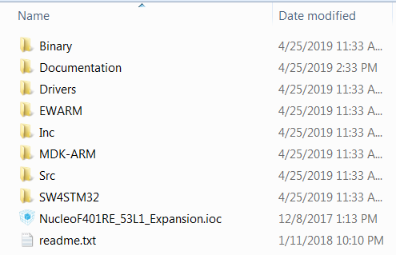
Example folder content
Search for STSW-XXX on st.com, download and unzip the file in your hard drive C:\ recommended.
Go to the “Example” folder
The example project has been pre-compiled for IAR, KEIL and Eclipse as shown below
Contains binary application file
VL53L1X ULD API and other STM32 drivers
Precompiled IAR project
Precompiled KEIL project
Precompiled Eclipse project

Slide 4
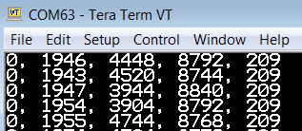
Run the example
Plug the expansion board on the F401RE Nucleo board
Connect the F401RE Nucleo board to a PC USB port
Flash the demo application by drag and drop the binary file located in the Binary directory, the demo will start immediately once the FW is loaded
Open a Tera-Term to monitor the ranging data
Range status, distance in mm, return signal rate, ambient rate, number of actual active SPAD

Slide 5
Modifying, compiling and running the example code
The example code is precompiled for the most popular professional IDEs
(KEIL,IAR and Eclipse)
I suppose that you already have your favourite IDE and familiar with.

