Slide 1
Big Five Psychometric Analysis

Slide 2
Table of Contents
The Data: 3
Data Cleaning: 4
General Descriptive Statistics: 5
Validity Analysis: 6 - 9
Reliability Analysis: 10
Mean Differences: 11 - 30
Regression Analysis: 31 – 35
Code: 36
Backup: 37

Slide 3
The Data
Data was collected through an interactive online Big Five Personality test.
Over 19,000 respondents.
Questions measured Extroversion, Neuroticism, Agreeableness, Conscientiousness, and Openness.
Questions were measured on a Likert Scale (0: Missed, 1: Disagree, 3: Neutral, 5: Agree).
Demographics recorded were race, gender, age, if English was their natural language, dominant hand, country, and source.
All data was imported, cleaned, modeled, and visualized in Rstudio.

Slide 4
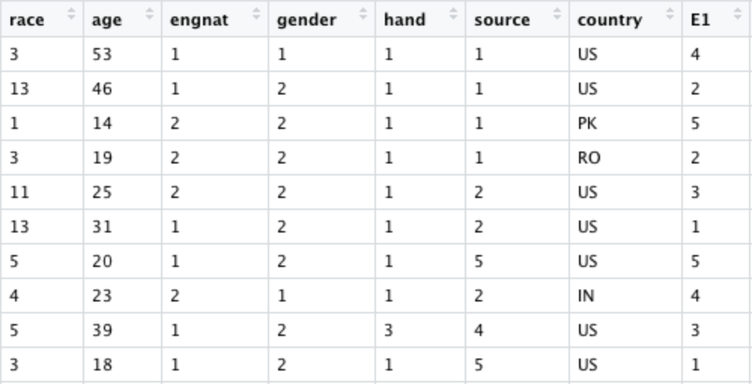
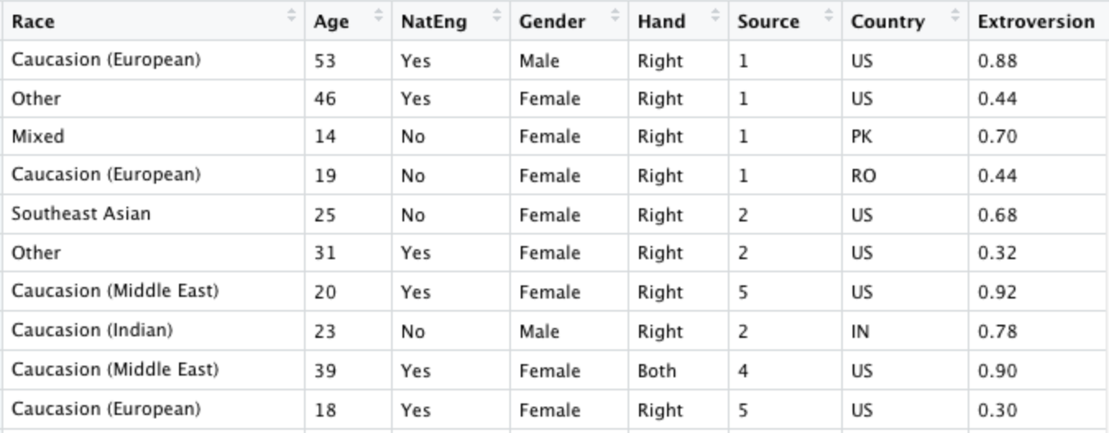
Data Cleaning
Subscales that were reversed scored were adjusted.
Column names and values were renamed for readability.
Categorical variables were converted to factors.
Some respondents put year of birth as their age response. This was adjusted for by subtracting their year of birth from 2012 (the year they took this test).
Scale composite scores were generated as an average of their subscale responses.
Some responses reported ages of less than 0 and greater than 110. These cases were removed.
Composite scores were placed after the demographics and before the subscale scores.

Slide 5
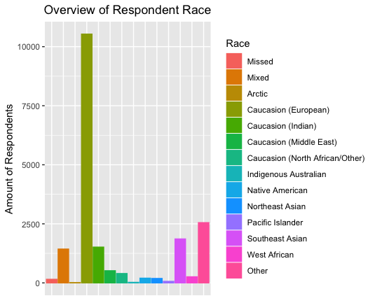
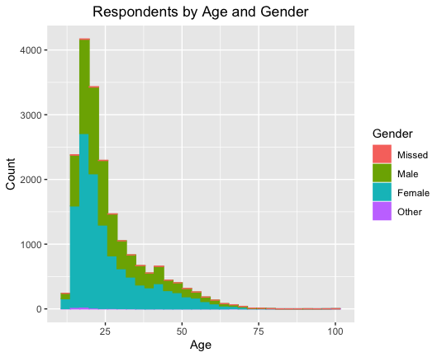
General Descriptive Statistics

Slide 6
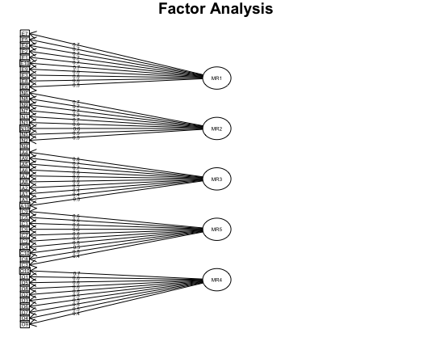
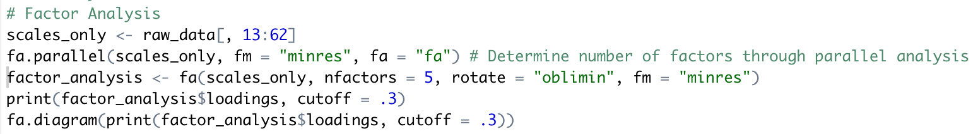
Validity Analysis
Factor Analysis was used to validate scales.
A cutoff value of .3 for the loadings was used to improve factor visibility.
Scales were validated.

Slide 7
Validity Analysis
Convergent and discriminant validity were also used to validate the scales through the mtmm() function.
We want subscale scores to be correlated with other subscale scores within that scale, and not correlated with subscale scores not in that scale.
Scale
1: Extroversion
2: Neuroticism
3: Agreeableness
4: Conscientiousness
5: Openness

Slide 8
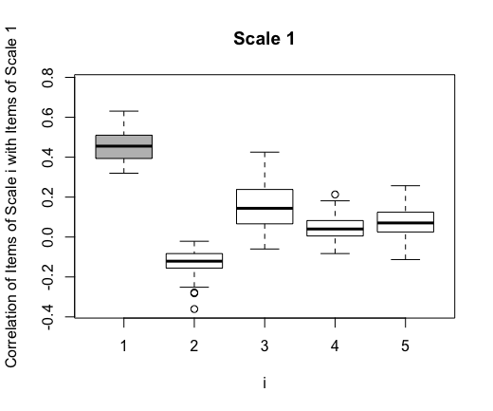
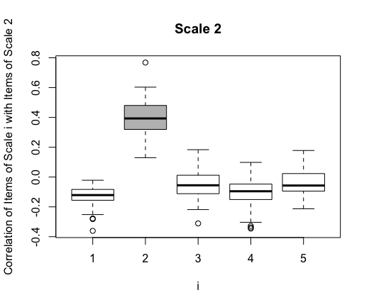
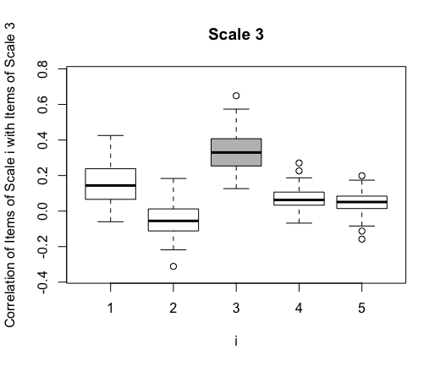
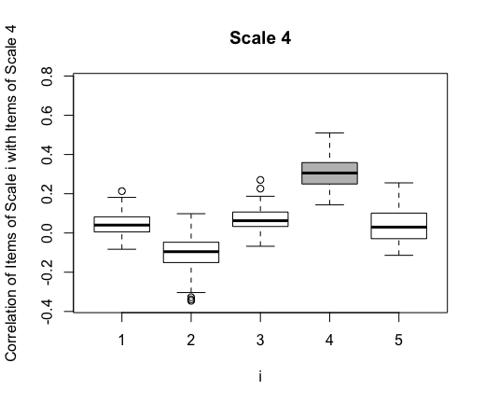
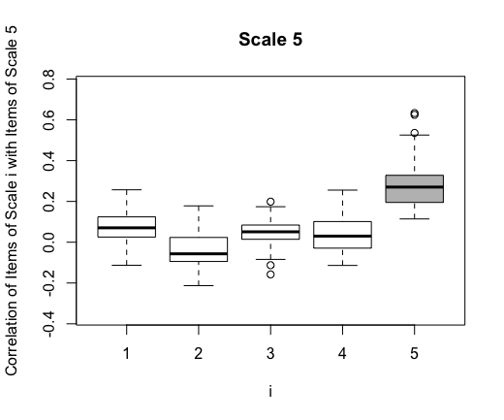
Validity Analysis

Slide 9
Validity Analysis
Overall, each subscale was correlated with its respective scale (convergently valid) and was not correlated to scales that didn’t measure the same trait (discriminately valid).
We can see that there is a slight relation between extroversion and agreeableness, but this is to be expected given the nature of each trait.

Slide 10
Reliability Analysis
Cronbach’s alpha and average interitem correlation were both used to measure reliability of the scales, using the alpha() function. Each scale was determined to be reliable.
Scale | Cronbach’s Alpha | Average Interitem Correlation
Extroversion | .89 | .45
Neuroticism | .87 | .4
Agreeableness | .84 | .34
Conscientiousness | .81 | .3
Openness | .80 | .28

Slide 11
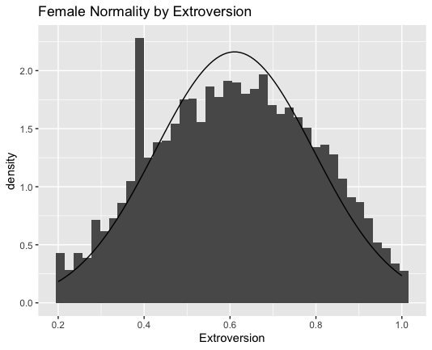
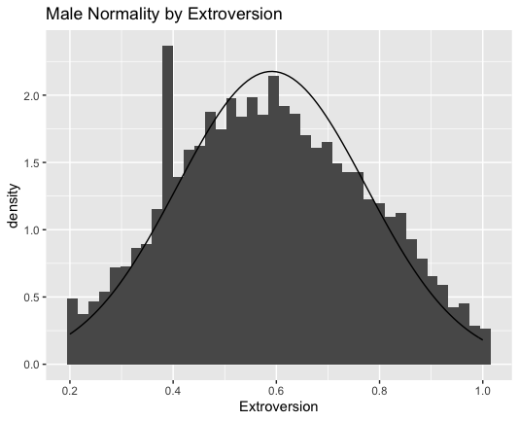
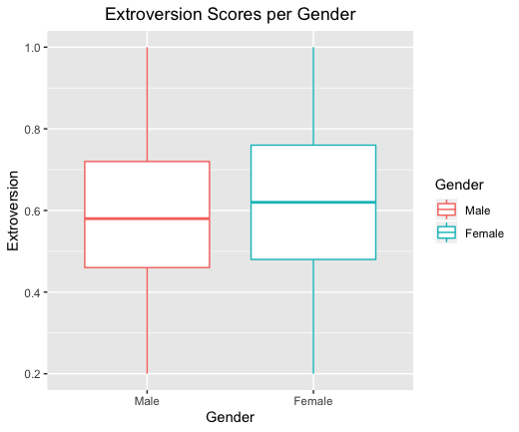
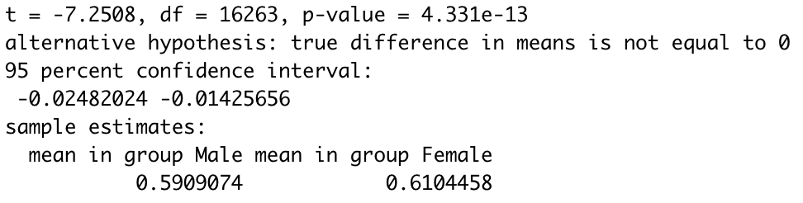
Mean Differences - Gender
Mean Differences in Extroversion trait for Males and Females
Significance value = .05
Samples are independent
Samples are normally distributed
Unpaired two-sample t-test
H₀: True difference in means = 0
H_{a}: True difference in means ≠ 0
Conclusion: Reject H₀
The true difference in means ≠ 0

Slide 12
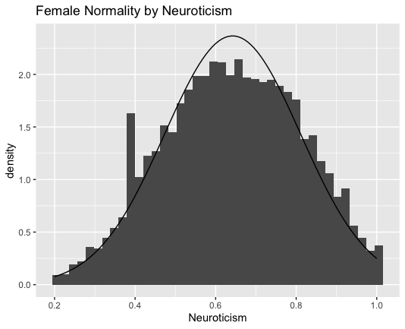
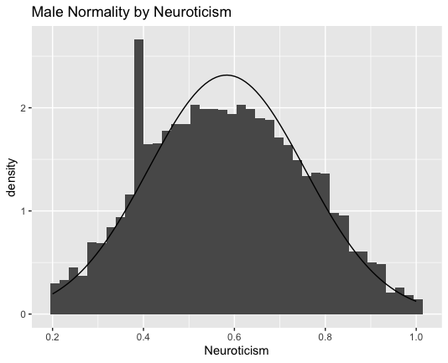
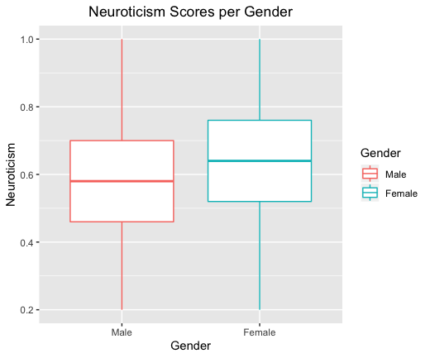
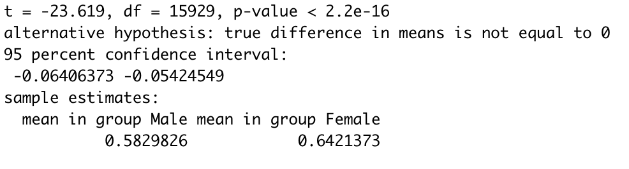
Mean Differences - Gender
Mean Differences in Neuroticism trait for Males and Females
Significance value = .05
Samples are independent
Samples are normally distributed
Unpaired two-sample t-test
H₀: True difference in means = 0
H_{a}: True difference in means ≠ 0
Conclusion: Reject H₀
The true difference in means ≠ 0

Slide 13
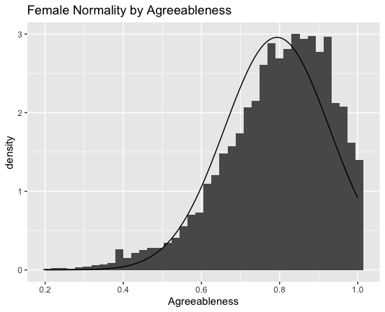
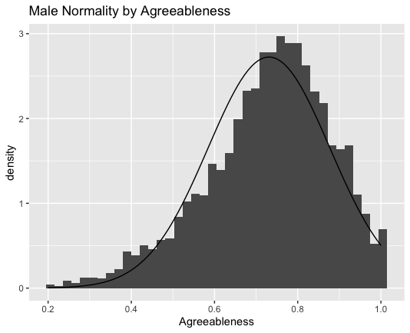
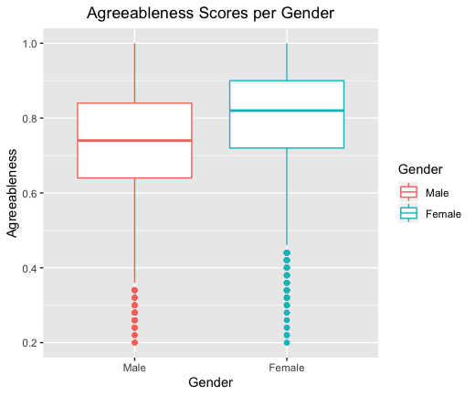
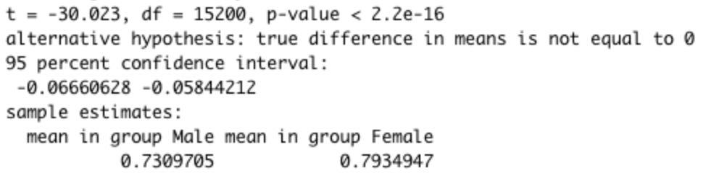
Mean Differences - Gender
Mean Differences in Agreeableness trait for Males and Females
Significance value = .05
Samples are independent
Samples are normally distributed
Unpaired two-sample Wilcoxon test
H₀: True difference in means = 0
H_{a}: True difference in means ≠ 0
Conclusion: Reject H₀
The true difference in means ≠ 0

Slide 14
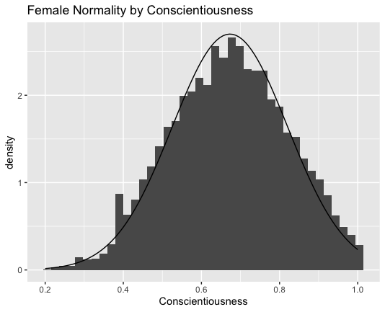
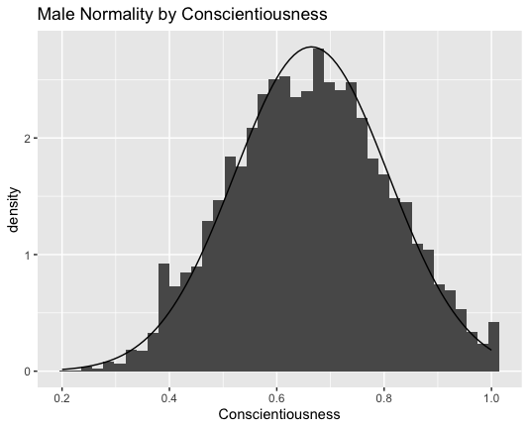
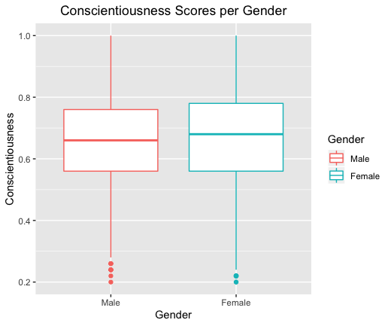
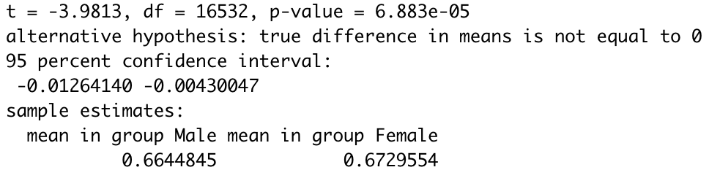
Mean Differences - Gender
Mean Differences in Conscientiousness trait for Males and Females
Significance value = .05
Samples are independent
Samples are normally distributed
Unpaired two-sample t-test
H₀: True difference in means = 0
H_{a}: True difference in means ≠ 0
Conclusion: Reject H₀
The true difference in means ≠ 0

Slide 15
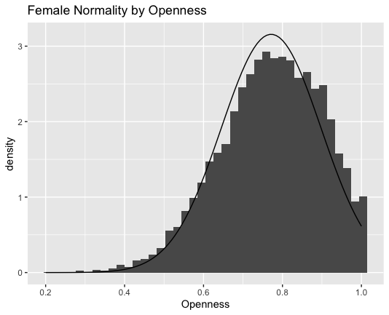
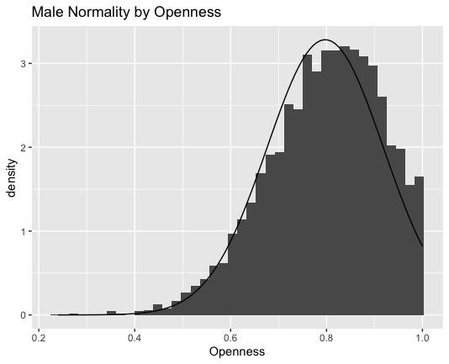
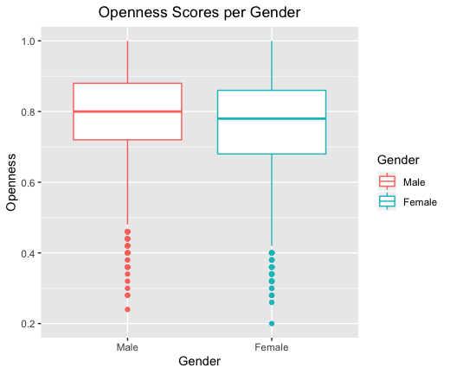
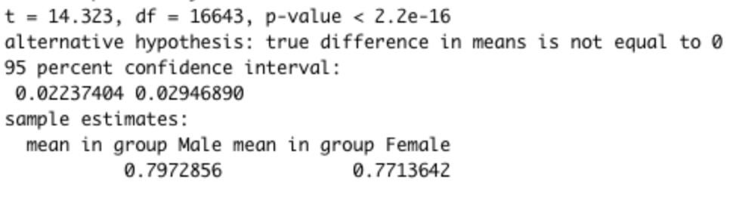
Mean Differences - Gender
Mean Differences in Openness trait for Males and Females
Significance value = .05
Samples are independent
Samples are normally distributed
Unpaired two-sample t-test
H₀: True difference in means = 0
H_{a}: True difference in means ≠ 0
Conclusion: Reject H₀
The true difference in means ≠ 0

Slide 16
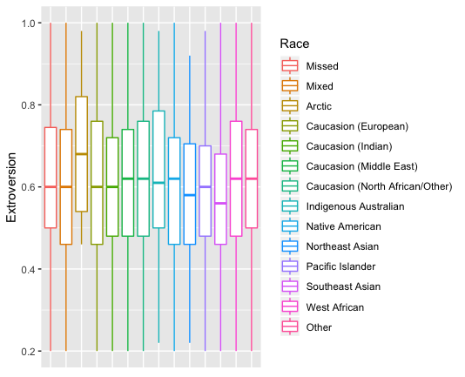
Mean Differences – Race (Extroversion)

Slide 17
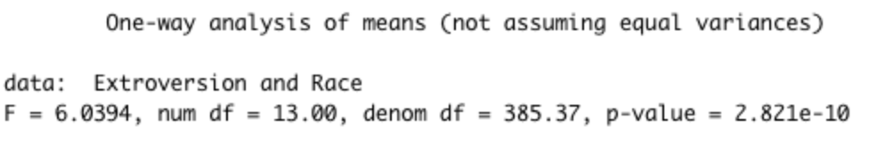
Mean Differences - Race
Mean Differences in Extroversion trait for all Races
Significance value = .05
Samples are independent
Samples are normally distributed (see backup slides for normality plot of residuals)
ANOVA Test with no assumption of equal variances
H₀: True difference in all means = 0
H_{a}: True difference in any means ≠ 0
Conclusion: Reject H₀
True difference in at least one pair of means ≠ 0
Pairwise t-test to find mean differences between groups
No assumption of equal variances
P-value adjustment method: BH
Significant mean differences
Southeast Asian and Caucasian (European); p-value: 1.6e-10
Southeast Asian and Caucasian (Indian); p-value; p-value: 4.0e-6
Caucasian (European) and Other; p-value: .04
Caucasian (Middle East) and Southeast Asian; p-value: 1.4e-5
Southeast Asian and Caucasian (North African); p-value: .0479
Southeast Asian and Other; p-value: 1.9e-13
Southeast Asian and West African; p-value: .004

Slide 18
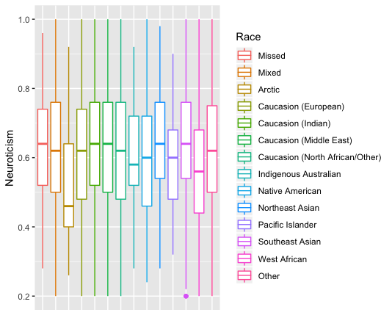
Mean Differences – Race (Neuroticism)

Slide 19
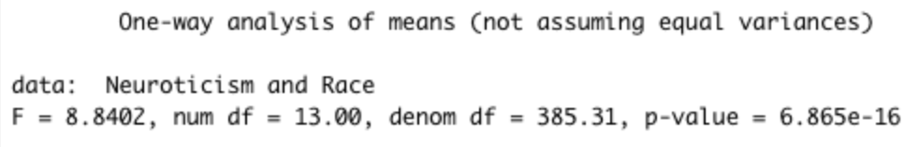
Mean Differences - Race
Mean Differences in Neuroticism trait for all Races
Significance value = .05
Samples are independent
Samples are normally distributed (see backup slides for normality plot of residuals)
ANOVA Test with no assumption of equal variances
H₀: True difference in all means = 0
H_{a}: True difference in any means ≠ 0
Conclusion: Reject H₀
True difference in at least one pair of means ≠ 0
Pairwise t-test to find mean differences between groups
No assumption of equal variances
P-value adjustment method: BH
Significant mean differences
Mixed and Caucasian (Indian); p-value: .0006
Caucasian (European) and Caucasian (Indian); p-value: 9.5e-9
Caucasian (European) and Caucasian (Middle East); p-value: .02
Mixed and Southeast Asian; p-value: .0015
West African and Mixed; p-value: .4e-5
West African and Caucasian (European); p-value: 4.3e-5
Caucasian (North African/Other) and Caucasian (Indian); p-value: .019
Native American and Caucasian (Indian); p-value: .0015
Native American and Caucasian (Middle East); p-value: .012
Pacific Islander and Caucasian (Indian); p-value: .013
Pacific Islander and Caucasian (Middle East); p-value: .04
West African and Caucasian (Indian); p-value: 2.6e-9
West African and Caucasian (Middle East); p-value: 9.6e-7
Caucasian (Indian) and Other; p-value: .0001
Caucasian (North African/Other) and Southeast Asian; p-value: .03
Caucasian (North African/Other) and West African; p-value: .00151
Northeast Asian and Native American; p-value: .024
Northeast Asian and Pacific Islander; p-value: .04
Southeast Asian and Native American; p-value: .003
Southeast Asian and Pacific Islander; p-value: .019
Northeast Asian and West African; p-value: 1.9e-5
Southeast Asian and West African; p-value: 3.6e-9
Southeast Asian and Other; p-value: .0003
West African and Other; p-value: 1.9e-5

Slide 20
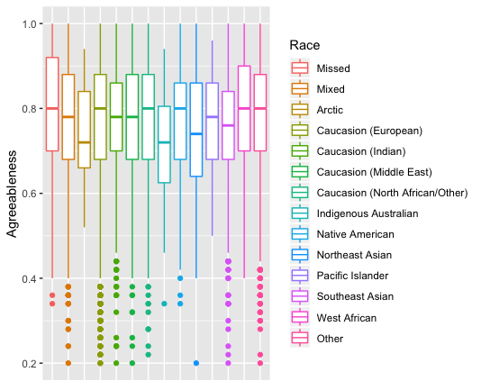
Mean Differences – Race (Agreeableness)

Slide 21
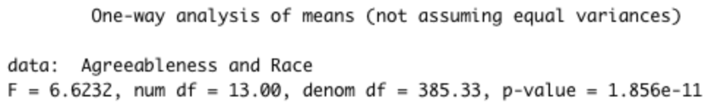
Mean Differences - Race
Mean Differences in Agreeableness trait for all Races
Significance value = .05
Samples are independent
Samples are normally distributed (see backup slides for normality plot of residuals)
ANOVA Test with no assumption of equal variances
H₀: True difference in all means = 0
H_{a}: True difference in any means ≠ 0
Conclusion: Reject H₀
True difference in at least one pair of means ≠ 0
Pairwise t-test to find mean differences between groups
No assumption of equal variances
P-value adjustment method: BH
Significant mean differences
Northeast Asian and Caucasian (European); p-value: .0223
Northeast Asian and Caucasian (Indian); p-value: .0331
Caucasian (European) and Southeast Asian; p-value: 7e-9
Caucasian (Indian) and Southeast Asian; p-value: 6.9e-5
West African and Mixed; p-value: .0076
Mixed and Other; p-value: .002
Northeast Asian and West African; p-value: .0015
Northeast Asian and Other; p-value: .0036
Southeast Asian and West African; p-value: .6.9e-5
Southeast Asian and Other; p-value: 3.1e-11

Slide 22
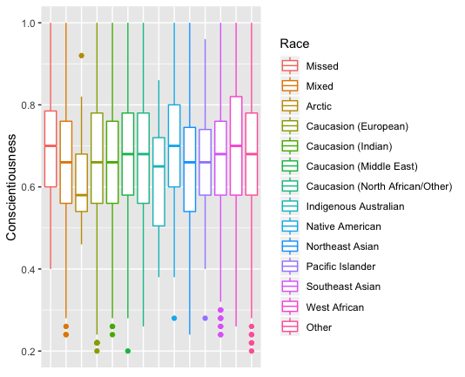
Mean Differences – Race (Conscientiousness)

Slide 23
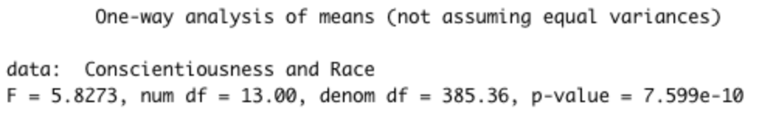
Mean Differences - Race
Mean Differences in Conscientiousness trait for all Races
Significance value = .05
Samples are independent
Samples are normally distributed (see backup slides for normality plot of residuals)
ANOVA Test with no assumption of equal variances H₀: True difference in all means = 0
H_{a}: True difference in any means ≠ 0
Conclusion: Reject H₀
True difference in at least one pair of means ≠ 0
Pairwise t-test to find mean differences between groups
No assumption of equal variances
P-value adjustment method: BH
Significant mean differences
Mixed and Native American; p-value: .02
Mixed and West African; p-value: .02
Mixed and Other; p-value: 2.7e-6
Caucasian (European) and Native American; p-value: .036
Caucasian (Indian) and Native American; p-value: .036
Caucasian (European) and Other; p-value: 9.3e-9
Caucasian (Indian) and West African; p-value: .036
West African and Caucasian (European); p-value: .036
Other and Mixed; p-value: 2.7e-6
Other and Caucasian (European); p-value: 9.3e-9
Other and Caucasian (Indian); p-value: 7.3e-5
Native American and Indigenous Australian; p-value: .036
West African and Indigenous Australian; p-value: .036
Other and Indigenous Australian; p-value: .043
Northeast Asian and Native American; p-value: .035
West African and Northeast Asian; p-value: .035
Northeast Asian and Other; p-value: .02
Southeast Asian and West African; p-value: .112
Southeast Asian and Other; p-value: .018

Slide 24
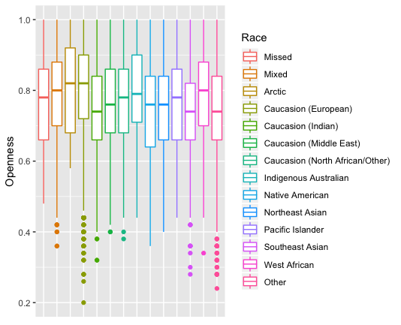
Mean Differences – Race (Openness)

Slide 25
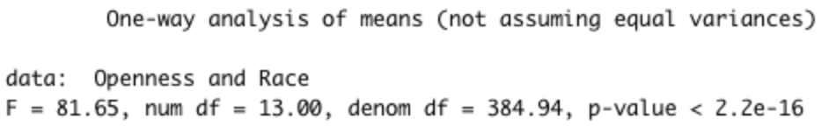
Mean Differences - Race
Mean Differences in Openness trait for all Races
Significance value = .05
Samples are independent
Samples are normally distributed (see backup slides for normality plot of residuals)
ANOVA Test with no assumption of equal variances
H₀: True difference in all means = 0
H_{a}: True difference in any means ≠ 0
Conclusion: Reject H₀
True difference in at least one pair of means ≠ 0
Pairwise t-test to find mean differences between groups
No assumption of equal variances
P-value adjustment method: BH
Significant mean differences
Mixed and Caucasian (European); p-value: .0003
Mixed and Caucasian (Indian); p-value: < 2e-16
Caucasian (North African/Other) and Mixed; p-value: .0136
Mixed and Native American; p-value: 2.8e-6
Southeast Asian and Mixed; p-value: < 2e-16
Mixed and Other; p-value: < 2e-16
Caucasian (European) and Caucasian (Indian); p-value: < 2e-16
Caucasian (European) and Caucasian (Middle East); p-value: 1.4e-14
Caucasian (European) and Caucasian (North African/Other); p-value: 9.3e-7
Caucasian (European) and Native American; p-value: 5.2e-10
Caucasian (European) and Northeast Asian; p-value: 1.1e-8
Caucasian (European) and Pacific Islander; p-value: .015
Caucasian (European) and Southeast Asian; p-value: < 2e-16
Caucasian (European) and West African; p-value: .027
Caucasian (European) and Other; p-value: < 2e-16
Caucasian (Middle East) and Caucasian (Indian); p-value: .016
Caucasian (North African/Other) and Caucasian (Indian); p-value: .00014
West African and Caucasian (Indian); p-value: 7.4e-6
Caucasian (Middle East) and Southeast Asian; p-value: .005
Caucasian (Middle East) and West African; p-value: .029
Caucasian (Middle East) and Other; p-value: .026
Caucasian (North African/Other) and Native American; p-value: .016
Caucasian (North African/Other) and Southeast Asian; p-value: 2.8e-5
Caucasian (North African/Other) and Other; p-value: .00021
Native American and West African; p-value: .00128
Northeast Asian and West African; p-value: .00815
Southeast Asian and West African; p-value: 2.1e-6
West African and Other; p-value: 1.1e-5

Slide 26
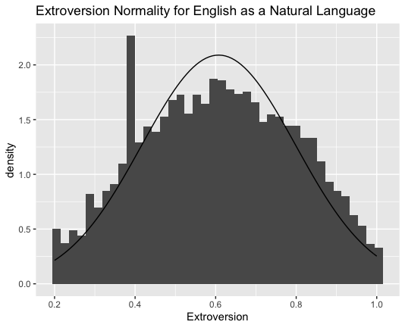
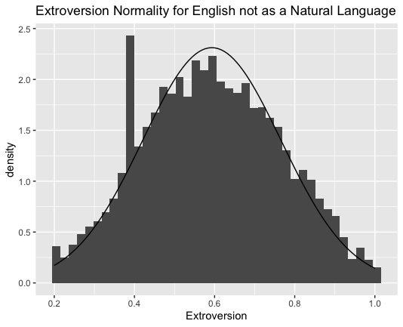
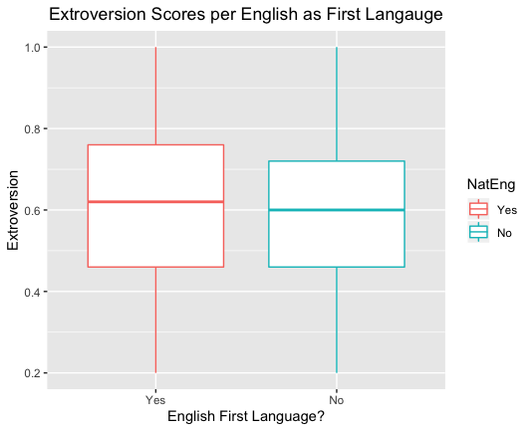
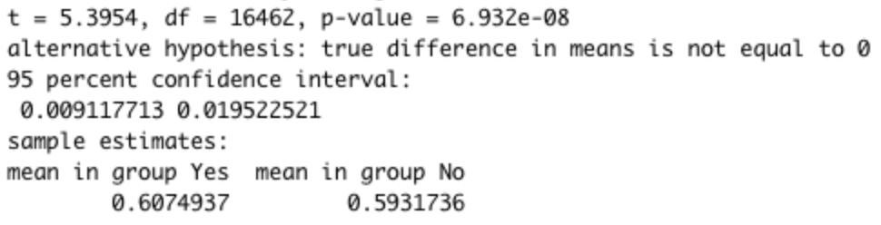
Mean Differences – English as a first Language
Mean Differences in Extroversion trait for respondents who report English as a first language and those who do not
Significance value = .05
Samples are independent
Samples are normally distributed
Unpaired two-sample t-test
H₀: True difference in means = 0
H_{a}: True difference in means ≠ 0
Conclusion: Reject H₀
The true difference in means ≠ 0

Slide 27
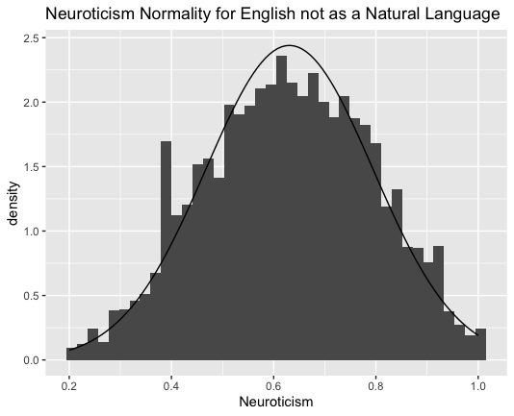
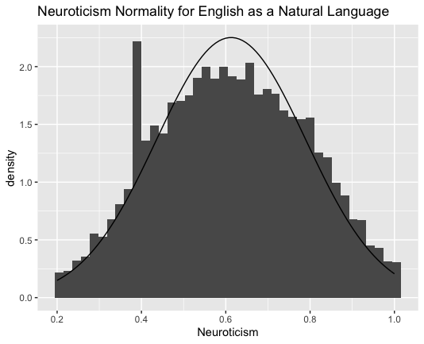
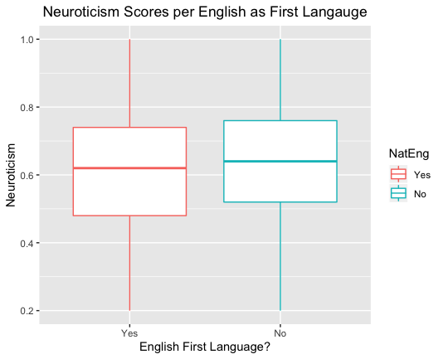
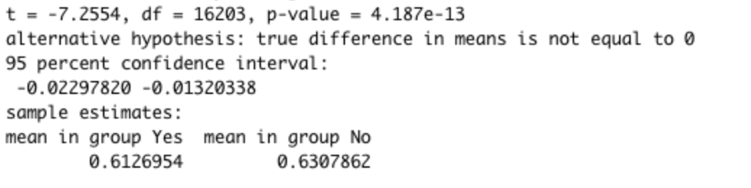
Mean Differences – English as a first Language
Mean Differences in Neuroticism trait for respondents who report English as a first language and those who do not
Significance value = .05
Samples are independent
Samples are normally distributed
Unpaired two-sample t-test
H₀: True difference in means = 0
H_{a}: True difference in means ≠ 0
Conclusion: Reject H₀
The true difference in means ≠ 0

Slide 28
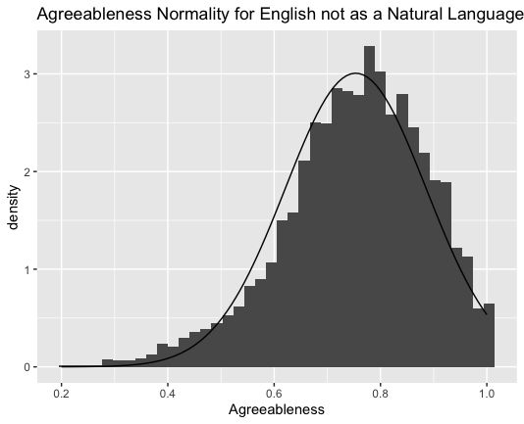



Mean Differences – English as a first Language
Mean Differences in Agreeableness trait for respondents who report English as a first language and those who do not
Significance value = .05
Samples are independent
Samples are normally distributed
Unpaired two-sample t-test
H₀: True difference in means = 0
H_{a}: True difference in means ≠ 0
Conclusion: Reject H₀
The true difference in means ≠ 0

Slide 29




Mean Differences – English as a first Language
Mean Differences in Conscientiousness trait for respondents who report English as a first language and those who do not
Significance value = .05
Samples are independent
Samples are normally distributed
Unpaired two-sample t-test
H₀: True difference in means = 0
H_{a}: True difference in means ≠ 0
Conclusion: Reject H₀
The true difference in means ≠ 0

Slide 30




Mean Differences – English as a first Language
Mean Differences in Openness trait for respondents who report English as a first language and those who do not
Significance value = .05
Samples are independent
Samples are normally distributed
Unpaired two-sample t-test
H₀: True difference in means = 0
H_{a}: True difference in means ≠ 0
Conclusion: Reject H₀
The true difference in means ≠ 0

Slide 31


Regression – Extroversion by Age and Gender
Extroversion = .55 + .0016(Age) + .009(Missed) + .02(Female) - .102(Other)
An increase in age is significantly correlated to the extroversion trait, but the model only explains 1.5% of the variation of the extroversion trait. Compared to males, females are significantly more extroverted and non-binary respondents are significantly less extroverted.

Slide 32


Regression – Neuroticism by Age and Gender
Neuroticism = .65 - .0023(Age) - .035(Missed) + .058(Female) - .092(Other)
A decrease in age is significantly correlated to the neuroticism trait, but the model only explains 5.2% of the variation of the extroversion trait. Compared to males, females are significantly more neurotic and non-binary respondents are significantly more neurotic.

Slide 33


Regression – Agreeableness by Age and Gender
Agreeableness = .068 + .002(Age) + .039(Missed) + .064(Female) - .018(Other)
An increase in age is significantly correlated to the agreeableness trait, but the model only explains 7.3% of the variation of the agreeableness trait. Compared to males, females are significantly more agreeable.

Slide 34


Regression – Conscientiousness by Age and Gender
Conscientiousness = .59 + .0027(Age) + .004(Missed) + .01(Female) - .028(Other)
An increase in age is significantly correlated to the conscientiousness trait, but the model only explains 4.7% of the variation of the conscientiousness trait. Compared to males, females are significantly more conscientious.

Slide 35


Regression – Openness by Age and Gender
Openness = .77 + .0009(Age) - .027(Missed) - .025(Female) + .035(Other)
An increase in age is significantly correlated to the openness trait, but the model only explains 1.7% of the variation of the openness trait. Compared to males, females are significantly less open and non-binary respondents are significantly more open.

Slide 36
Code

Slide 37





Mean Differences by Race

