Slide 1
s, F_{IS}, m, K
Malcolm Augat

Slide 2
Questions
How does selection (s) act in structured populations?
Does purging selection act on inbred individuals or families?
What are the effects of migration (m) versus colonization (K) ?

Slide 3
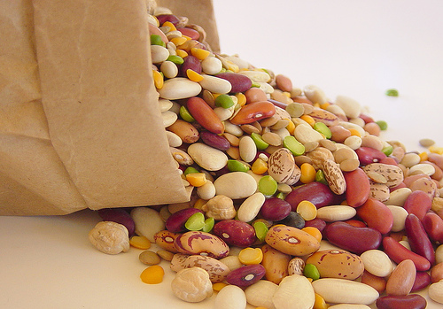

Sampling

Slide 4
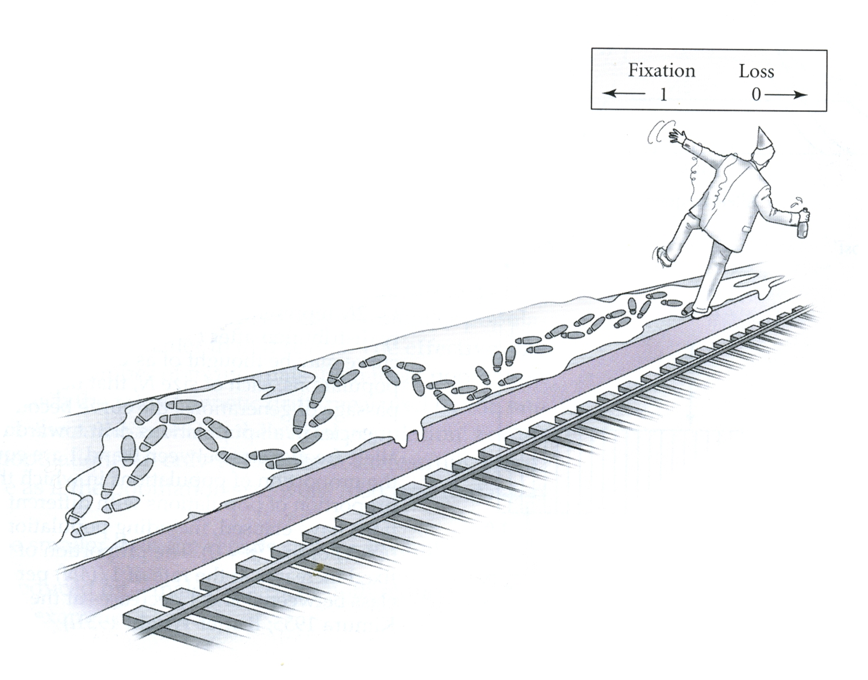
Drift

Slide 5
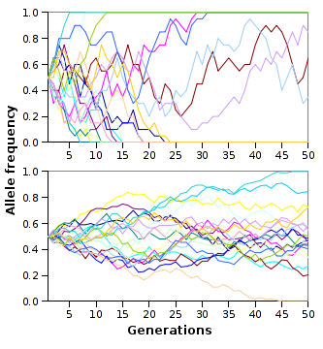
Drift

Slide 6
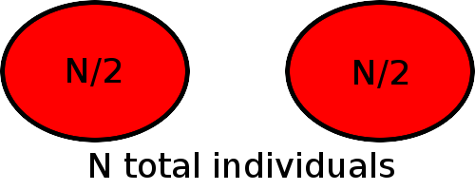
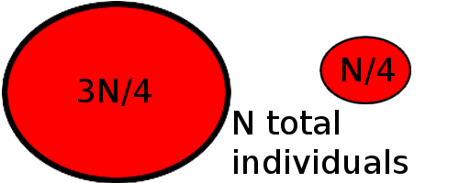
Structured populations

Slide 7
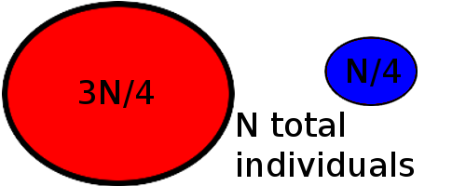
Structured populations

Slide 8
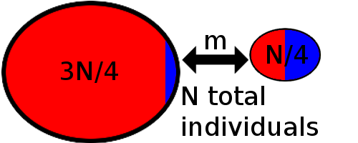
Migration

Slide 9
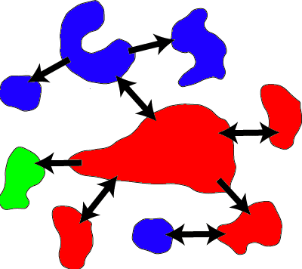
Migration

Slide 10
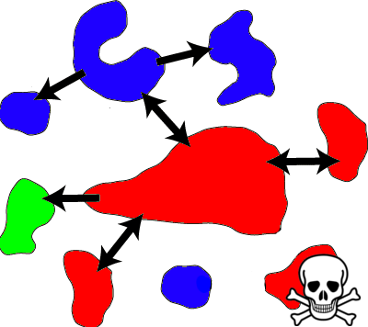
Extinction

Slide 11
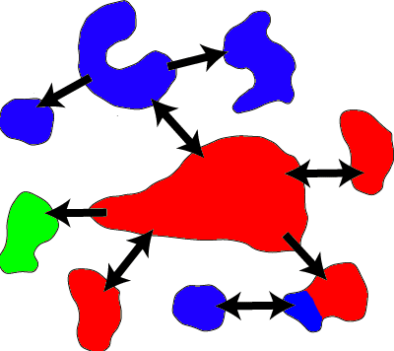
Colonization
Migrant pool colonization

Slide 12

Colonization
Propagule colonization

Slide 13

Inbreeding
Reduction in heterozygotes from expected
F_{IS} = (H₀ – H) / H₀
Can fix deleterious alleles, more homozygotes

Slide 14
F statistics
Partitions the genetic variance
Total variance (F_{IT}), among population variance (F_{ST}), and within population variance (F_{IS})
1 – F_{IT} = (1 – F_{IS})(1 - F_{ST})

Slide 15
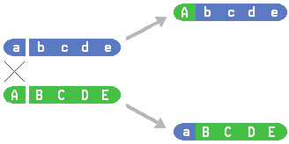
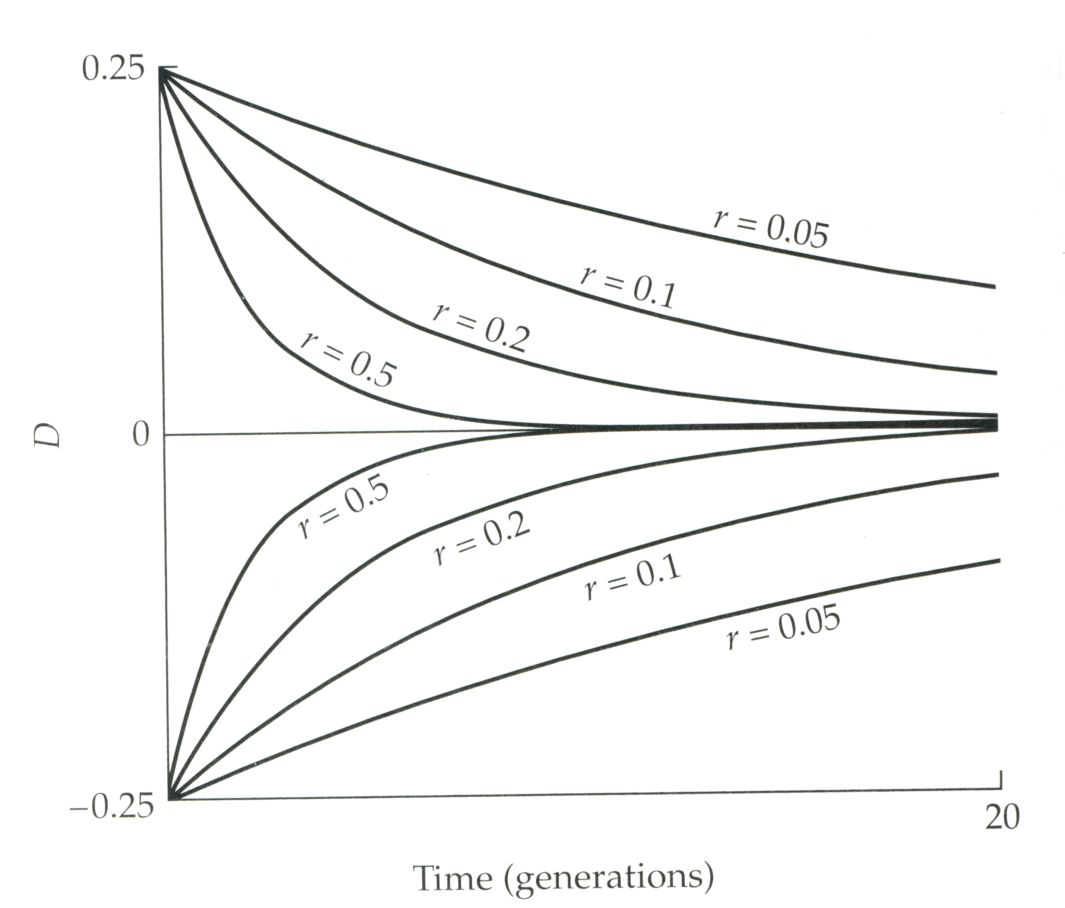
Linkage disequilibrium
Physical linkages
Historical linkage
Population structure inhibits recombination
Hill-Robertson effect

Slide 16
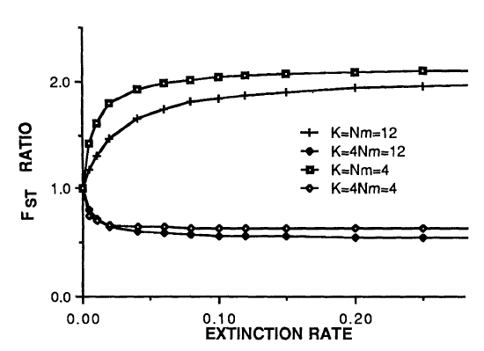
Wade 1988

Slide 17
Questions
How does selection (s) act in structured populations?
Does purging selection act on inbred individuals or families?
What are the effects of migration (m) versus colonization (K) ?

Slide 18
Methods
Simulate a metapopulation and explore parameters that affect how selection acts
quantiNemo
Recoding to allow for different rates of migration and colonization
To do
Running the simulations and getting results

Slide 19
?

Slide 20
Image credits
[3] http://saffronhut.blogspot.com/
[3] http://ccelearn.csus.edu/wasteclass/mod9/mod9_05.html
[4] Futuyma, D. J. 2005. Evolution. Sinauer.
[5] http://en.wikipedia.org/wiki/Evolution
[9] http://www.ca.uky.edu/agc/pubs/for/for76/for76.htm
[13] http://www.guardian.co.uk/news/blog/2008/sep/15/animalwelfare
[15] http://anthro.palomar.edu/biobasis/bio_3.htm
[15] Rice, S. H. 2004. Evolutionary Theory. Sinauer.
[16] Wade, M. J. 1988. Extinction And Recolonization - Their Effects On The Genetic Differentiation Of Local-Populations. Evolution.

