Slide 1
Inbreeding depression in a propagule-dispersing metapopulation
Malcolm Augat
Taylor Lab

Slide 2
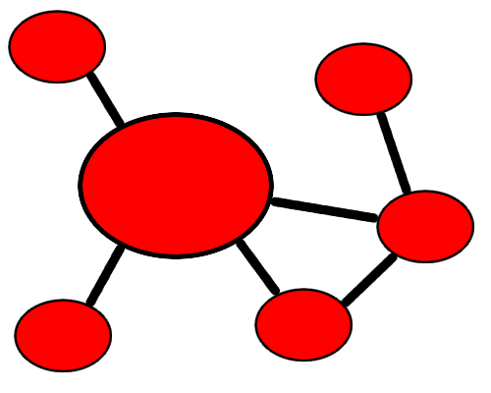
Metapopulations
Spatially structured populations
Divided into patches with limited migration and gene flow among patches
Fewer potential mating partners within patches

Slide 3
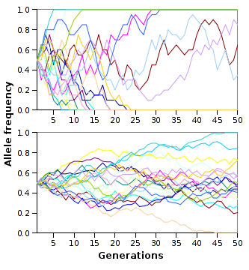
Drift
Random fixation of alleles by imperfect sampling
Affected by population size
Can cause patches to differentiate
[1]

Slide 4

Inbreeding
Mating partners are often more highly related in structured populations
Inbred individuals tend to be homozygous at more loci
Inbreeding often exposes recessive alleles, which can be deleterious
[2]

Slide 5
Metapopulation dynamics
Driven by dispersal: migration and colonization
Some populations exist in nonequilibrium states with constant patch turnover
Metapopulation dynamics affect relatedness within and among patches

Slide 6

Migration
Movement of individuals from a patch to another occupied patch
Increases genetic diversity within patches if patches are fixed for different alleles
[3]

Slide 7

Colonization
Patches can go extinct
  All individuals in them die or disperse
New patches can be colonized or extinct patches recolonized
[4]

Slide 8
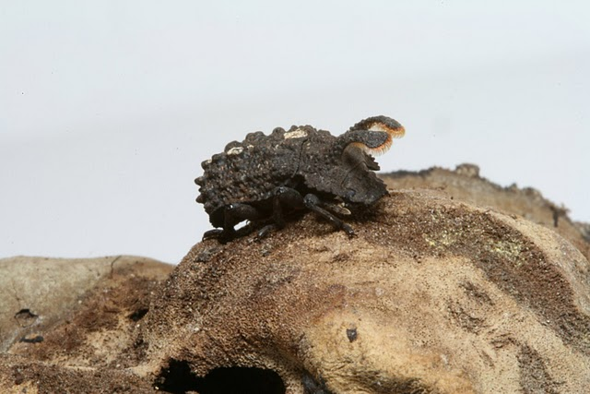
Migrant-pool dispersal
Individuals emigrate to patches independently of other emigrants
Default model
[5]

Slide 9

Propagule-pool dispersal
Individuals emigrate as a group
Many individuals from the same patch emigrate to a new patch together
Emigrants are more likely to be related

Slide 10
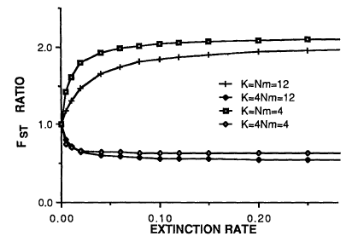
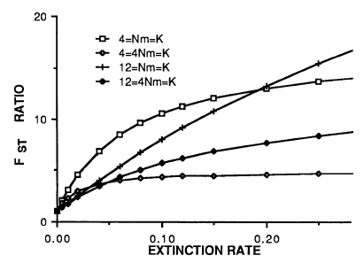
Wade and McCauley 1988
Metapopulation with ongoing patch extinction and recolonization
Migrant-pool migration
Migrant- and propagule-pool colonization had different effects on patch differentiation
Migrant-pool colonization
[6]
Propagule-pool colonization

Slide 11
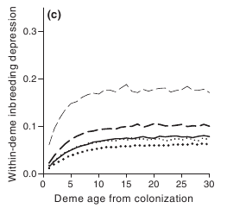
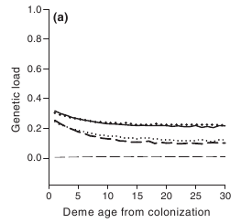
Zhou et al. 2010
Metapopulation with extinction and migrant-pool migration and colonization
Inbreeding depression and genetic load change with the time since colonization
[7]

Slide 12
Questions
How do inbreeding and genetic load change as time since colonization increases with propagule dispersal?
What are the effects of propagule migration versus propagule colonization?
How does the effect of selection change?

Slide 13
Methods
Simulate with quantiNEMO
200 patches with capacity of 25 individuals each
Each individual has 100 loci with fitness effects
Loci have multiplicative effect on fitness
  Nondeleterious homozygotes: 1.0
  Heterozygotes: 1.0
  Deleterious homozygotes: 0.9

Slide 14
Results
Insert results here

Slide 15
Future directions
Short-term
  Get results for propagule dispersal
  Examine different effects of propagule dispersal and propagule colonization
Long-term
  Quantitative traits
  Different strength of selection
  Effects of linkage due to spatial structure on selection

Slide 16
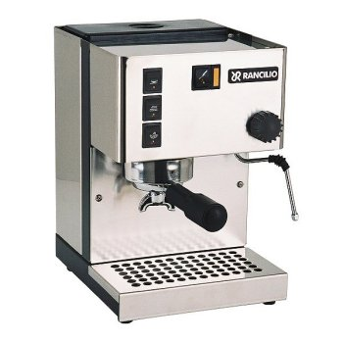
Acknowledgements
Doug Taylor
Peter Fields
Dan Sloan
Andrea Berardi
Brian Sanderson
Kim Gilbert
Laura Bergner
Lei Li
First-year biology graduate students
[8]

Slide 17
Questions?

Slide 18
References and image credits
[1] en.wikipedia.org/wiki/Evolution
[2] www.guardian.co.uk/news/blog
[3] criterionglobal.wordpress.com/2008/10/
[4] www.thespacereview.com/article/221/1
[5] Photo courtesy Vince Formica
[6] Wade, M. J. and McCauley D. E. 1988. Extinction and recolonization: Their effects on the genetic differentiation of local populations. Evolution.
[7] Zhou S. et al. 2010. Genetic load, inbreeding depression and heterosis in an age-structured metapopulation. JEB.
[8] www.coffee-maker-review.net/rancilio-silvia-espresso.html

