Slide 1
Touchstone 5: Client Website Final Project
▸ Project Title: Trailblazers Client Website
▸ Your Name: Mohammed Adhab
▸ Client Name: Trailblazers
▸ Live Website Link: https://maui204.github.io/Mohammed/
▸ GitHub Repository: maui204/Mohammed
Notes:
This presentation summarizes my Trailblazers client website final project, including the site's goals, structure, design, interactive features, accessibility, and what I learned during development.

Slide 2
Client Goals & Audience
▸ Client Goal: Provide visitors with clear information about Trailblazers and make important content easy to find.
▸ Target Audience: People interested in Trailblazers who want to learn about its services, activities, and information.
▸ Design Choice: I created simple navigation with clearly labeled sections so users can quickly find what they need.
Notes:
I chose simple and consistent navigation because users should not have to search around the website to find information. Clear navigation makes the website easier to understand and allows visitors to move between important sections quickly.

Slide 3
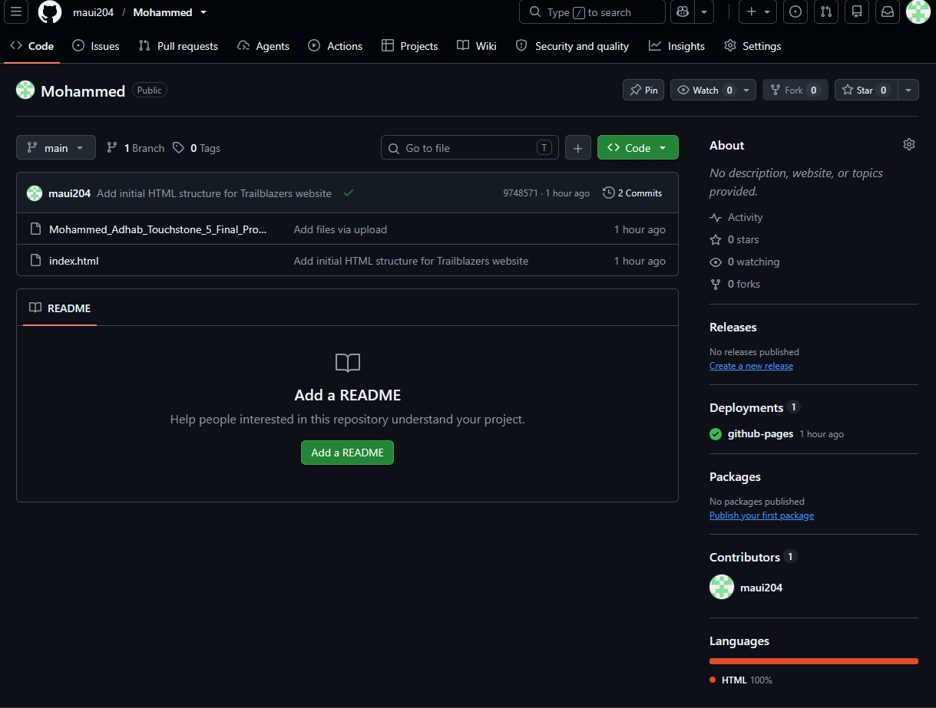
Site Structure & Content
▸ Pages Included: Home, About, Services/Information, and Contact.
▸ Navigation: Users move through the website using the main navigation menu.
▸ Structure Decision: Clear headings and organized sections make the pages easy to scan.
▸ Insert: Desktop screenshot of the Trailblazers website.
Notes:
The website structure makes information easier to find because content is separated into clearly identified sections. The desktop screenshot should show the navigation and headings so users can see how the content is organized.

Slide 4
Visual Design System
▸ Color: A consistent color palette creates a professional and unified appearance.
▸ Typography: Readable font sizes and strong contrast improve readability.
▸ Layout: Content is organized using headings, sections, spacing, and consistent alignment.
▸ Insert: Desktop and mobile screenshots.
Notes:
One important design choice was maintaining consistent typography and spacing. This creates a clear visual hierarchy so users can quickly distinguish headings from regular content and understand which information is most important.

Slide 5
Interactive Feature
▸ Feature: Interactive website navigation.
▸ User Action: The user clicks a navigation link or button.
▸ Result: The website displays the selected page or section.
▸ Insert: Screenshot showing the navigation or another interactive feature.
Notes:
The interactive navigation improves the user experience by reducing the effort required to locate information. Instead of searching through everything, visitors can select the section they want and move directly to relevant content.

Slide 6
Data Storage
▸ Storage Type: localStorage.
▸ What is Stored: User-related website information or preferences that should remain after refresh.
▸ When: Information is stored when the user performs the related interaction on the website.
Notes:
Using localStorage improves convenience because information can remain available in the user's browser after the page is refreshed. This can prevent users from having to repeat the same action or enter the same information again.

Slide 7
Accessibility
▸ Accessibility Features: Alternative text for meaningful images; good color contrast and readable text; clear headings and semantic structure; clearly labeled navigation links and controls.
▸ Focus Feature: Alternative text for images.
Notes:
Alternative text makes visual content more accessible to visitors who use screen readers. Instead of receiving no information about an important image, the user can hear a description of its purpose. This benefits people with visual impairments and improves overall usability.

Slide 8
Self-Evaluation
▸ Strength: The website has a simple and organized design.
▸ Evidence: Navigation, headings, content sections, and a consistent layout demonstrate this throughout the site.
▸ User Impact: Visitors can understand the site quickly and locate important information without unnecessary steps.
Notes:
The organization of the website is one of its strongest features. The navigation menu and clearly separated content sections make it easy for visitors to understand where they are and where they can go next.

Slide 9
Process Reflection
▸ Planning: I planned the main pages, navigation, content, colors, and general layout.
▸ Change: During development, I adjusted the layout, spacing, and responsive design.
▸ Why did it change? I wanted the website to work better on different screen sizes and make content easier to read.
Notes:
As I developed the website, I realized some parts of the original layout needed adjustment for smaller screens. I improved the responsive layout and spacing so the website would remain readable and usable on desktop and mobile devices.

Slide 10
Challenges & Lessons Learned
▸ Challenge: Creating a layout that looked good and remained easy to use on desktop and mobile screens.
▸ Solution: I used responsive design techniques and adjusted layout, spacing, and content positioning.
▸ Lesson: I learned that a website should be tested throughout development instead of waiting until the end.
Notes:
This experience taught me the importance of responsive design and continuous testing. In future projects, I would test desktop and mobile layouts earlier so I could identify problems sooner and make development more efficient.

