Slide 1
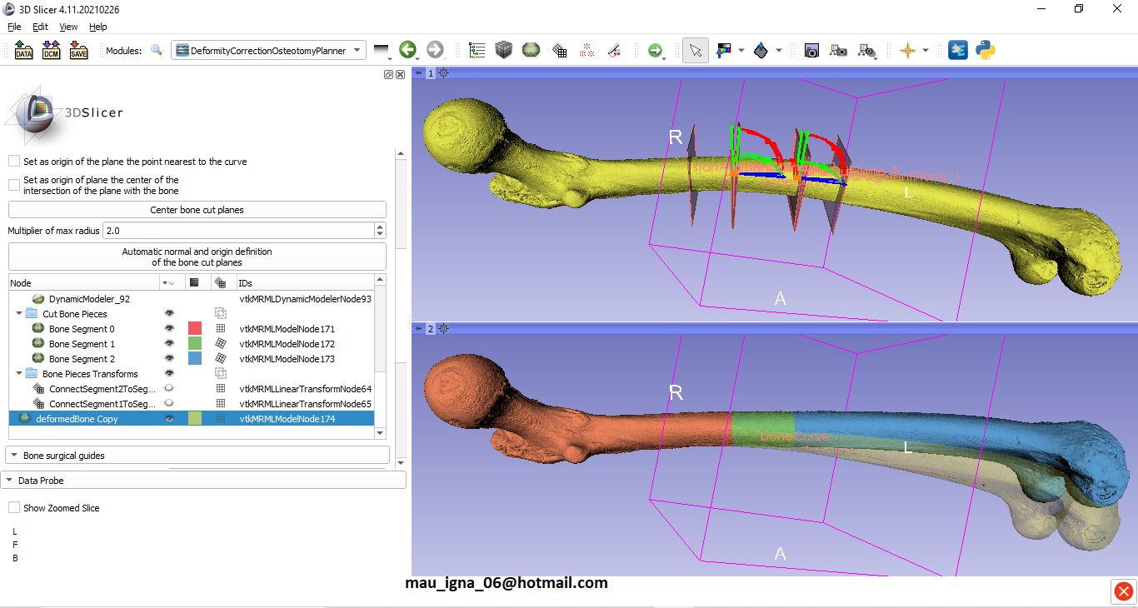

Slide 2
Virtual Surgical Planning
All planes have an asociated frame.
Bone Piece 2
y
z
x
boneCutPlane3
Each bone piece is a point mesh.
To apply a transform to a bone piece is to apply the transform to each point of the geometry
DeformedBone
boneCutPlane0
boneCutPlane2
Bone Piece 0
boneCutPlane2
Bone Piece 1
boneCutPlane1
CorrectedBone

Slide 3
Bone Piece 2 (FT)
Bone Piece 0
Bone Piece 1
FT: First Transform
Bone Piece 2 (FT) = boneCutPlane3FrameToBoneCutPlane2FrameTransform*[Bone Piece 2]

Slide 4
Bone Piece 0
Bone Piece 1 (FT)
Bone Piece 2 (ST)
FT: First Transform; ST: Second Transform
Bone Piece 1 (FT) = boneCutPlane1FrameToBoneCutPlane0FrameTransform* (Bone Piece 1)
Bone Piece 2 (ST) = boneCutPlane1FrameToBoneCutPlane0FrameTransform * [Bone Piece 2 (FT)]
Bone Piece 2 (ST) = boneCutPlane1FrameToBoneCutPlane0FrameTransform *
boneCutPlane3FrameToBoneCutPlane2FrameTransform * [Bone Piece 2]

Slide 5
Iterative process for more Bone Pieces
NT: Nth Transform; N-1T: (N-1)th Transform; N-2T: (N-2)th Transform; N-iT: (N-i)th Transform;
Bone Piece N (NT) = boneCutPlane1FrameToBoneCutPlane0FrameTransform * [Bone Piece N (N-1T)]
Bone Piece N (NT) = boneCutPlane1FrameToBoneCutPlane0FrameTransform *
boneCutPlane3FrameToBoneCutPlane2FrameTransform * [Bone Piece N (N-2T)]
Bone Piece N (NT) = boneCutPlane1FrameToBoneCutPlane0FrameTransform *
boneCutPlane3FrameToBoneCutPlane2FrameTransform * … *
boneCutPlane((2*i)-1)FrameToBoneCutPlane((2*i)-2)FrameTransform * [Bone Piece N (N-iT)]
Bone Piece N (NT) = boneCutPlane1FrameToBoneCutPlane0FrameTransform *
boneCutPlane3FrameToBoneCutPlane2FrameTransform * … *
boneCutPlane((2*i)-1)FrameToBoneCutPlane((2*i)-2)FrameTransform * … *
boneCutPlane(2*N-1)FrameToBoneCutPlane(2*N-2)FrameTransform * [Bone Piece N]
Bone Piece 0
Bone Piece 1 (FT)
Bone Piece 2 (ST)
Bone Piece N (NT)
…

