Slide 1
FIN: A Money Tracker Mobile Application With Built-In Mobile Decision Support System
By mary louise reyes
10298996
Final year project presentation
April 10, 2019

Slide 2
What is it?
Track Finances
Adding Entries
Categorise Entries
Summarise Entries
Mobile Decision Support System
‘Should I buy this?’
Purchasing recommendations.

Slide 3
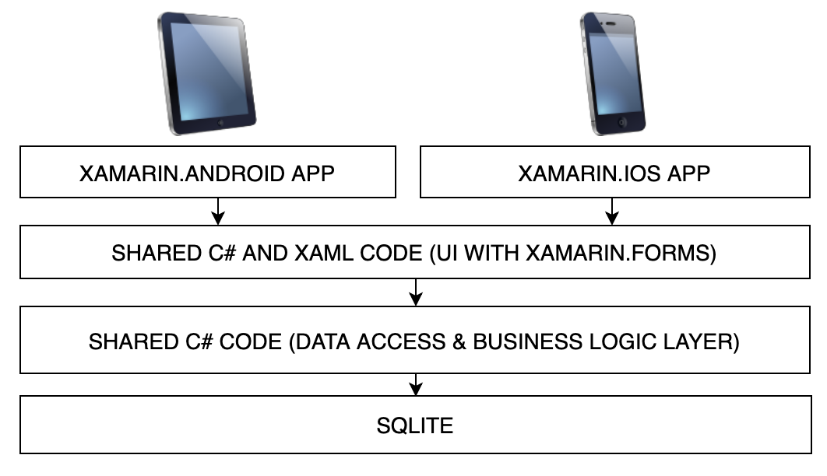
Mobile Application
SQLite
C#
MVVM Architecture
XAML UI
Xamarin Toolkit
Cross-platform compatibility

Slide 4
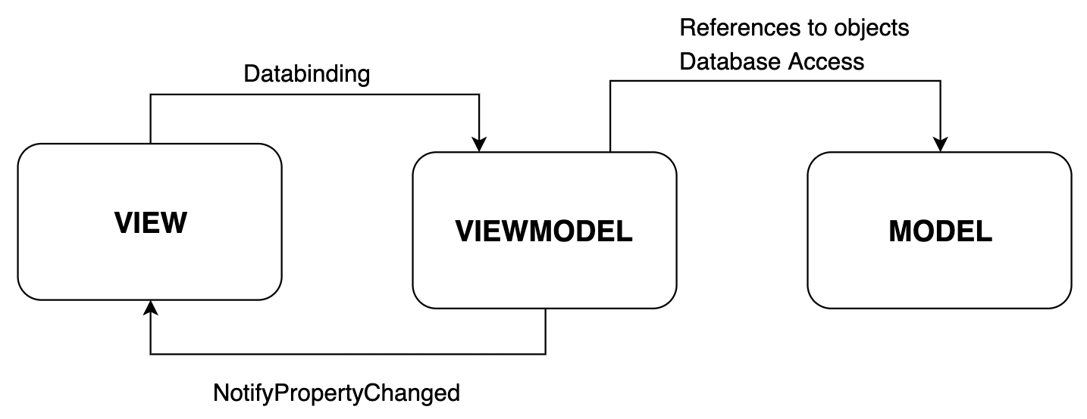
MVVM Architecture
<Label Text = {Binding Balance} />
decimal Balance
{
get => database.GetBalance();
set
{ _balance = value;
OnPropertyChanged(“Balance”);
}
database.GetBalance();

Slide 5
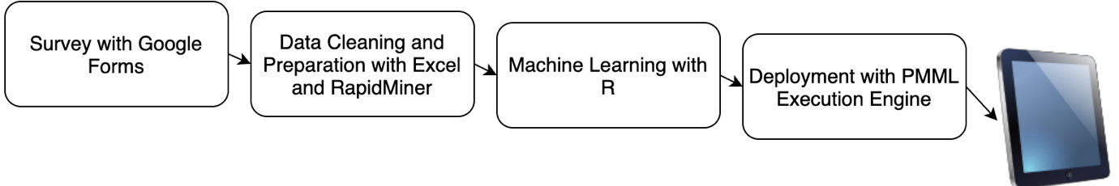
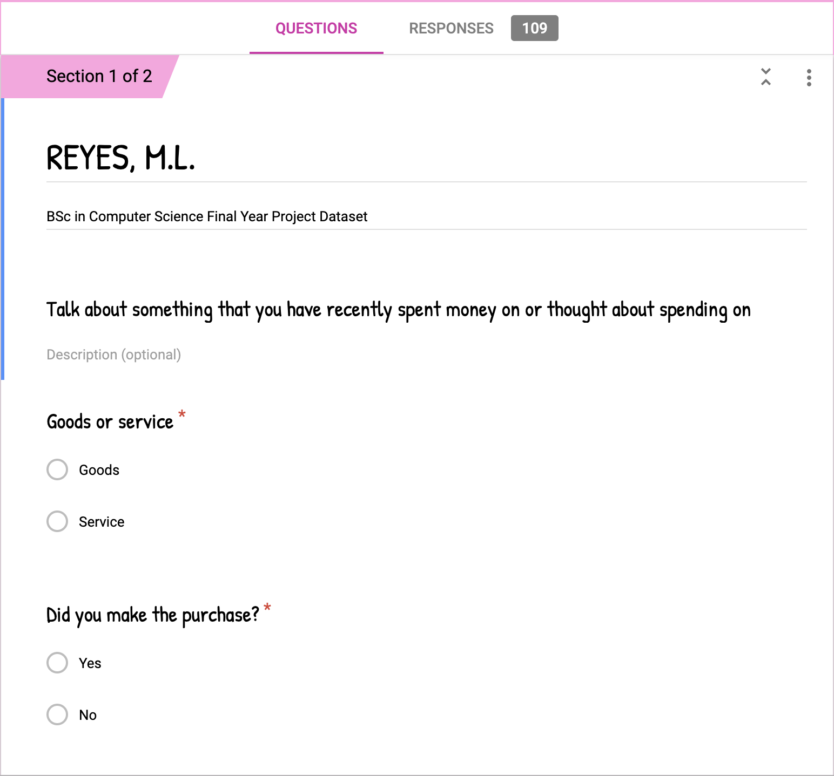
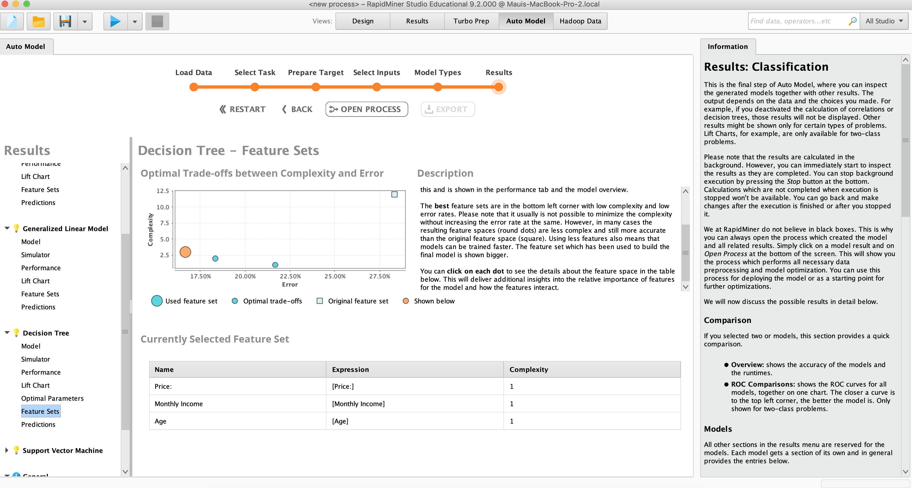
Machine Learning

Slide 6
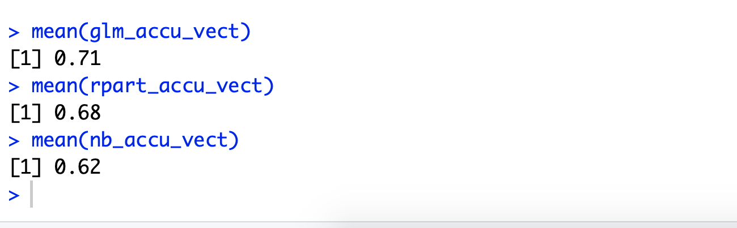
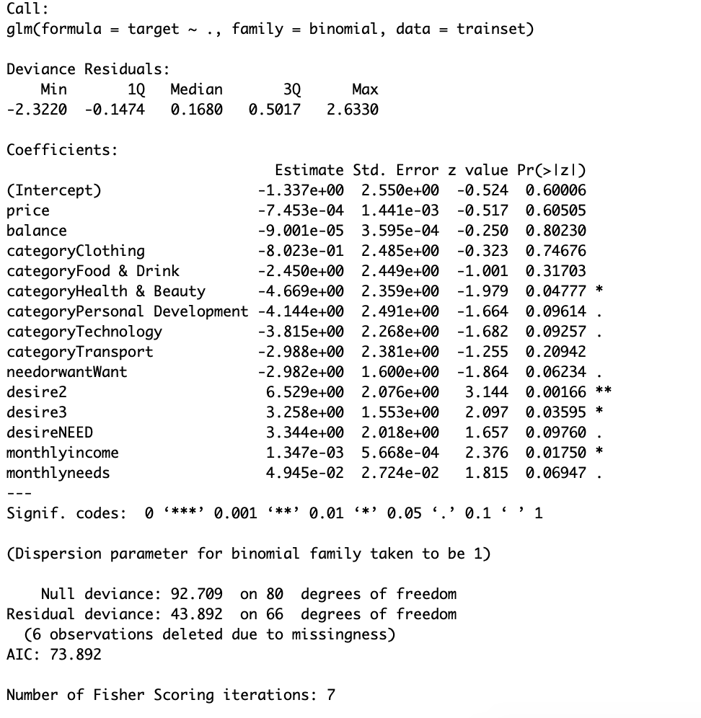
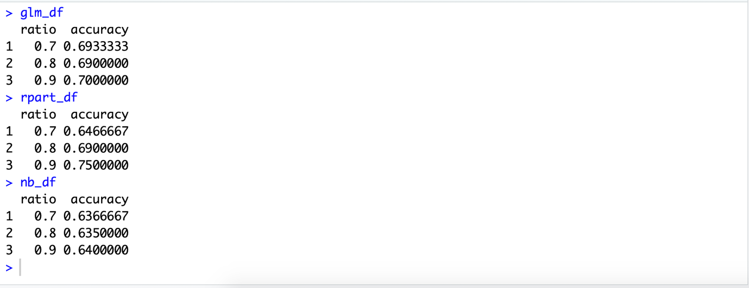
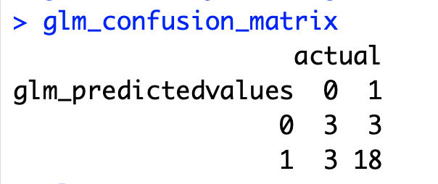
Machine Learning with R
Find the best train and test set ratio
Find the best algorithm
GLM Model
Evaluate the model with confusion matrix accuracy
(Accuracy = .7778 )

Slide 7
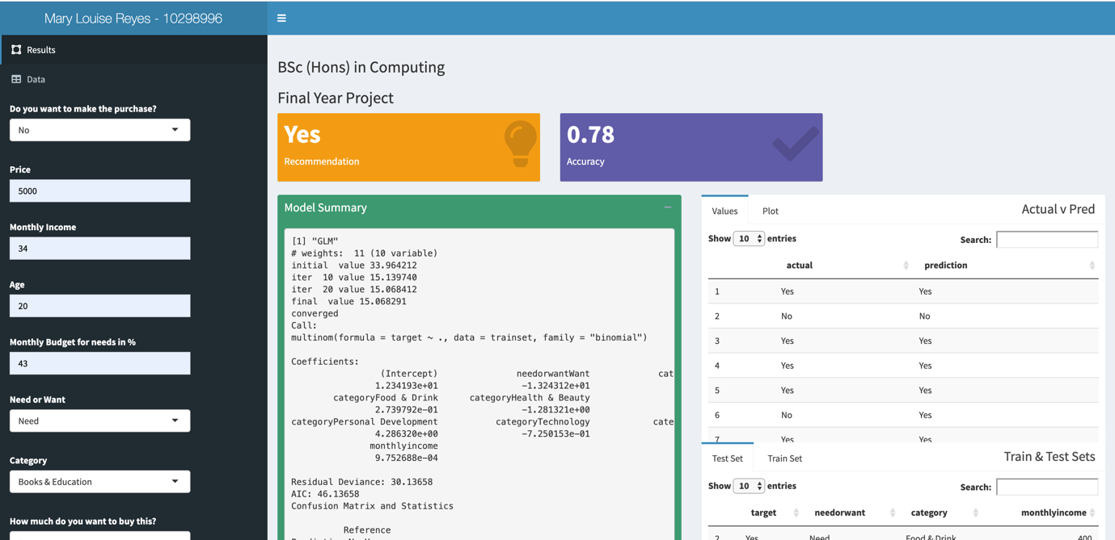
R-Shiny Application
Supports GLM, SVM, Naïve Bayes, and Decision Trees
Heavily relies on user input
Does not have capacity to take values from C# properties

Slide 8
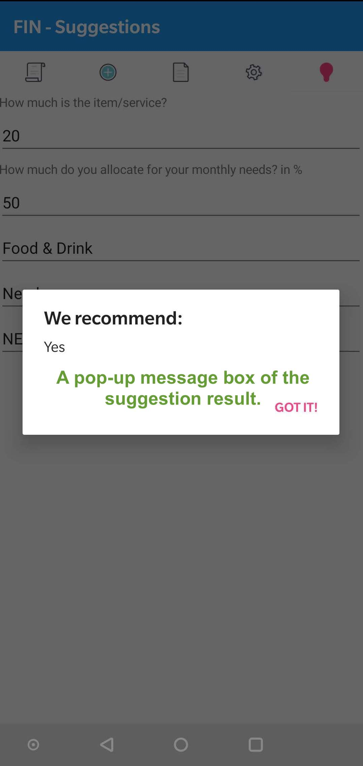
Deploying the Predictive Models
Predictive Modelling Markup Language
Data Mining Group
R library(pmml)
XML based language
Syncfusion PMML Execution Engine
Application uses glm.pmml because it is the most accurate algorithm

Slide 9
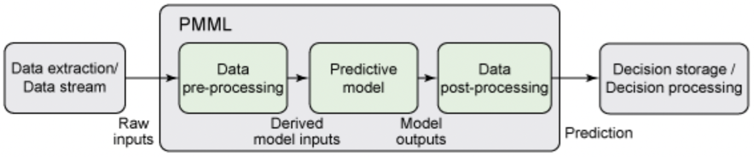
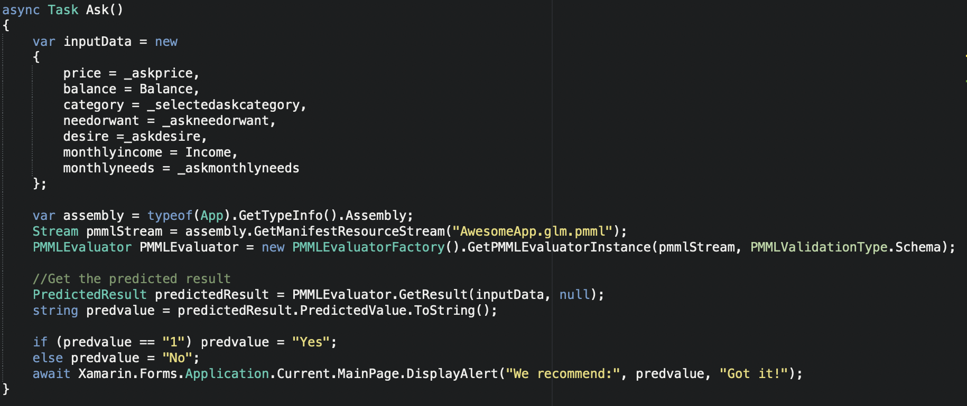
Integrating Machine Learning Model in the Mobile Application
Syncfusion PMML .Net Core NuGet package
Create an object with independent variables
User Input
Properties
PMMLEvaluator.GetResult()

Slide 10
Demo

Slide 11
FIN: A Money Tracker Mobile Application
With Built-In Mobile Decision Support System
By Mary Louise Reyes
10298996@mydbs.ie
Final year project presentation
April 10, 2019

