Slide 1
AngularJS
Markus Veijola March 2014

Slide 2
Introduction
AngularJS is a toolset for building the framework most suited to your application development.
It is fully extensible and works well with other libraries. Every feature can be modified or replaced to suit your unique development workflow and feature needs.
Angular provides built-in protection from basic security holes including cross-site scripting and HTML injection attacks.
AngularJS does round-trip escaping on all strings for you and even offers XSRF protection for server-side communication.
Compatible with other security measures like Content Security Policy (CSP), HTTPS (SSL/TLS) and server-side authentication and authorization that greatly reduce the possible attack vectors.

Slide 3
Introduction
AngularJS is a templating system (i.e. Jade), it is bidirectional and offers great data binding.
The template is compiled in the browser and the compilation step produces a live view.
This means you, the developers, don't need to write code to constantly sync the view with the model and the model with the view as in other templating systems.
AngularJS supports following browsers: Safari, Chrome, Firefox, Opera, IE9 and mobile browsers (Android, Chrome Mobile, iOS Safari).
Performance:
Startup time depends of: network connection, state of the cache, browser used and available hardware.
Runtime performance depends:number and complexity of bindings on the page as well as the speed of your backend (for apps that fetch data from the backend).

Slide 4
Introduction
Angular uses jQuery library if it's present in your app when the application is being bootstrapped.
If jQuery is not present in your script path, Angular falls back to its own implementation of the subset of jQuery that we call jQLite.

Slide 5
Content
What we will cover here from AngularJS:
Idea behind AngularJS
Installing\how to take in use
Views
Directives
Filters
Controllers
Scopes
Modules
Routing
Services and Factories
Animation
Become More Modular
Creating Custom AngularJS Directives
Promises

Slide 6
Target Audience
You should be familiar with following techniques to get out most of the provided content:
HTML
CSS
JavaScript

Slide 7

SPA (Single Page Applications)
The idea behind the SPA is that we can load different views (or screens) inside the container when user interacts with the page without the need to reload the whole page. This follows the same idea as jQuery mobile page architecture.
This behavior is more like in desktop applications.
<div> </div>
View 1
User clicks i.e a link

Slide 8
SPA (Single Page Applications)
SPAs handles the navigations history of our application. This means that for example you can go from view2 to view 1 by pressing the browsers back button.
Building a SPA application requires following technologies:
DOM manipulation (loading and display views)
Data Binding
History (navigation between pages)
Ajax
Routing
ETC…

Slide 9
It is a SPA framework
AngularJS contains:
One core script
Couple auxiliary scripts
You can use these to build full featured SPA application.
Routing
Data Binding
MVC
ViewModel
Dependency Injection
Templates
Controllers
Views
Factories
Testing
Data Validation
History
Directives
Filters

Slide 10
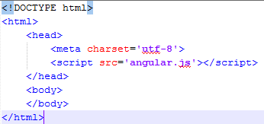
How to get started?
Reference the AngularJS script in an HTML page. To do this:
Go to web page https://angularjs.org/ and press the download button.
Download the uncompressed (angular.js) file. Store the file in your working directory where you develop your application (i.e. C:\AngularJS\Projects\FirstApp)
Reference the stored angular.js script file from your HTML page….That’s it.
Load the angular script

Slide 11
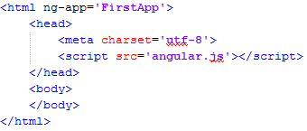
How to get started?
Add the ng-app directive.
Directive

Slide 12
What Are Directives?
At a high level, directives are markers on a DOM element (such as an attribute, element name, comment or CSS class) that tell AngularJS's HTML compiler ($compile) to attach a specified behavior to that DOM element or even transform the DOM element and its children. (AngularJS Documentation).
When you fill your html markup with directives it is said to be a Template, something that will change dynamically via compilation when user interacts with the page.
You can find all the build-in directives from the documentation https://docs.angularjs.org/api

Slide 13
What Are Directives?
From the documentation your can read the meaning of ng-app directive:
Use this directive to auto-bootstrap an AngularJS application. The ngApp directive designates the root element of the application and is typically placed near the root element of the page - e.g. on the <body> or <html> tags.
Bootstrapping is the equivalent of initializing, or starting, your Angular app, meaning you can use syntax like {{1+2}} in your html markup.

Slide 14
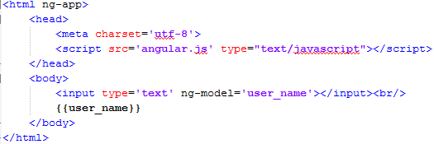
Data Binding Using Directives
One of the powerful features in AngularJs is data binding. To get you a first sight what this means let’s add one data binding in our application.
Model
Binding

Slide 15

Data Binding Using Directives
In previous example we used directive ng-model in <input> element. Model is something that holds the data, in this case it will hold the data that user will type in to our input element. To reference this data we gave it a name “user_name”. Now you can use this name in your markup to display the data. In our case we just simply used the “mustache” syntax {{user_name}} to display the text what user inputs.
You can use the “mustache” syntax also inside other elements like <h1>{{user_name}}</h1>
And all this WITHOUT a line of JavaScript code!

Slide 16


Understanding the Building Blocks
Usually when I start to learn something new, like AngularJS framework, I see a pile of junk: thinking directives, models, factories…how they all fit together? How to I construct a super car from those peace's?

Slide 17
Understanding the Building Blocks
To understand the building blocks and how they connect together the best way is to show a picture of it.
Module
Routes
UI
Logic/data
View
Controller
$scope
Directives
Factory
Filters
Service

Slide 18
Understanding the Building Blocks
The Big Picture
Module
config
Routes
Views
$scope
Controller
Directives
*Factory

Slide 19
Module
Module is a container object for:
Controllers
Routes
Factories/Services
Directives
Filters

Slide 20
Factories and Services
Are used for:
To retrieve data using RESTful services
Share data between controllers
Contain the custom logic for your application

Slide 21
Controllers
Are responsible of:
Retrieve data from factory or service
Handle the events triggered by view
Use the $scope object to interact with the view
Know how to handle the business logic
Act as a brain for the view

Slide 22
$scope
$scope object acts as a glue between the controller and view. You use this to share the data between the controller and the view.
In previous example we used this directive ng_model=‘user_name’. What actually happens here is that the variable ‘user_name’ is added to our $scope object. Now both the view and the controller can use this variable to share data.

Slide 23
Views
Are responsible of:
Render the user interface
Contain HTML and CSS
Bind the data provided by the controller via the $scope object.
Uses directives to enhance HTML and render data.

Slide 24
Routes
Routes are the way to navigate in the application. What actually happens in router is that it launches our view and the controller that is attached to our view. The controller may then use factory or service to load some data from database and share it to the view that renders the data. When user then click a link etc. the router can load another view to display some other data.

Slide 25
Summary so far
AngularJS is full featured framework to build web applications.
Applications are usually organized into one or more modules (containers) you see examples how to do this later.
Module consists of different parts:
Controllers
Factory/services
Directives
Filters

Slide 26
The Examples
Best way of learning things is to see a little examples, that uses all the building-blocks that framework offers.
Each example covers some topic like module example shows you what modules are what they contains and how you build them.

Slide 27
Directives, Filters and Data Binding
The first example will show you how you build application containing the most used directives. It also shows you how you can filter and order data. And we don’t forget the concept of data binding which actually comes as natural in all AngularJS applications.

Slide 28
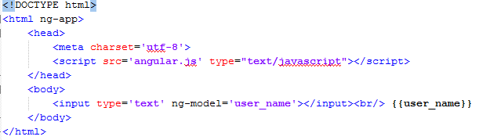
Directives, Filters and Data Binding
A short recap: what you have already seen…
Directive
Data Binding Syntax
Another directive

Slide 29
Directives, Filters and Data Binding
A more complex example what we inspect here contains next features
Dynamic lists, tables etc. with ng-repeat directive
Data initializing with ng-init directive
Data filtering

Slide 30
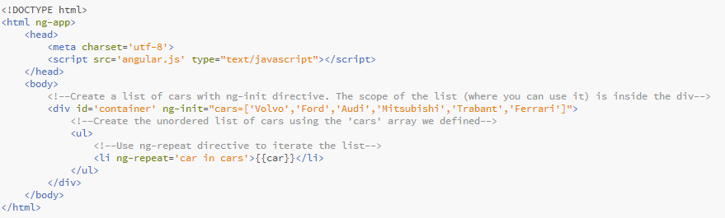
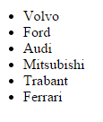
Directives, Filters and Data Binding
Use of ng-init and ng-repeat directives

Slide 31
Directives, Filters and Data Binding
Using Filters. Firs of all let’s point the changes I made for this example. AngularJS is expecting an array of objects when filters are used. So I changed.
This
To this

Slide 32
Directives, Filters and Data Binding
Next we need some data we used to filter the list of cars. I decided to append an input element where user can write the filter rule (like if one wants to search all the cars starting with letter A then one types letter A in textbox)

Slide 33
Directives, Filters and Data Binding
And the last thing is to append the filtering in our repeater

Slide 34
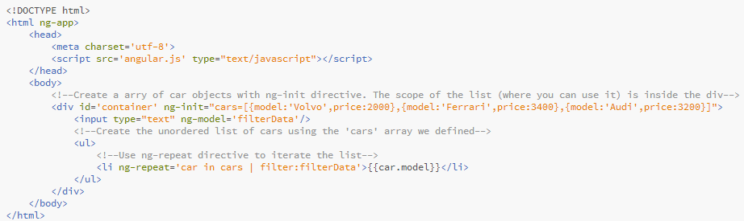
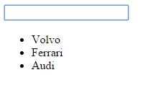

Directives, Filters and Data Binding
And complete example
Filtering in action

Slide 35
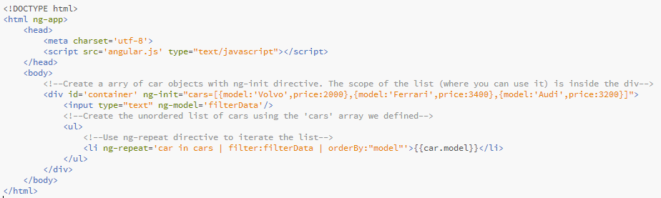
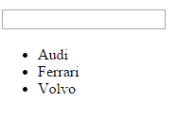
Directives, Filters and Data Binding
And use of orderBy which in our example orders the cars in alphabetical order….

Slide 36
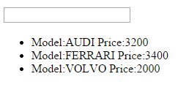
Directives, Filters and Data Binding
Lowercase and uppercase….

Slide 37
Modules,Views, Controllers and Scope
In previous example we initialized our data in our markup (the cars array). This is not very “handy” way of doing things, because it comes a maintenance issue when the amount of data increases. Also it is very hard to test the data that is initialized in the view.
More practical way is to use Model View pattern, where view only renders the data and the controller (or model) actually contains the data. You remember this? This I what we do next…
Module
View
$scope
Controller

Slide 38
Modules,Views, Controllers and Scope
First of all we need to create a module. To do this you need to create a JavaScript file (i.e. myapp.js).
Inside this file we create the module that consist of controller and the needed data. We also need to discuss the concept of scope and $scope object. But first lets create a model and see how we bind that model to our view!

Slide 39
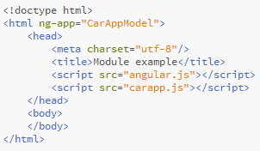
Modules,Views, Controllers and Scope
Now I have created a carapp.js JavaScript file and index.html file. In html file we load both the angular.js and carapp.js files. Note the value in ng-app directive: it is very important as you can shortly see…

Slide 40
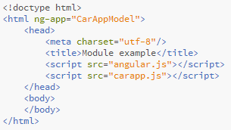

Modules,Views, Controllers and Scope
Next thing to do is create a module in our carapp.js file.
You can think of a module as a container for the different parts of your app – controllers, services, filters, directives, etc.
Here we make the binding between the view and module. The name is the secret.
The line above creates a module with
name CarAppModel, and return the created model to our variable
CarApp. The second argument [] is
for defining dependencies to other modules i.e.
var demo = angular.module(‘myModule’,[‘anotherModule’]);

Slide 41
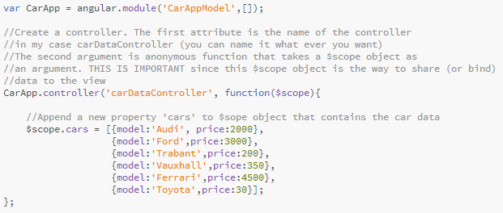
Modules,Views, Controllers and Scope
Now we have a module and we have make a binding between the view and the module.
No we can start to append controllers in our module. It is done as simple as code below….

Slide 42
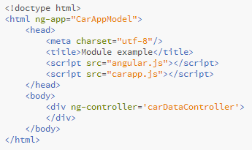
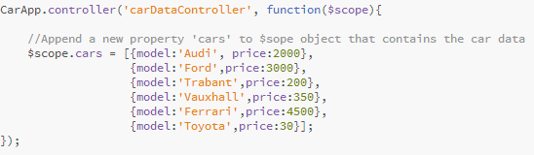
Modules,Views, Controllers and Scope
Now we have the controller, but we don’t use that in our view yet. The secret of injecting the controller in view is surprisingly: ng-controller directive.

Slide 43
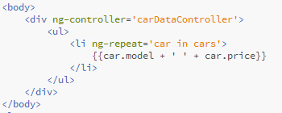
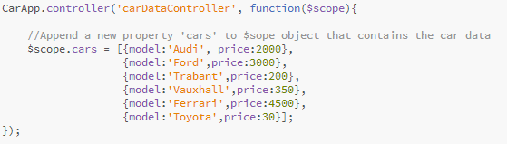
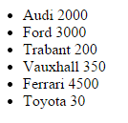
Modules,Views, Controllers and Scope
No we can use the data declared in our controller…

Slide 44
Understanding Controllers
When a Controller is attached to the DOM via the ng-controller directive, Angular will instantiate a new Controller object, using the specified Controller's constructor function.
A new child scope will be available as an injectable parameter to the Controller's constructor function as $scope.
Use Controllers to
Set up the initial state of the $scope object.
Add behavior to the $scope object.

Slide 45
Understanding Controllers
Do not use controllers to:
Manipulate DOM — Controllers should contain only business logic.
Format input — Use angular form controls instead.
Filter output — Use angular filters instead.
Share code or state across controllers — Use angular services instead.
Manage the life-cycle of other components (for example, to create service instances).

Slide 46
Routes,Factories and Services
When talking about SPAs we have one page but many views. Normally when user click a link a new page is loaded, but in AngularJS a new view is rendered.
To navigate between these views we need to define the route between those views, for example if user clicks a link or confirm button, you probably direct user to another view.
To do this we need to configure routes to our module.

Slide 47
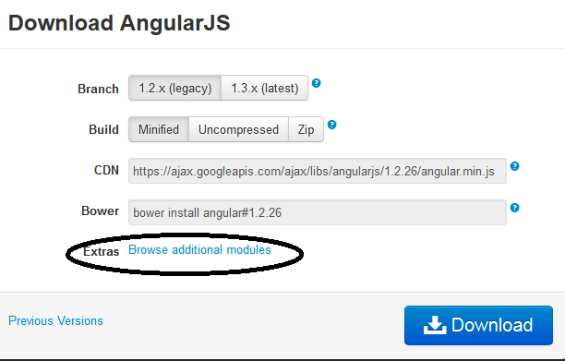
Routes,Factories and Services
Starting with AngularJS version 1.2, ngRoute is in its own module and must be loaded by loading the additional angular-route.js file.
Go to https://angularjs.org/ press download button and select Browse additional modules, search angular-route.js file and download it.

Slide 48
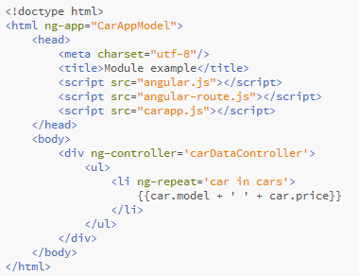
Routes,Factories and Services
Load the module (angular-route.js) in your html file…

Slide 49
Routes,Factories and Services
Now we have a dependency to another module, so we need to tell it to our own CarApp module…remember the empty brackets [] in angular.module function? Well no we need to use that.
Define dependencies….

Slide 50
Routes,Factories and Services
Now we can define our routes using the config function. Remember this?
Module
config
Routes

Slide 51
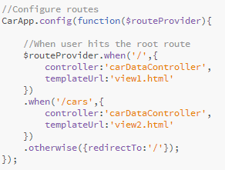
Routes,Factories and Services
We use the $routeProvide object here to inject our views to some specific route.

Slide 52
Routes,Factories and Services
The previous code want’s to say: Hey! when user enters to example url www.myapp.com/ then use the view1.html and that view uses the carDataController
When the user enters to url www.myapp.com/cars then use view2.html that also uses carDataController (it also can be some other controller you have defined).
If the user enters to url something like www.myapp.com/xys then redirect to ‘/’ which is our view1.html

Slide 53
Routes,Factories and Services
Now we need to do those views view1.html and view2.html. We also need to modify the index.html.

Slide 54
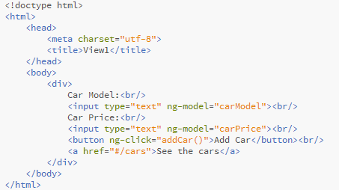
View1.html
This is the content of view1.html. As you can see we have two text fields with models carName and carPrice. We also have a button there with directive ng-click. As an value it has a function addCar(), what we haven’t defined yet, but we will add this function to our carDataController. It will append a new car to our cars array. And then there is an link element that href value is set to #/cars. Now if you look at our route code, this path should load the view2 for us.

Slide 55
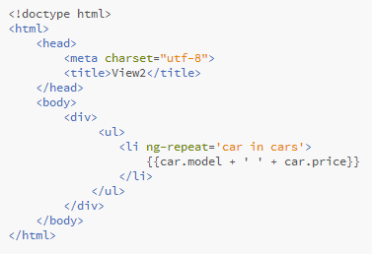
View2.html
This view simply lists all the cars we have….

Slide 56
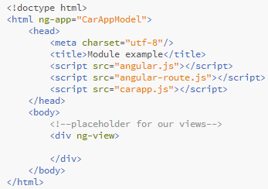
Index.html
And then we modify our root template the index.html that will act as a placeholder for our views (view1.html and view2.html).

Slide 57
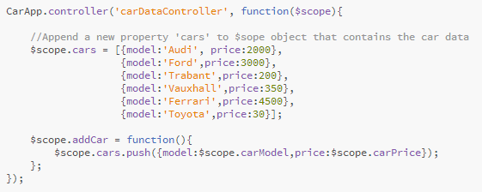
The addCar function
The last thing to do is to append the addCar function to our controller. As you remember view1 had a button and when clicked it call the addCar function from our controller.

Slide 58
Does it work?
Well yes and no. When user press the add car button in view1 the car is added to our static array of cars. But when you click the link ‘see the cars’ you can see that the car you pushed is not shown. This is because actually you give a new instance of carDataController to view2, which of course gets the initialized list of cars.
To fix this we need something to share the data between views.
There are three ways to do that:
Factories
Services
All these are used to share data between controllers and thereby also between views! The differ in the way they are constructed.

Slide 59
Factories
Factories and Services are singletons that means there is only one instance of them in one application.
When you’re using a Factory you create an object, add properties to it, then return that same object. When you pass this service into your controller, those properties on the object will now be available in that controller through your factory.
Creating a factory is a simple thing, just call angular factory() method, give the name and the callback as an argument for it.

Slide 60
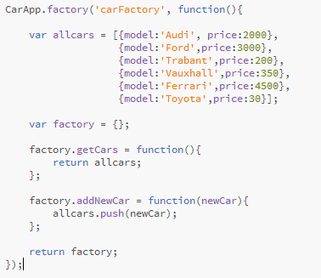
Factories
Here is our factory.

Slide 61
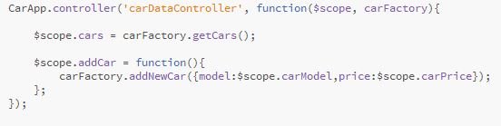
Factories
And here is the modified controller code

Slide 62
Factories
Now if you test the application you can actually append a car in the array in view1 and see it in the view2.
So this is the reason why you use factories, you can simply share some data between views, controllers and so on.

Slide 63
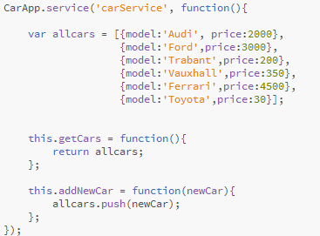
Services
When you’re using Service, it’s instantiated with the ‘new’ keyword. Because of that, you’ll add properties to ‘this’ and the service will return ‘this’. When you pass the service into your controller, those properties on ‘this’ will now be available on that controller through your service.

Slide 64
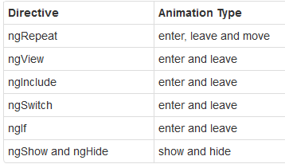
Animation
The directive nganimate is very simple. You just need to declare the ng-animate attribute to an element that have another directive that changes the DOM.
You can use the animations with the directives:

Slide 65
Animation
And there are three ways to make animations in AngularJS:
CSS3 Transitions
CSS3 Animations
Javascript
ngAnimate directive lives on it’s own module, so you have to load it (like angular-route.js) and include it in your html file.

Slide 66
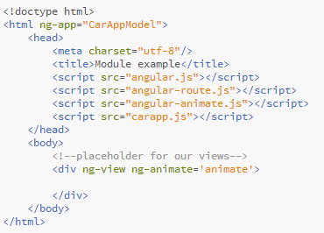
Animation

Slide 67
Animation
Set ngAnimate as a module dependency

Slide 68
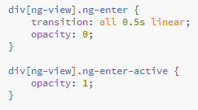
Animation
Do some CSS in this case for ng-view

Slide 69
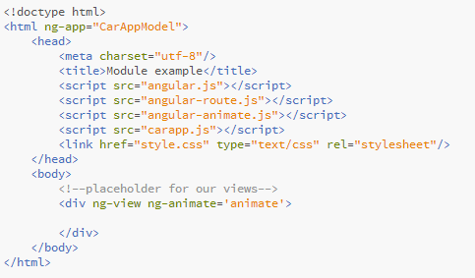
Animation
Apply the animation in html

Slide 70
Animation
The ng-enter class is applied to the element when it is added to the DOM and rendered on the page.
The ng-move class is applied when items are moved around in the DOM.
The ng-leave class is applied when they're removed from the DOM.
"starting" class that represents the style at the beginning of the animation
"active" class that represents the style at the end of the animation

Slide 71
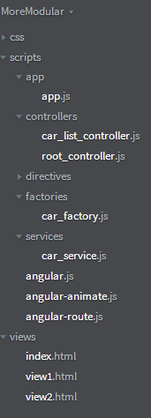
Become More Modular
This was all about fundamental concepts in AngularJS.
There is one thing still I want to show and discuss with you.
When you start a big project with angular you should think much, much more in modular way than in our examples so far.
Next we arrange our application so that our project structure looks as follow. As you can see our controllers scripts are in own folder, views are in own folder etc. This helps a lot of maintenance when you project grows bigger!

Slide 72
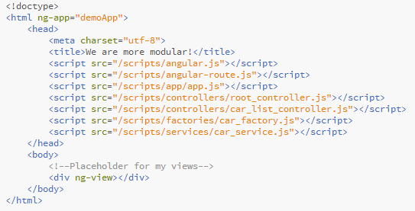
Become More Modular
Lets see what the files now contain starting with index.html

Slide 73
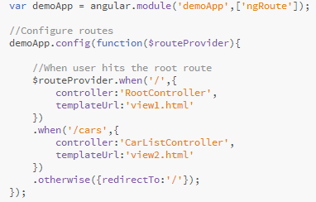
Become More Modular
App.js

Slide 74
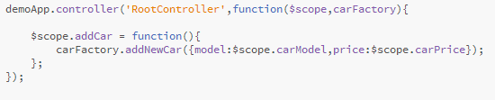
Become More Modular
Root-controller.js

Slide 75

Become More Modular
Car_list_controller.js

Slide 76
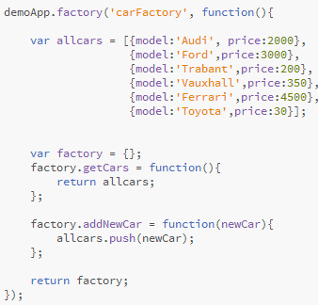
Become More Modular
Car_factory.js

Slide 77
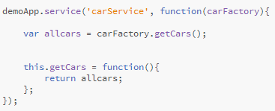
Become More Modular
Car_service.js

Slide 78
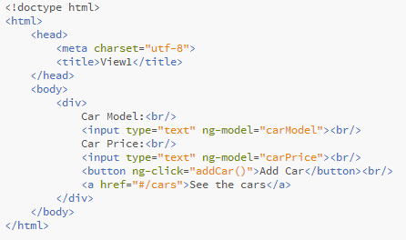
Become More Modular
View1.html

Slide 79
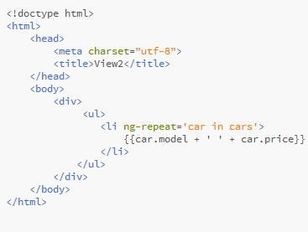
Become More Modular
View2.html

Slide 80
Creating Custom AngularJS Directives
AngularJS provides many built-in directives that can be used to manipulate the DOM, route events to event handler functions, perform data binding, associate controllers/scope with a view, plus much more.
Directives such as ng-view, ng-controller, ng-repeat, and many others found in the AngularJS core script make it easy to get started using the framework.
Although the built-in directives cover many different scenarios, there may be times when you find yourself needing custom directives and wondering how to get started writing them

Slide 81
Creating Custom AngularJS Directives
AngularJS directives can be a bit hard to understand the first time you see them. They offer many different options, have a few cryptic features and are generally challenging at first.
They take a little practice but you can do powerful things with them once you get the hang of it.

Slide 82
Creating Custom AngularJS Directives
There are naming rules when writing custom directives:
Don’t use “ng-” prefix in your own directives!
You have to use “camel-case” naming convention. For example…
//Use of own directive in HTML
<div my-directive><div>
//The actual javascript implementation
directive(‘myDirective’ function(){
//Your directive implementation
});
Naming Convention:
HTML: my-directive
JavaScript: myDirective

Slide 83
Creating Custom AngularJS Directives
When to create custom directives?
If you want reusable HTML component
If you want reusable behavior
If you want to wrap i.e. jQuery plugin.

Slide 84
Creating Custom AngularJS Directives
Creating a directive
Place your directives to own module, so they can be reused easily in other project -> reusable components is the idea!
Write the directive code
Use the directive in your applications

Slide 85
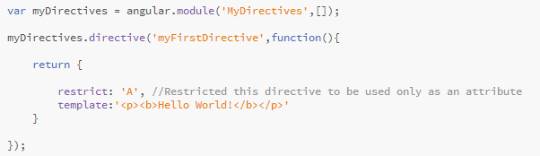
Creating Custom AngularJS Directives
Create your own module. This one is placed under Directives folder in file with name my_directives.js

Slide 86
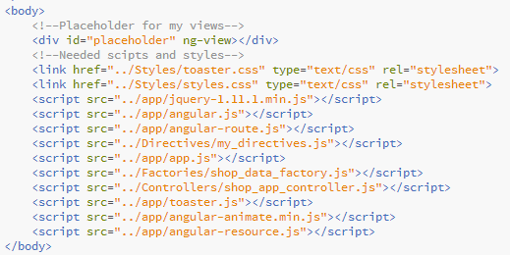
Creating Custom AngularJS Directives
Remember to load your module!

Slide 87
Creating Custom AngularJS Directives
Ask AngularJS to load your module as dependency…

Slide 88
Creating Custom AngularJS Directives
Use your directive in html

Slide 89
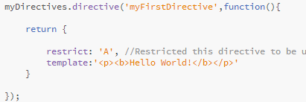

Creating Custom AngularJS Directives
There are four types of directives which you define in restrict attribute (or use combinations)
A: restricted to be only used as attribute->
E: Restricted to be element
C: Restricted to be a class
M: Restricted to be a comment
You can use combination also
‘AE’: Can be either an attribute or element!

Slide 90
Creating Custom AngularJS Directives
template: This specifies the HTML markup that will be produced when the directive is compiled and linked by Angular. This does not have to be a simple string. The template can be complex, often involving other directives, expressions ({{ }}), etc.
More often you will use templateUrl instead of template attribute, because templateUrl references to an external .html file where you markup is located.

Slide 91
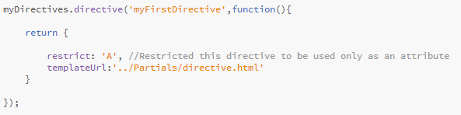
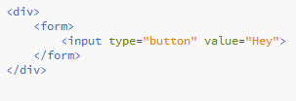
Creating Custom AngularJS Directives
directives.html

Slide 92
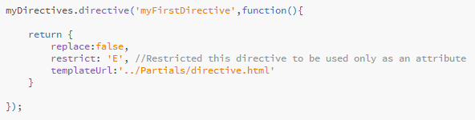
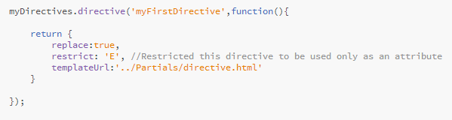
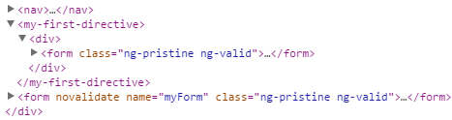
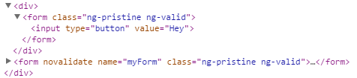
Creating Custom AngularJS Directives
replace – This specifies if the generated template will replace the HTML element on which the directive is attached. The default value (if replace attribute is not used in directive) is false…See

Slide 93
The link function and scope
In addition to performing data binding operations with templates directives can also be used to manipulate the DOM. This is done using the link function.
In link function you can also bind the directive to events like mouse click etc.
The link function normally accepts 3 parameters including the scope, the element that the directive is associated with, and the attributes of the target element.

Slide 94
The link function and scope
By default a directive does not get a new child scope. Rather, it gets the parent’s scope. This means that if the directive is present inside a controller it will use that controller’s scope for example:
<div ng-controller=“myController”>
<my-custom-directive></my-custom-directive>
<div>

Slide 95

The link function and scope

Slide 96


The link function and scope
Binding data from parent scope…

Slide 97

The link function and scope
Isolated scope -> not parent scope
Normally you can use parent scope attributes (it is injected to you directive by default) in your directive like:
These comes from the parent scope

Slide 98

The link function and scope
If you define an isolated scope like this the parent scope will be NO LONGER AVAILABLE!
Isolated scope defined
These wont work anymore

Slide 99
The link function and scope
Since the directive is now completely cut-off from the parent scope how do we pass data into the directive for data binding purposes? You use @, =, and & characters which seems a bit strange at first glance but isn’t too bad once you understand what the characters represent.

Slide 100
The link function and scope
The @ local scope property is used to access string values that are defined outside the directive.
For example, a controller may defined a name property on the $scope object and you need to get access to that property within the directive.
To do that, you can use @ within the directive’s scope property.

Slide 101


The link function and scope
Using @

Slide 102


The link function and scope
In cases where you need to create a two-way binding between the outer scope and the directive’s isolate scope you can use the = character.

Slide 103


The link function and scope
The & local scope property allows the consumer of a directive to pass in a function that the directive can invoke. For example, let’s assume you’re writing a directive and as the end user clicks on a button that the directive emits you want to notify the controller.

Slide 104
The link function and scope
You really should always use isolated scopes in your directives to make them reusable. If you use in your custom directive the parent controller scope, the you are not able to use you directive in another controller unless you really know what you are doing.

Slide 105

Attributes
To handle attributes of your directive you can use link function attr parameter.
Prints out {foo;1,bar:2}

Slide 106
Attributes
If you want to set attribute values for your directive use attrs.$set() function.
If you want to get notified if attribute values are changed use attrs.observe() function.

Slide 107
How Directives are Compiled?
When the application bootstraps, Angular starts parsing the DOM using the $compile service.
This service searches for directives in the markup and matches them against registered directives.
Once all the directives have been identified, Angular executes their compile functions.
The compile function returns a link function which is added to the list of link functions to be executed later.
This is called the compile phase.
If a directive needs to be cloned multiple times (e.g. ng-repeat), we get a performance benefit as the compile function runs once for the cloned template, but the link function runs for each cloned instance.
That’s why the compile function does not receive a scope.

Slide 108
Controller
You can also pass a controller or implement one to your directive using controller: attribute.

Slide 109
$HTTP
The $http service is a core Angular service that facilitates communication with the remote HTTP servers via the browser's XMLHttpRequest object or via JSONP (JSON with Padding”.
The $http API is based on the deferred/promise APIs exposed by the $q service. While for simple usage patterns this doesn't matter much, for advanced usage it is important to familiarize yourself with these APIs and the guarantees they provide.

Slide 110

$HTTP
Usually you do your http request from service, factory or provider. Here is a basic example:

Slide 111
$resource
$resource module sits in the top of $http module.
It is used to make request to RESTful (Representational state transfer) API’s.
To use $resource object you need to download ngResource module, reference the angular-resource.js from .html file and mark it as a dependency to your app. Then you can use it in your factory or service…

Slide 112

$resource

Slide 113
$resource

Slide 114


$resource
Using $resource

Slide 115
Understanding AngularJS Promises
This topic makes usually people to look gray and sick.
Promises are in some way, very hard to understand or follow. But there are big benefits waiting for you when you figure out how this stuff works.
Let’s start this by looking callback function in JavaScript, how they work and how you usually use them.
And Remember! It’s all about asynchronous programming!

Slide 116
Understanding AngularJS Promises
Deferred and Promise objects.
Deferred: Object that represents an asynchronous action in progress. The action can success or fail. Deferred object can be Resolved or Rejected!
Promise: Represents the result of an action that is performed asynchronously. The action may or may not be finished at any given point in time. It is an attribute of deferred object. Contains then() function for success and error handling. Then() function can be chained.

Slide 117
Understanding AngularJS Promises
You have seen this: a basic example of a callback:
window.onload = function(event){
console.log(‘DOM is now ready’);
}
Yay! A callback function!

Slide 118
Understanding AngularJS Promises
In JavaScript, functions are first-class objects; that is, functions are of the type Object and they can be used in a first-class manner like any other object (String, Array, Number, Object, etc.), since they are in fact objects themselves.
They can be stored in variables, passed as arguments to functions, created within functions, and returned from functions. Like this…
//Store our function
button.onclick = handleClick;
//Implement the function
function handleClick(event)
{
alert(‘callback function called’);
}

Slide 119
Understanding AngularJS Promises
Imagine a situation where we need to get user information from server.
We need to make a request to server, but due to latency, traffic etc. in network we cannot say HOW long it will take to get a response.
We have two options:
Just sit and wait until the response arrives. It can take 10ms to 10 minutes. Just wait DOING nothing.
Second option is to do the same thing asynchronously using callbacks.

Slide 120

Understanding AngularJS Promises
Here is the option one. We make a delay using time and for iterations to block the main thread to mimic the delays in network (for 5s).
Code is blocked here for 5s

Slide 121

Understanding AngularJS Promises
Using callbacks now we use the setTimeout for delay..

Slide 122
Understanding AngularJS Promises
The latter option seems to be just fine, but there is one thing: what if something goes wrong when setting userData object values in setUserData function?
What if, for example “server” was not able to set the name or the address information to object?
This could lead to bug in our code. The question is what we can do?
Of course we can check the attribute values simply using if statements, but what if the same object is used in many places. The check has to be DONE in every place before we can use the object->Lots of repeatedly code!

Slide 123
Understanding AngularJS Promises
That is why we can use Promises. We can for example think that we send the userData object to get the data from the server, and the userData “promises” that when it comes back the next conditions are possible:
All the data is valid and in place and you can use it
Some or all data is invalid. You can try to make corrections or just ignore the invalid data. Or show error flag to everyone that we failed!
And all this is done in ONE place.

Slide 124
Understanding AngularJS Promises
In AngularJS for example $http object is based on promises implementation. When ever you use $http object like $http,get(‘someUrl’), it return an promise object.
Also AngularJS has $q object which is a promise implementation.
Next examples try to illustrate how you can use these promise objects in your application.

Slide 125

Understanding AngularJS Promises
Using Promise library $q consists of three steps…
Create a promise
Add “future” handler
Execute promise when data is available..

Slide 126

Understanding AngularJS Promises
Chaining…

Slide 127

Understanding AngularJS Promises
Passing data…

Slide 128


Understanding AngularJS Promises
Handling error situations…

Slide 129

Understanding AngularJS Promises
Http promise object

Slide 130
Understanding AngularJS Promises
The next example will illustrate the “real life” example. The idea is to create an application where user can fetch weather data using the city information.
We have to make two request
Geocode the city name to latitude and longitude
Use these latitude and longitude values to get the local weather.
No the first request can fail, meaning there would be no reason to make a second one. Also the second one can fail, meaning we don’t still have the weather data for user.
We build this example application to show the power of promises.

Slide 131

Understanding AngularJS Promises

Slide 132
$rootScope
$rootScope is the mother of all scopes in your application.
Using $rootScope object you can make application wide properties -> share data between different scopes.
This thus pollutes your namespaces so be careful with it!

