Slide 1
HTML 5
Markus Veijola March 2014

Slide 2
Introduction
HTML or Hypertext Markup Language is the main markup language for creating web pages that display information in web browser.
HTML is not a programming language it is a markup/declarative language.
HTML is written in form of HTML elements or tags enclosed in angle brackets like <body>.
HTML elements form the building blocks of all websites. HTML allows images and objects to be embedded and can be used to create interactive forms.
It provides a means to create structured documents by denoting structural semantics for text such as headings, paragraphs, lists, links, quotes and other items.
It can embed scripts written in languages such as JavaScript which affect the behavior of HTML web pages.

Slide 3
Introduction
Web browsers can also refer to Cascading Style Sheets (CSS) to define the look and layout of text and other material.
The purpose of a web browser is to read HTML documents and compose them into visible or audible web pages. The browser does not display the HTML tags, but uses the tags to interpret the content of the page.
You can think that web browser is like a word processor that knows what to do with the HTML tags.
HTML is a formal Recommendation by the World Wide Web Consortium (W3C) and is generally adhered to by all the major browsers.

Slide 4
Who Should Learn/Understund HTML?
There is no one answer for this question, but for the Web programmer writing web applications:HTML knowledge is required!
We mean here a person who is writing computer programs for the web, such as scripts written in PHP, Perl, Python, Ruby, JavaScript, JSP, JSF or whatever computer language your application is using.
It doesn't matter what language your application is written in; it will still need to generate HTML code for your visitors' web browsers to display.
Most people creating they home/web pages for private, company or hobby can use any WYSIWYG editor to build they web pages->no HTML knowledge required.

Slide 5
Definitions of web sites vs. web apps
We definitely have to categories when thinking of content we create in Internet: Web sites/pages and web applications. The question is what makes the difference?
The word “applications” had been applied to Web sites that provided advanced user interactions and capabilities previously available only through installable software like Webmail, Google Maps and Google Docs.
Web apps provides a richer user experience and access to advanced browser capabilities, possibly mimicking the native UI of the device.
Web apps are action-oriented rather than information oriented.
Working also off-line, for example using HTML5 ApplicationCache, localStorage, or indexed database.

Slide 6
Where are we focusing in this course?
The first part focus to learn HTML by creating web sites/pages.
The second part focuses for creating web applications so. End-to-end applications where we build/generate UI with HTML and the application logic is backed in server and implemented with JavaScript, PHP, or Java EE technology.

Slide 7
Getting Started

Slide 8
TOOLS
To create a web page or site you need at least:
Editor which you use to write the html document, CSS and JavaScript code.
Web browsers for testing/debug purposes.
You can use any editor that can save plain text, but there are hundreds of different editors that are specifically designed for creating web pages.
Here are few WYSIWYG editors:
Dreamviewer
NVU
KomposZer

Slide 9
Tools
Here are some editors you can use to write HTML code by hands:
Sublime text
Aptana Studio
Coffeecup
Notepad++
Netbeans IDE
Brackets

Slide 10
Tools
Some other useful tools you might find handy:
Fiddler tool for debugging HTTP traffic and more.
Wampserver server for testing your web site in real environment (not over file protocol). Especially crucial if use AJAX technique in your web page.
W3 Validator for validating and testing your HTML documents.
CSS Validator for validating your CSS code.
JSLint The JavaScript Code Quality Tool.
JavaCsript Obfuscator to obfuscate your JavaScript code from other people.

Slide 11
About Browsers
When you create you web pages or web applications it is very important that you test your page at least with most used browsers like IE, Firefox, Chrome, Opera, Safari etc.
Most browsers try to follow the W3C recommendations, but the are DIFFERENCES how they do that.
If you use HTML5/CSS3 definitions there are big gaps between browsers.
If you use JavaScript, some browsers supports some features in theirs own way, so make sure your JavaScript works in every browser or follow the standard Standard ECMA-262
To test HTML5 compatibility of browser you can use this tool: HTML5 Test

Slide 12
How It Works?
HTML is a language for describing web pages. The content is stored in file with ‘.html’ prefix. Usually this file is stored in some www server in Internet.
One usually uses a browser to download and display that content.
Browser
HTTP Request (www.kaleva.fi)
Web Server
HTTP Response (HTML Document)

Slide 13
How It Works?
Here is the scenario:
You open a browser, write some URL address (www.kaleva.fi) and hit the Enter.
The browser sends a GET request to the domain defined in the URL address.
The domain (server) handles the request and searches a file with the name index.html from server disk.
The server returns the index.html file as an response to browser.
Browser gets the response, reads and processes the index.html file, creates an DOM (document Object Model) from that file and renders the content in browser window.
If HTML document contains tags for images, video, embedded object, audio, JavaScript or CSS files the browser loads each of these files from the server using separate HTTP request.

Slide 14
HTML Document

Slide 15
HTML Document
HTML document is composed by using predefined (opening and closing) tags with angle brackets and attributes which browser can understand/process.
HTML document is an hierarchal tree of HTML elements/tags.
Here are few links where the tag names and purposes are defined:
HTML5 Element List
W3School Tag List
Here link to all HTML tag attributes:
HTML Attribute Reference

Slide 16
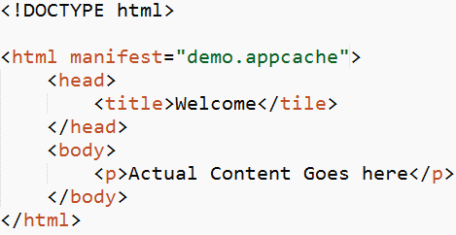
Minimalist Example
Opening tag
Attribute and it’s value
Child Element
Closing Tag

Slide 17
HTML <!DOCTYPE> Declaration
The <!DOCTYPE> declaration must be the very first thing in your HTML document.
Is not an HTML tag -> it is an instruction to the web browser about what version of HTML the page is written in.
Always add the <!DOCTYPE> declaration to your HTML documents, so that the browser knows what type of document to expect.

Slide 18
HTML <html> Tag
Tells the browser that this is an HTML document.
Must be the root element of any HTML document (meaning all other elements in your HTML document must be child elements of this).

Slide 19
HTML <head> Tag
Is a container element to all ‘not visible for user’ content such as scripts, styles and meta information.
Execption for previous is a title tag which content user can see in browser toolbar.
The following elements can go inside the <head> element:
<title> (this element is required in the head section)
<style>
<base>
<link>
<meta>
<script>
<noscript>

Slide 20
HTML <body> Tag
Contains all the content that is actually rendered in browser window such as text, hyperlinks, images, tables, lists, etc..
This is the place where you build your actual web site content.

Slide 21
How to start building the web site?
First of all there are lots of HTML elements and tags you can use to describe the content of your web page.
It takes time to get know all of them, but we can group the elements depending of their purpose in HTML document.
These are the groups
Root element
Metadata
Scripting
Sections
Grouping Content
Text-level semantics
Edits
Embedded Content
Tabular data
Forms
Interactive Elements

Slide 22
Root Element
This is the easiest one, because there is exactly one root element <html>. All other elements must be descendants of this element.

Slide 23
Metadata
HTML meta tags are officially page data tags that lie between the open and closing <head> tags in the HTML code of a document.
The text in these tags is not displayed, but parsable and tells the browsers (or other web services) specific information about the page. Simply, it “explains” the page so a browser can understand it.
Metadata is also used by search engines (like google) to find your page in Internet.

Slide 24
Metadata
Tags used to define metadata are:
<head>
<title>
<meta>
<base>
<link>
<style>

Slide 25
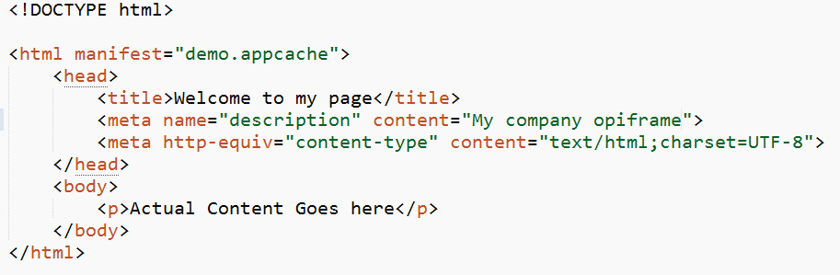
Metadata Example

Slide 26
Scripting
Scripting tags defines an external script file, or actual inline script used in your web page or alternative content to display when the browser doesn't support scripting.
Tags are:
<script>
<noscript>

Slide 27
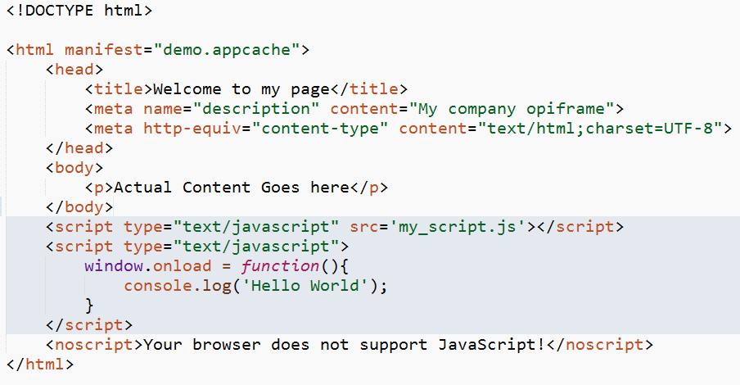
Scripting Example
Load external script
Inline script

Slide 28
Sections
The structure of a document, i.e. the semantic structure of what is between <body> and </body>, is fundamental to presenting the page to the user.
HTML uses the notion of sections and sub-sections of a document to describe its structure.
Section elements are:
<body>
<section>
<nav>
<article>
<aside>
<h1>,<h2>,<h3>,<h4>,<h5>,<h6>
<header>
<footer>
<address>
<main>

Slide 29
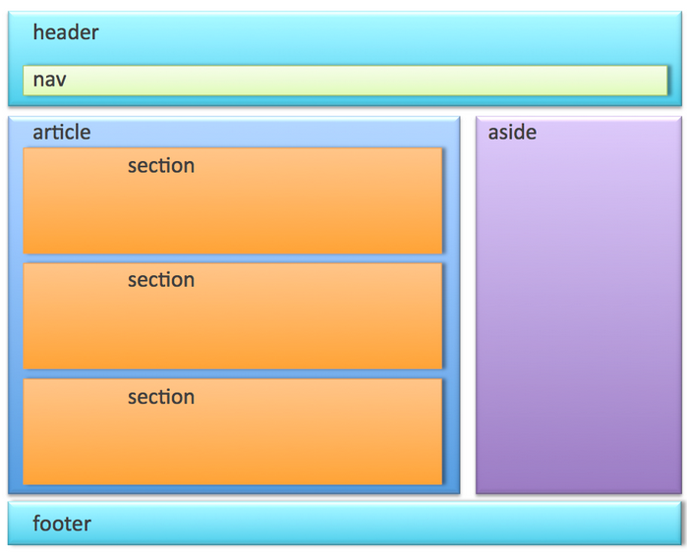
Sections
Sections elements are used to divide your web page to logical “pieces”

Slide 30
Grouping content
Elements that lets you groups the content like list, divisions, paragraphs, figures etc.
The elements are:
<p>
<hr>
<pre>
<blockquote>
<ol>
<ul>
<li>
<dl>
<dt>
<dd>
<figure>
<figcaption>
<div>

Slide 31
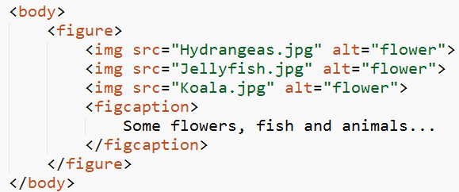
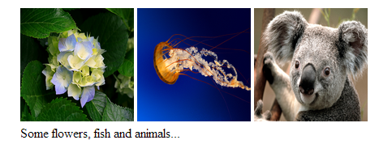
Grouping Example

Slide 32


Text-level semantics
Text-level semantic elements are in means of defining the part of the text formatting like <em> that represents emphasized text…

Slide 33
Text-level semantic elements
<a>
<em>
<strong>
<small>
<s>
<cite>
<q>
<dfn>
<abbr>
<data>
<time>
<code>
<var>
<samp>
<kbd>
<sup>,<sub>
<i>
<b>
<u>
<mark>
<rt>
<rp>
<bdi>
<bdo>
<span>
<br>
<wbr>

Slide 34
Embedded content
Embedded content means images, video, audio etc. what you actually can embed in your web page.
The elements are:
<img>
<iframe>
<embed>
<object>
<param>
<video>
<audio>
<source>
<track>
<canvas>
<map>
<area>
<svg>
<math>

Slide 35
Tabular Data
Tabular Data/Table data. Data that is wanted to be displayed in table format that consist of rows and columns.
The tags are:
<table>
<caption>
<colgroup>
<col>
<tbody>
<thead>
<tfoot>
<tr>
<td>
<th>

Slide 36
Tabular Data Example
Tip: The thead, tbody, and tfoot elements will not affect the layout of the table by default. However, you can use CSS to style these elements.

Slide 37
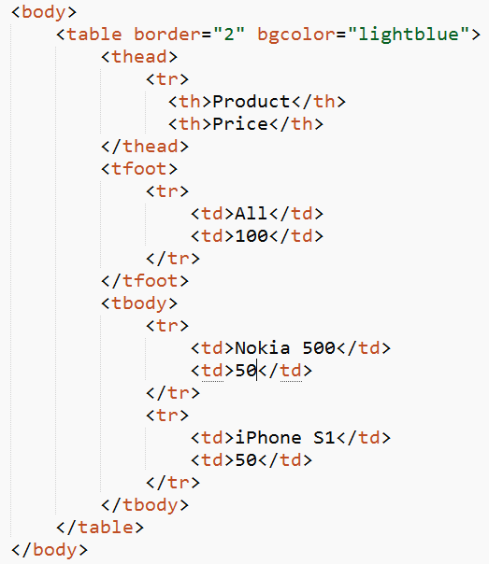
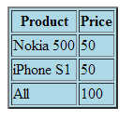
Tabular Data Example

Slide 38
Forms
Represents a form , consisting of controls, that can be submitted to a server for processing.
The tags are:
<form>
<fieldset>
<legend>
<label>
<input>
<button>
<select>
<datalist>
<optgroup>
<option>
<textarea>
<keygen>
<output>
<progress>
<meter>

Slide 39
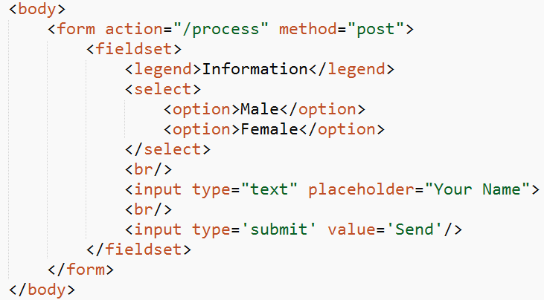
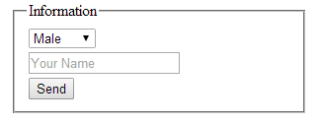
Forms Example

Slide 40
Interactive elements
Represents a widget from which the user can obtain additional information or controls.
Tags are:
<details>
<summary>
<menuitem>
<menu>

Slide 41
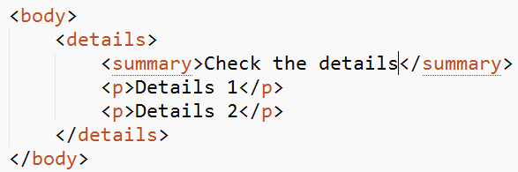

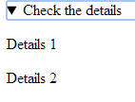
Interactive elements Example

Slide 42
Block and Inline Elements

Slide 43
Block and Inline Elements
There are two different kind of elements in HTML:
Block elements
Inline elements
Block elements reserves as much space in horizontal axis as possible. It creates a new line before and after element automatically. Can contain other block level elements or inline elements.
Inline elements reserves as much space space in horizontal axis that is needed. Does not create a new line. Can contain other inline elements or nothing at all.

Slide 44
Block and Inline Elements
One of the most common mistakes is trying to set a width of an inline element. This is because inline elements don't have widths. That is, they do have widths, but the width is set by the container box.
Some CSS properties that inline elements ignore include:
width and height
max-width and max-height
min-width and min-height

Slide 45
Changing the Type of an Inline Element to Block and Vice Versa
With CSS you can change the type of an element from inline to block or the reverse with just one CSS property:
display:block;
display:inline;
display:none;

Slide 46
When to Change the Display Property
In general you should not. there are some cases where turning a block-level element into an inline and vice versa can be useful.
Horizontal lists: Lists (ol, ul) are block level elements and creates an vertical list. If you need to create a horizontal list you can set the display property of the list to inline.
Headers in the text : Sometimes you might want to use h1..h6 elemets as headers but keep them in the same line as a text.
Removing the element : And of course, if you want to remove the element completely from the document flow, you can set the display to none.

Slide 47
Block and Inline Elements
Examples of block elements:
<h1>…<h6>
<div>
<section>
<p>
<nav>
<article>
<footer>
<aside>
<table>
<ol>, <ul>, <dl>

Slide 48
Block and Inline Elements
Examples of inline elements:
<img>
<a>
<span>
<mark>
<strong>
<i>
<em>
<b>
<input>

Slide 49
HTML Attributes
HTML elements can have attributes.
Attributes provide additional information about an element.
Attributes are always specified in the start tag.
Attributes come in name/value pairs like: name="value“. The exception is Boolean type attributes where only the attribute name is required.
Attribute values should always be enclosed in quotes.

Slide 50
HTML Attributes
There are few attributes that you can use in any HTML element:
class: Specifies one or more class names for an element (refers to a class in a style sheet)
id: Specifies a unique id for an element
style: Specifies an inline CSS style for an element
title: Specifies extra information about an element (displayed as a tool tip)
Other attributes are specific to some particular HTML element.
You can find a complete list of HTML attributes from here: HTML Attributes

Slide 51
Navigation
Usually when you build up your web page(s)/application you need more than one page for your content.
If you have more than one page you need to navigate between these pages. This can be done with anchor <a> element.
A link has two ends -- called anchors -- and a direction.
The link starts at the "source" anchor and points to the "destination" anchor, which may be any Web resource (e.g., an image, a video clip, a sound bite, a program, an HTML document, an element within an HTML document, etc.).

Slide 52
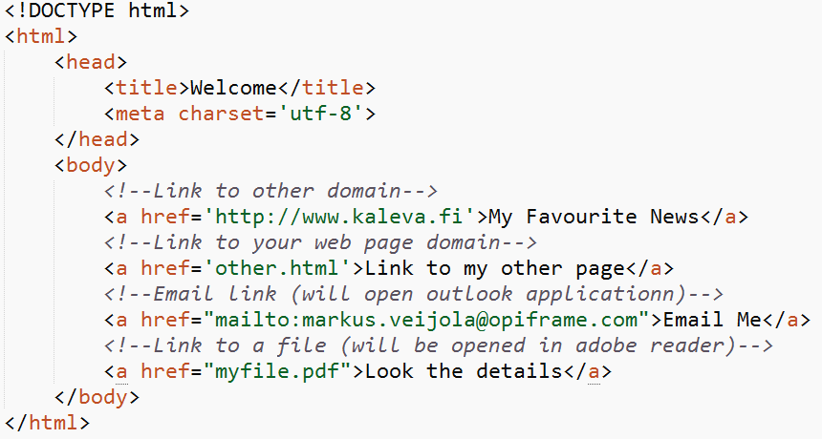
Navigation with anchor

Slide 53
Using External Content
Usually when building web sites, one also wants to use Cascading Style Sheets (CSS), JavaScripts, images, video, or audio in the websites to bring even more informative content.
This can be done using <link>, <script>, <img>, <audio> and <video> elements.

Slide 54
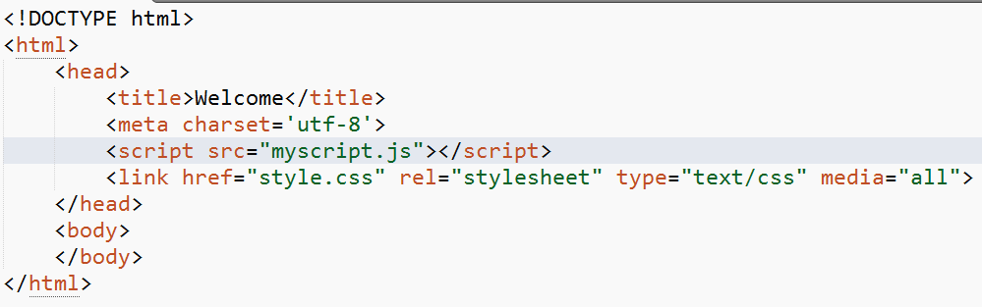
Examples

Slide 55
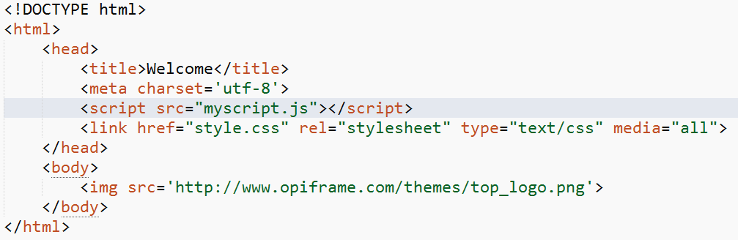
Examples

Slide 56
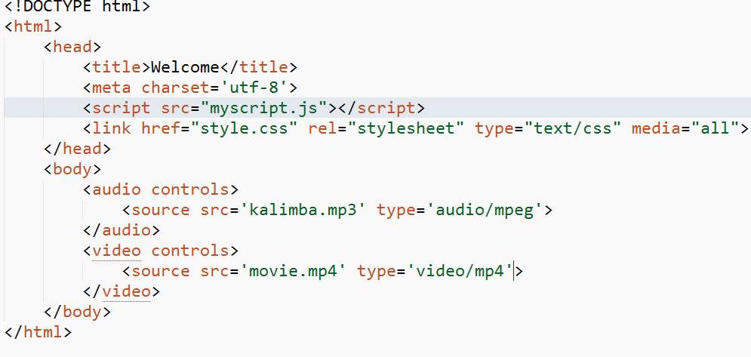
Examples

Slide 57
Tips!
Not all tags have closing tags like this (<html></html>)
Some tags, which do not wrap around content will close themselves. The line-break tag for example, looks like this : <br> - a line break doesn’t hold any content so the tag merrily sits by its lonely self.
All you need to remember is that all tags with content between them should be closed, in the format of opening tag → content → closing tag.
You might come across “self-closing” tags, whereby a br tag, for example, will look like “<br />” instead of simply “<br>” or <input type=“text”> -> <input type=“text”/>. You van use either format.
Comments in html file are done <!—This is a comment→

Slide 58
Basic HTML5 Web Page
The next example contains the basic elements used in html5 to build up a basic web page. It uses the new semantic (HTML5) tags like <nav>, <header> , <section> and <article> to divide the page in logical peaces.

Slide 59
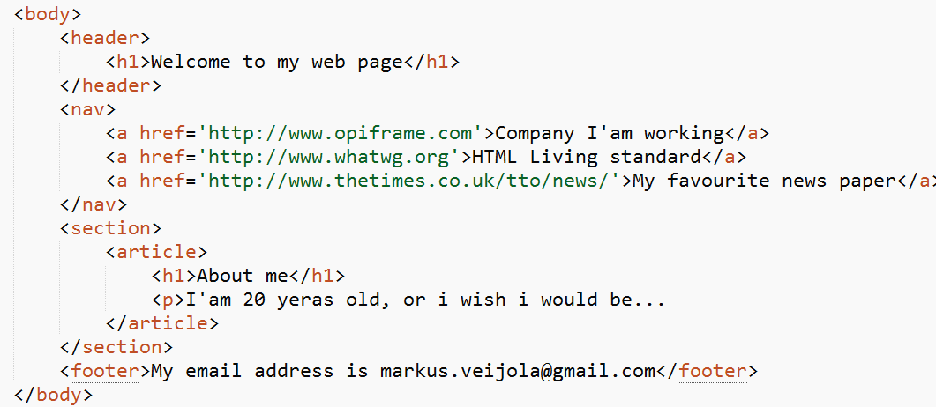
Basic HTML5 Example

Slide 60
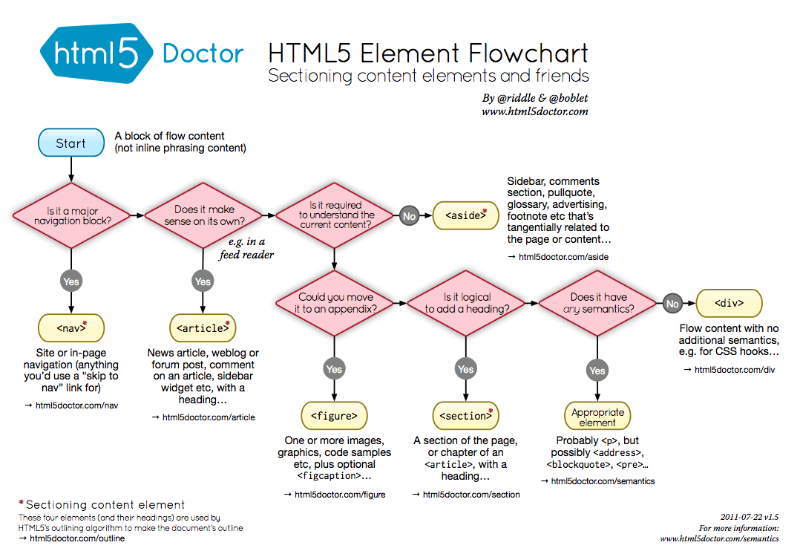
Using New Tags Chart!

