Slide 1
JavaScript and AJAX Asynchronous JavaScript and XML.
Markus Veijola March 2014

Slide 2
Introduction
Not a new programming language
Not an technology -> its an technique new way to use existing standards.
Ideal for exchanging data with a server, and update parts of a web page - without reloading the whole page.
Technique for creating fast and dynamic web pages.
Based on Internet standards.
XMLHttpRequest object
JavaScript/DOM
CSS
XML
Example of application using AJAX: Google Suggest

Slide 3
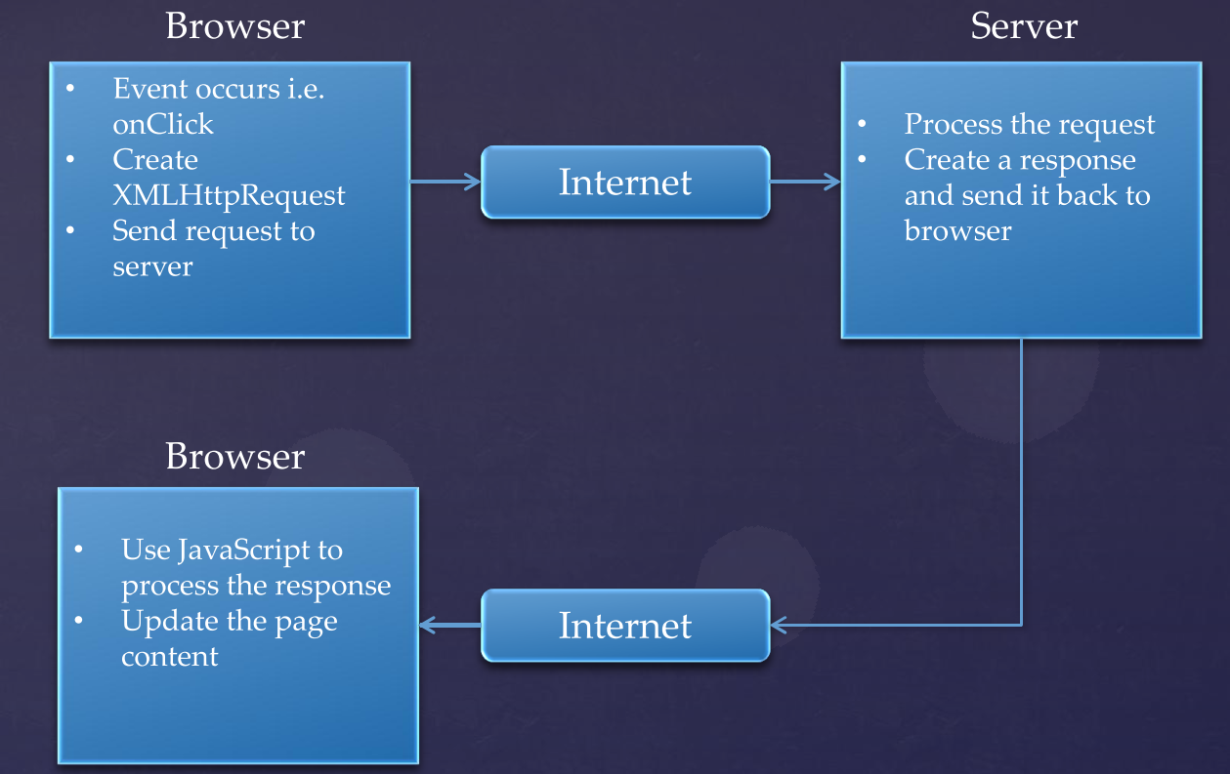
The idea

Slide 4
XMLHttpRequest object
Supports next HTTP methods
GET
POST
PUT
To sent the data to server you need to use two methods from XMLHttpRequest object
open(method,url,async)
method: the type of request: GET, POST or PUT
url: the location of the file on the server
async: true (asynchronous) or false (synchronous)
send(string)
string: Only used for POST requests
For receiving data from server you need to define the callback function for XMLHttpRequest object event handler onreadystatechange

Slide 5
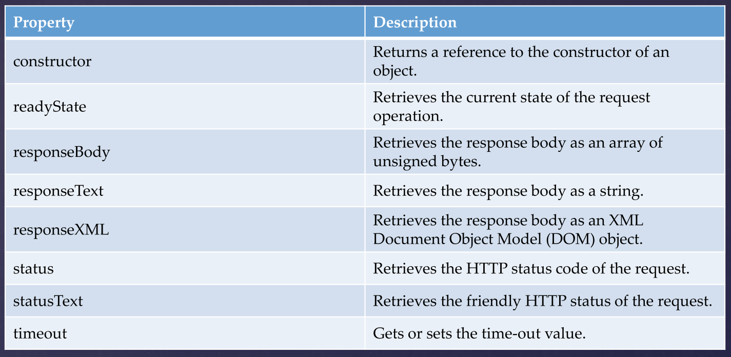
XMLHttpRequest properties

Slide 6
XMLHttpRequest Events
onreadystatechange
Sets or retrieves the event handler for asynchronous requests.
ontimeout
Raised when there is an error that prevents the completion of´the request.

Slide 7
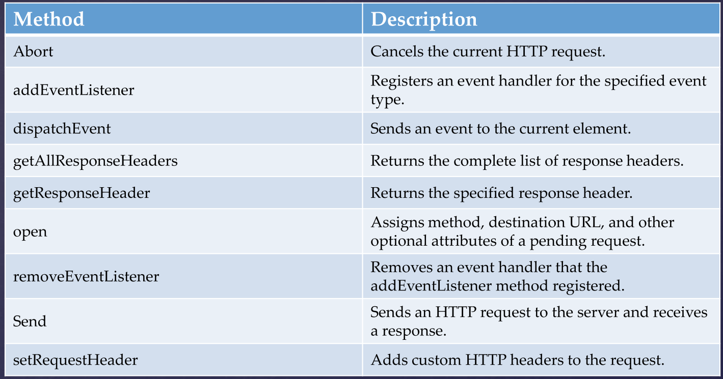
XMLHttpRequest Methods

Slide 8
Browser support
All modern browsers (IE7+, Firefox, Chrome, Safari, and
Opera) have a built-in XMLHttpRequest object.
Syntax for creating an XMLHttpRequest object:
var http = new XMLHttpRequest();
Old versions of Internet Explorer (IE5 and IE6) uses an ActiveX Object:
variable=new ActiveXObject("Microsoft.XMLHTTP");

Slide 9
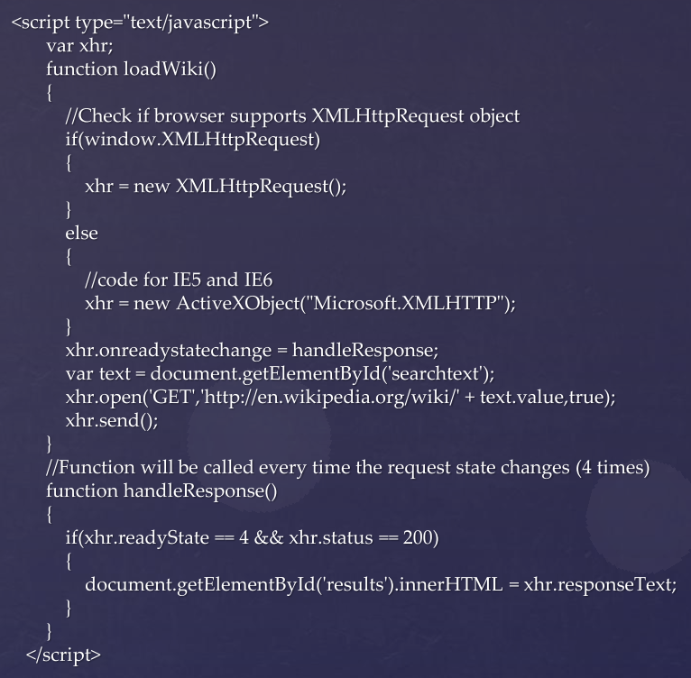
Example

Slide 10
Same Origin Policy
The same origin policy prevents a document or script loaded from one origin from getting or setting properties of a document from another origin.
This means that you can make AJAX request only to the same server where the HTML document was loaded.
NOTE!Same-origin policy depends of the browser. Seems that IE don’t care about this policy.

Slide 11
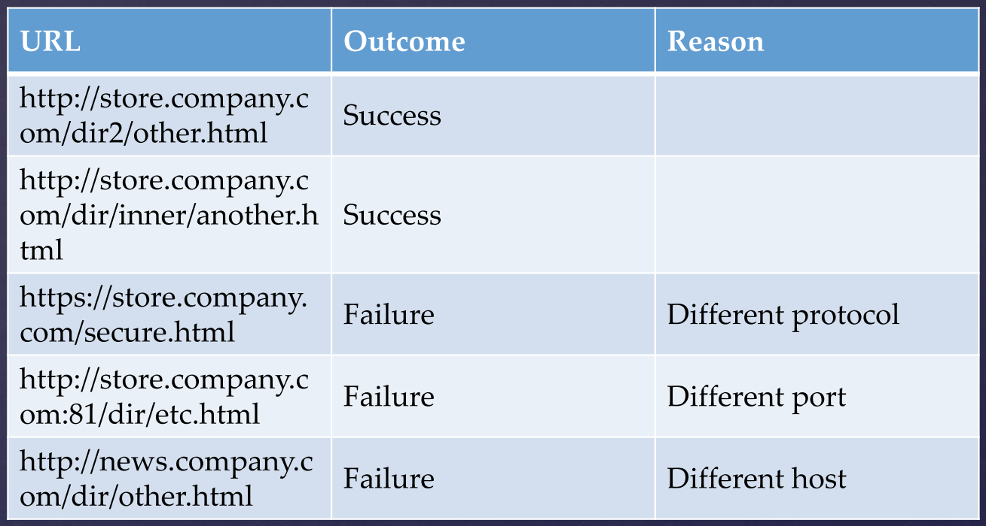
Same Origin Policy
The following table gives examples of origin comparisons to the URL http://store.company.com/dir/page.html:

Slide 12
CORS
Cross-Origin Resource Sharing (CORS) is the way to go around the same origin policy restrictions.
The use-case for CORS is simple. Imagine the server opiframe.com has some data that the site test.com wants to access.
This type of request traditionally wouldn’t be allowed under the browser’s same origin policy.
However, by supporting CORS requests, opiframe.com can add a few special response headers that allows test.com to access the data.
As you can see from this example, CORS support requires coordination between both the server and client and specially from server.

Slide 13
CORS
To do CORS, you just simply create an xmlhttprequest object and then a plain request.
What you must check is that server includes Access-Control-Allow-Credentials response header to “true”.

