Slide 1
JavaScript and Canvas.
Markus Veijola March 2014

Slide 2
Introduction
Canvas is a rectangular area where every pixel can be controlled.
Canvas element can be created by defining id, width and height attributes.
Drawing to canvas element is done with JavaScript.
JavaScript uses canvas id to find right element and creating the drawing context.
There are lots of issues you need to consider when using canvas element for drawing: one important is performance
If you are creating animations for games in canvas, how effectively you redraw the screen content?
There is one tool for testing this kind of performance, that can be found from here http://jsperf.com/
Canvas has several methods for drawing paths, boxes, circles,characters, and adding images.

Slide 3
Introduction
Where you need to use canvas?
Simple diagrams
Fancy user interfaces
Animations
Charts and graphs
Embedded drawing applications
Working around CSS limitations

Slide 4
Canvas Tools
Drawing tools
Rectangles
Arcs
Paths and line drawing
Bezier and quadratic curves
Effects
Fills and strokes
Shadows (very expensive to use)
Linear and radial gradients
Alpha transparency
Compositing
Transformations
Scaling
Rotation
Translation
Transformation matrix
Data handling
Loading external images by URL, other canvases or data URI
Retrieving a PNG representation of the current canvas as a data URI

Slide 5
Canvas Basics
The very basic code to draw on canvas element
<!DOCTYPE html>
<html lang="en">
<head>
<title>Canvas Example</title>
<script>
function ready()
{
var canvas = document.getElementById('canvas');
var context = canvas.getContext('2d');
context.fillStyle='red';
context.fillRect(0,0,400,400);
}
</script>
</head>
<body onload="ready()">
<canvas id="canvas" width="400" height="400"></canvas>
</body>
</html>

Slide 6
Canvas Basics
In previous example, the context object is the one that is used to draw something on canvas.
It ´has several functions and properties you can use to draw different kind of shapes and do different define different kinds of effects.

Slide 7
Canvas Basics
To define the color you want to use to draw you can use fillStyle property. For example to draw red rectangle:
context.fillStyle=”red";
context.fillRect(20,20,150,100);
For defining the color you can use the pre-defined colors like ”red”, 6 –digit or 3 –digit hexadecimal color, or rgb colors
context.fillStyle="#FF0000";//6 –digit
context.fillStyle = '#00f'; //3 –digit
context.fillStyle = 'rgba(0, 0, 0, 0.5)'; //last parameter is alpha

Slide 8
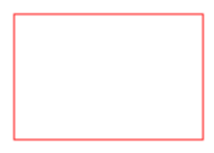
Canvas Basics
To draw a rectangle without filling color, you can define it as follow:
var c=document.getElementById("myCanvas");
var ctx=c.getContext("2d");
ctx.strokeStyle="#FF0000";
ctx.strokeRect(20,20,150,100);

Slide 9

Canvas Basics
You can use shadows with elements
var canvas = document.getElementById('canvas');
var context = canvas.getContext('2d');
context.shadowOffsetX = 5;
context.shadowOffsetY = 5;
context.shadowBlur = 10;
context.shadowColor = "DarkGoldenRod";
context.fillStyle = "Gold";
context.fillRect(20, 20, 100, 120);

Slide 10
Canvas Basics
You can get canvas width and height using the width and height properties
var wid = canvas.width;
var hei = canvas.height;

Slide 11
Canvas Basics
Different line properties
var canvas = document.getElementById('canvas');
var context = canvas.getContext('2d');
context.lineWidth = 10; //Set the pen size
context.lineCap = "round"; //Possible values "butt", "round", "square"
context.lineJoin = "bevel"; //possible values "round", "bevel", "miter"
context.fillStyle = "red";
context.beginPath();
context.moveTo(10,10);
context.lineTo(140,10);
context.stroke();

Slide 12
Canvas Basics
Text properties
context.font = 'italic 30px sans-serif';
context.textAlign = ”center”;//"start", "end", "left", "right", "center“
context. textBaseline = “top”; // "top", "hanging", "middle", "alphabetic", "ideographic", "bottom“
context.strokeText(‘Text on the canvas!', 20, 20);
context.fillStyle=“red”;
context.fillText(‘Red text on the canvas!', 100, 80);

Slide 13
Canvas Basics
By default the starting point of drawing is the upper left corner. You can use moveTo() function to define the pencil x, and y coordinates
context.moveTo(20,20);

Slide 14
Canvas Basics
Other drawing functions
void clearRect(double x, double y, double w, double h);
void fillRect(double x, double y, double w, double h);
void strokeRect(double x, double y, double w, double h)
void fillText(DOMString text, double x, double y, optional double maxWidth);
void strokeText(DOMString text, double x, double y,optionaldouble maxWidth);

Slide 15
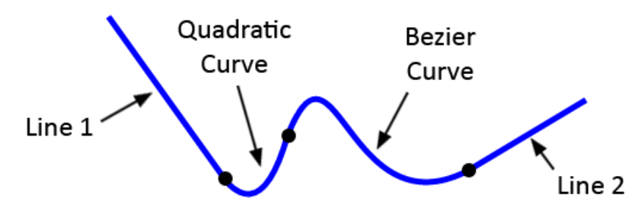
Canvas Basics
Canvas and paths
//Start path
context.beginPath();
context.moveTo(100, 20);
// line 1
context.lineTo(200, 160);
// quadratic curve
context.quadraticCurveTo(230, 200, 250, 120);
// bezier curve
context.bezierCurveTo(290, -40, 300, 200, 400, 150);
// line 2
context.lineTo(500, 90);
context.lineWidth = 5;
context.strokeStyle = "blue";
context.stroke(); //End path

Slide 16
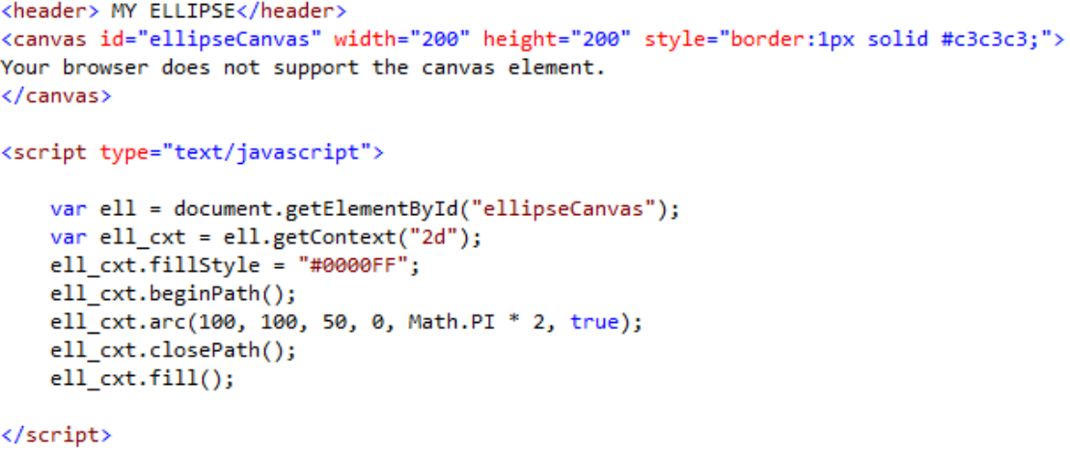
Canvas Basics
Ellipse

Slide 17
Canvas Basics
Canvas and Images.
There are many different kind of functions to draw images in canvas:
void drawImage((HTMLImageElement or HTMLCanvasElement or HTMLVideoElement) image, double dx, double dy);
void drawImage((HTMLImageElement or HTMLCanvasElement or HTMLVideoElement) image, double dx, double dy, double dw, double dh);
void drawImage((HTMLImageElement or HTMLCanvasElement or HTMLVideoElement) image, double sx, double sy, double sw, double sh, double dx, double dy, double dw, double dh);

Slide 18
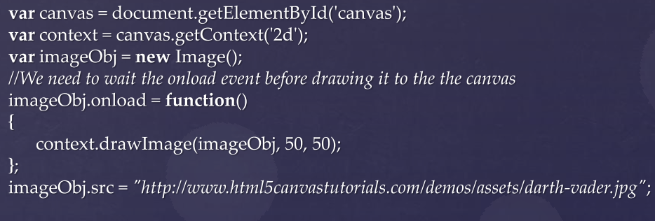
Canvas Basics

Slide 19
Canvas Basics
Colors
6-digit Hexadecimal values(#0000FF)
3-digit Hexadecimal values(#FF0)
RGB-values (0,0,255)
Named colors(yellow, green)
In addition to normal fill color also gradient can be defined for the shape
Linear gradient
var gradient = shape.createLinearGradient();
gradient.addColorStop(0, ”pink”);
gradient.addColorStop(1,”green”);
Radial gradient
var gradient = shape.createRadialGradient();
gradient.addColorStop(0, ”pink”);
gradient.addColorStop(1,”green”);

Slide 20
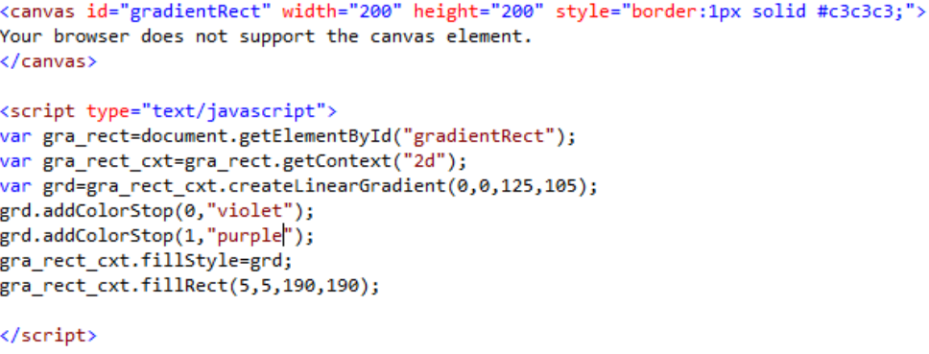
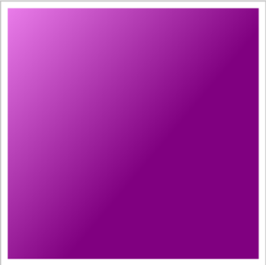
Canvas Basics

Slide 21
Canvas Basics
Event handling:
<!DOCTYPE html>
<html lang="en">
<head>
<title>Canvas Example</title>
<script>
function ready()
{
var canvas = document.getElementById('canvas');
canvas.addEventListener('click', on_canvas_click, false);
var context = canvas.getContext('2d');
}
function on_canvas_click(ev)
{
console.log(ev.clientY);
console.log(ev.clientX);
}
</script>
</head>
<body onload="ready()">
<canvas id="canvas" width="400" height="400"></canvas>
</body>
</html>

Slide 22
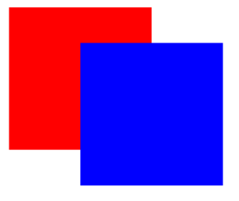
Canvas Basics
Translate -> move the context
var canvas = document.getElementById('canvas');
var context = canvas.getContext('2d');
context.fillStyle = "#ff0000";
context.fillRect(10,10, 100, 100);
context.translate(50, 25);
context.fillStyle = "#0000ff";
context.fillRect(10,10, 100, 100);

Slide 23
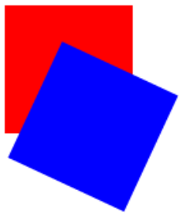
Canvas Basics
Rotate
var canvas = document.getElementById('canvas');
var context = canvas.getContext('2d');
context.fillStyle = "#ff0000";
context.fillRect(10,10, 100, 100);
context.translate(50, 25);
context.rotate( (Math.PI / 180) * 25); //rotate 25 degrees.
context.fillStyle = "#0000ff";
context.fillRect(10,10, 100, 100);

Slide 24
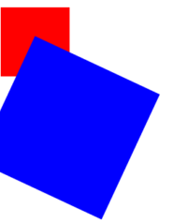
Canvas Basics
Scaling
var canvas = document.getElementById('canvas');
var context = canvas.getContext('2d');
context.fillStyle = "#ff0000";
context.fillRect(10,10, 100, 100);
context.translate(50, 25);
context.rotate( (Math.PI / 180) * 25); //rotate 25 degrees.
context.scale(2,2);
context.fillStyle = "#0000ff";
context.fillRect(10,10, 100, 100);

Slide 25
Canvas Basics
Because we have to use JavaScript to control canvas elements it's also very easy to make (interactive) animations. Unfortunately the canvas element was never designed to be used in this way so there are limitations.
Probably the biggest limitation is that once a shape gets drawn it stays that way. If we need to move it we have to redraw it and everything that was drawn before it.
It ´can take a lot of time to redraw complex frames and the performance depends highly on the speed of the computer it's running on (some browsers supports hardware accelerated renedering).

Slide 26
Canvas Basics
We need a way to execute our drawing functions over a period of time. There are two ways to control an animation like this. First there's the setInterval and setTimeout functions which can be used to call a specific function over a set period of time.
setInterval(animateShape,500);
setTimeout(animateShape,500);
You can also use requestAnimationFrame that is recommended forthese cases. See https://developer.mozilla.org/enUS/docs/DOM/window.requestAnimationFrame
Note!requestAnimationFrame is an experimental tehnology….

Slide 27
Canvas Basics
Example
script>
var canvas;
var context;
function ready()
{
canvas = document.getElementById('canvas');
context = canvas.getContext('2d');
context.fillStyle = "#0000ff";
context.fillRect(10,10, 100, 100);
setInterval(rotate,500);
}
function rotate()
{
context.clearRect(0,0, 400, 400);
context.rotate( (Math.PI / 180) * 25); //rotate 25 degrees.
context.fillRect(10,10, 100, 100);
}
</script>

Slide 28
Tips!
There are many libraries available, that makes it a little bit easier to draw and animate objects in canvas
One of them is eselJS that is a game library designed for canvas element.
Find more information here: http://www.createjs.com/#!/EaselJS

