Slide 1
JavaScript and Geolocation.
Markus Veijola March 2014

Slide 2
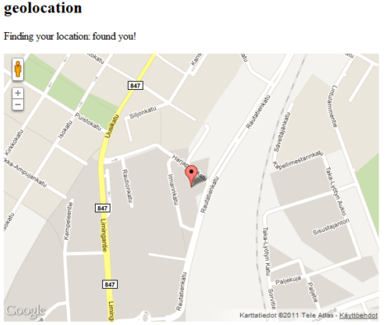
Introduction
HTML5 specifies a geolocation API
Makes it possible to locate users
Location-aware services, eg. Social network

Slide 3
Introduction
You should remember that all browsers are not supporting geolocation by default
Usually requires that user enables geolocation from browser settings/accepts to reveal the location.
You should remember this when creating a web application that is based on this particular feature!

Slide 4
Using the API
Geolocation can be added to a webpage in following way:
Check browser support
if(navigator.geolocation)
{
//Supported
}
Read location using geolocation object
navigator.geolocation.getCurrentPosition(success,error);
Use the location info...
function success(location)
{
console.log(location.coords.latitude);
}

Slide 5
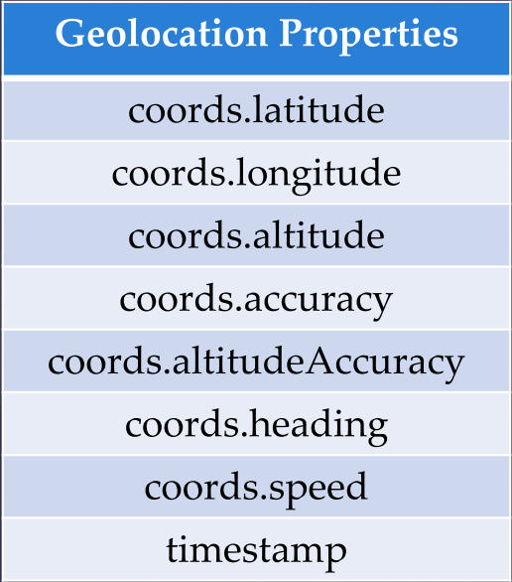
Using the API
The geolocation has next attributes you can use in your application.

Slide 6
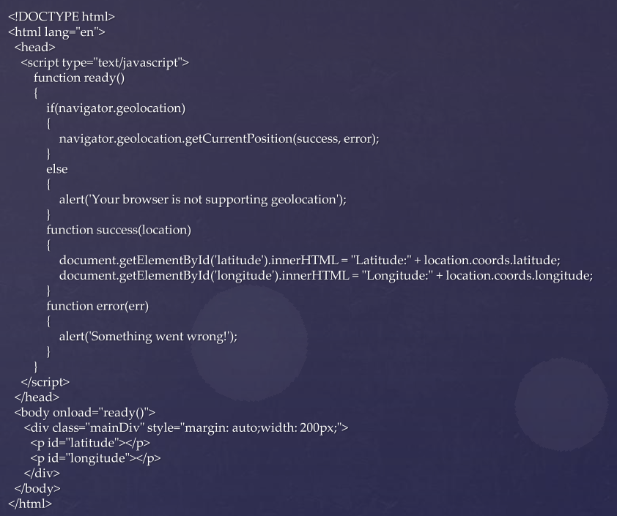
Using the API

Slide 7
Google Maps API
Geolocation can be combined with GoogleMaps API
First you need to load the JavaScript API from Google CDN
<script type="text/javascript"
src="http://maps.google.com/maps/api/js?sensor=false">
</script>
Then define the element in your page, where we can draw the map
<div id="map" style="width:500px; height:500px" ></div>

Slide 8
Google Maps API
Before you do anything with GoogleMaps API you REALLY should take a look at the documentation https://developers.google.com/maps/documentation/javascript/reference
This is the place where you get all the needed information.
See also FAQ https://developers.google.com/maps/faq
See Usage Limits
Terms of service

Slide 9
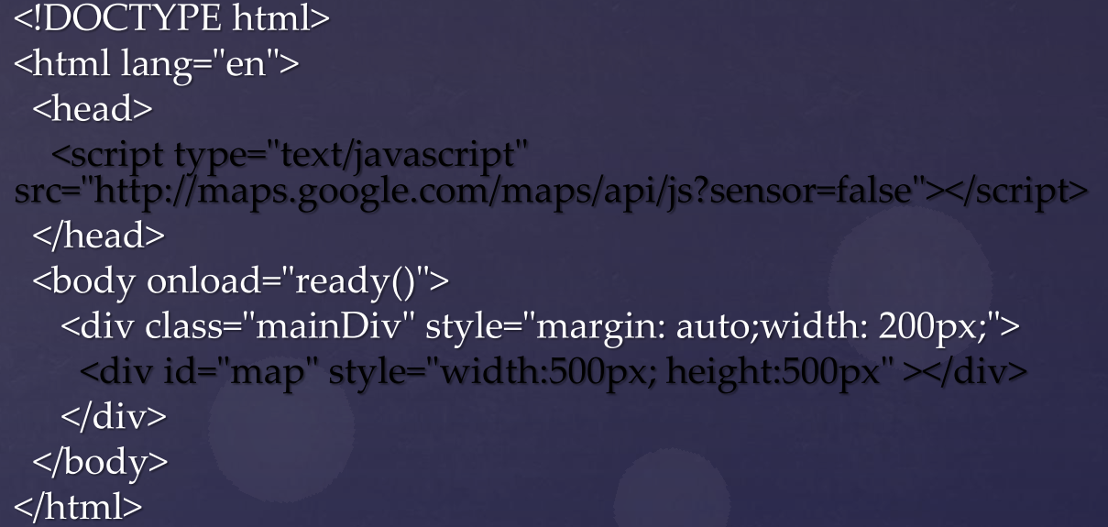
Google Maps API

Slide 10
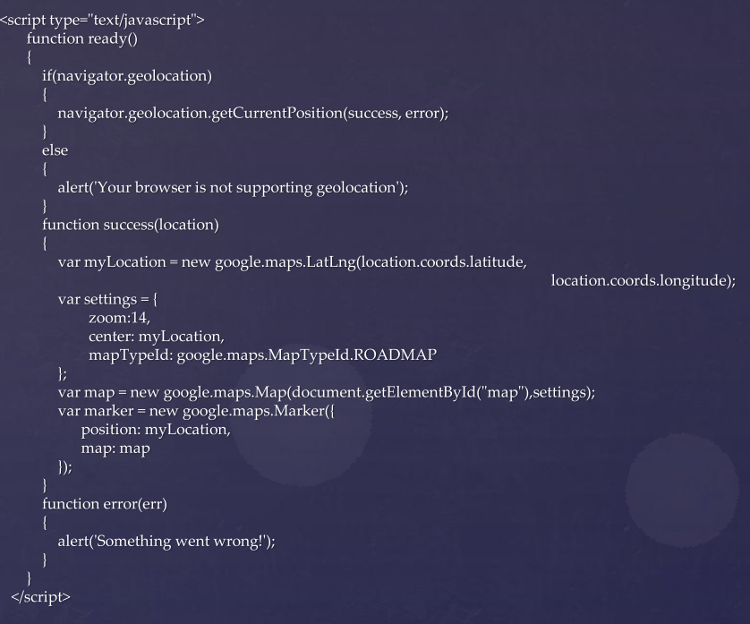
Google Maps API

