Slide 1
JavaScript and Web Storage.
Markus Veijola March 2014

Slide 2
Introduction
From web-page developers point of view the stateless nature of web is a problem
For storing data there have been few solutions:
Cookies
Most commonly used
Allow to login automatically to pages, but also saves our browsing history which can become an privacy issue
Query part information (i.e. GET or POST request)
Saving data to server
HTML5 introduces also new ways to store data

Slide 3
Introduction
Web storage consist of two new object which are used for storages data on the client
localStorage – stores data without time limit
sessionStorage – stores data for one session
Replaces cookies, which are not so suitable for storing large amounts of data
Today all modern browsers supports these two new objects.

Slide 4
Web Storage
Basically it is a client-side database.
It is a database that resides in the users browser and not on your server.
The difference between this database and others you may be familiar with resides in that this is for key-value storage.
This means you won’t be writing any sql statements while using localStorage.
The data stored will be on a per browser basis. If a user switches between Safari and Firefox, it won’t use the same database.
Same if they use your app on one machine and go to another somewhere else, that data will only be available on the machine it was created/saved on.

Slide 5
Web Storage
The data you store in local or session object can be any type supported by JavaScript, including strings, Booleans, integers, or floats.
However, the data is actually stored as a string.
If you are storing and retrieving anything other than strings, you will need to use functions like parseInt() or parseFloat().
You can store 5MB on an users local machine.
Browsers isolate LocalStorage values based on scheme + hostname + unique port
scheme is ”http” or ”https”
Hostname is i.e. Opiframe.com
Port is i.e. 80
The result of this separation means that a value saved to LocalStorage on http://www.opiframe.com cannot be accessed by pages served from https://www.opiframe.com (and vice versa).

Slide 6
Web Storage
LocalStorage and sessionStorage define methods for saving and reading data from the storages
setItem
getItem
Data is saved in with a name
For example:
localStorage.setItem(”meaningOfLife”,”42”);
localStorage [”meaningOfLife”]=”42”;
localStorage.meaningOfLife = ”42”;

Slide 7
Web Storage
getItem
For example:
localStorage.getItem(”meaningOfLife”);
localStorage[”meaningOfLife”];
localStorage.meaningOfLife
RemoveItem-method can be used to remove saved data. This´function takes a key as an attribute (localsStorage.removeItem(”meaningOfLife”)).
LocalStorage can also be cleared with localStorage.clear(); method.

Slide 8
Web Storage
You can track the changes in localStorage if needed.
Trap the storage event
The storage event is fired on the window object whenever setItem() removeItem(), or clear() is called and actually changes something.
window.addEventListener(“storage”, mycallback);
function mycallback(e)
{
//At this point, the variable e will be a StorageEvent object, which has the following useful properties.
//1. key : the named key that was added, removed, or modified
//2. oldValue : the previous value (now overwritten), or null if a new item was added
//3. newValue : the new value, or null if an item was removed
//4. url: the page which called a method that triggered this change
if(e.url)
{
console.log(e.url);
}
else
{
console.log(e.uri);
}
}

Slide 9
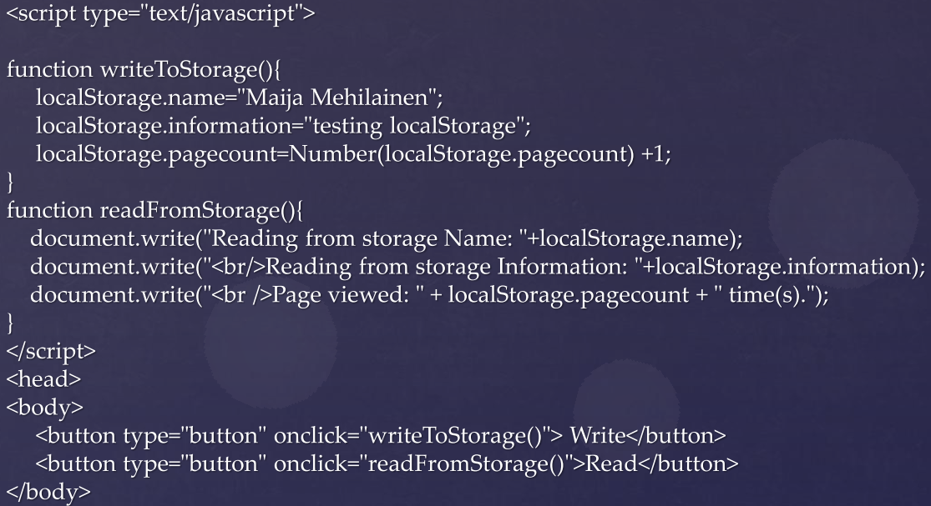
Web Storage

