Slide 1
JavaScript Basics
Markus Veijola March 2014

Slide 2
Introduction
JavaScript is the most popular scripting language on the internet, and works in all major browsers, such as Internet Explorer, Firefox, Chrome, Opera, and Safari.
You use JavaScript to dynamically update/change/modify the Web page content or to append interactivity to HTML pages.
JavaScript make possible to:
React events such as mouse click, keyboard, media or dom events
Manipulate HTML elements dynamically (the DOM)
Validate data i.e. User input
Detect UA (user agnets aka. Browser)
Create cookies
In HTML5 store data in local storage
In HTML5 detect geolocation
In HTML5 create Web Workers
In HTML5 use Web SQL
In HTML5 handle Server-Sent Events
In HTML5 handle your own microdata
In HTML5 add support to drag and drop

Slide 3
Introduction
Few important consepts to understand:
DOM = Document Object Model
When browser loads the .html page from server it reads the .html page from beginning and creates an document object of the elements in the page. The objects are created in THAT order you have defined them in HTML document.
It is very easy to get null reference error if you try to manipulate DOM when it is not ready.
JavaScript is a prototype language containing object oriented programming language features.
JavaScript is a lightweight, interpreted programming language. The code you write is interpreted to bytecode at runtime (when browser executes your code).
All JavaScripts (when defined internally) are placed inside <script> </script> tags.

Slide 4
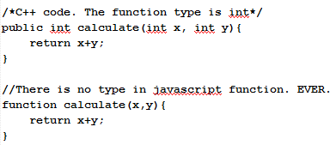
Introduction
JavaScript fundamentals:
There are no types like int, strings or float. There is only one generic var type where you can store any kind of information. The actual type is defined at runtime, but usually you don’t have to worry about this.
Everything, even functions are objects in JavaScript. This often confuses people.
Functions in javascript never have explicit type. See next example

Slide 5
Using JavaScript
There is two ways to use JavaScript in your web pages
Internal way
External way
Internal means that you embed you JavaScript in your html document.
External means that you write your JavaScript code in a separate file, and then load the file from your html document using the <script> tag.

Slide 6
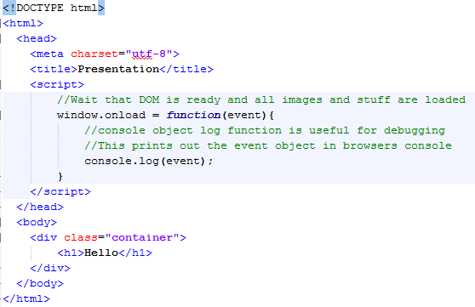
Internal JavaScript

Slide 7
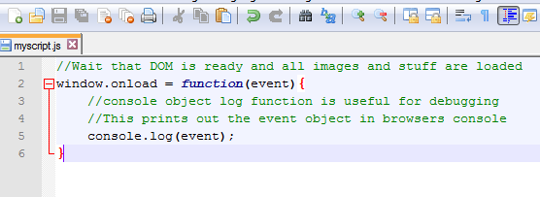
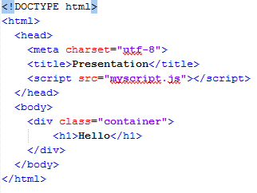
External Script
Create a file with .js extension i.e. myscript.js and store it in the same folder where your .html file locates. Then load the .js file in your html document.

Slide 8
DOM Manipulation
One common thing to do in JavaScritpt is to modify the DOM tree. You can:
Add new HTML elements dynamically
Remove elements
Change position, color, content etc. of element
Generally speaking dynamically update the web page content.

Slide 9
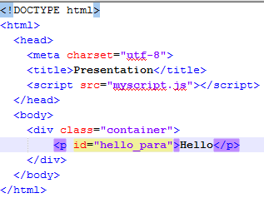
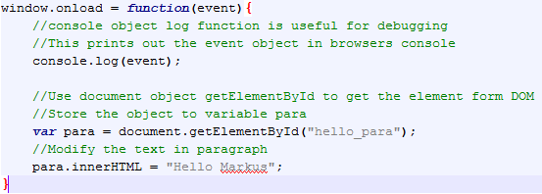

DOM Manipulation
Modifying element content…

Slide 10
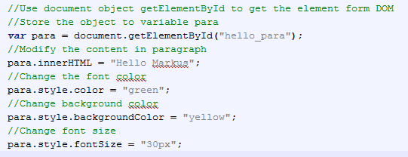
DOM Manipulation
When you get some object from DOM using i.e. getElementById function you can then modify that elements properties, like
Color
Font
Content
Size
Position
Border
Basically anything you can do in css file…

Slide 11
DOM Manipulation
Sometimes you want to modify bunch of elements at once. For example you may have 10 <p> elements in your markup and you want to change the font size of every paragraph in JavaScript. In this situation you can use getElementsByTagName() or getElementsByName() function. Just remember that these functions return always an array [] of objects.

Slide 12
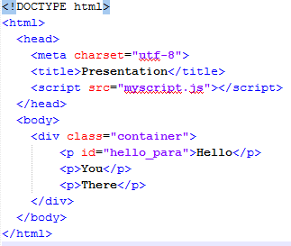
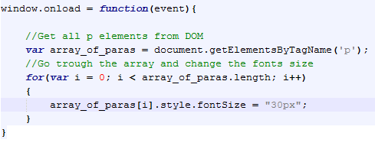
DOM Manipulation

Slide 13
DOM Manipulation
Also it is very common to append or remove elements from DOM. When you append a new element in Dom you must think where you want to append it, that is what is the parent of this new element. Same thing when you remove the element. See the next examples to get it more clear…

Slide 14
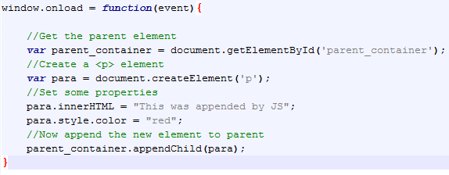
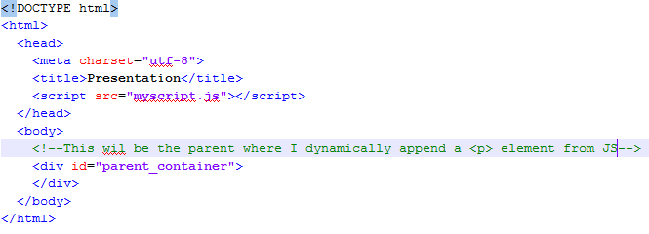

Append Element

Slide 15
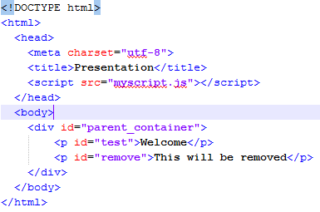
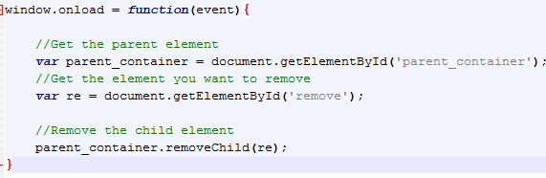
Remove Element

Slide 16
Event Handling
Event handling is also one common thing to do in JavaScript.
Browser environment offers many kinds of events you can handle yourself and then do something. The event types are:
Window events
Form events
Keyboard events
Mouse Events
Media Events

Slide 17
Event Handling
In JavaScript the same thing can be done in numerous different ways, also the event handling.
We have already handled one window type event the “onload”.
window.onload = function(event){
}
What happens here is that we attach an anonymous function to window object onload event. When onload event triggres in will call our anonymous function. The function is anonymous because it doesen’t have a name in it. This is one way to handle events -> attach an anonymous function to it.

Slide 18
Event Handling
This works the same as the previous example, but at this time we attach named function to onload event.
//Attach a function handledomready to onload event
window.onload = handleDomReady;
//Then the actual implementation
function handleDomReady(event){
console.log(“We are ready to manipulate dom”);
}

Slide 19
Event Handling
You can also use build in addEventListener() function
window.addEventListener(‘load’, domReady);
function domReady(event)
{
//Do something
}

Slide 20
JavaScript objects
In JavaScript, objects are everything. When you understand objects, you will understand JavaScript.
JavaScript is designed on a simple object-based paradigm.
An object is a collection of properties, and a property is an association between a name and a value.
A property's value can be a function, in which case the property is known as a method.
In addition to objects that are predefined in the browser, you can define your own objects.
And again because we are talking JS objects there are many ways to define them.

Slide 21
JavaScript objects and properties
Creating an empty object is what you will see very often. It is simply as this:
//Create an empty object. It don’t contain any properties
var car = {};
Creating an object with properties can be done as follow:
//Create object
var cat = new Object();
//Define the properties
cat.age = 2;
cat.name = “Missy”;

Slide 22
JavaScript objects and properties
In JavaScript you define the properties for object “on fly”. This means that if you create an object you can at ANY time define a new property for it.
Properties of JavaScript objects can also be accessed or set using a bracket notation. Objects are sometimes called associative arrays, since each property is associated with a string value that can be used to access it. For example the previous cat object
cat[‘age’] = 2; is the same as cat.age = 2;
You can even attach new properties using bracket notation:
cat[‘color’] = ‘red’;

Slide 23
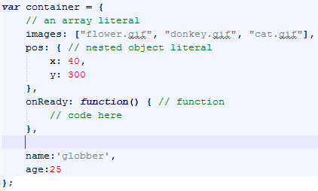
Object Literals
An object literal is a comma-separated list of name-value pairs wrapped in curly braces. Object literals encapsulate data, enclosing it in a tidy package. This minimizes the use of global variables which can cause problems when combining code.

Slide 24
JavaScript Constructor
You can also use so called constructor for creating objects. In JavaScript constructor is not any special function like in C++ or java or C# since in JavaScript the constructor function is just like a normal function.
A constructor is any function which is used as a constructor. The language doesn’t make a distinction. A function can be written to be used as a constructor or to be called as a normal function, or to be used either way.
If you use a function WITH new keyword you are using JavaScript function as an constructor.

Slide 25
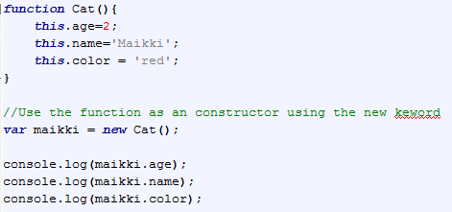
JavaScript Constructor

Slide 26
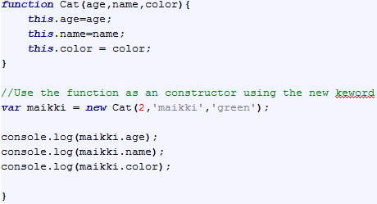
JavaScript Constructor
Constructor with parameters

Slide 27

What happens when constructor is called?
When new Cat() is called, JavaScript does four things:
It creates a new object
It sets the constructor property of the object to Cat
It sets the object to delegate to Cat.prototype
It calls Cat() in the context of new object.
The result of new Cat() is this new object.
Lets see the step more deeply…
Step one means that empty {} object is first created
Sets the constructor property to be type of Cat just means:

Slide 28
What happens when constructor is called?
It sets the object to delegate to Cat.prototype. Actually the prototype property in JavaScript object is related to inheritance in JS.
Prototype property is just an empty object but it gets a special treatment here.
When an object is constructed, it inherits all of the properties of its constructor’s prototype.
The example speaks more than words…

Slide 29
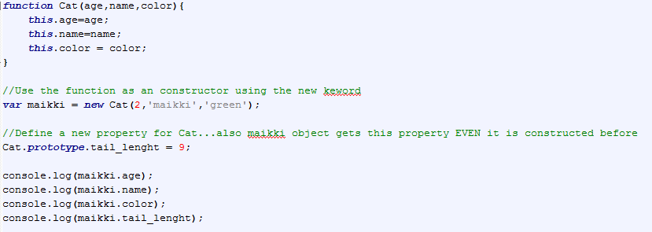
What happens when constructor is called?

Slide 30

What happens when constructor is called?
Finally it calls Cat() in the context of the new object. Inside the function, this is set to the object we’re constructing. (Why? Because that’s what Java does.) So

Slide 31
Inheritance
All objects in JavaScript inherit from at least one other object. The object being inherited from is known as the prototype, and the inherited properties can be found in the prototype object of the constructor as seen before, but let’s look an example of “real” inheritance.

Slide 32
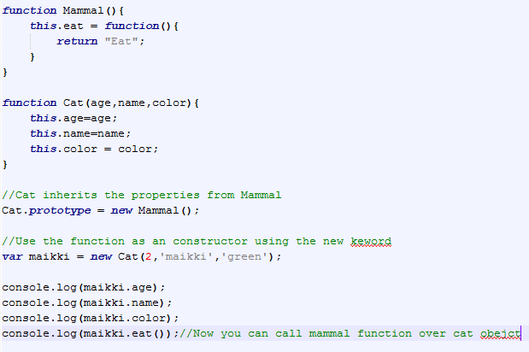
Inheritance

Slide 33
Closures
Closures in JavaScript are very powerful programming paradigm.
A closure is an inner function that has access to the outer (enclosing) function’s variables—scope chain.
The closure has three scope chains: it has access to its own scope (variables defined between its curly brackets), it has access to the outer function’s variables, and it has access to the global variables.
The inner function has access not only to the outer function’s variables, but also to the outer function’s parameters.

Slide 34
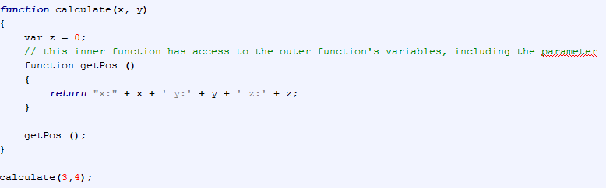
Closures

Slide 35
Closures For The Creation Of Private Variables
Javascript doesn't have a native concept of private variables.
As such, object properties - including all this-scoped properties - are public. That is, they can be accessed and mutated by their environment.
This is a big problem at least in big project where the namespace easily is polluted and broken.
Var-scoped variables, on the other hand, are only available to their local execution context. People have started to use var-scoped variables in conjunction with closures in order to force Javascript to allow for some sort of private variable functionality.
Closures can give a little help for this.

Slide 36
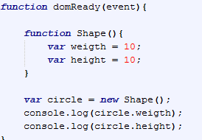
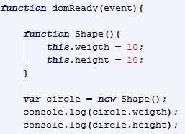
Closures For The Creation Of Private Variables
Let’s look an example. What will program print on console in next cases?

Slide 37
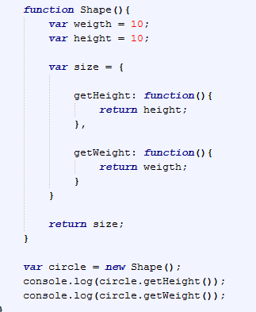
Closures For The Creation Of Private Variables
We can solve the previous problem by using closures.

Slide 38
Closures
There are many practical problems where you can use closures but we are not covering those here. You can always ask from google when needed.

