Slide 1
JavaScript Drag and Drop.
Markus Veijola March 2014

Slide 2
Introduction
HTML5 defines a group on APIs, one being Drag and Drop API
There are few things which need to be defined to start using DnD API
Define object that can be dragged
Define target for the object
Define event handlers with JavaScript
<img> and <a> are draggable by default, others need attribute draggable to be set to true
There are lots of libraries (like jQuery) that makes DnD for application very easy.

Slide 3
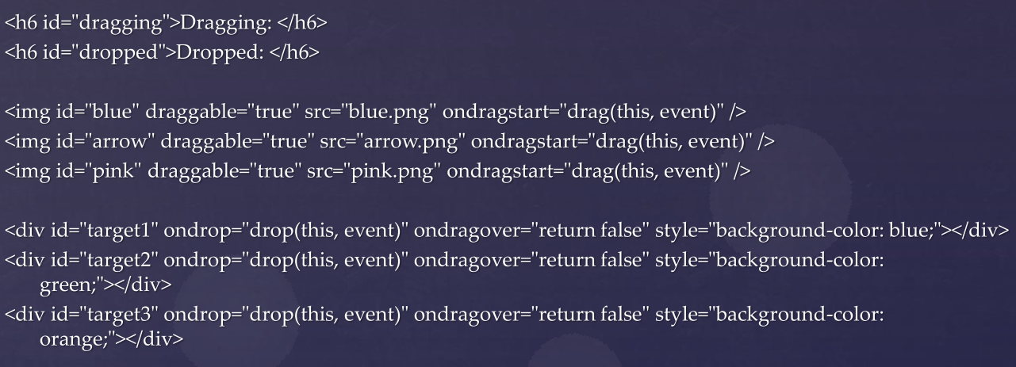
DnD

Slide 4
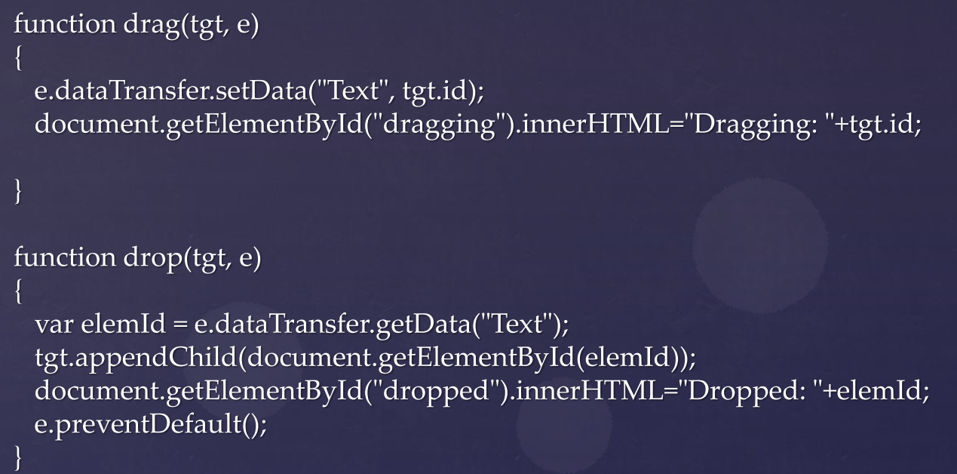
DnD

