Slide 1
JavaScript “threads”/web workers.
Markus Veijola March 2014

Slide 2
Introduction
Web Workers allow you to run JavaScript in parallel thread on a web page, without blocking the user interface.
A 'worker' is a script that will be loaded and executed in the background. Web Workers provide a way to do this :
var worker = new Worker(‘loaddata.js’);

Slide 3
Introduction
There are limitation when you use workers
Workers don't have access to the DOM. No document, getElementById, etc. (The exceptions are setTimeout, setInterval, and XMLHttpRequest what you can use.)
No access to parent or window object either.

Slide 4
Introduction
You can use workers by communicating with it using messages.
All browsers support passing in a string message (Firefox 3.5 also supports passing in JSON-compatible objects).
This message will be delivered to the worker
The worker can post/return messages to client.

Slide 5
Example
Next example will work as follow
Worker will simply increase a value of variable using timeout
User can start and stop worker.
User can define a timeout value that is passed to worker
We play animation in canvas (UI thread) at the same time when we calculate our value in background thread.

Slide 6
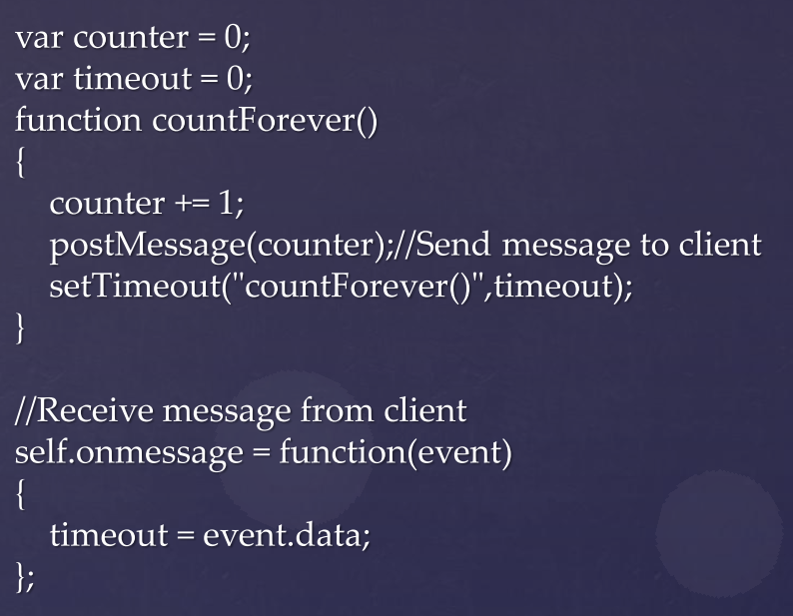
Example
The worker file…(workload.js)

Slide 7
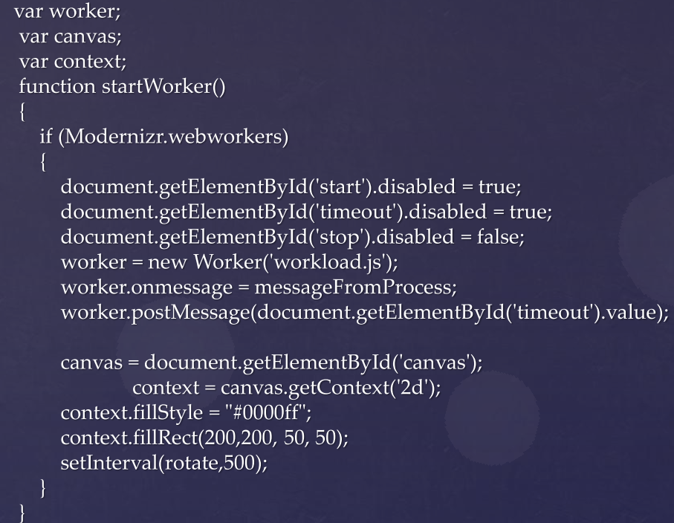
Example

Slide 8
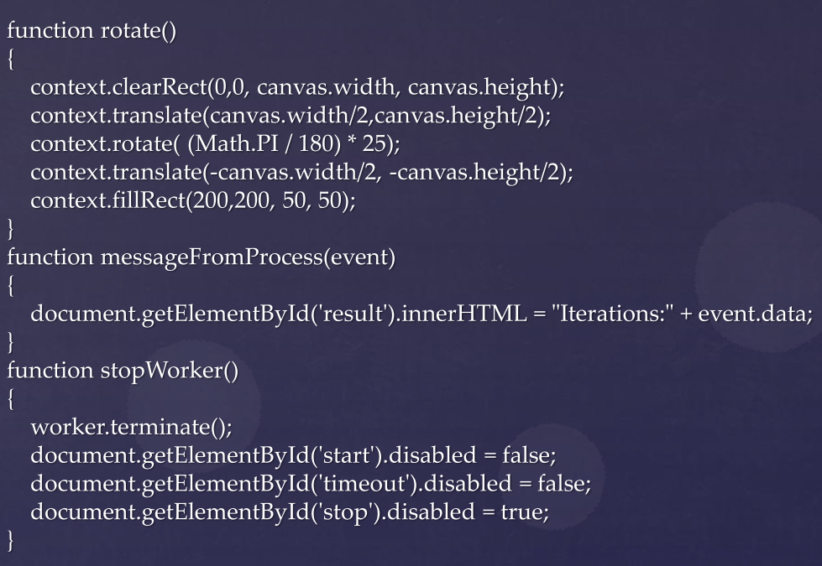
Example

Slide 9
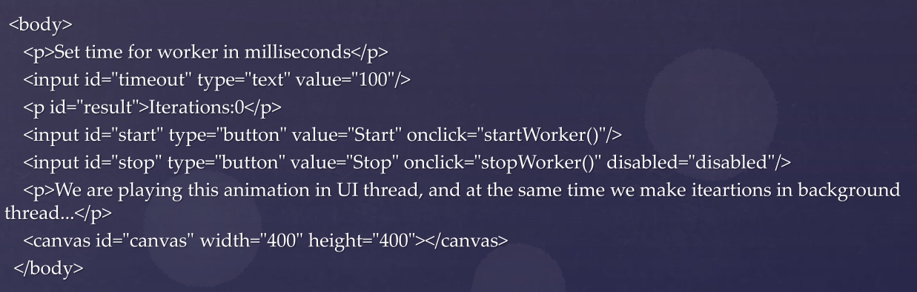
Example

