Slide 1
CSS3
Markus Veijola
March 2014

Slide 2
Introduction
CSS (Cascading Style Sheet) is a style language that defines layout of HTML documents. For example, CSS covers fonts, colors, margins, lines, height, width, background images, advanced positions, animation and many other things.
HTML is used to structure content. CSS is used for formatting structured content.

Slide 3
Introduction
CSS was a revolution in the world of web design. The concrete benefits of CSS include:
  Control layout of many documents from one single style sheet
  More precise control of layout;
  Apply different layout to different media-types (screen, print, etc.);
  Numerous advanced and sophisticated techniques.

Slide 4
Introduction
An example of a style change would be to make words bold. In standard HTML you would use the <b> tag like so:
<b>make me bold</b>
This works fine, and there is nothing wrong with it, except that now if you wanted to say change all your text that you initially made bold to underlined, you would have to go to every spot in the page and change the tag.

Slide 5
The Basic CSS Syntax
CSS can be thought to be more programming language than declarative language.
The syntax you use in CSS follows the next paradigm:
selector{
property:value;
}
//Affects to all <p> elements in your html page. Will set the //background color to ligthblue
p{
background-color:’lightblue’;
}

Slide 6
CSS Selectors
There are many kind of selectors you can use in your CSS file.
Here are few link where you can find the selector types:
  W3 School CSS Selector Reference
  W3C Recommendations
  The most used selectors in CSS are:
  Element selector
  Class selector
  Id selector
There are three ways to define styles:
  Inline (style defined with HTML style attribute)
  Internal (Style defined in the HTML file)
  External (Style defined in external .css file)

Slide 7
Inline Style
Defining style as Inline is the most rarely (and advicely should be avoided) used way. The situation where inline styles are used is when:
  You want to override some style. HTML elements inherits style definitions from their ancestors and you can override the inherited style from some specific element using Inline style.
But:
  Inline styles cause more maintenance headaches.
  Inline styles are not as accessible for a screen reader or other assistive device.
  Inline styles make your pages bigger, complicated and confusing.

Slide 8
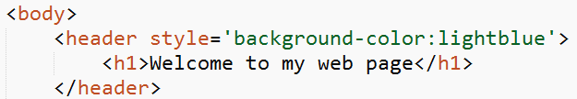
Inline Style
Inline style definition
Child element will inherit
The parent style

Slide 9
Internal Style
Internal style is defined in the same file as the .html file.
When you want to define a specific style for ONE page of your web pages, then you may define the style as internal.
Internal style is defined in <head> section of your .html page using the <style> element.
But:
  Increases the size of your .html file.

Slide 10
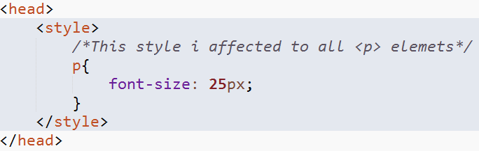
Internal Style
Internal style

Slide 11
External style
External style is the most common used way of defining your web page styling. The styles are defined in a SEPARATE .css file.
This .css file is loaded using <link> element in <head> section of your .html file.
You can use the same style easily in many web pages which makes is most useful way of defining styles.

Slide 12
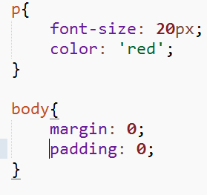
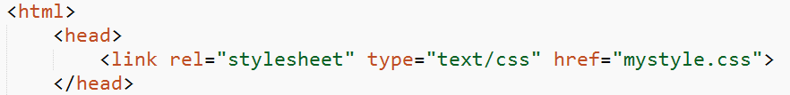
Internal Style
CSS declarations in file named mystyle.css
.html file using mystyle.css style file.
Load the external .css file

Slide 13
Selectors
Selectors as the name suggest is the way we can “select” which elements in HTML page are affected by the style declaration.
For example to make style declaration to affect all <h1> elements in your HTML page you can define style as follow:
h1{
color:blue;
background-color:’green’;
}
The previous selector is called element selector and is a good way to declare a style for a bunch of elements in your HTML page.

Slide 14
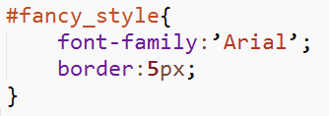
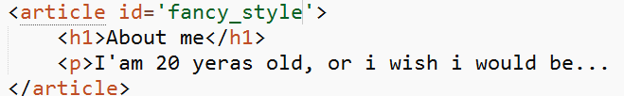
Selectors
When you want to specify some particular element which you want to affect by your style, you use the id selector.
  You are free to define the name of the selector by yourself, but don't start the name with the number!
  You use the name with the # sign in your style declaration.
Define the style for the id
Define the id for your html element

Slide 15
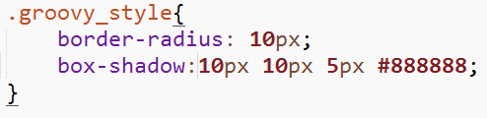
Selectors
The class selector is used when you want to define style for several different kind of elements in your html page.
  Styles defined with class selector can also inherit styles from another styles (explained later)!
  The class selector is most often used on several elements.
  Declaration starts always with “.”
Define the style for the class selector
Define the class attribute for your elements

Slide 16
Descendant Selector
The descendant selector matches all elements that are descendants of a specified element.
The first simple selector within this selector represents the ancestor element—a structurally superior element, such as a parent element, or the parent of a parent element, and so on. The second simple selector represents the descendant element we’re trying to match.

Slide 17
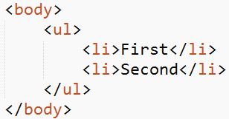
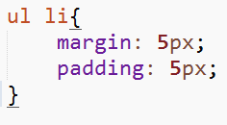
Descendant Selector
The combinator we use in a descendant selector is a whitespace character. The style affects to ul element and all the li child elements it has.

Slide 18

Adjacent Selector.
Adjacent selector will select only the element that is immediately preceded by the former element.
In the next case, only the first paragraph after each ul will have red text.

Slide 19



Adjacent Selector.
Example

Slide 20
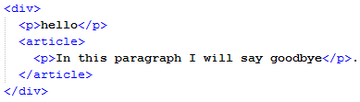


The “bigger than” x > y
You can use the > to select all direct child elements of some type to be affected. See next example…

Slide 21



Attribute selectors
Attribute selectors allow you to select elements based on the attributes they contain. This is very efficient in many situations.
For example you can select every img element that have alt attribute with the following css declaration:

Slide 22

Selecting by attribute value
Attribute selectors instantly get more useful when you consider that you can select by attribute value, not just attribute name.
The following rule selects all images with an src attribute value of top_logo.png

Slide 23

Selecting based on substrings within the attribute value
You can use next characters to select elements based on substrings in attribute value
^
$
*
The ^ character dictates that this selector should select <img> elements only if they have the string “top_” at the start of the src attribute value.

Slide 24

Selecting based on substrings within the attribute value
The $ character dictates that this selector should select <img> elements only if they have the string .png at the end of the src attribute value.

Slide 25

Selecting based on substrings within the attribute value
The * character dictates that this selector should select <img> elements only if they have the string “op” anywhere within the src attribute value.

Slide 26
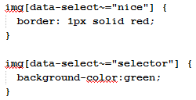
The “tilda” ~
The tilda (~) symbol allows us to target an attribute which has a spaced-separated list of values.

Slide 27
Pseudo-classes
Pseudo-classes are used to provide styles not for elements, but for various states of elements.
The most common pseudo-classes you’ll come across is those used to style link states.
  :link — the normal, default state of links, just as you first found them.
  :visited — selects links that you have already visited in the browser you are currently using.
  :focus — selects links that currently have the keyboard cursor within them.
  :hover — selects links that are currently being hovered over by the mouse pointer.
  :active — selects links that are currently being clicked on.

Slide 28
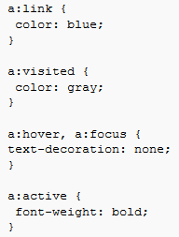
Pseudo-classes
Examples

Slide 29



The language (lang) pseudo-class
The :lang pseudo-class selects elements whose languages have been set to the specified language using the lang attribute.

Slide 30


The target pseudo-class
The target pseudo-class allows you to select an element if it is the target of the current page URL.
The style is activated when the link is clicked.

Slide 31
UI element state pseudo-classes
These pseudo-classes are all concerned with styling advanced states of UI elements.
You use them to style HTML form elements, particularly when some of the new features of HTML5 forms are being used, such as built in validation.

Slide 32
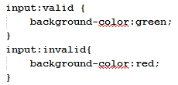


UI element state pseudo-classes
Invalid state: no value given in textfield
Valid state: some value given in textfield

Slide 33
Structural pseudo-classes
Structural pseudo-classes are advanced selectors allowing you to target specific elements based on their position in the document hierarchy. These were introduced in CSS3.
The most used one is the :nth-child selector

Slide 34


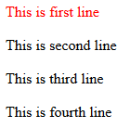
Structural pseudo-classes
Example

Slide 35
Structural pseudo-classes
Formula examples…
p:nth-child(5): select the 5th adjacent list item
p:nth-child(4n+1): select every 4th list item starting at 0, and then add 1 to each result. So numbers 1, 5 and 9.
p:nth-child(3n-2): select every 3rd list item, and subtract 2 from each result. So numbers 1, 4 and 7.

Slide 36
Pseudo-elements
Pseudo elements differ from pseudo-classes in that they don't select states of elements; they select parts of an element.
:first-letter
:first-line

Slide 37


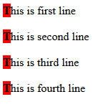
Pseudo-elements
Examples

Slide 38



Pseudo-elements
Second example

Slide 39
The :before and :after pseudo elements
You can use the :before and :after pseudo-elements to specify that content should be inserted before and/or after the element you are selecting. You then specify what content you want to insert or generate.

Slide 40



The :before and :after pseudo elements
Example: Insert the logo image (top_logo.png) before any h1 element.

Slide 41
Properties and Values
Using properties and setting some values for properties actually defines the style for element or elements. Take some time to see what kind of properties you can use from the link below.
You can find the full list of properties from here: List of CSS properties
And for last comments in CSSare done /*This is comment*/

