Slide 1
CSS3 and Layouting
Markus Veijola March 2014

Slide 2
Introduction
Designing the layout for your web application can be a daunting job.
There are few fundamental layout styles that are recommended to be used. Still while there are, you need to build that layout and maybe tweak it to your own needs.
CSS offers few attributes how we can affect to position, size, visibility and usability of our HTML elements, but they come with a bunch of rules and caveat.

Slide 3
Display property
Display is CSS's is one property for controlling layout. Every element has a default display value depending on what type of element it is.
The default for most elements is usually block or inline (See the HTML basic material for more). A block element is often called a block-level element. An inline element is always just called an inline element.

Slide 4
Display property
A block-level element starts on a new line and stretches out to the left and right as far as it can.
As an example of block-level elements are h1 and div. There is this kind of default CSS rule for them:
h1{
display:block;
}

Slide 5
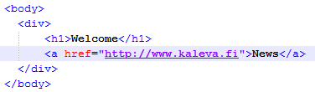
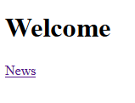
Display property
Let’ s look a normal behavior of h1 element. Consider that we have next kind of simple html structure and we run it in the browser. The results are as follow….

Slide 6
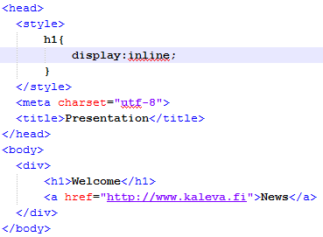

Display property
Now if we change the h1 style rule a little bit we can see how it affects to our layout…

Slide 7
Display property
Other values you can use with display property are
Inline (a and span elements as an example)
none (for example script element has this display value as an default).
Inline-block make elements inline, but preserving their block capabilities such as setting width and height, top and bottom margins and paddings (remember that you are not able to set i.e. width for inline element).
Box (for flexible box layouting)
There are bunch of other values too, but they are so very rarely used that we skip them.

Slide 8
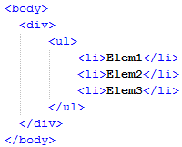

Display property
Inline-block value is on of the display values you probably use one day.
Let’s see how it work with an example. Lets see how <ul> element works with default style settings…

Slide 9
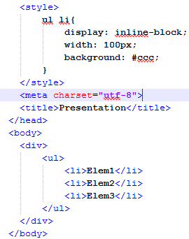

Display property
No lets make some magic an horizontal list, we can control the width f the element…

Slide 10
Display property
CSS3 introduces also new “box” value for display property and bunch of new properties related to that. Next we see how we can use this new value to create flexible Box Layout Module.
Using box layout you can layout elements in column vertically or horizontally.
Next example demonstrates this.

Slide 11
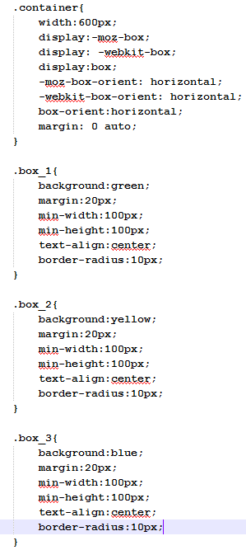
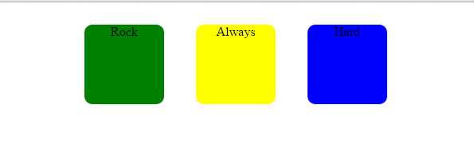
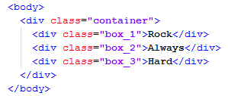
Display property
Layout horizontally

Slide 12
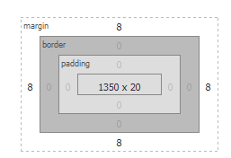
Margin
The margin clears an area around an element (outside the border). The margin does not have a background color, and is completely transparent.
The top, right, bottom, and left margin can be changed independently using separate properties. A shorthand margin property can also be used, to change all margins at once.
To be short: margin is for setting space between html elements.

Slide 13
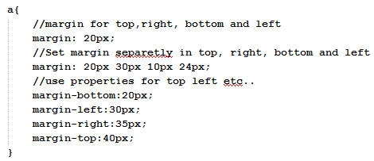
Three ways of margin
Example

Slide 14
Centering with margin
Sometimes we want to center i.e. text or picture in center of the reserved space for element. This can be done by setting the margin property to value auto. What we have to remember is that you HAVE to set the width property of element also.

Slide 15
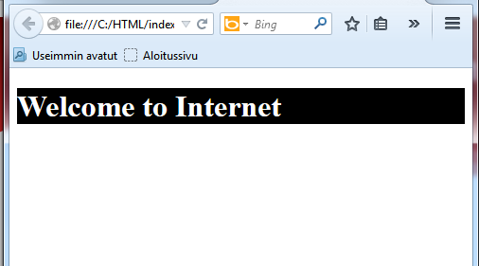
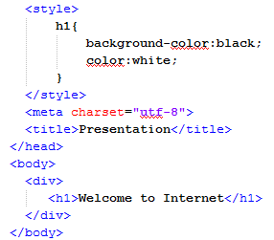
Centering with margin
No centering.

Slide 16
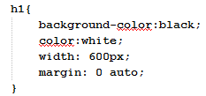
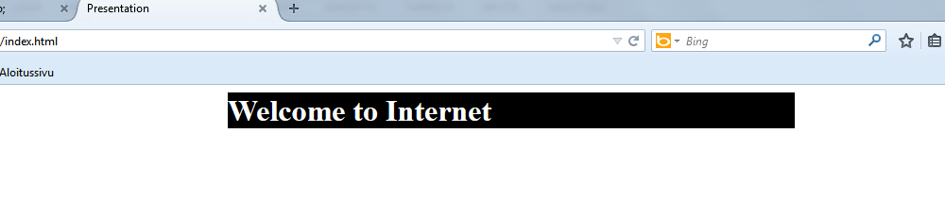
Centering with margin
Note the changes in style…
The element will take up the width you specify, then the remaining space will be split evenly between the two margins.

Slide 17
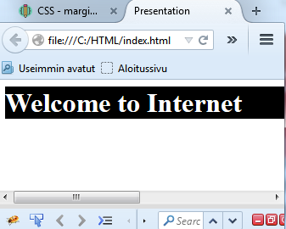
Centering with margin
The problem:The only problem occurs when the browser window is narrower than the width of your element. The browser resolves this by creating a horizontal scrollbar on the page

Slide 18
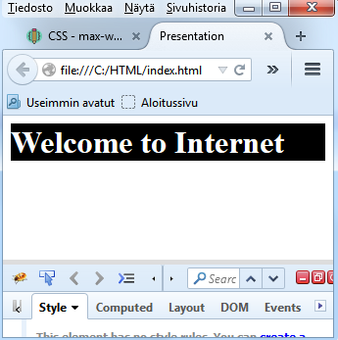
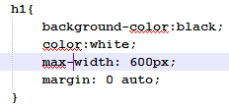
Centering with margin
Solution: Use max-width property instead of width!
No scrollbar! improve the browser's handling of small windows. Makes a site usable on mobile.

Slide 19
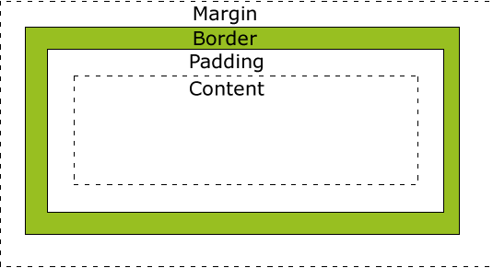
The box model
All HTML elements can be considered as boxes. They contain a border (by default an invisible one but it is still there), some margin, padding and the actual content.

Slide 20
The box model
There are few things you should know about the box-model especially if you define a width for some element.
When you set the width of an element, the element can actually appear bigger than what you set: the element's border and padding will stretch out the element beyond the specified width.
This means that if you set child element width to be 100% and then define some margin and padding for it -> child becomes bigger than parent.
Remember that any height or width does NOT include paddings, margins and border widths. And large content could push a box wider than what is was set for.
You can also use this property in parent element to avoid annoying affects: overflow:hidden

Slide 21
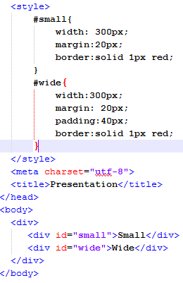
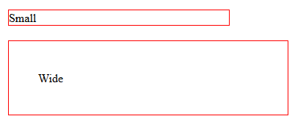
The box model
See this example where we have two elements with the same width, but they appear to be different size when rendered on the screen…

Slide 22
The box model
The previous problem can be solved by using simple math, just subtracting out the padding and border from width.
CSS3 introduces also new property called box-sizing that was created just for this problem.

Slide 23
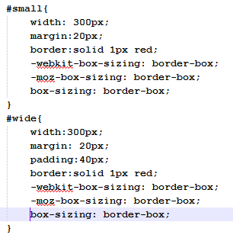
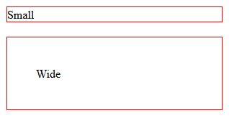
The box model

Slide 24
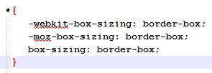
The box model
To make this more generic, you can apply the previous rule to every element in your HTML document using * selector:

Slide 25
Position property
The most complex and scared property for lay outing is position property.
Probably because it contains many unintuitive rules to make things work as you wanted. This is true at least in situations where you have a complex layout in some web site and you want to change it.
If you have used position property to do so, change to one property can affect to whole application in weird ways.

Slide 26
Position property
There are few values what you can use with position property:
Static
Relative
Absolute
Fixed
The static is the default position value for all HTML elements. The properties top, bottom, left and right has no effect in element which position is static. The element follows the normal flow of the page. The normal flow of the document is how your elements stack one on top of each other, from the top down, in the order in which they appear in your markup.
Normally you wouldn't specify position static for the element unless you needed to override a positioning that had been previously set.

Slide 27
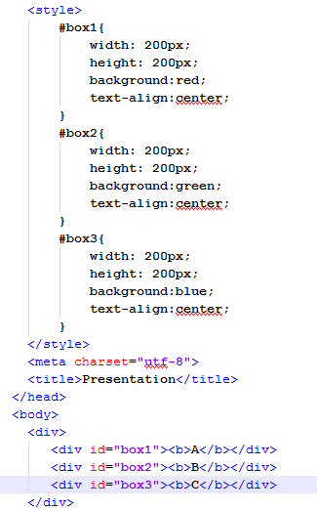
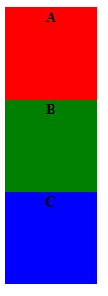
Position property:static
Lets look an example how normal flow works (the static one), it is like a pile of boxes you put on top of each other

Slide 28
Position property:relative
Relatively positioned elements behave just like statically positioned elements; they play well with others, stack nicely.
But relatively positioned elements have greater powers than their static siblings. We can adjust a relatively positioned element with offset properties: top, right, bottom, and left.

Slide 29
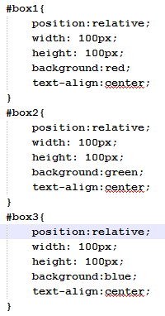
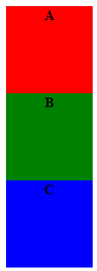
Position property:relative
Let’s change the previous example position property value to relative to see the affects.

Slide 30
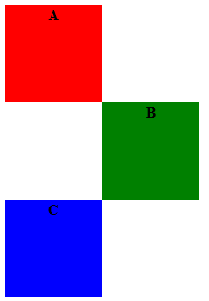
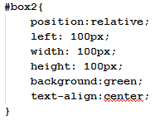
Position property:relative
As you could see it works the same as the static example. But now we take the greater forces in use: we move one of the blocks using left property.

Slide 31
Position property:relative
When you use the offset property to shift a relatively positioned element, it doesn’t affect the element(s) that follow.
Notice that our box2 element is not sitting inside of any other elements, so the coordinate system it’s using to offset itself 200 pixels from the left is the document itself.

Slide 32
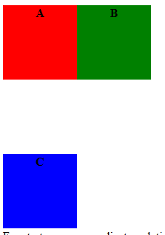
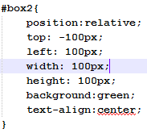
Position property:relative
Relative positioned elements reserves the space as it was placed in static case. To prove this we change the box 2 CSS a little bit…
This space is still reserved for box2 as in normal flow of page. This is because relatively positioned components are NOT removed from the document model!

Slide 33
Position property:relative
Relatively positioned elements are always positioned relatively to their parents coordinate system.
See from the next page what happens if we put box2 inside the box1 element….

Slide 34
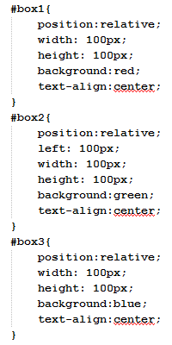
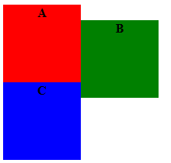
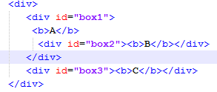
Position property:relative
Box 2 now follows the parent box1
coordinate system.

Slide 35
Position property:absolute
Unlike the static and relative values, an absolutely positioned element is removed from the normal flow. This means you can put it anywhere, and it won’t affect or be affected by any other element in the flow.
An absolutely positioned element can therefore overlap other content unless you take action to prevent it.
Again we can see what this means by looking an example.. We use the same markup, but a little different CSS rules.

Slide 36
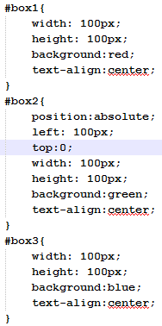
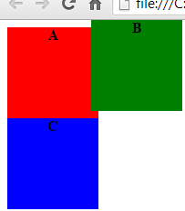
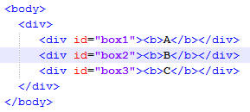
Position property:absolute

Slide 37
Position property:absolute
Just like relative elements, absolute elements create a new coordinate system for child elements.
NOTE! An absolute positioned element is positioned relative to the first parent element that has a position other than static. You should remember this when you use different positioning methods and nest elements inside each other!
Note! Absolute position element has it’s top,left, bottom and right properties set to “auto” by default. If you don’t set these values explicitly absolutely positioned element works like a static element!

Slide 38
Position property:fixed
An element with position: fixed shares all the rules of an absolutely positioned element, except that the viewport (browser/device window) positions the fixed element, as opposed to any parent element. Additionally, a fixed element does not scroll with the document. It stays, well…fixed. Let’s look at an example.

Slide 39
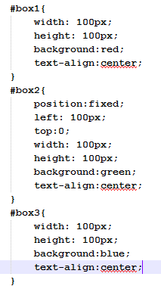
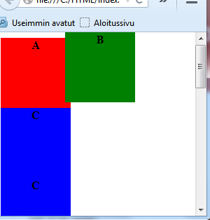
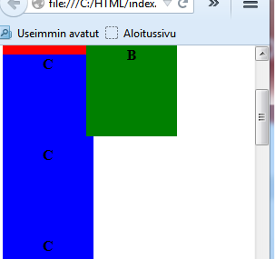
Position property:fixed
Even if window is
Scrolled, the fixed
Element stays in
Same place
In viewport.

Slide 40

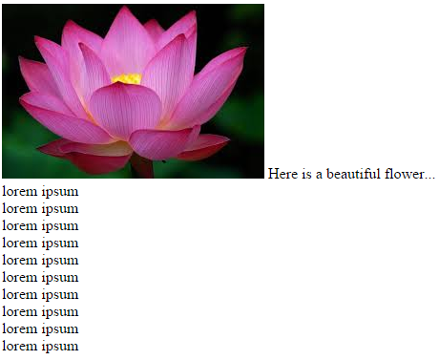
The float property
One of the most common uses for the float property is to float an image with text wrapping.
Float property used
Float property not used

Slide 41
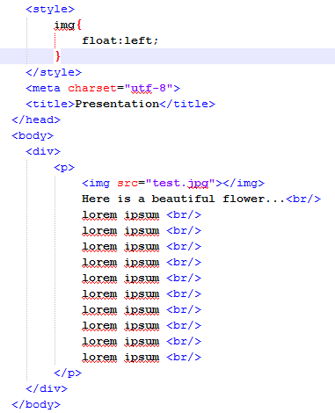
The float property

Slide 42
The float property
Float property can have next values
Left
Right
Elements after the floating element will flow around it. To avoid this, use the clear property.
The clear property specifies which sides of an element other floating elements are not allowed.
Div{
clear: both;//clears both right and left settings
clear:left;
clear:right;
}

Slide 43
Media Queries
A media query consists of a media type and at least one expression that limits the style sheets' scope by using media features, such as width, height, and color.
Media queries, added in CSS3, let the presentation of content be tailored to a specific range of output devices without having to change the content itself.
Media queries consist of a media type and can, as of the CSS3 specification, contain one or more expressions, expressed as media features, which resolve to either true or false. The result of the query is true if the media type specified in the media query matches the type of device the document is being displayed on and all expressions in the media query are true
In short: More responsive UI / layout when user views your web application with different devices/screen sizes. Application automatically can adapt to these changes.
There are two ways to implement media queries in your app and next slides will cover them both.

Slide 44
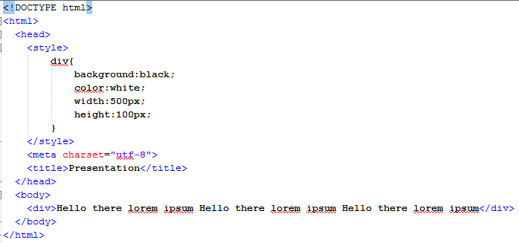
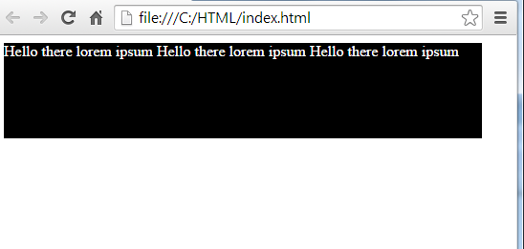
Media Queries
First we look the problem we had before CSS introduced media queries. Consider that we have next kind of html file.

Slide 45
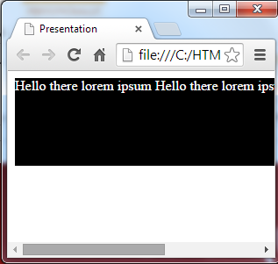
Media Queries
As you could see there seems to be no problem at all in our previous example. But let’s see what happens if we make our browser window more narrow….
As you can see part of the text is hidden
User cannot see all the content at once
This situation illustrates how our user will see our web page with mobile device. Not so good uh!

Slide 46
Media Queries
The solution in modern days is to use media queries.
There is two ways to do this. First we check how we can link our web page to particular .css file depending the screen size of user device.
First things you must think and decide is what devices you want to support. The device screen size is crucial here.
Before we continue you must clarify next properties for your self: width, height, min-width, min-height, max-width, max-height since these are very important.

Slide 47
Width
The width CSS property specifies the width of the content area of an element. The content area is inside the padding, border, and margin of the element (remember the box-model?).
You can use next units to define the width
Px (pixels)
%
Em (1em is equal to the current font size.)
In (inch)
There are more of these but rarely used.

Slide 48
Width
The next example defines that the width of the div element will be 80% of parent elements width. Remember that div have at least body element as it parent.
div{
width:80%;
}
This seems to be ok, but we have to remember that this 80% can be calculated from different screen sizes like 480 or 1400 and it can affect to your web page look&feel.

Slide 49
min-width and min-height
The min-width and max-width properties are used to tell the browser to render an element at a “minimum” size.
div{
min-width:500px;
min-height:200px;
}
In the above case element would have, at the very least, dimensions of 500×200 pixels — even if the element was empty.

Slide 50
Max-width and max-height
Instead of a minimum size for an element, these properties set the maximum size.
div{
max-width:200px;
max-height:200px;
}
The above example div can be only 200x200 pixels no matter what.

Slide 51
Media Queries
Back to the original business: Media Queries. Now that we know all about width and height properties it is easier to understand the following.
First of all we create three different .css files containing style definitions to 3 different screen sizes.
Small.css
Medium.css
Large.css

Slide 52
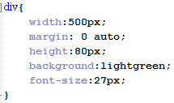
Small.css

Slide 53
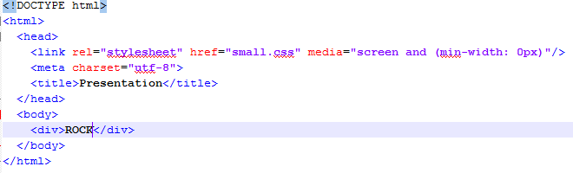
Media Queries
Now that we have our css file we create a rule when this file should be loaded with media attribute

Slide 54
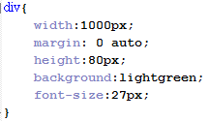
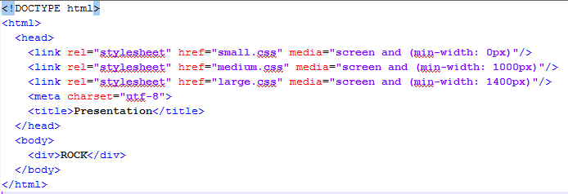
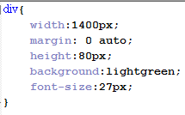
Media Queries
Now we can create our medium and large .css files and load them too with different rules.
Medium.css
Large.css

Slide 55
Media Queries
Now if you test the previous web page and change the width of the browser window, you can see that browser dynamically uses the correct css file depending of the browser window width. That’s a good news for us!

Slide 56
Media Queries: Another approach
Another approach is to use just one .css file for all situations. There you then use @media property to define styles for different screen sizes and devices.
Next example works the same as the first one, but with only one .css file.

Slide 57


Media Queries: Another approach
All.css

