Slide 1
CSS3 and Transformations
Markus Veijola March 2014

Slide 2
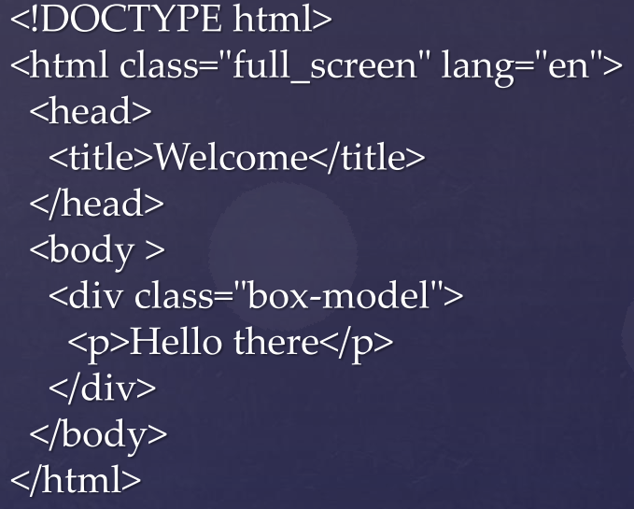
Introduction
Transforms are used to move, rotate, scale or skew some element in in your page.
The transforms are defined in .css file
Let’s start to investigate CSS transforms by defining a very simple .html file

Slide 3
Transitions
Next we need to define the transition in .css file for some
element (in our case the div containing the class box-model).
.box-model
{
-webkit-transition: all 1s ease-in-out;
-moz-transition: all 1s ease-in-out;
-o-transition: all 1s ease-in-out;
transition: all 1s ease-in-out;
}

Slide 4
Transitions
In the previous example the value ‘all’ means, that if we change any numeric value of that div, the change will take 1s (so it does not happen immediately, instead trough an animation), and it uses one of the build in easing function ease-in-out that is optional.
Note that ‘all’ is the default value, so you could define the previous transition also like this: transition: 1s ease-in-out;
If you now try the web page, you can see that nothing happens.
This is because we have not changed any numeric property of that div element. We need something that triggers the transition.
There are few ways to trigger that
You can use JavaScript to change the i.e. margin property of div element
You can use pseudo classes in .css file
We are going to use the pseudo classes in this case…

Slide 5
Transitions
Now if you define next peace of code in your .css file, and test the web page, you can see that when you move mousecursor over the div, it will fade away. When you move cursor off the div, it will appear again. But both of these happens trough the transition...
Note that transition also affects to child elements (in this case to p element inside the div)
.box-model:hover
{
opacity: 0;
}

Slide 6
Other Examples
Colors
.box-model:hover
{
background-color:#fc3;
color: #000;
}
Position
.box-model:hover
{
margin: 300px;
}

Slide 7
Transition
You can also define transition to some spesific property of the element. You use next syntax for that:
-moz-transition-property: width; /* Firefox 4 */
-moz-transition-duration: 2s; /* Firefox 4 */
OR
-moz-transition: width 2s; /* Firefox 4 */
Then in .css
.box-model:hover
{
width: 300px;
}

Slide 8
Transition
CSS3 defines multiple 2D Transform methods
matrix(n,n,n,n,n,n)
translate(x,y)
transleX(n)
translateY(n)
scale(x,y)
scaleX(n)
scaleY(n(
rotate(angle)
skew(x-angle, y-angle)
skewX(angle)
skewY(angle)

Slide 9
Example
.box-model:hover
{
background-color: #fc3;
color: #000;
-webkit-transform: rotate(360deg) scale(1,2);
}

Slide 10
Animation
CSS3 enables also animation creation to the webpage
Less need for animated images, flash animations or javascript
Animations are created in @keyframes, which changes the style of the webpages.

Slide 11
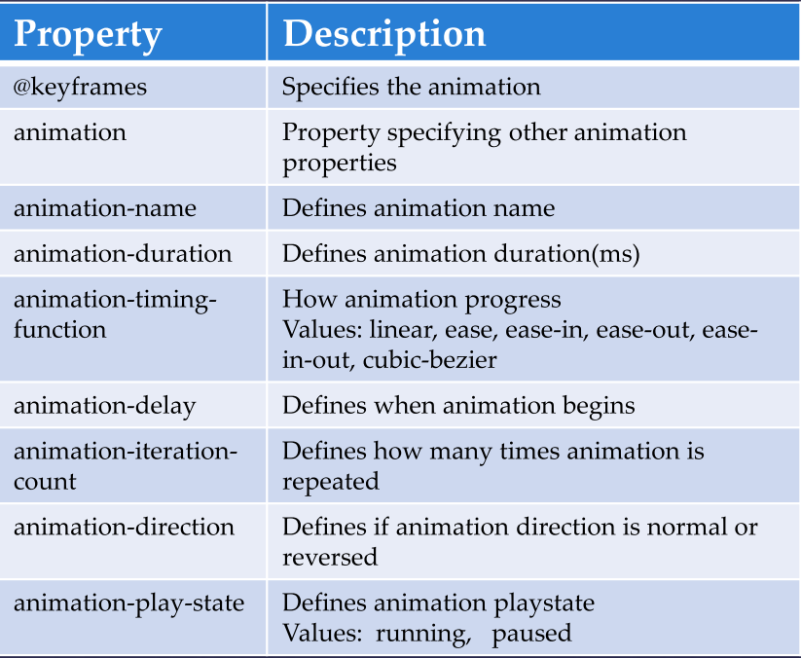
Animation
Essential properties

Slide 12
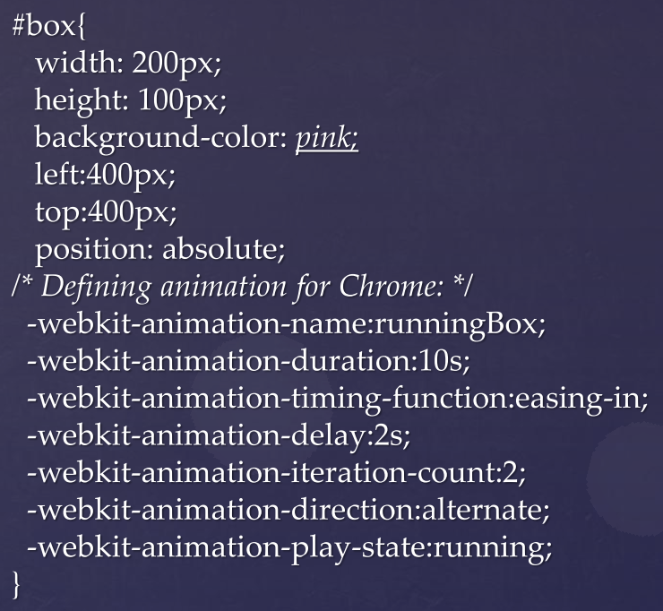
Animation
Example

Slide 13
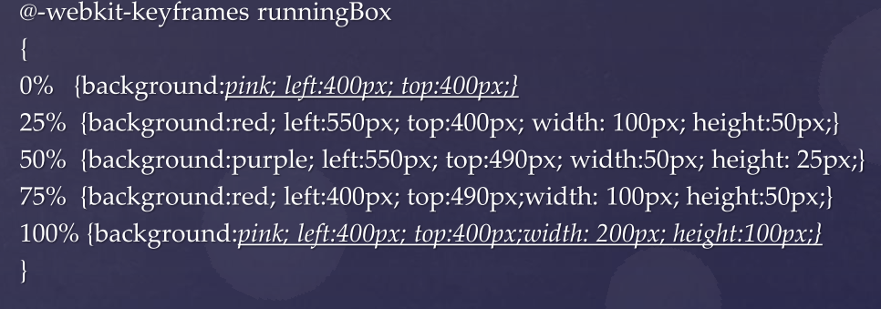
Animation

Slide 14
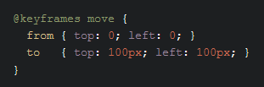
Animation
You can also use from and to properties:

