Slide 1
PHP
Markus Veijola October 2014

Slide 2
Introduction
PHP (Hypertext Preprocessor)
” PHP is an HTML-embedded scripting language. Much of its syntax is borrowed from C, Java and Perl with a couple of unique PHP-specific features thrown in. The goal of the language is to allow web developers to write dynamically generated pages quickly.” (source:php.net)
There are several other server side scripting languages such as Perl, Python, ASP and JSP to just mention few ones.

Slide 3
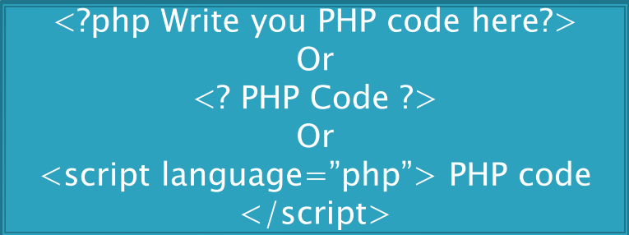
Syntax
Syntax - The rules that must be followed to write properly structured code.
PHP's syntax and semantics are similar to most other programming languages like C –language.
All PHP code must be contained within the following…

Slide 4
How it works
All .php files are stored in server (just like.html files)
When server gets a request to return a .php file to client, the server preprocesses the file using the proper server application (PHP engine). This application processes all the code inside <?php ?> tags, generates the .html file from that information and sends it to client.
php code is NEVER executed in client side (i.e. In browser).

Slide 5
Simple PHP example
Create a simple file with following content and save it to you local server with name index.php
<html>
<head>
<title>My First PHP Page</title>
</head>
<body>
<!—Note the semicolon at the end of the line!!!->
<?php echo "Hello World!"; ?>
</body>
</html>

Slide 6
Data Output
There are two ways to print out some data from PHP code
<?php print(”Hello World”);?>
<?php echo ”Hello World!”;?>

Slide 7
Variables
All variables begin with a $ sign.
<?php
$greeting=“Have a nice day!”;
$integer_value=256;
?>

Slide 8
Outputting Variables
<?php
$greeting=”Hello there”;
echo $greeting;
print($greeting);
?>
<?php
$name=”Markus”;
echo ”hello there $name </br>”;
?>

Slide 9
Formatting Strings
Can be done using plain HTML syntax...
<?php
// This won't work because of the quotes around specialH5!
echo "<h5 class="specialH5">I love using PHP!</h5>";
// OK because we escaped the quotes!
echo "<h5 class=\"specialH5\">I love using PHP!</h5>";
// OK because we used an apostrophe '
echo "<h5 class='specialH5'>I love using PHP!</h5>";
?>

Slide 10
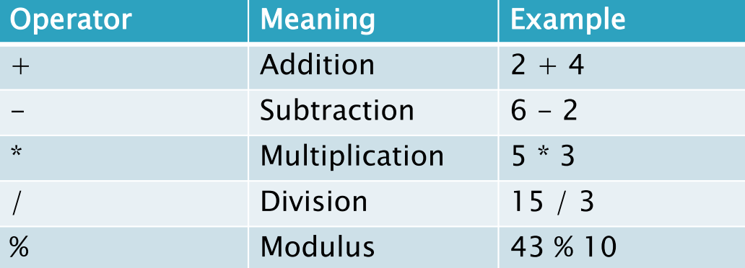
PHP Operators
Operators are used to assign a value or check or compare the value of variable.
Here are all the arithmetic operators in PHP

Slide 11
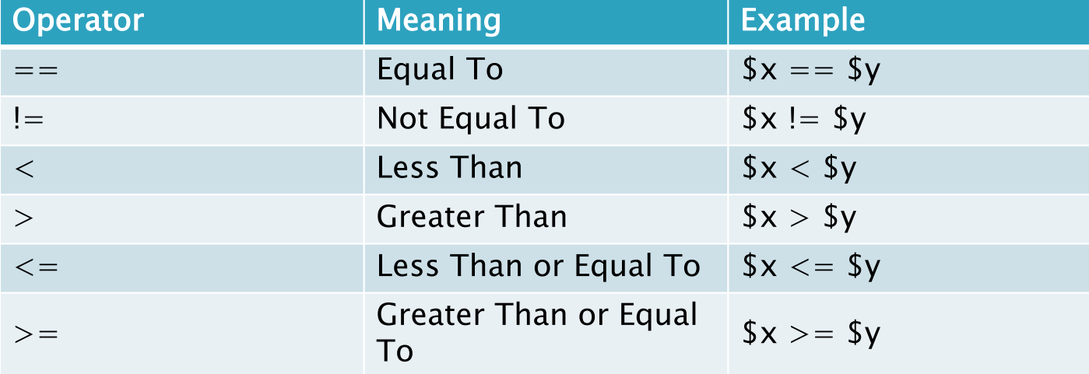
PHP Operators

Slide 12
Special Operators
The period "." is used to add two strings together in PHP
<?php
$first=“Hello”;
$second=“ World”;
$concatenated= $first.$second;
echo concatenated;
?>
//Example prints out Hello World…

Slide 13
PHP Include Statement
You can include other .php files in particular .php file when needed.
This way you can split large .php codes in smaller parts (this way the modifications are easier to do in large projects)

Slide 14
PHP Include Statement
<html>
<body>
<a href="http://www.example.com/index.php">Home</a> -
<a href="http://www.example.com/about.php">About Us</a> -
<a href="http://www.example.com/links.php">Links</a> -
<a href="http://www.example.com/contact.php">Contact Us</a> <br />
//Other .php file
<?php include("menu.php"); ?>
<p>This is my home page that uses a common menu to save me time when I add
new pages to my website!</p>
</body>
</html>

Slide 15
Comparsion
The PHP if statement is very similar to other programming languages like c.
$name = "markus";
if ( $name == "Markus" ) {
echo "Hello tehre markus!<br />";
}
echo "Welcome to my homepage!";

Slide 16
Comparsion
If else statement
$number_three = 3;
if ( $number_three == 3 ) {
echo "The if statement evaluated to true";
} else {
echo "The if statement evaluated to false";
}

Slide 17
Comparsion
Elseif statement
$employee = ”Markus";
if($employee == ”Markus"){
echo ”You are fired";
} elseif($employee == ”Jukka"){
echo ”Hello Jukka!";
}else {
echo ”Oh it was just Heikki...";
}

Slide 18
Comparsion
Switch statement
$name = "Markus";
switch ($name){
case "Markus":
echo "Teach Web -technologies";
break;
case "Erno":
echo "Linux is your stuff...";
break;
case "Janne":
echo "Teach cloud programming...";
break;
default:
echo ”I don’t know this one....”;
break;
}

Slide 19
Data Handling
A very common application of PHP is to have an HTML form gather information from a website's visitor and then use PHP to do process that information.
Let’s see an example

Slide 20
Data Handling
Order.html file content (using post method)
<html>
<body>
<h4>Select the wanted animal type and write the name</h4>
<form action="process.php" method="post">
<select name="animal_type">
<option>Dog</option>
<option>Cat</option>
<option>Other</option>
</select>
Quantity: <input name=”animal_name" type="text" />
<input type="submit" />
</form>
</body>
</html>

Slide 21
Data Handling
Process.php
<html>
<body>
<?php
$name = $_POST['animal_name'];
$type = $_POST['animal_type'];
echo "Your animal is $animal_type and it name
is $animal_name ";
?>

Slide 22
Data Handling
HTML foOrder.html file content (using GETmethod)
<html>
<body>
<h4>Select the wanted animal type and write the name</h4>
<form action="process.php" method=”get">
<select name="animal_type">
<option>Dog</option>
<option>Cat</option>
<option>Other</option>
</select>
Quantity: <input name=”animal_name" type="text" />
<input type="submit" />
</form>
</body>
</html>

Slide 23
Data Handling
Process.php
<html><body>
<?php
$name = $_GET['animal_name'];
$type = $_GET['animal_type'];
echo "Your animal is $animal_type and it name
is $animal_name ";
?>

Slide 24
PHP Functions
A function is just a name we give to a block of code that can be executed whenever we need it.
<?php
function printName($first, $last)
{
echo "Hello $first $last";
}
printName("Markus","Veijola");
?>

Slide 25
PHP Functions
<?php
function mySum($numX, $numY){
$total = $numX + $numY;
return $total;
}
$myNumber = 0;
echo "Before the function, myNumber = ". $myNumber
."<br />";
$myNumber = mySum(3, 4);
// Store the result of mySum in $myNumber
echo "After the function, myNumber = " . $myNumber
."<br />";
?>

Slide 26
Arrays
<?php
$employee_array[0] = "Markus";
$employee_array[1] = "Janne";
$employee_array[2] = "Erno";
echo "Hello $employee_array[0] employee_array[2]";
?>

Slide 27
Associative Arrays
<?php
$salaries["Markus"] = 1000;
$salaries["Janne"] = 4000;
$salaries["Erno"] = 6000;
echo "Markus has $salaries["markus"]";
?>

Slide 28
Iteration
While loop
<?php
$counter = 10;
echo $counter;
while ( $counter <= 100 ) {
$counter += 10;
}
?>

Slide 29
Iteration
Building HTML table with while loop
$counter = 10;
echo "<table border=\"1\" align=\"center\">";
echo "<tr><th>Value</th>";
while ( $counter <= 100 ) {
echo "<tr><td>";
echo $counter;
echo "</td><td>";
$counter = $counter + 10;
}
echo "</table>";

Slide 30
Iteration
For loop
$brush_price = 5;
echo "<table border=\"1\" align=\"center\">";
echo "<tr><th>Quantity</th>";
echo "<th>Price</th></tr>";
for ( $counter = 10; $counter <= 100; $counter += 10) {
echo "<tr><td>";
echo $counter;
echo "</td><td>";
echo $brush_price * $counter;
echo "</td></tr>";
}
echo "</table>";

Slide 31
File Handling
Creating a new file
<?php
$ourFileName = "testFile.txt";
$ourFileHandle = fopen($ourFileName, 'w') or
die("can't open file");
fclose($ourFileHandle);
?>

Slide 32
File Handling
Opening file –different ways
Read: 'r’
Write: 'w’
Append: 'a’
Read/Write: 'r+’  Opens a file so that it can be read from and written to.
The file pointer is at the beginning of the file.
Write/Read: 'w+’ This is exactly the same as r+, except that it deletes all information in the file when the file is opened.
Append: 'a+’  This is exactly the same as r+, except that the file pointer is at the end of the file.

Slide 33
File Handling
Writing to file
<?php
$myFile = "testFile.txt";
$fh = fopen($myFile, 'w') or die("can't open file");
$stringData = "Some text to file\n";
fwrite($fh, $stringData);
$stringData = "more text\n";
fwrite($fh, $stringData);
fclose($fh);
?>

Slide 34
File Handling
Reading bytes from file
<?php
$myFile = "testFile.txt";
$fh = fopen($myFile, 'r');
$theData = fread($fh, 5);
fclose($fh);
echo $theData;
?>

Slide 35
File Handling
Reading the whole file content
<?php
$myFile = "testFile.txt";
$fh = fopen($myFile, 'r');
$theData = fread($fh, filesize($myFile));
fclose($fh);
echo $theData;
?>

Slide 36
File Handling
Deleting the file
<?php
//Just make sure that file is closed before delete
$myFile = "testFile.txt";
$fh = fopen($myFile, 'w') or die("can't open file");
fclose($fh);
//Now we can delete the file
unlink($myFile);
?>

